Slide 1
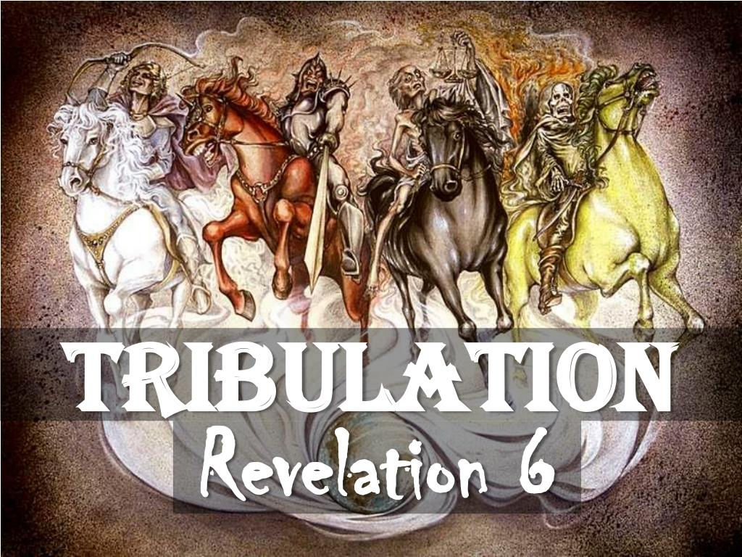
RECAP SESSION 13 TRIBULATION
After the RAPTURE of the Church of Believers, the Tribulation will start with the signing of a peace covenant between the Antichrist and Israel for 7 years.
The Antichrist will break this treaty after 3 ½ years when he sets himself up as God in the Temple.
This is when God pours out His wrath on earth with 7 seals, 7 trumpets and 7 bowls.
God will send 2 prophets to preach the Gospel, and they will be slain at the 3 ½ year mark but after 3 days God will resurrect them and take them to heaven.
The Anti-Christ will receive a deadly head wound around the 3 ½ year mark but God will allow Satan to resurrect him, and the Antichrist will be the one that kills the 2 prophets.
God will seal 144,000 Jewish men to proclaim the Gospel, and they can’t be killed.
The Great Tribulation beginning after the 3 ½ year mark will end with the 7th Bowl Judgement with God returning to earth on the Mount of Olives with the Saints to defeat the gathered armies and Satan with a word from His mouth.

Slide 2
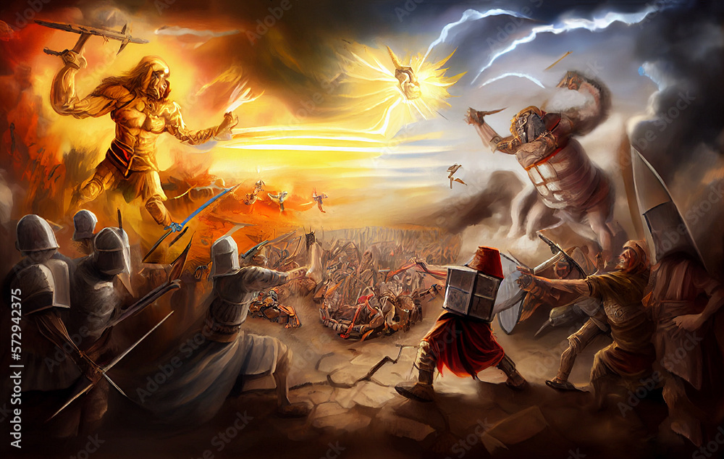
CREDITS
Gracethrufaith.com https://gracethrufaith.com/end-times-prophecy/the-sheep-and-goat-judgment-matt-2531-46/
Neverthirsty.org https://www.neverthirsty.org/bible-qa/qa-archives/question/earth-be-like-in-millennial-kingdom/
Alan Nolan https://www.youtube.com/watch?v=Wsdd2Pqf9YM
Bible various versions
Gotanswers.org
Various YouTube videos

Slide 3
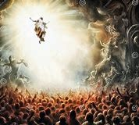
Please watch Supplemental Video: Battle of Armageddon
End of the Tribulation
Revelation 19 depicts the scene of total defeat of the Antichrist, False Prophet and the armies of the earth that gathered to take Jerusalem in the Valley of Megiddo. Jesus will descend from Heaven with His host of Saints and His armies all riding white horses clothed in white linen.
17 And I saw an angel standing in the sun; and he cried with a loud voice, saying to all the fowls that fly in the midst of heaven, Come and gather yourselves together unto the supper of the great God;
18 That ye may eat the flesh of kings, and the flesh of captains, and the flesh of mighty men, and the flesh of horses, and of them that sit on them, and the flesh of all men, both free and bond, both small and great.
19 And I saw the beast, and the kings of the earth, and their armies, gathered together to make war against him that sat on the horse, and against his army.
20 And the beast was taken, and with him the false prophet that wrought miracles before him, with which he deceived them that had received the mark of the beast, and them that worshipped his image. These both were cast alive into a lake of fire burning with brimstone.
21 And the remnant were slain with the sword of him that sat upon the horse, which sword proceeded out of his mouth: and all the fowls were filled with their flesh.

Slide 4
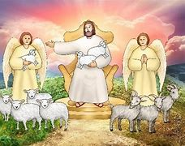
The Millennium Begins
Judgement of the Sheep and Goats (also known as the Judgement of the Nations)
Matt. 25:31-33 Tells us that sometime after Battle of Armageddon, :.. All the nations will be gathered before him, and he will separate the people one from another as a shepherd separates the sheep from the goats. He will put the sheep on his right and the goats on his left. “
In Joel 3:1-3 the prophet speaks of a time when the Lord will gather the nations together in the Valley of Jehoshaphat to hold them accountable for the way they’ve treated His people. This judgement is for those who have made it through the Tribulation period. Jesus separates the righteous (the sheep) from the unrighteous (the goats) based on their deeds.
“Then he will say to those on his left, ‘Depart from me, you who are cursed, into the eternal fire prepared for the devil and his angels. For I was hungry, and you gave me nothing to eat, I was thirsty, and you gave me nothing to drink, I was a stranger, and you did not invite me in, I needed clothes, and you did not clothe me, I was sick and in prison and you did not look after me.” Matthew 25:41
The timing of this event is debated, some think it is right after the Second Coming of Christ and others at the end of the Millenium when Satan is cast into the Lake of Fire.

Slide 5
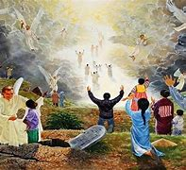
Resurrection of Old Testament and Tribulation Saints
There are a couple of thoughts as to when the Old Testament Saints and Tribulation Saints will be resurrected. One thought is after the Millennium and the other thought is after Jesus’ Second Coming.
The one presented in this session is that they both will be resurrected after the Second Coming of Jesus and prior to the Millenium Reign.
The Tribulation Saints by Revelation 20:4,6 “Then I saw thrones, and they sat on them, and judgment was given to them. And I saw the souls of those who had been beheaded because of their testimony of Jesus and because of the word of God, and those who had not worshiped the beast or his image, and had not received the mark on their forehead and on their hand; and they came to life and reigned with Christ for a thousand years . . . Blessed and holy is the one who has a part in the first resurrection; over these the second death has no power, but they will be priests of God and of Christ and will reign with Him for a thousand years.”
The Old Testament Saints by Ezekiel 37:22, 24 clearly refers to the millennial reign of Christ when we are told “My Servant, David shall be king.” Ezekiel 37:12-14 refers to the resurrection of Old Testament saints at the beginning of the millennial kingdom. To be a King in the millennial time frame, he would have to resurrected prior to the beginning.

Slide 6
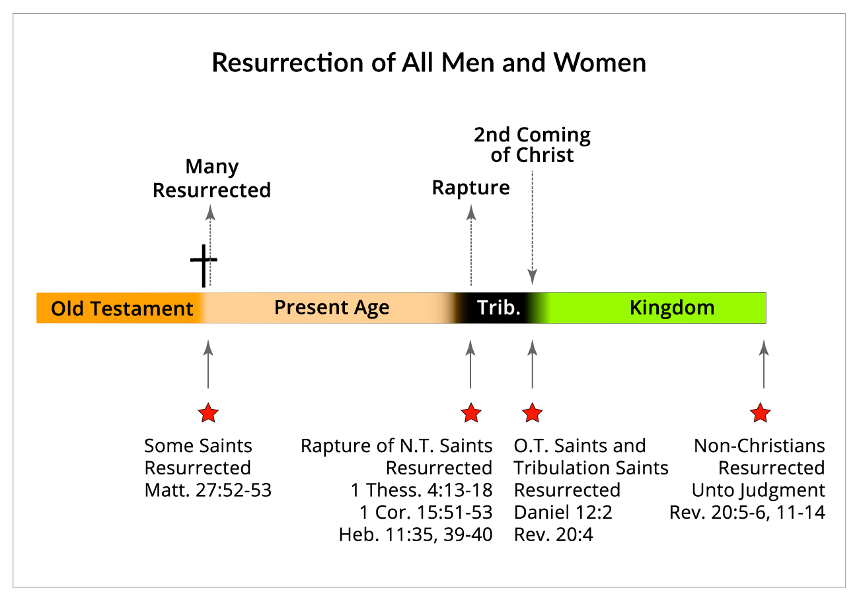

Slide 7
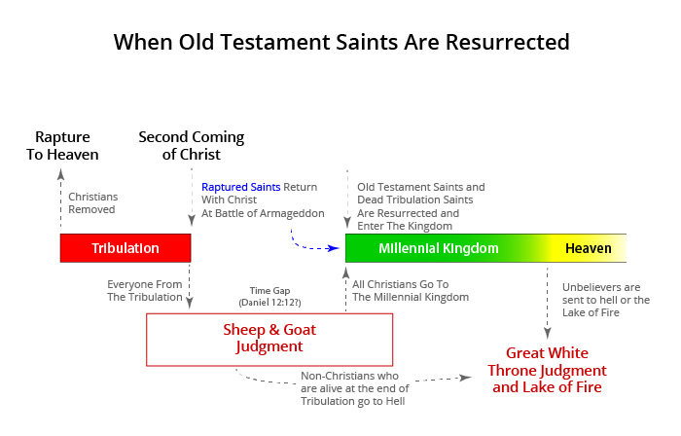

Slide 8
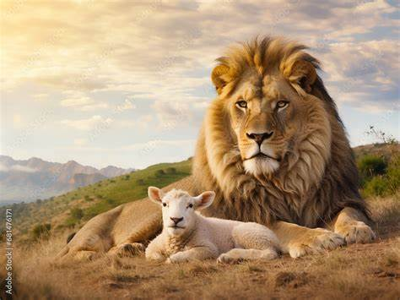
The Millennial Reign
https://www.youtube.com/watch?v=0VzA9e6_zLQ
Please watch Supplemental Video: Millennium Purpose
Revelation 20:1-6 Tells of a 1000-year reign of Christ and of binding and sealing Satan in the Abyss so that he couldn’t deceive the nations. This is not the Lake of Fire which is at the end of the Millennial time.
As stated before in Revelation 20:6, saints will rule and reign with Christ. It is thought that, based on how we were rewarded in the Bema Judgement, will determine the ruling/reigning authority. The Parable of the Talents in Matthew 25 suggests that you are “rewarded” on what was given to you to use. This could be compared to what authority you will be given.
Jesus will rule with King David over Israel. Jeremiah 30:9, “But they shall serve Jehovah their Elohim, and David their king whom I will raise up unto them”. This verse clearly states that David will be king, and that Israel will serve him as well as Christ. Ezekial 37:24, “And My servant David shall be king over them; and they all shall have one shepherd.
The earth will revert to the time before the fall of man in the Garden of Eden. The curse mentioned in Genesis 3:17-19 will be removed. Every animal, including humans will eat plants, no meat as stated in Genesis 1:30.
The peace mentioned in Ezekiel 34:23-25 will extend to the animal kingdom. First, Isaiah 11:6-7 states the animals will be at peace with each other. Second, peace will also exist between animals and people. Both Isaiah 11:6, 8 prophesy that a little boy will be able to lead these animals and play with snakes without harm.
Isaiah 33:24 There will be no sickness or illness There will still be death because of sin. There will be no satanic influence at this time but the mortals will have free will. Isaiah 65:20 No more shall an infant from there live but a few days, Nor an old man who has not fulfilled his days; For the child shall die one hundred years old, But the sinner being one hundred years old shall be accursed. Death will be justified because they will have the Adamic nature.

Slide 9
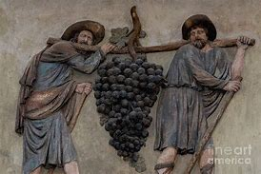
Free from any oppression; no social, political or religion Isaiah 14:3-7 “..oppressor has come to an end. All lands at peace and they will sing.”
The conditions in the millennial kingdom will extend to the vegetation. Ezekiel 34:26-27 prophesies that God will send rain showers, and the trees will produce fruit. Joel 3:18 adds that the vineyards will be so productive that the mountains will drip with sweet wine. Milk will flow and the streams will overflow with water. That is, famine will not exist. Consequently, the plant kingdom will flourish, including food crops.
Any deformity will be healed. Jesus healed everyone around him in his first appearance. Everyone will be around Him and He will heal at a global scale. Isaiah 29:18 In that day the deaf shall hear the words of a book, and out of their gloom and darkness the eyes of the blind shall see. Isaiah 35:5-10 He will open the eyes of the blind, lame leap, and mute tongues speak.
Mortal parents who do not take the Mark of the Beast will reproduce. Isaiah 65:22 speaks that they will live as trees. Trees in Jesus time were most connected to the Olive tree that have extremely long-life spans. The current oldest tree is 1800 years old. Jeremiah 31:29 talks about parents passing down lifestyles to their children using sour grapes as an example. (sins of parents passed down to children). They will have to accept Jesus just as we do.
All will speak the same language. Zephaniah 3:9 For then I will restore to the peoples a pure language, that they all may call on the name of the LORD, To serve Him with one accord. It will not be from any of the present languages but like Adam’s language.
There will be Global economic prosperity. There will be work going on. Mortals are working and we will watch over them. Isaiah 65:20-25 “21.They will build houses and dwell in them; they will plant vineyards and eat their fruit. 22.No longer will they build houses for others to inhabit, nor plant for others to eat. For as is the lifetime of a tree, so will be the days of My people, and My chosen ones will fully enjoy the work of their hands…”

Slide 10
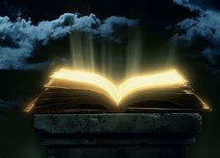
Post Millennium Reign
The Final Rebellion (Second Gog/Magog war see Session 10 Wars)
Revelation 20:7-10
After a 1000 years, Satan will be loosed from the Bottomless Pit.
He will go forth to deceive the nations.
As described earlier, there will be those on earth during the Millenium who will reject Christ. These, under the leadership of “released” Satan, will make war on Jerusalem.
Fire will come down from Heaven and devour the armies.
Satan will be cast into the Lake of Fire.
Satan will join the Anti-Christ and False Prophet in the Lake of Fire forever.
Great White Throne Judgement
Unbelievers' bodies will be reunited with their spirit/soul. Revelation 20:11-14 Revelation 20:5
The Book of Life will be opened and those whose names do not appear will be judged. Revelation 20:11-14
Unbelievers will be judged “according to their deeds”... John 5:29 Revelation 20:12-13
After judgement, they will be cast into the Lake of Fire forever along with Hell. Revelation 20:14-15
Christians will not be judged here as their judgement occurred at time of death or Rapture as they went to heaven. (Session 12 Prophetic Timeline Rapture)

Slide 11
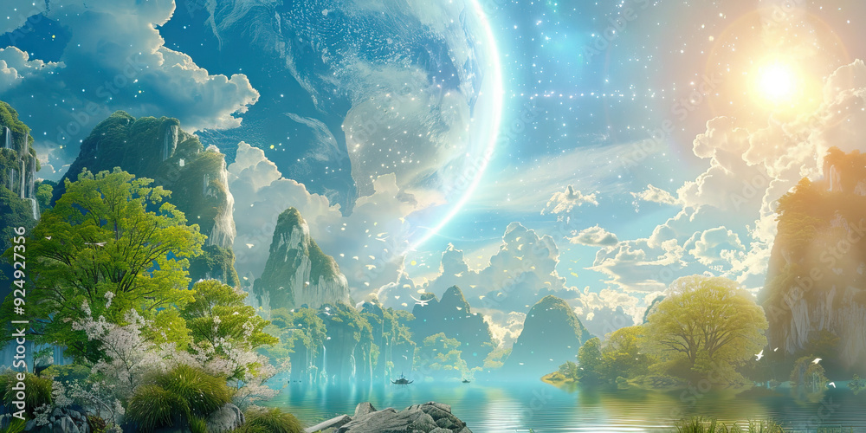
New Heavens and New Earth Revelation 21-22
In Revelation 22:1, John says, “Then I saw a new heaven and a new earth, for the old heaven and the old earth had disappeared. And the sea was also gone.” NLT This verse tells us that the earth, skies and universe will be remade. Revelation 21:5, God tells us “everything is made new” no longer will earth be under the curse of sin. Isaiah 65:17, Isaiah 66:22 and 2 Peter 3:13 also confirms this. Isaiah also says that “the former things will not be remembered, nor will they come to mind” and the old order of things, with the accompanying sorrow and tragedy, will be gone. Thus God “wipes” the tears from out eyes.
Revelation 21 tells us there will be a “new” Jerusalem that will descend from Heaven to the new Earth. It is also referred to as the tabernacle of God, the Holy City, the city of God, the celestial city, the city foursquare, and Heavenly Jerusalem, and is literally heaven on earth.
Please watch Supplemental Video: New Heaven
https://www.youtube.com/shorts/U1nah97xfxw

Slide 12
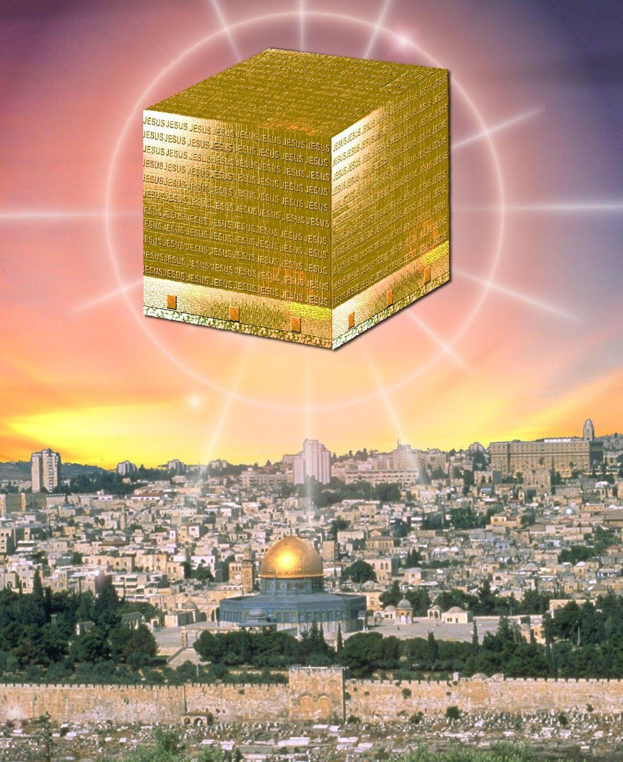
What will this new Jerusalem and new Earth look and be like?
“And the twelve gates were twelve pearls; every several gate was of one pearl: and the street of the city was pure gold, as it were transparent glass.” Revelation 21:21
“In the middle of its street, and on either side of the river, was the tree of life, which bore twelve fruits, each tree yielding its fruit every month.” Revelation 22:2
Revelation 21:3, Tells us God no longer will be separate from us but that He will be with us, and we will serve Him.
no more sea (Revelation 21:1)
no more death (Revelation 21:4)
no more mourning (Revelation 21:4)
no more weeping (Revelation 21:4)
no more pain (Revelation 21:4)
no more curse (Revelation 22:3)
no more night (Revelation 22:5)
God “will wipe every tear from their eyes” (Revelation 21:4)
God being eternal and living “outside” time (Isaiah 57:15) will cause time to cease to exist and we will live forever with Him. (Revelation 10:6)

Slide 13
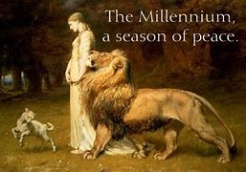
SUMMARY
After the Battle of Armageddon, the Anti-Christ and False Prophet will be cast into the Lake of Fire. A word from Jesus annihilates the remaining armies.
There will be a Judgement of Sheep and Goats where the nations are judged on how they treated Israel. The timing of this event is debated on whether it happens before or after the Millenium.
The Old Testament Saints and Tribulations Saints bodies are reunited with their bodies to rule in the Millenium. The timing of this event is also debated.
This new dispensation will have the conditions on earth revert to the pre-sin era where animals will eat grass, be tame along with humans and other animals.
Tribulation survivors will who have not taken the mark of the beast will live on into the Millenium with bodies such as was before the fall of man.
There will be children born and repopulate the earth.
There will be death, but not from disease or sickness but from those that revert to their sin nature.
Christians will rule with Christ and David over these Tribulation survivors and offspring.
Satan will be loosed at the end of the 1000 years and deceive the nations, descending upon Jerusalem.
They will be destroyed by fire from heaven and Satan will be cast into the Lake of Fire forever.
The Great White Throne Judgement will happen at the end of the Millenium where the bodies of the Unbelievers will be reunited with their spirit/soul and stand before Jesus to answer for their actions.
These will be cast into the Lake of Fire with Satan to be tormented forever.
A new heaven and earth will be created along with a New Jerusalem that descends from Heaven.

Slide 14
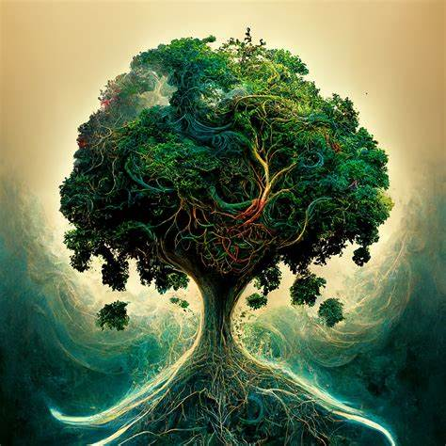
SUMMARY CONTINUED
God then will dwell in the New Jerusalem where we will worship Him forever.
The New Jerusalem will have:
  Streets of Gold
  Gates of Pearl
  Fruit trees that bare monthly
  Tree of Life
  No more sea
  No more death
  No more mourning
  No more weeping
  No more pain
  No more curse
  No more night
  No more tears
Time will cease to exist, and we will live forever in this new paradise.
Please watch Supplemental Video: Overview of Events

