Slide 1
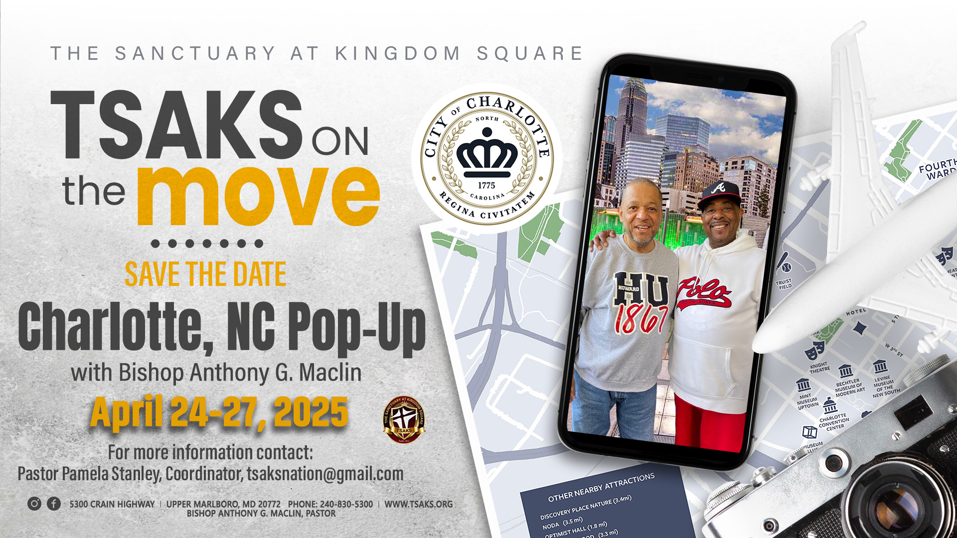

Slide 2
TSAKS Nation Pop-up purpose
TSAKS Nation Pop-Up fellowship events are designed to visit a variety of cities and states throughout the country where TSAKS members have relocated. Our gatherings are intended to strengthen our fellowship, remain connected, and enjoy the sights and sounds of the places we visit. Having our Pop-Up gathering is more than just an event; it is a way to create a strong, connected Christian community that extends beyond the boundaries of our church and geographical area.

Slide 3


Charlotte was founded in 1768. King George III of England named “Charlotte Town” after his wife, Queen Charlotte. The city is often called the “Queen City” in her honor.
The downtown area of Charlotte is known as “Uptown” due to its higher elevation compared to the rest of the city.
Charlotte is the home to several professional sports teams including NFL’s Carolina Panthers and NBA’s Charlotte Hornets. Three of NASCARs biggest events are held at the Charlotte Motor Speedway: The Coca-Cola 600, the Bank of America 500 and the NASCAR Sprint All-Star Race.

Slide 4

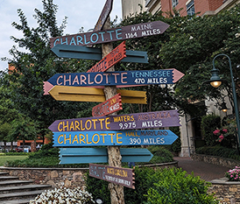
TSAKS Nation Pop-Up 2025
Charlotte, North Carolina
April 24-27, 2025

Slide 5
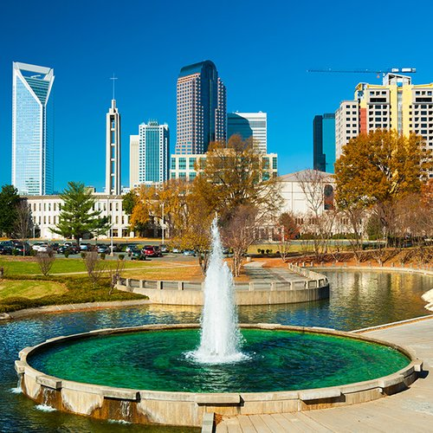
All expenses are self-pay.
SpringHill Suites Charlotte City Center
311 East 5th Street
$169/night
Mention: The Sanctuary at Kingdom Square
Last Day to Book: April 2nd

Slide 6

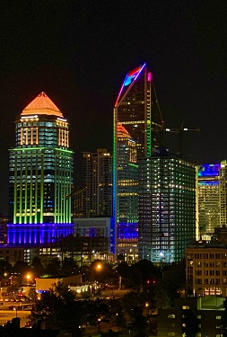
Thursday, April 24, 2025
3:00pm Hotel Check-in
4:00pm Meet & Greet at the hotel
6:00pm Dinner
Roosters Wood Fired Kitchen
150 N. College Street
www.roosterskitchen.com

Slide 7
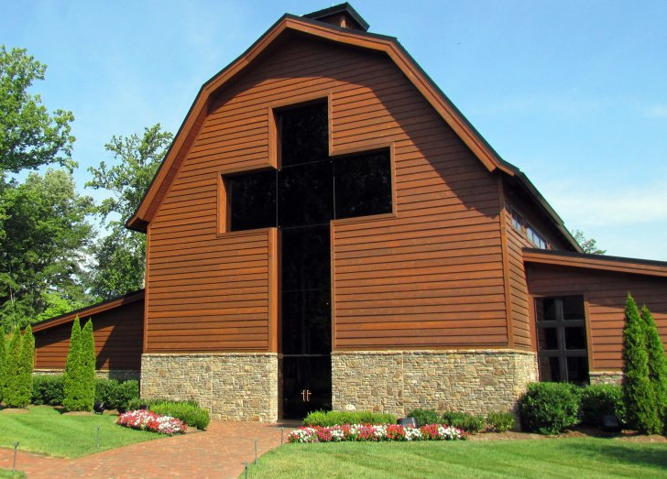
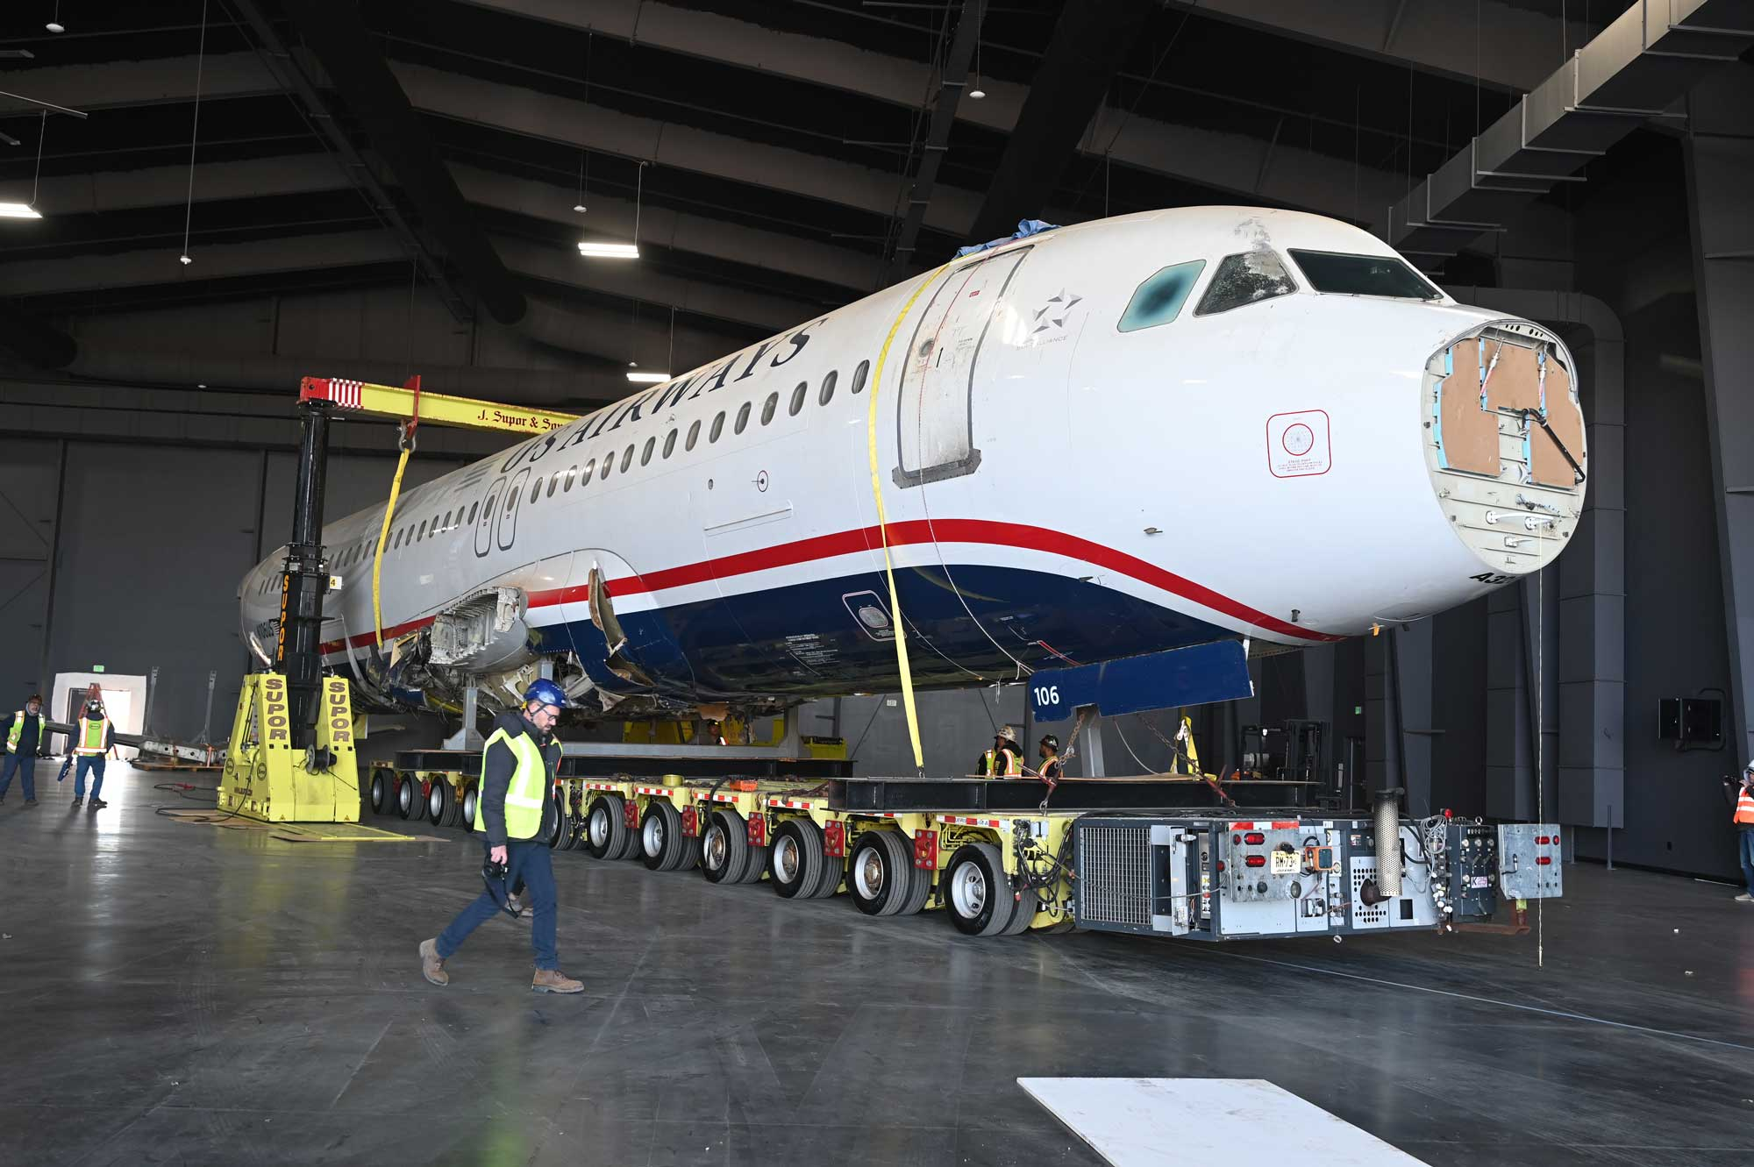
Friday, April 25, 2025
9:30am Complimentary Breakfast Buffet at hotel
10:30am Billy Graham Tours (Free)
4330 Westmont Drive
www.billygrahamlibrary.org/tour-operators
Sullenberger Aviation Museum ($24 or $18 for 15+)
4108 Minuteman Way
www.sullenbergeraviation.org/plan-your-visit/group-sales/
1:00pm Lunch
5:00pm Dinner at Midwood Smokehouse
12410 Johnston Road
www.midwoodsmokehouse.com

Slide 8

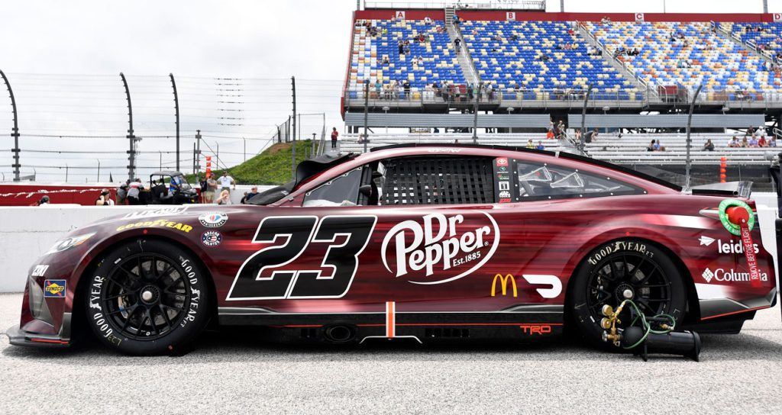
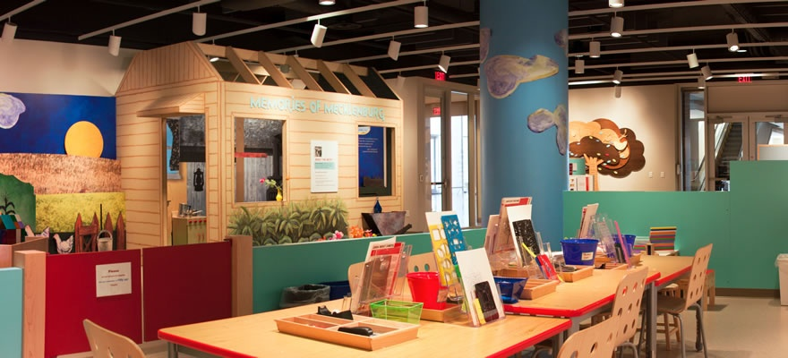

Saturday, April 26, 2025
9:30am Complimentary Breakfast Buffet at hotel
10:00am Leisure Time
NASCAR Hall of Fame – Charlotte ($24-49)
400 E. MLK Jr. Blvd
www.nascarhall.com
Mint Museum ($10)
500 South Tryon Street
www.mintmuseum.org
Shopping Options:
South Park Mall: 4400 Sharon Road
Charlotte Premium Outlets: 5404 New Fashion Way
Concord Premium Outlets: 8111 Concord Mills Blvd
2:00-6:00pm Food, Fun & Fellowship hosted by the Parkers
Rosemont Clubhouse
1327 Rosemont Drive

Slide 9

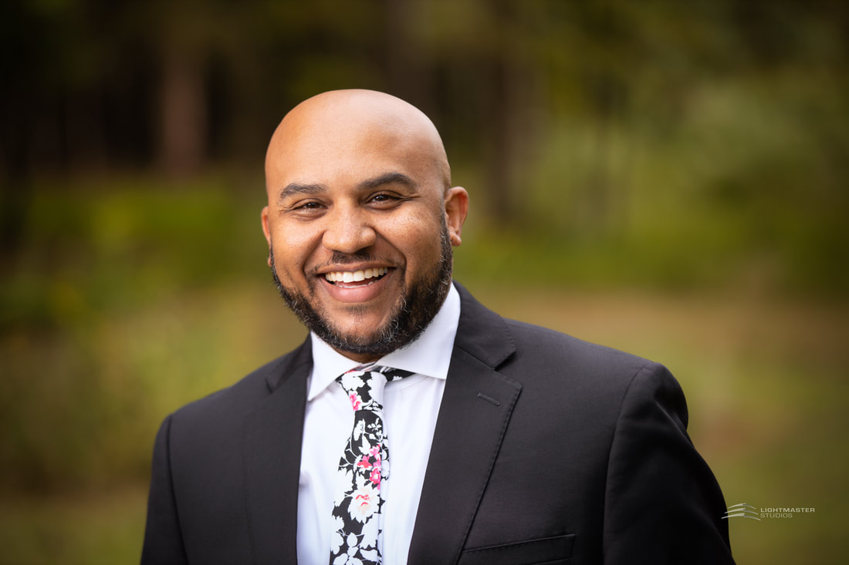
Sunday, April 27, 2025
10:30am Worship Service at Liberty Hill Missionary Baptist Church
520 Billy Howey Road
Waxhaw, NC 28173
www.thelibertyhill.church
2:00pm Reception
Depart Charlotte

Slide 10
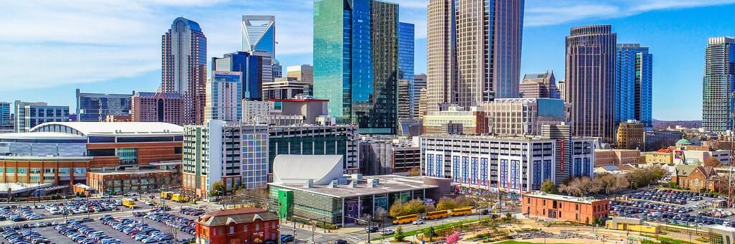
For more information
and to RSVP:
tsaksnation@gmail.com

