Slide 1
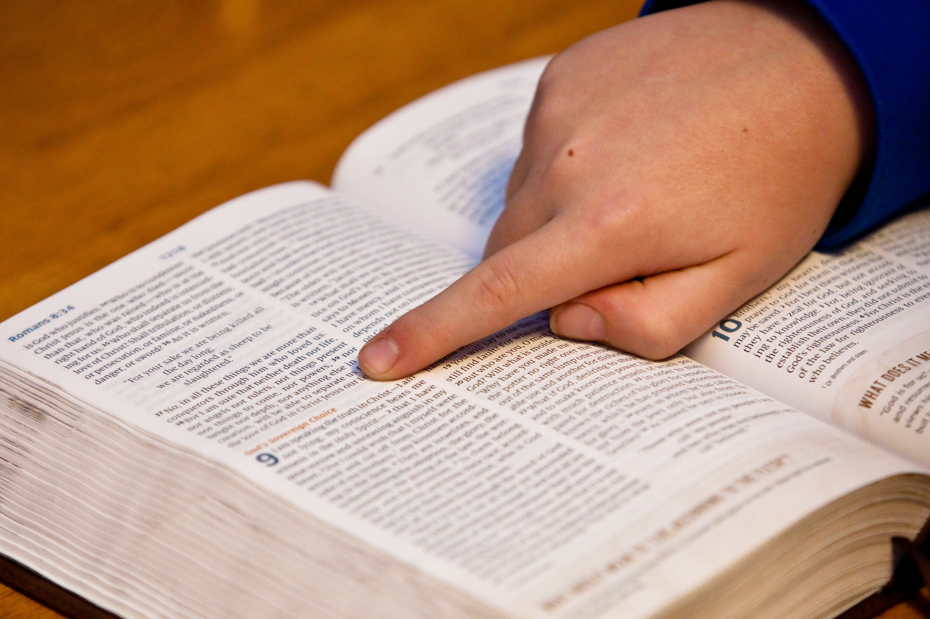
Bible Study Methods
Lesson 6: Grammar Part 2
TFT: Tim Oakleaf

Slide 2

Today’s agenda
Housekeeping
Review: “GIGO”
Intro: “Did I say that?”
Lesson 6: The Role of Grammar, Pt 2
Takeaways
This Photo by Unknown Author is licensed under CC BY-SA

Slide 3

Housekeeping
Handout Class Notes
Get Headcount
Bathrooms
Exit Plan
This Photo by Unknown Author is licensed under CC BY-ND

Slide 4

Teaching to learning styles
1. Lecture for
auditory Learners
(listening)
2. PowerPoint for
Visual learners
(seeing)
3. Writing exercises for
kinetic Learners
(motion & seeing)
4. Q+A and homework for
Interactive Learners (Engagement & responses)
This Photo by Unknown Author is licensed under CC BY-NC-ND

Slide 5

Who can name any of the Principles 1-4?
Lesson 5 Review: “GIGO!”
Grammar in, Grammar out!
Who can give us one takeaway?
This Photo by Unknown Author is licensed under CC BY-NC

Slide 6

Who can remind us what an idiom is?
Intro: “did I say that?!”
Diff. between Idioms & multiple meanings?
This Photo by Unknown Author is licensed under CC BY-NC-ND

Slide 7

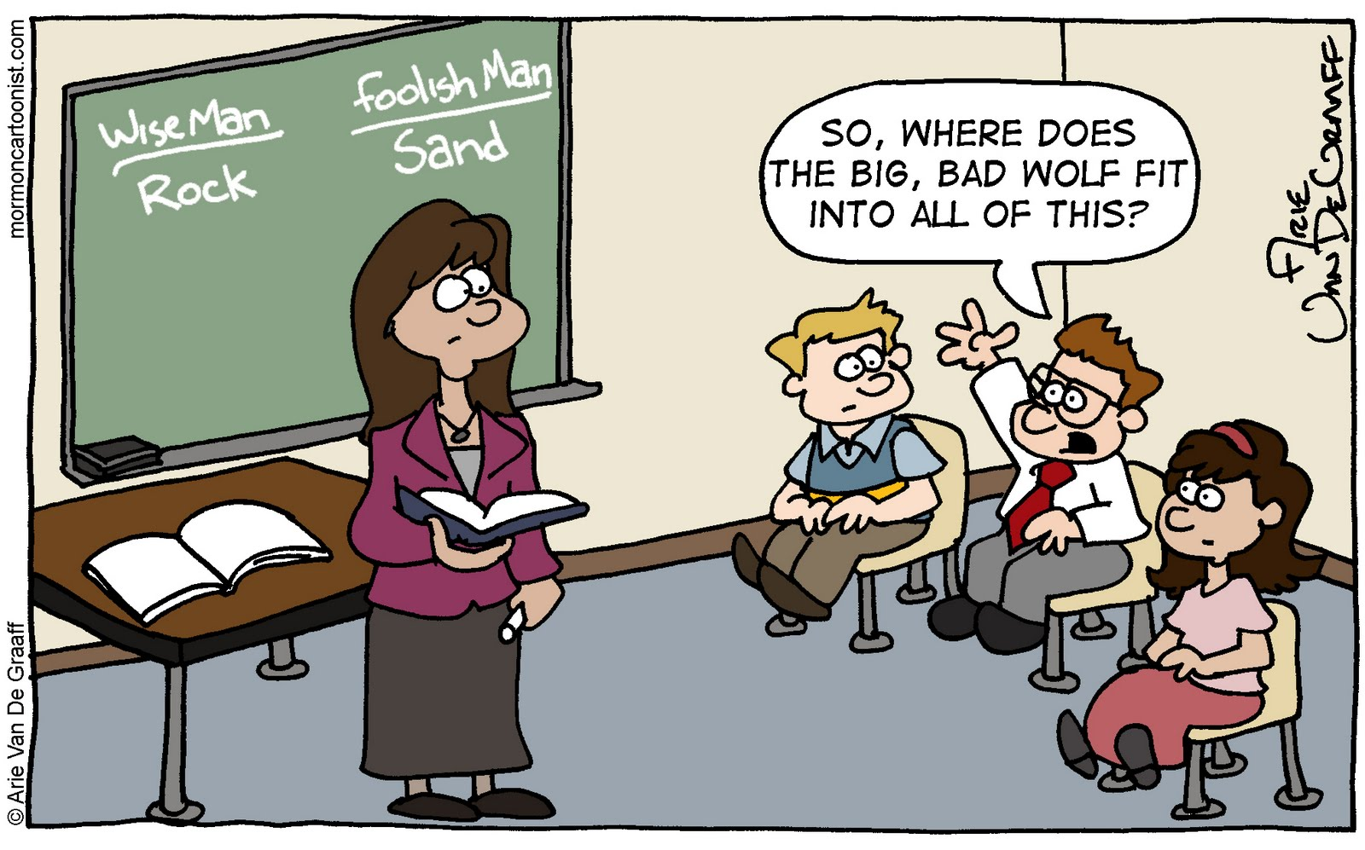
Meanings change over time
Etymology?
“Nice” =
foolish or stupid,
then pleasant, now desirable
“Awful” =
Inspiring versus
extremely bad
This Photo by Unknown Author is licensed under CC BY-NC-ND
This Photo by Unknown Author is licensed under CC BY-SA-NC

Slide 8
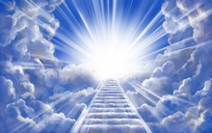


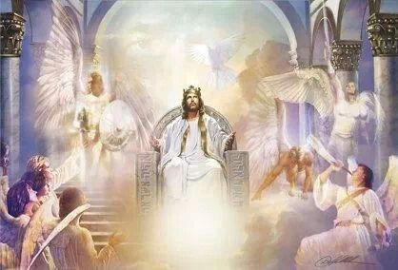
Bible Words
“Sozo”
= save
Spiritually, grant eternal life
John 3:17 =
James 5:15 =
Physically, protect from harm
“Ouranos” = heaven
Matthew 5:16 =
Earth’s atmosphere
Matthew 6:26 = The dwelling place of God and…
This Photo by Unknown Author is licensed under CC BY-SA-NC
This Photo by Unknown Author is licensed under CC BY

Slide 9

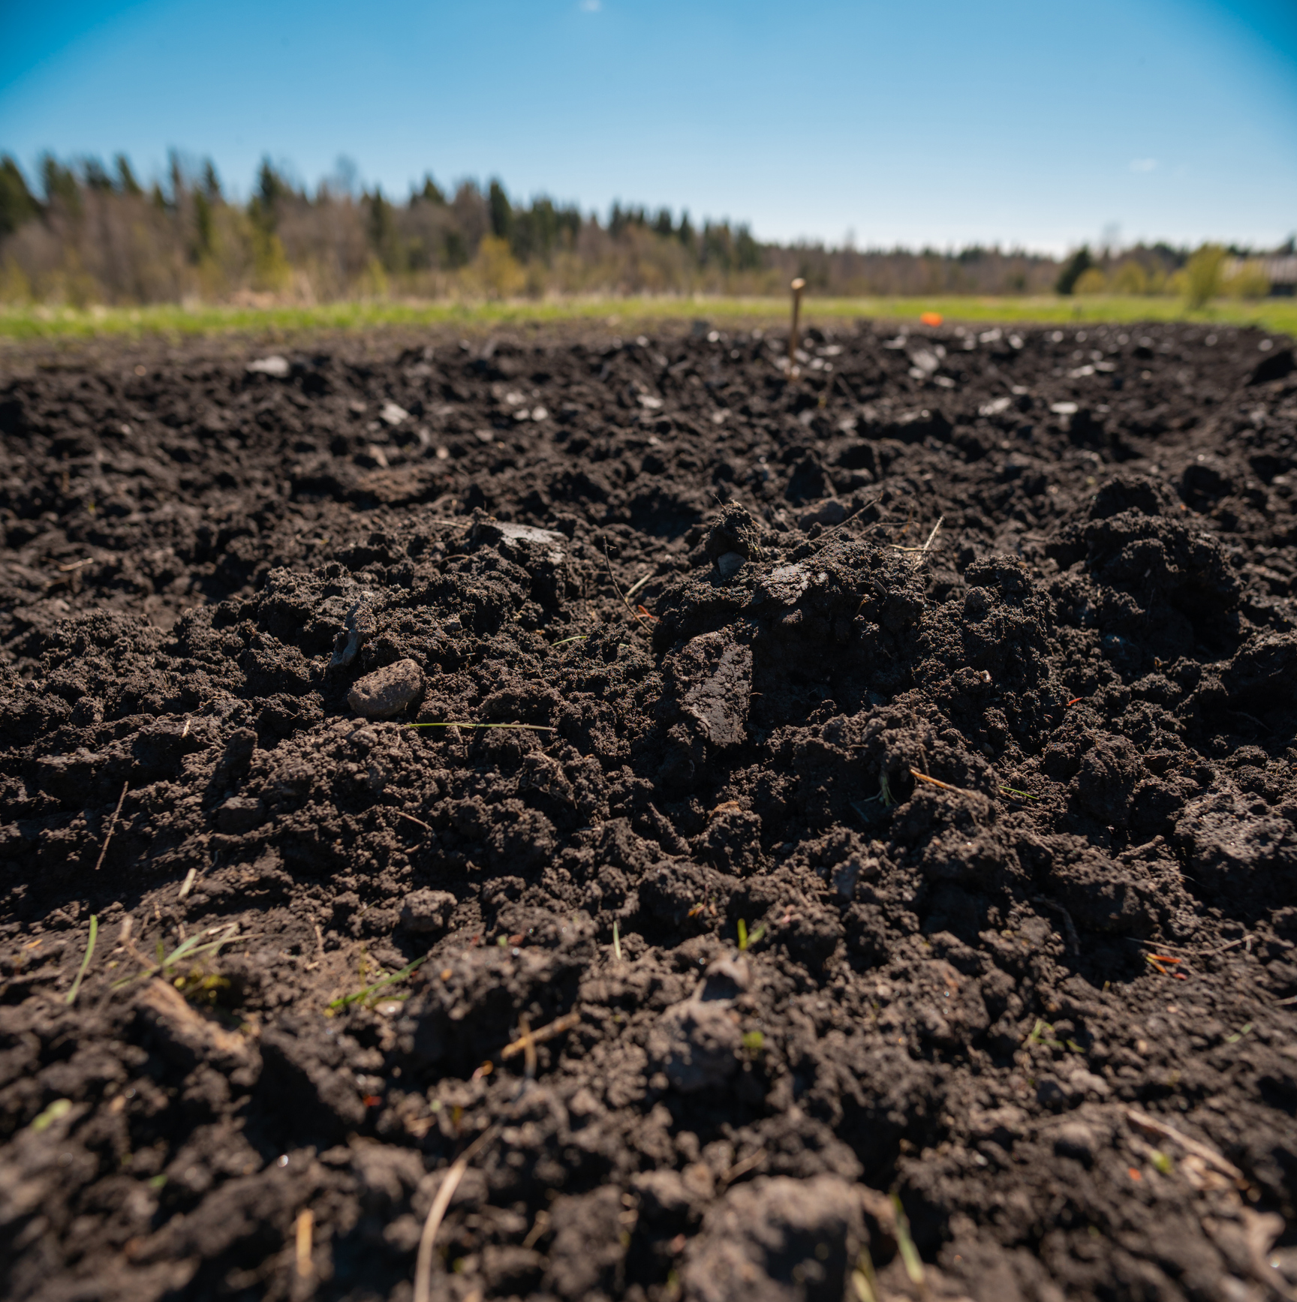
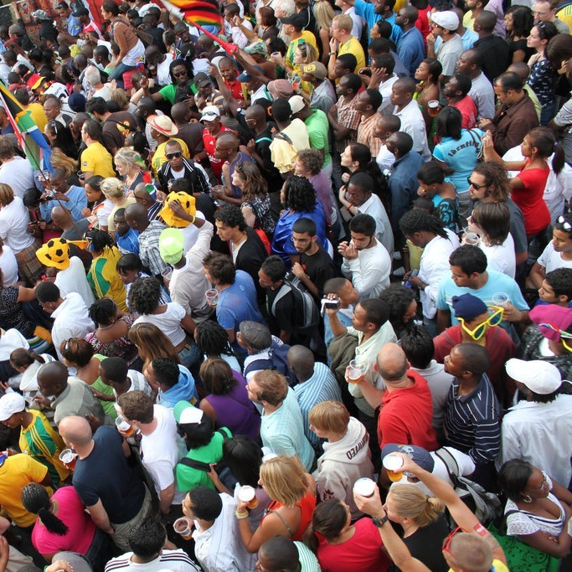

Bible Words
“Ge” = Earth
Matthew 5:18 =
Our planet
Matthew 13:5 =
Our land (soil)
Luke 21:35 =
Inhabitants of our planet (“among men”)
“Aleipho” = anoint
Luke 7:38 = Pouring perfumed oil for refreshment/washing
James 5:14 = Healing of the sick
How do we get it right?

Slide 10
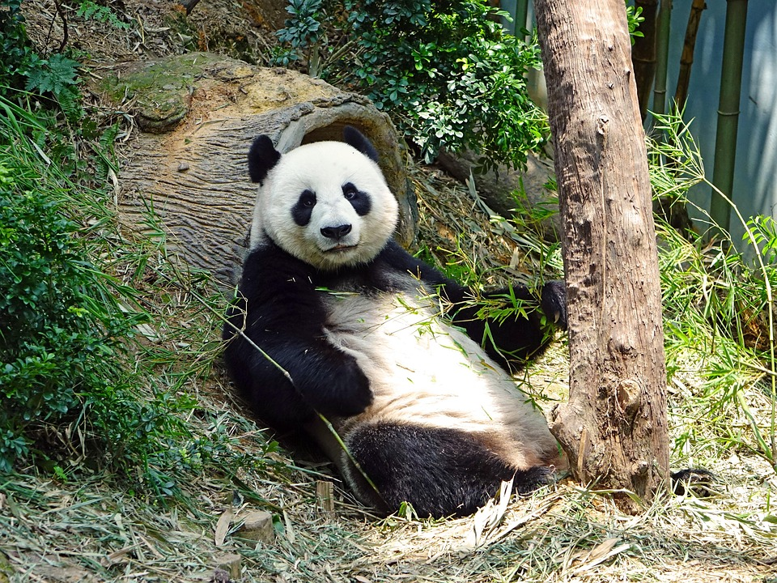
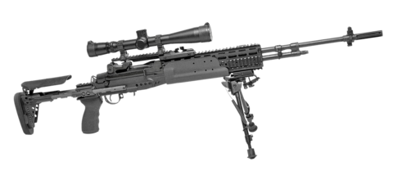
Meg’s personal favorite, The Panda…
The importance of Grammar
“The Panda eats shoots and leaves.”
[Diet]
“The Panda eats, shoots, and leaves.”
[Behavior]
Grammar,
Saving lives one comma at a time!
This Photo by Unknown Author is licensed under CC BY-SA

Slide 11
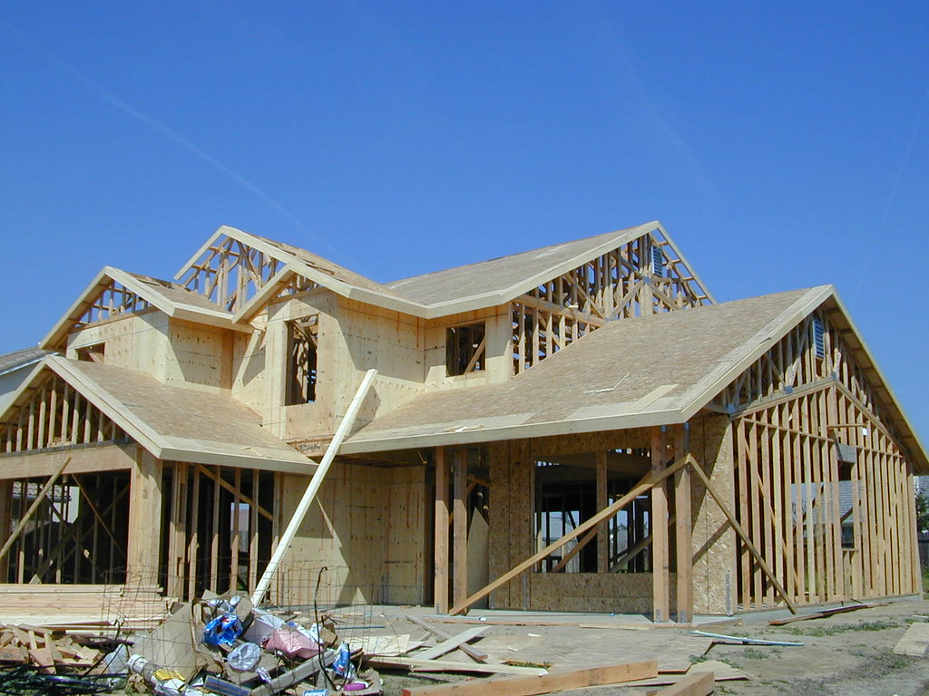
1. Framework/Structure of Content delivery
2. Effective sharing of thoughts, ideas, and feelings
3. meaningful Combinations and sequences of words
Lesson 6: Grammar, Pt 2
“Parts is parts!”
This Photo by Unknown Author is licensed under CC BY

Slide 12
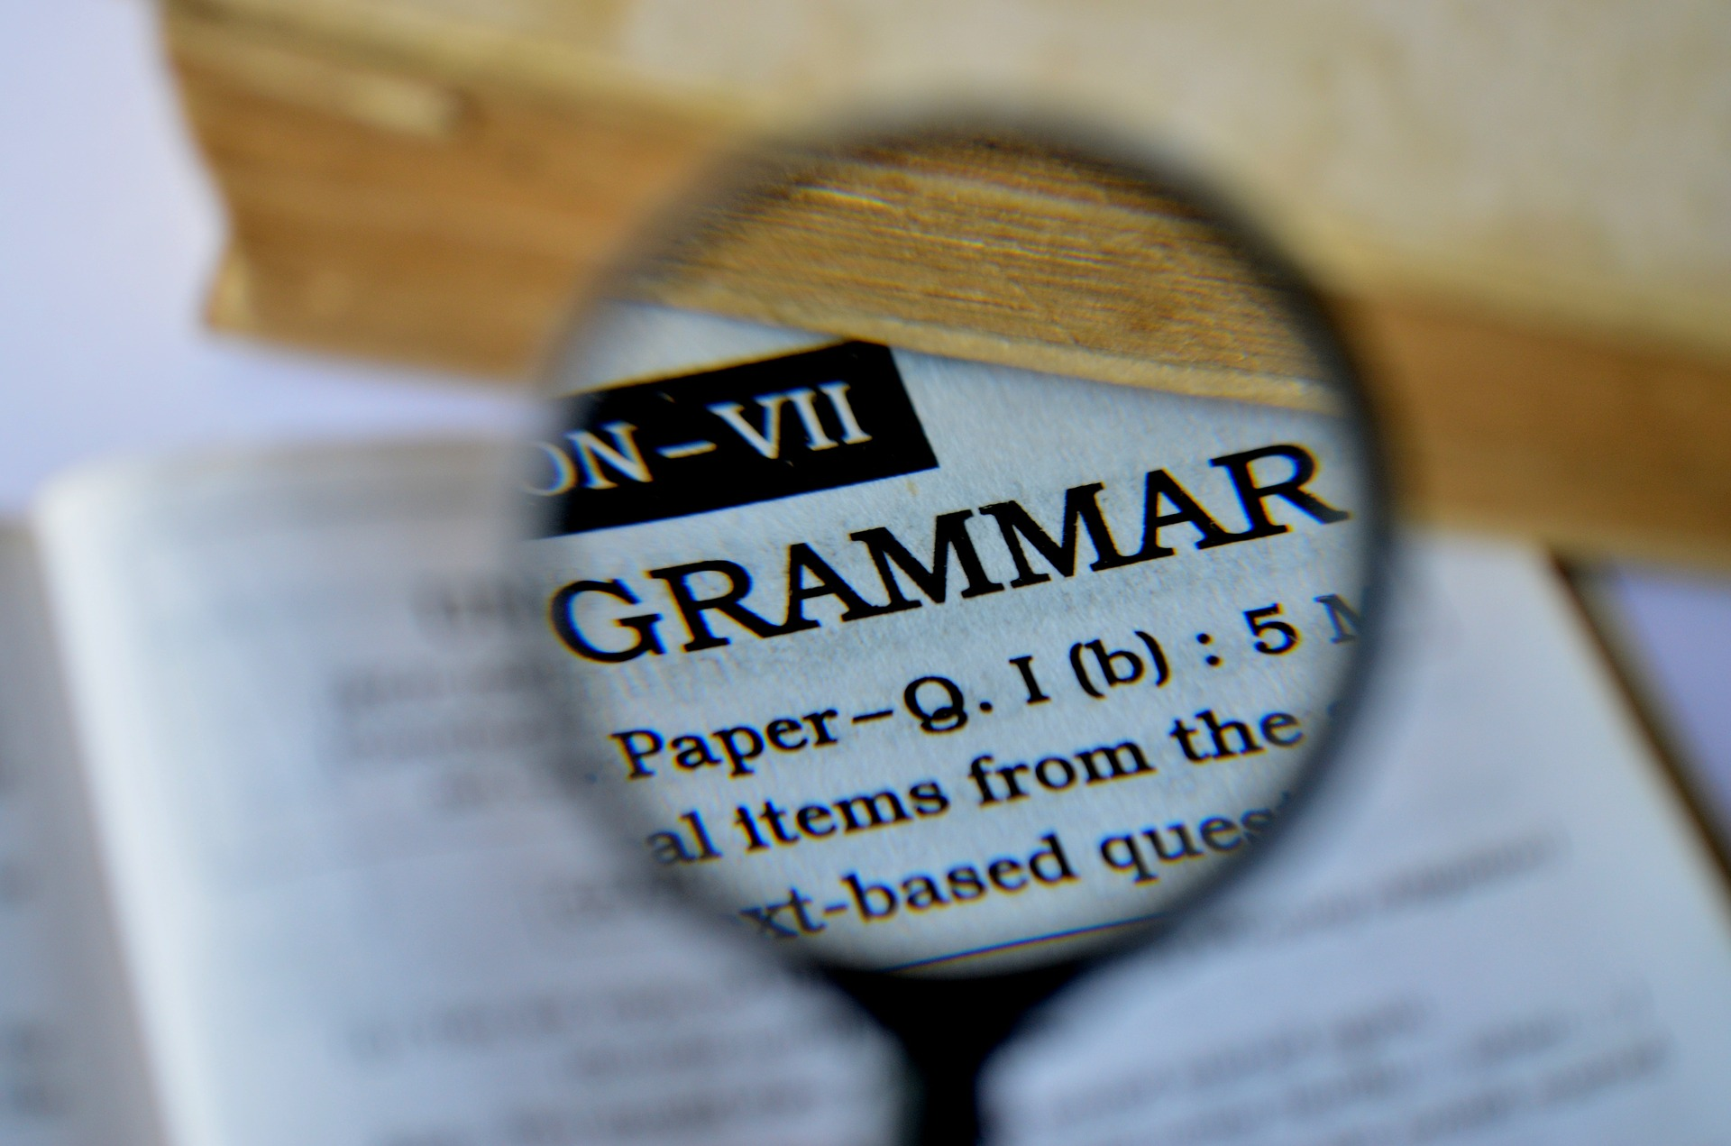
Lesson 6: The Role of Grammar Part 2
Second 4 of 8 Principles:
#5 – Word Studies
#6 - Structures
#7 – small details
#8 – Commentaries
But first….
This Photo by Unknown Author is licensed under CC BY

Slide 13
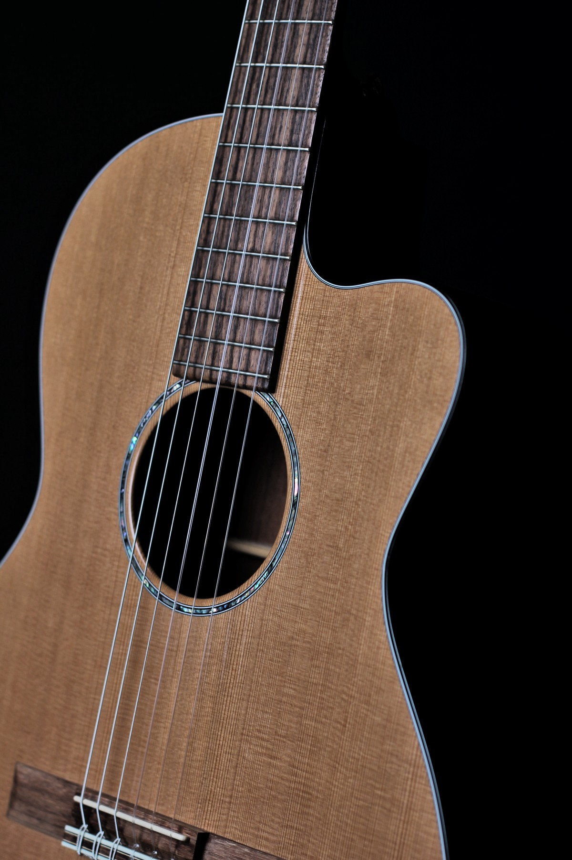
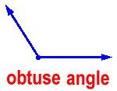
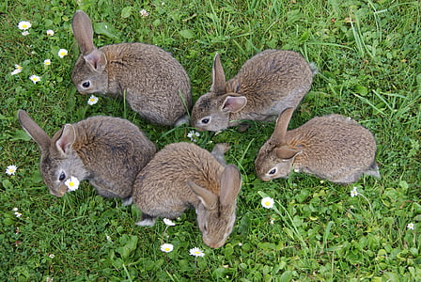
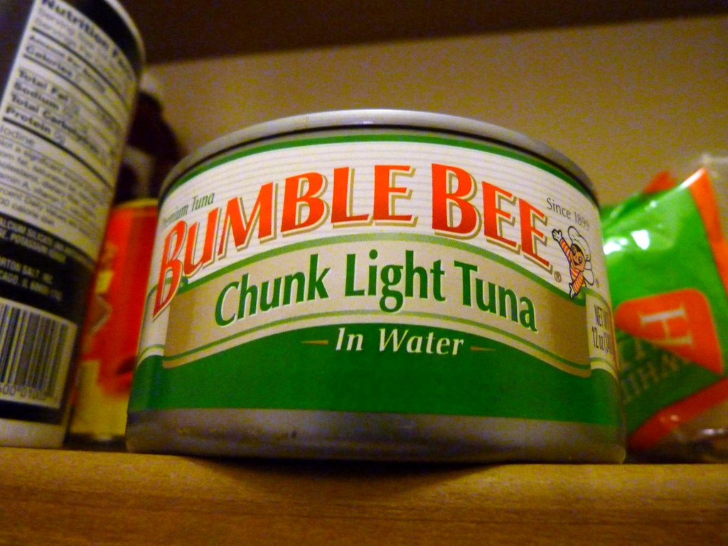


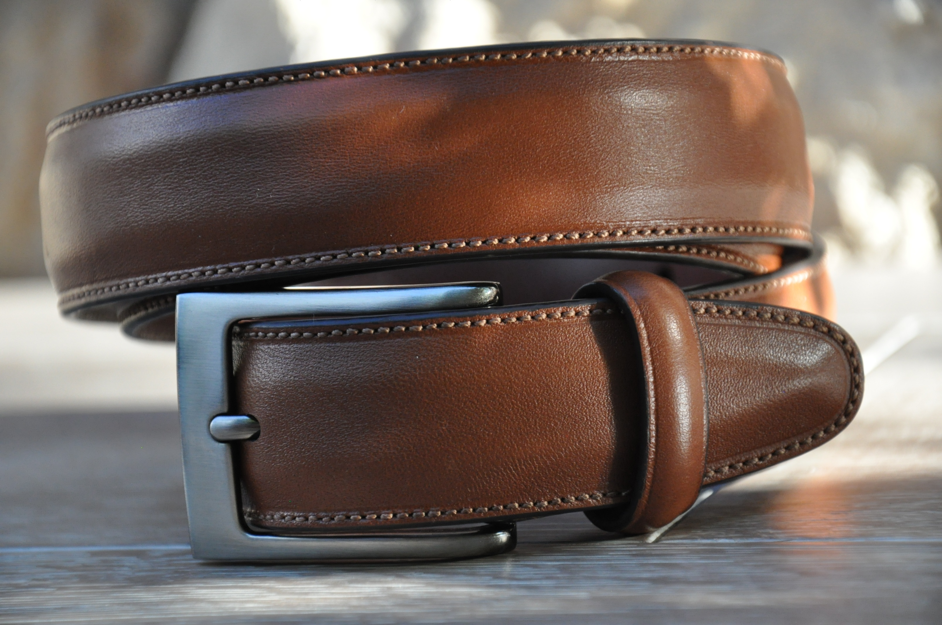


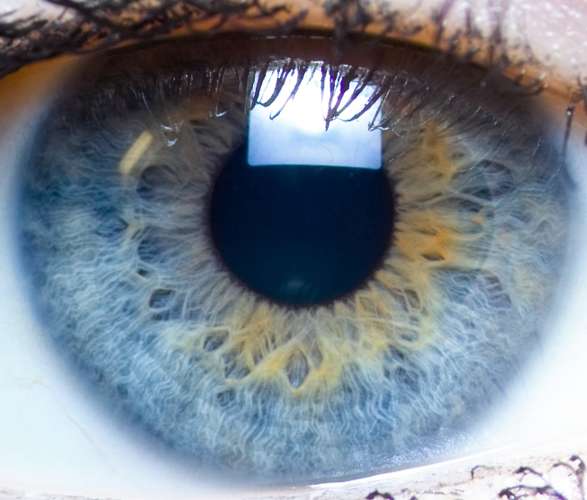
This Photo by Unknown Author is licensed under CC BY
playing with puns
This Photo by Unknown Author is licensed under CC BY-NC
This Photo by Unknown Author is licensed under CC BY-SA
This Photo by Unknown Author is licensed under CC BY-NC
This Photo by Unknown Author is licensed under CC BY-SA
This Photo by Unknown Author is licensed under CC BY

Slide 14

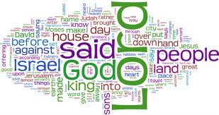
Recognizing different meanings
Principle #5
Word study
Avoiding mistakes in interpretation
1st example:
1 Thessalonians 4:13 & 5:6 – “asleep” vs. “Sleep”,
Koimao vs. katheudo
This Photo by Unknown Author is licensed under CC BY-SA-NC
Having Died vs. spiritual lethargy considering his return (See v.7)

Slide 15
Principle #5
Word study
2nd example:
Matthew 24:3 & 30 – “coming”
Parousia vs. erchomai
Parousia = 2nd coming, arrival on earth plus events leading up to it
Erchomai = specific time of his arrival
This Photo by Unknown Author is licensed under CC BY-SA-NC
Process vs. arrival

Slide 16

Principle #6 structure
Q
&
A
Chiasms/chiastic parallelisms
A1
A2
Restatements or answers in reverse order
B1
B2
Example:
Breakfast A1–lunch B1-dinner C1, dinner C2-lunch B2-breakfast A2
C1
C2
A1, B1, c1 – C2, B2, A2

Slide 17
Principle #6 structure
Example:
2 Timothy 2:12-14
V11, A1: “For if we died with him, we shall live with Him”
V13, A2: “If we are faithless, he remains faithful for he cannot deny himself”
V12 B1: “if we endure, we shall reign with him”
V12, B2: “if we deny him , he also will deny us”

Slide 18
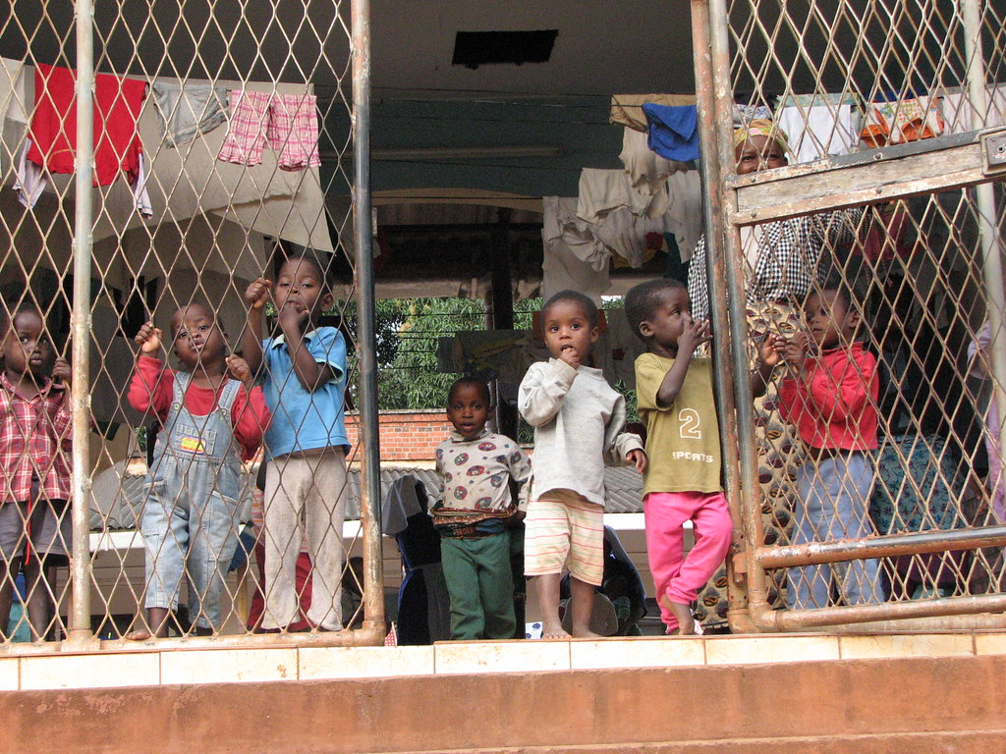
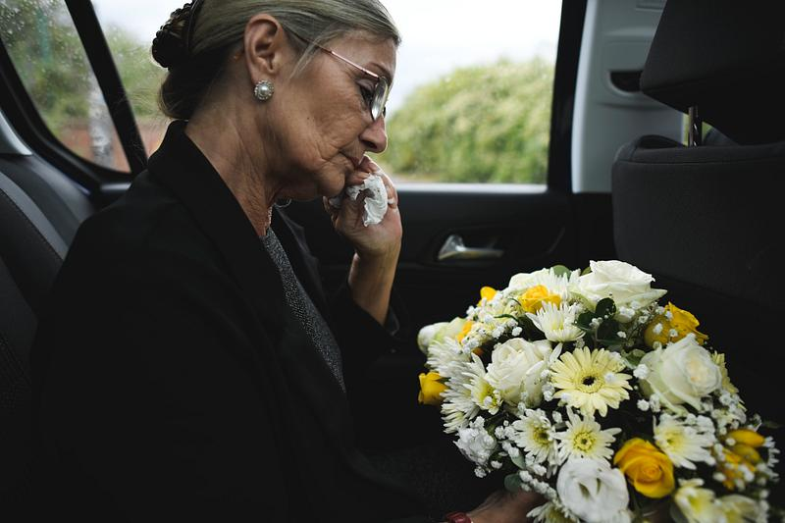
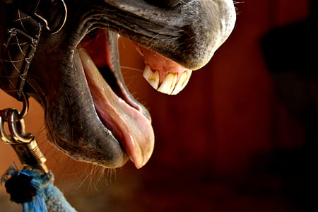
Principle #6 structure
Another Example:
James 1:26+27
Bridling the tongue (A)
And
Showing mercy to widows and orphans (B)
Chapter 2: showing mercy (B2)
And
Chapter 3 controlling the tongue (A2)
This Photo by Unknown Author is licensed under CC BY-NC-ND

Slide 19
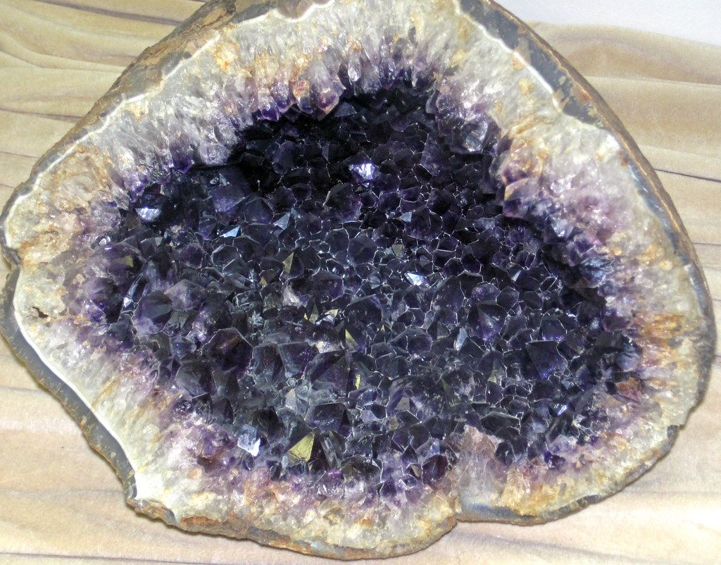

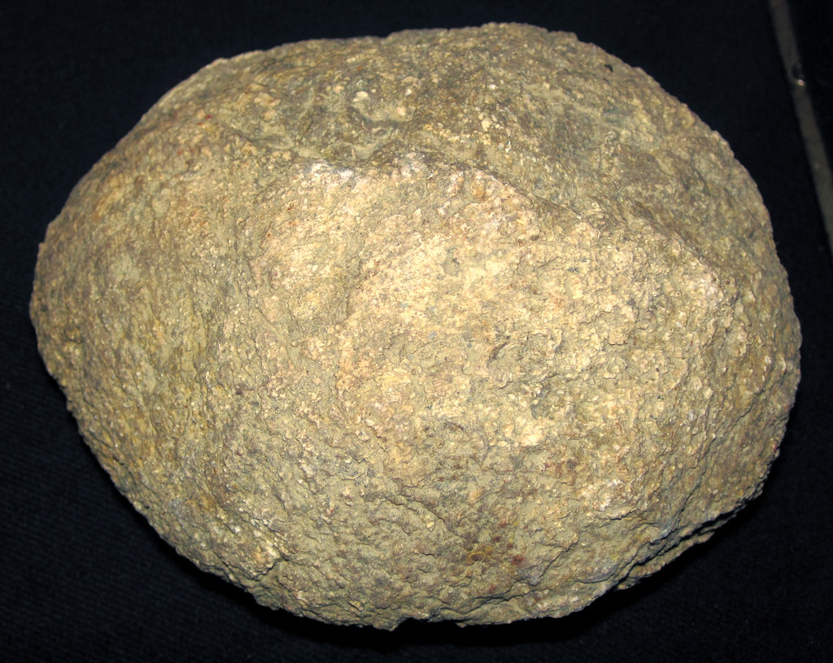
Principle #7
details
Geode?
Must open it
Same can be said for A simple word or phrase in the bible
Example: Matthew 22:31+32 “Sad you see!”
“eimi” = present tense = “I Am” Not “I was”
A single verb with major doctrinal implications!
This Photo by Unknown Author is licensed under CC BY
This Photo by Unknown Author is licensed under CC BY
This Photo by Unknown Author is licensed under CC BY

Slide 20
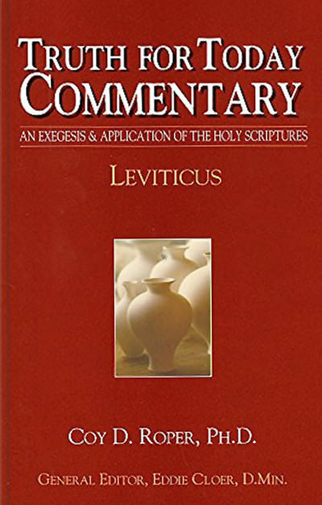
Principle #8 commentaries
Last
after utilizing all other methods
for comparing to my results
may uncover a need for additional investigation…
This Photo by Unknown Author is licensed under CC BY-SA-NC

Slide 21

Principle #8 commentaries
Look for those written by language scholars
Watch out for liberal, legalistic, or unbiblical content
Ask trustworthy believers for confirmation
Ask them also for suggestions as to reliable titles
Multiple and various
Details on structure, verb tenses, modifiers, etc.
Often reveal specifics contributing to accurate results

Slide 22
Take aways
Bible Study = Skill Development + Practice
Progress not Perfection
Fun = a little bit every day
Word studies, Chiastic Structures, Focusing on specific details, and Commentaries can be helpful

Slide 23
Take aways
Identify – Observe what it says
Clarify – Determine what it means
Confirm – Use resources and reference materials
Commentaries should be used judiciously

Slide 24
Next week: Bo Spires
Lesson 7: Discovering the Intentional Theological Message of a Biblical Book

Slide 25
resources
Supremacy of Grace excerpts from Knowing God.
Basic Bible Interpretation by Dr. Roy B. Zuck.
Figures of Speech Used in the Bible by E.W. Bullinger.
12 Dynamic Bible Study Methods by Rick Warren.
A Greek English Lexicon of the New Testament and Other Early Christian Literature by Walter Bauer, F.W. Gingrich, and Frederick Danker.

Slide 26
resources
6. The Bible Knowledge Commentary by John F. Walvoord and Roy B. Zuck.
7. Vine’s Expository Dictionary of New Testament Words by W.E. Vine.
8. Notes from Dr. Thomas L. Constable are available on the Sonic Light website.
9. Christy Voelkel’s Blue Letter Bible class on the BTC website.
10. Davis Dictionary of the Bible by John D. Davis

Slide 27
resources
11. The Analytical Greek Lexicon Harold K. Moulton
12. Nave’s Topical Bible by Orville J. Nave

Slide 28

THANK YOU for coming!
Tim Oakleaf
315-706-1428
teelow22@hotmail.com

