Slide 1

Bible Study Methods
Lesson 5: Grammar, Part 1
Your TFT: Tim Oakleaf

Slide 2

Today’s agenda:
Housekeeping
Intro: “You are Driving Me Crazy!”
Review: “What in the World is Hermeneutics?”
Lesson 5: The Role of Grammar, Pt 1
Conclusion: “Keep in mind…”
Takeaways
This Photo by Unknown Author is licensed under CC BY-SA

Slide 3

Housekeeping
Handout Class Notes
Get the Headcount
Bathrooms
Exit Plan
Expectations
My Teaching Philosophy
This Photo by Unknown Author is licensed under CC BY-NC-ND

Slide 4

expectations
Progress not…
Fun = slow and steady
The better you know the Bible the more accurately you will be able to apply it.
This Photo by Unknown Author is licensed under CC BY-SA

Slide 5

My teaching philosophy
1. Lecture for auditory Learners
(listening)
2. PowerPoint for Visual learners
(seeing)
3. Writing exercises for kinetic Learners
(motion & seeing)
4. Q+A and homework [optional] for Interactive Learners (Engagement & responses)

Slide 6
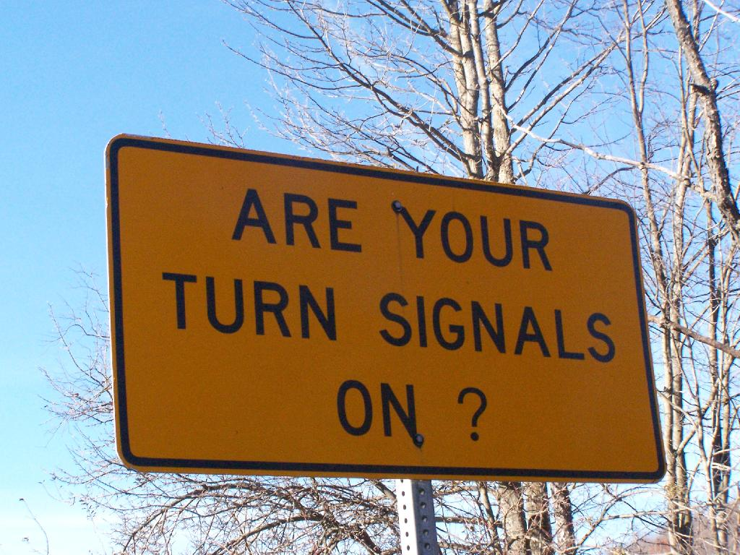


Who? What? How? +/-? When? Where?
“you are Driving me crazy!”
Goal? Main components?
Vehicle Operation, Rules & Regulations
This Photo by Unknown Author is licensed under CC BY

Slide 7
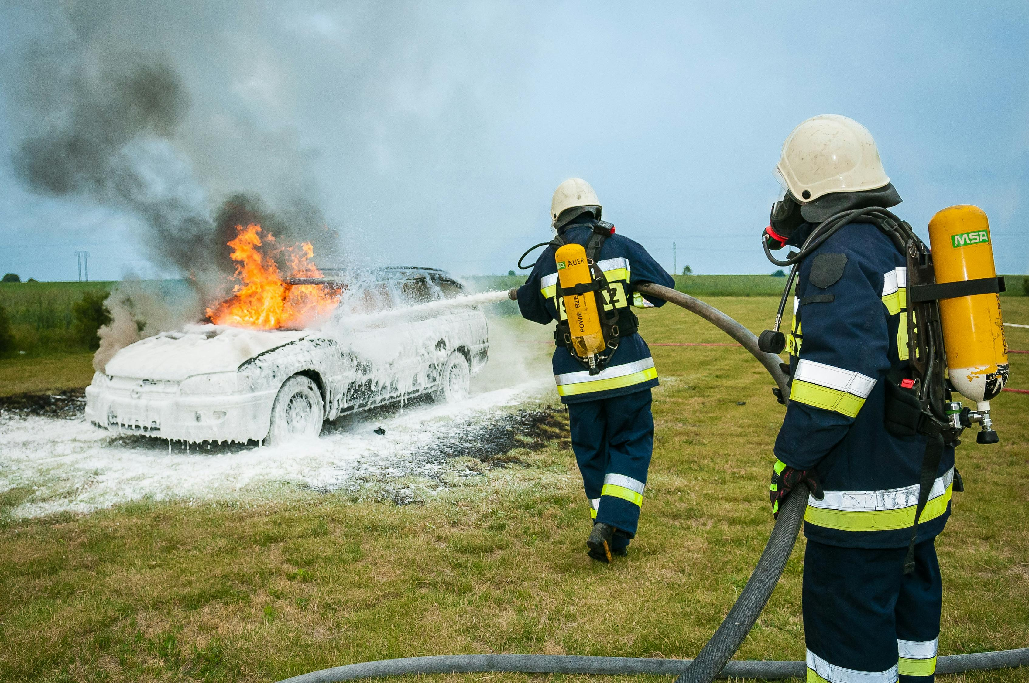
“you are Driving me crazy!”
Applied how?
Instinctively and spontaneously!
Under a Variety of circumstances!
better driver training needed?

Slide 8
Better bible training needed?
“you are Driving me crazy!”
“Operational” principles: Rules of interpretation, proper application. development needed to avoid crashing and burning theologically.

Slide 9
Explain and interpret vs adding one’s own bias, thinking, and desires
What in the world is Hermeneutics?
Exegesis vs Eisegesis
Theory and methodology of interpretation

Slide 10

1. Framework/Structure of Content delivery
Lesson 5: The Role of Grammar Part 1
What is grammar?
Why is it important?
2. tools of writing for understanding
3. meaningful Combinations and sequences
This Photo by Unknown Author is licensed under CC BY

Slide 11
“It get?... Perceptive my students are!”
Lesson 5: The Role of Grammar Part 1
As for written communications, does it get any more important than this?
This Photo by Unknown Author is licensed under CC BY

Slide 12
Today: First 4 of 8 Principles: #1 - Broader Context #2 – added Divisions #3 - Main Topic #4 – Figures of Speech
Lesson 5: The Role of Grammar Part 1
This Photo by Unknown Author is licensed under CC BY

Slide 13
Lesson 6: The Role of Grammar Part 2
come back Next week for
Second 4 of 8 Principles: #5 – Word Studies #6 - Structures #7 – small details #8 – Commentaries

Slide 14
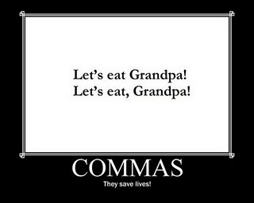
The importance of commas!
This Photo by Unknown Author is licensed under CC BY-NC-ND

Slide 15


Read it, Re-read it, Read it again!
Principle #1
the Broader Context
The ultimate context:
Meta-narrative
Example: Proverbs
Theme, Benefits, Context, purpose
This Photo by Unknown Author is licensed under CC BY-SA

Slide 16
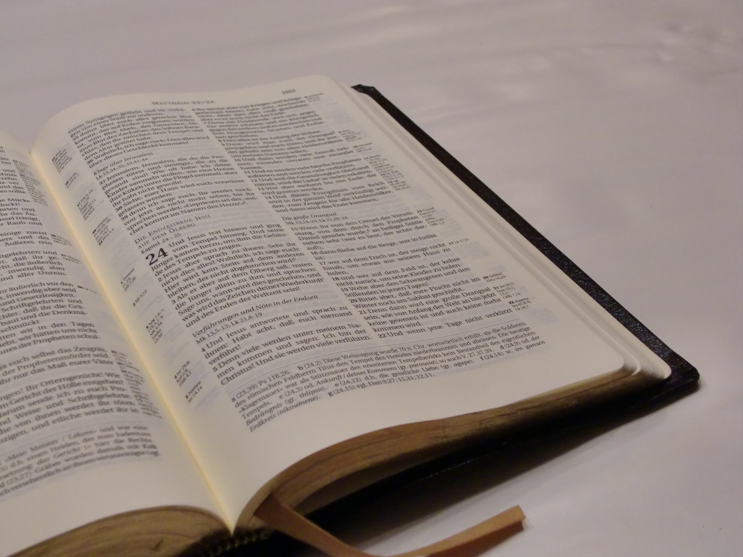
Principle #2
Chapter and verse divisions
Matthew 16:28
A prediction
Word study
Conclusions - based on what?
Flow of the text

Slide 17
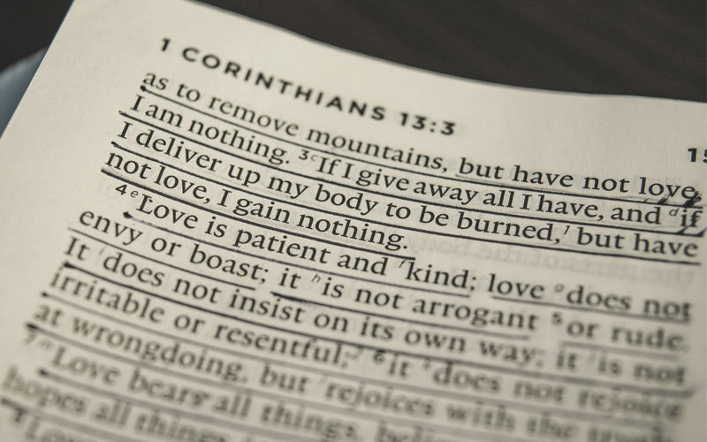
Principle #3
Main topic
Adhd anyone?
Connections
Flow of ideas
Clear break
Example:
1 Corinthians 13
Main topic?
Interactions during their assembly
This Photo by Unknown Author is licensed under CC BY-SA-NC

Slide 18
Principle #4
Figures of speech
We got smoked!
That subject is a hot potato!
Don’t let the cat out of the bag!
Forget it. It's over your head.
We are burning daylight.
Literal vs. figurative
Common source of Theological error
An idiom is an expression
Fun with idioms:

Slide 19
Match the bible idioms!
Answers:
Let me Catch my breath
A Drop in the bucket
The Apple of one’s eye
By the Skin of one’s teeth
Set in stone
Extending an olive branch
Flowing with milk and honey
Draw a line
Job 9:18
Isaiah 40:15
Psalm 17:8
Job 19:20
Exodus 31:18
Genesis 8:11
Exodus 3:8

Slide 20
Conclusion: keep in mind…
“As you read through the Bible, you should “keep your eyes peeled” for idioms. Some of them you may not be able to “make heads or tails of” at first, but a good commentary or study Bible can “lend a hand.” With a little research and background information, understanding most passages containing idioms in the Bible can become “easy as pie.”” From GotQuestions.org/idioms-in-the-Bible.html

Slide 21
Takeaways
Bible Study = Skill Development = Practice
Progress not Perfection
Fun = take it a little bit(e) at a time!

Slide 22
Takeaways
Foundation (Meta-Narrative) + Framework (Bible Knowledge) + Infrastructure (Grammar) = Completed Building (Interpretation)
Bible knowledge increases discernment, increases accuracy of interpretation, increases benefits from applications.

Slide 23
resources
Supremacy of Grace excerpts from Knowing God.
Basic Bible Interpretation by Dr. Roy B. Zuck.
Figures of Speech Used in the Bible by E.W. Bullinger.
11 Dynamic Bible Study Methods by Rick Warren.
A Greek English Lexicon of the New Testament and Other Early Christian Literature by Walter Bauer, F.W. Gingrich, and Frederick Danker.

Slide 24
resources
The Bible Knowledge Commentary by John F. Walvoord and Roy B. Zuck.
Vine’s Expository Dictionary of New Testament Words by W.E. Vine.
Notes from Dr. Thomas L. Constable are available on the Sonic Light website.

Slide 25

THANK YOU for coming!
Tim Oakleaf
315-706-1428
teelow22@hotmail.com

