Slide 1

Meta Analysis of Existing Research on Pastors in the NAD
Gerardo Oudri
NAD Ministerial

Slide 2
Background
Over the past decade, the Institute of Church Ministry (ICM) has conducted nine major studies of Adventist pastors:
Pastor educational experiences and family life,
Pastor wellbeing and stressors,
Pastor longevity,
Pastors who have left congregational ministry,
Female pastors,
Rural pastors,
Hispanic pastors,
Recently hired pastors
FACT Clergy Health and Well-being Survey 2023

Slide 3
Background, cont.
These research efforts employed diverse methodologies:
Qualitative in-depth interviews,
Focus groups, and
Quantitative survey analysis
The studies were conducted for different purposes and funded by various entities.
As a result, these studies had not been systematically analyzed together to create a comprehensive, data-driven understanding of Seventh-day Adventist pastors in the NAD.
This fragmentation has limited the broader impact and practical application of the findings.

Slide 4
Background, cont.
To address this gap, ICM conducted a meta-analysis of these existing studies to:
Synthesize key findings across studies
Identify overarching themes, particularly strengths and challenges
Provide a cohesive, evidence-based perspective on the current landscape of Adventist pastoral ministry
Offer practical recommendations for denominational leadership

Slide 5
Analysis Results

Slide 6
Three Common Strengths Across Studies
Pastors have a deep sense of ministry as a calling
Across all groups ministry is viewed as a divine calling, not simply a career choice​​​.
“It was actually when I was 16 that I really felt the call of ministry on my life. And I just felt this thing on my heart. I felt like the Holy Spirit was saying, ‘You’re going to do this someday.’” (JW—Female Pastor Study)

Slide 7
Three Common Strengths Across Studies
Adventist pastors are resilient
Pastors build resilience when they:
Devote time to spiritual practices*
Have a supportive spouse
Foster support networks
Retain professional counseling services
Engage in self-care activities
*Shows increase in post COVID research

Slide 8
Three Common Strengths Across Studies
Adventist Pastors see their work as meaningful
“The small moments with people and bringing God into that space for that family where they may have lost hope or lost sight or lost faith. Every time that happens is a reconfirmation I’m where I belong and I’m doing what I’m supposed to be doing.” (Kelly Gontz, female pastor)
“Seeing people grow in Christ. Seeing people depend more on Him and less on the pastor, or less on anybody else…Just to watch them become more joyful and more peaceful in life... is really where I get my passion from.” (BL, newly hired pastor)
Among newly hired pastors who are committed to remain in ministry a significant majority (71%) believe strongly in the value of their ministry.

Slide 9

Common Challenges Across Studies
Pastors experience:
Pervasive emotional and mental health struggles
Widespread spiritual challenges
A persistent sense of overwhelm
A profound shortage of mentorship
A significant lack of social support
Varying degrees of support from their conferences

Slide 10
Common Challenges Across Studies
Pervasive emotional and mental health struggles
Burnout, depression, and lack of emotional support are common issues
“I would say my mental, emotional, spiritual, and relational health has been steadily declining since the first day I started the ministry.” (LL, newly hired pastor)
“[My wife] has helped me uncover the signs of stress, panic. I had normalized all those things in my life. I had no idea the physiological toll was taken on me. Now I can spot stress when it's coming. I know what burnout feels like.” (1st generation Hispanic pastor)

Slide 11
Common Challenges Across Studies
Widespread spiritual challenges
Pastors Spiritual Challenges | Percent
Making time for personal devotions | 66.6
Difficulty with personal prayer | 55.9
Trouble maintaining personal connection with God | 53.9
“As an elder and as a student, I felt more spiritually connected with God. And one thing that I realized is that Saturday was a day of relief that I enjoyed. Since I became a pastor, that doesn’t exist anymore.” (EF, newly hired pastor)

Slide 12
Common Challenges Across Studies
A persistent sense of overwhelm
“Hispanic pastors who are hired part time and they're given three districts, and [the Conference] knows the culture that they are coming from. That part-time is only in the title because they know all these pastors are going to give their hearts of those three churches. And they're going to work like animals for those three churches, and they do. But they're still getting a part time paycheck. That happens so often.” (1st generation Hispanic pastor)
“My kids said to me, ‘Mom, you are going to kill yourself, you are working too hard.’ Yet I felt pressure to work harder in order to measure up to the male pastors in the conference. (P, former female Adventist pastor)

Slide 13
Possible Source
of Overwhelm

Slide 14
Common Challenges Across Studies
A profound shortage of mentorship
“I think [mentoring] is one of the weaknesses that we have in the church. I remember in the past you must start as an associate pastor. You work with that pastor for years and that pastor has a responsibility to mentor you. But today, we start our ministry having zero experience. Sometimes the pastors suffer, the family and the church because [one day] we are swimming in a pool and the next day you are swimming in the ocean.” (1st generation Hispanic pastor)

Slide 15
Common Challenges Across Studies
A significant lack of social support
“There’s a reason why Jesus sent His disciples out two-by-two. If you have a friend you can talk to, and even if this friend is not be able to resolve your issues, at least you have somebody to talk to. It comes out, this catharsis, it can help. The conference should make room for this to happen, to address it, publicize it, because no preacher’s gonna raise his hand and say, ‘I need help.’” (Focus Group Participant, Pastor Health Study)
“I don't know [what I would do] if I didn't have [my husband’s] support and him being so hands on. I could be in the middle of dinner, and I get a call “So and so is in the hospital. Can you come immediately?” And [I say], “Oh, my goodness!...Can you finish these beans?” And he does it without complaining and all these kinds of things. (DL, female pastor)

Slide 16
Common Challenges Across Studies
Varying degrees of support from their conferences
I really like our ministerial people, but I’ve never had a visit and never had a meeting with them. (JB, newly hired pastor).
I felt like [my] Conference was very good in terms of trying to equip their pastors. Our Conference leadership was very progressive in the way that they would challenge us to grow and try new things and support us as we face challenges. (A, former Adventist pastor)
The challenge that I had was lack of support and care for pastors.… When you reach out for some help, there’s none. Even to the point when I sent in my resignation there was very little communication and even after I left there was not even a letter to say, ‘Thanks for your service. Wish you well.’ Not even a conversation. So, it tells me that I made the right decision. (M, former Adventist pastor)
I think that’s been a lot of [my difficulty is] just not feeling the [Conference] support… There are so many things I feel … I can’t quite talk about to the conference. And not sure who to share that with. (LL, newly hired pastor)

Slide 17

Trends -- 10 Years of Data
Pastors are more likely to leave congregational ministry than in the past.
1
Church members continue to show increased signs of dysfunction and conflict.
2
Pastors remain underprepared to deal with “real life” problems in their congregations and the practical day-to-day aspects of pastoring.
3

Slide 18
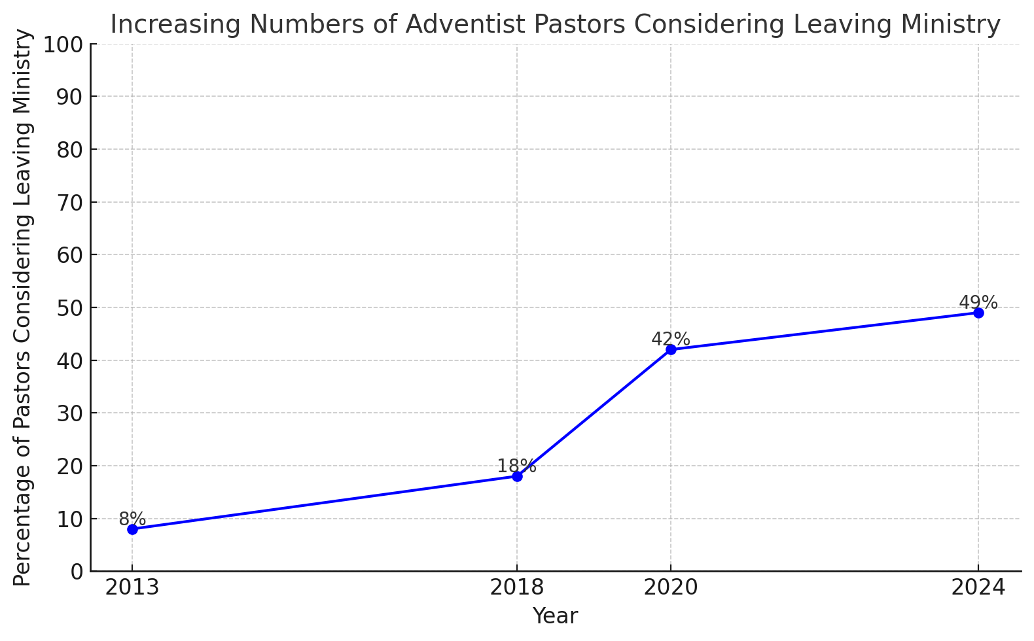
More Pastors Considering Leaving 2013 - 2024

Slide 19
Trends Across Studies
Church Member Difficulties, Conflict, and Apathy are Major Stressors
“What was challenging was very difficult church members. People that just made your life miserable. People that talked about you. People that made false information about you and spread it to other people.” (R, Former Adventist Minister)
“In my first church, the first elder was opposed to women in ministry. During my first sermon there, my installation, when I got up to speak, he left with a group of other people.” (JL, female pastor)
Among newly hired pastors, the most frequently reported obstacle in their ministry is the lack of membership involvement, passion, or engagement, identified by 57% of respondents.

Slide 20
Trends Across Studies
Lack of preparation for practical duties (2013 – 2024)
“We studied a lot of theory and theology, and all this stuff. You don’t use that stuff in real pastoral work. I can’t think of one practical time where I had to explain the importance of ‘vav’ to a church member that couldn’t pay their rent, had a family member deported, or didn’t understand why God had forsaken him. [We need] more practical coaching, teaching.” (T, former Adventist pastor)
For newly hired pastors, training on the day-to-day aspects of ministry, such as counseling and meeting members’ social needs, was the most pressing issue with 81% of respondents prioritizing it.
Examples:
Conducting funerals
Running board meetings
Engaging in conflict resolution
Leading strategic planning initiatives
Chairing finance committees (general lack of financial literacy)

Slide 21
Recommendations
Invest in and implement structured, tiered mentorship
Pair new pastors with mentors across different experience levels.
Prioritize mentorship access for women, ethnic minorities, and rural pastors​​​.
Initiate NAD-wide lay-leader training for pastor thriving
Educate church members about pastor roles and healthy boundaries
Publicly affirm women and minority pastors to reduce microaggressions and marginalization​​​.

Slide 22
Recommendations
Provide Accessible Mental Health Resources
Increase awareness of confidential counseling resources
Normalize care-seeking as a strength in ministry culture​​.
Fund or incentivize resilience and wellness training.
Update Metrics of Ministry Success
Include spiritual growth, relational trust, and community engagement as valid success measures.
De-emphasize tithe and baptism counts as sole indicators​​.

Slide 23
References
Činčala, P. & Drumm, R. (2021). Seventh-day Adventist Pastor in North American Division Health Qualitative Study Report: What can and must be done to save the health of Adventist pastors [Unpublished report]. Institute of Church Ministry.
Činčala, P., Drumm, R., PhD, Williams, I., & Brauer, A. (2022, May). “It takes a lot of discipline to say, ‘I’m going to walk with God today’”: Recognizing and Addressing Barriers to Pastors’ Spiritual Wellbeing. Adventist Human Subjects Researchers Association Conference. Orlando, FL
Činčala, P. & Son, I.(July 30, 2024). Clergy Survey 2023 Health and Well-being. Report for FACT Research Group, Exploring the Pandemic Impact on Congregations.
Činčala, P., & William, M. (2020). Pastoral longevity in ministry survey report. Unpublished report.
Drumm, R & Činčala, P. (2023, May). “Laughable at best, criminal at worst”: Why Adventist Clergy Leave Pastoral Ministry. Adventist Human Subjects Researchers Association Conference. Adventist University of Africa, Nairobi, Kenya.
Drumm, R. & Cincala, P. (September 2024). Hispanic Pastor Qualitative Study. Unpublished report.
Drumm, R. & Cincala, P. (January 2025). Qualitative Report on Newly Hired Pastors. Unpublished report.
Drumm, R., Hargrove, T., Crumley, L., & Cincala, P. (May 2024). It takes a lot to be a pastor if you’re a man. it takes a lot more to be a pastor if you’re a woman”: Gender Challenges among SDA Female Pastors. 18th Annual International Conference on Sociology. Athens, Greece.
Heck, A., Drumm, R. D., McBride, D. C., & Sedlacek, D. (2017). Seventh-day Adventist clergy: Understanding stressors and coping mechanisms. Review of Religious Research, 0(0), 1–18.
Vine, C. E. W., Drumm, R. D., Cincala, P., Crumley, L. P., Hargrove, T. D., & Son, I. P. (2024). Ministry in rural areas and small towns research report (Unpublished report).

