Slide 1

It’s NOT
Your
Turn
Heather Thompson Day

Slide 2
Now without faith it is impossible to please God
Hebrews 11:6

Slide 3
For we walk by faith, not by sight.
2 Corinthians 5:7

Slide 4
For in it the righteousness of God is revealed from faith to faith, just as it is written:
The righteous will live by faith.
Romans 1:17

Slide 5
For everyone who has been born of God overcomes the world. And this is the victory that has overcome the world—our faith.
1 John 5:4

Slide 6
In all circumstances take up the shield of faith, with which you can extinguish all the flaming darts of the evil one
Ephesians 6:16

Slide 7
Jesus said to him,
“Go, your faith has saved you.”
Mark 10:52

Slide 8
Jesus heard this and was amazed at him, and turning to the crowd following him, he said, “I tell you, I have not found so great a faith even in Israel.”
Luke 7:9

Slide 9
The Greek word for faith, is ‘pistis’ and while the word does describe beliefs, it also has a complementary component to it that people often overlook. Pistis has an underlying property of trust.

Slide 10
Pistis is not just a word that communicates what we believe, but it also communicates who we trust

Slide 11
Who do you trust when it’s not your turn?

Slide 12
Now without trust it is impossible to please God
Hebrews 11:6

Slide 13
For we walk by trust, not by sight.
2 Corinthians 5:7

Slide 14
For in it the righteousness of God is revealed from trust to trust, just as it is written:
The righteous will live by their trust.
Romans 1:17

Slide 15
For everyone who has been born of God overcomes the world. And this is the victory that has overcome the world—our trust.
1 John 5:4

Slide 16
In all circumstances take up the shield of trust, with which you can extinguish all the flaming darts of the evil one
Ephesians 6:16

Slide 17
Jesus said to him,
“Go, your trust has saved you.”
Mark 10:52

Slide 18
Jesus heard this and was amazed at him, and turning to the crowd following him, he said, “I tell you, I have not found so great a trust even in Israel.”
Luke 7:9

Slide 19
The word "pastor" originates from the Latin word "pastor," which means "shepherd"

Slide 20
“Some commentators, recognizing that kalos, ‘good’, has overtones of beauty, prefer ‘noble shepherd’, or ‘worthy’ or ‘model’.”
Bruce Milne, commentary, The Message of John: Here Is Your King

Slide 21
Jesus presents himself not just as a “good” shepherd, but he is also a ‘model’ shepherd.
Bruce Milne, commentary, The Message of John: Here Is Your King

Slide 22
So let’s look at the ministry of not just our ‘good’ shepherd
but our
‘model’ shepherd

Slide 23
“In his gospel, Luke lists all the political and religious leaders in power and then notes how the word of God bypassed them and came to John in the wilderness. The locus of God’s presence and activity is not found in the corridors of great power.”
Rich Villodas

Slide 24
Upside-down Kingdom

Slide 25
In the fifteenth year of the reign of Tiberius Caesar—when Pontius Pilate was governor of Judea, Herod tetrarch of Galilee, his brother Philip tetrarch of Iturea and Traconitis, and Lysanias tetrarch of Abilene— during the high-priesthood of Annas and Caiaphas,
the word of God came to John son of Zechariah in the wilderness.
Luke 3:1-2

Slide 26
Upside-down Kingdom

Slide 27
He came to Nazareth, where he had been brought up. As usual, he entered the synagogue on the Sabbath day and stood up to read. The scroll of the prophet Isaiah was given to him, and unrolling the scroll, he found the place where it was written:
Luke 4:16-17

Slide 28
The Spirit of the Lord is on me, because he has anointed me to preach good news to the poor...
Luke 4:18

Slide 29
He then rolled up the scroll, gave it back to the attendant, and sat down. And the eyes of everyone in the synagogue were fixed on him. He began by saying to them, “Today as you listen, this Scripture has been fulfilled.”
Luke 4:20-21

Slide 30
They were all speaking well of him and were amazed by the gracious words that came from his mouth
Luke 4:22

Slide 31
Jesus: IT’S YOUR TURN!

Slide 32
Great introductory sermon. The crowd is applauding. Jesus could have left it at that and his first sermon would be considered successful, but he doesn’t.

Slide 33
“But I say to you, there were certainly many widows in Israel in Elijah’s days, when the sky was shut up for three years and six months while a great famine came over all the land. Yet Elijah was not sent to any of them except a widow at Zarephath in Sidon.”
Luke 4:25-26

Slide 34
Zarephath is in the region of Sidon where they worshipped Baal.

Slide 35
Jesus has just stood in a Jewish synagogue, claimed to be the Jewish Messiah, but then said that God sent the great prophet Elijah not to a widow in Israel, but to a pagan widow

Slide 36
“But I say to you, there were certainly many widows in Israel in Elijah’s days, when the sky was shut up for three years and six months while a great famine came over all the land. Yet Elijah was not sent to any of them except a widow at Zarephath in Sidon.”
Luke 4:25-26

Slide 37
The church of Jesus’ day had waited a long time for a King that would save Israel.
And Jesus ushers in an upside-down kingdom as a Messiah that seeks to save everyone.

Slide 38
When they heard this, everyone in the synagogue was enraged. They got up, drove him out of town, and brought him to the edge of the hill that their town was built on, intending to hurl him over the cliff.
Luke 4:28-29

Slide 39
You and I, would see this first sermon as a failure.
But Jesus does not see failure.
Jesus sees obedience.

Slide 40
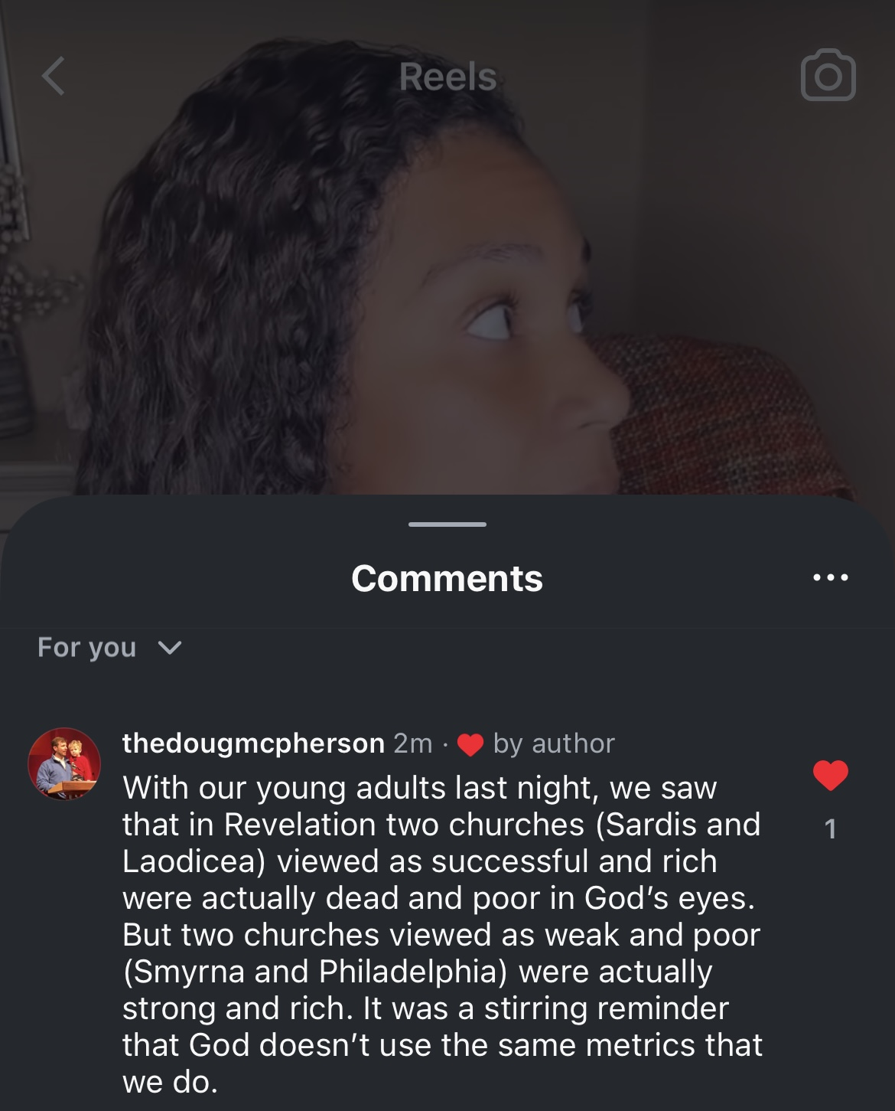
-Pastor Doug Mcpherson,
Mayfield Road Baptist Church,
Arlington

Slide 41
Let’s go back to our model shepherd’s ministry.

Slide 42
And he did not do many miracles there because of their lack of faith.
Matthew 13:58

Slide 43
Jesus goes into a town with his ministry even though it would not be fruitful there.

Slide 44
Jesus’s ministry was only three years. You would think that Heaven would direct his path away from any obstacles.

Slide 45
Many non-Christian scholars actually believe that John the Baptist was more popular than Jesus during their lifetimes.

Slide 46
Jesus never needed the numbers. Failure and obstacles was simply part of the reality of the work.

Slide 47
God is looking for shepherds who will be able to lead, despite their circumstances, rather than because of them

Slide 48
Have you read Acts lately?
Acts 4: Peter and John get arrested for preaching
Acts 7 Stephen is stoned

Slide 49
Acts 8 Persecution scatters the church
Acts 9 Paul flees Damascus
Acts 12,13,14,16 and 17 are stories of being expelled, jailed, stoned, and opposed.

Slide 50
Some people listen, some churches grow, but many people do not. We minimize their ‘failures’ and overemphasize the success.

Slide 51
“Consider the sower (other versions say farmer) who went out to sow. As he sowed, some seed fell along the path... Other seed fell on rocky ground where it didn’t have much soil…”
Matthew 13:1-9

Slide 52
What farmer do you know that would sow seed on rocks?

Slide 53
God does.

Slide 54
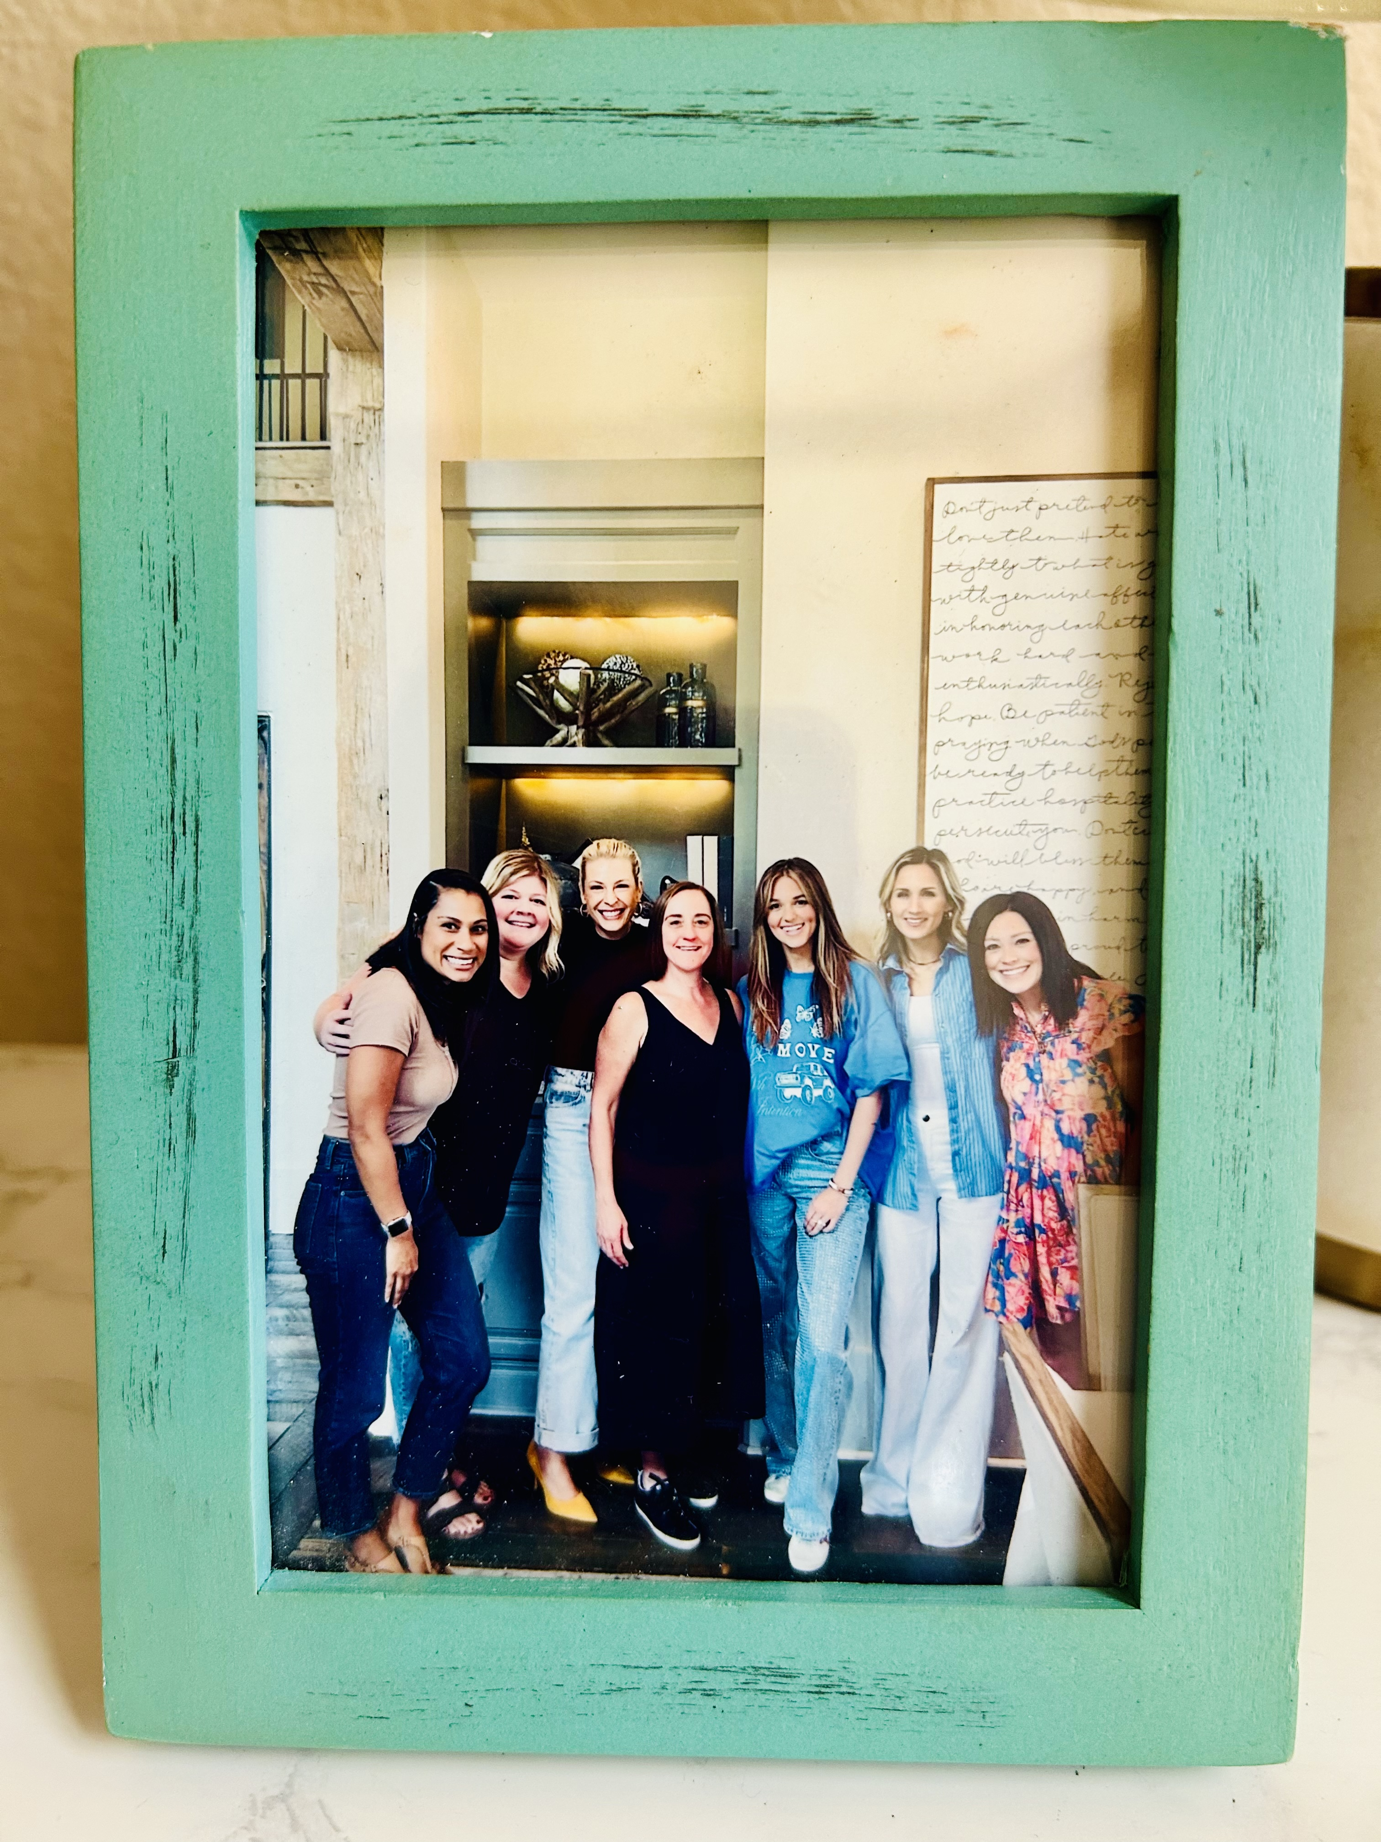

Slide 55
It’s Not
Your
Turn

Slide 56
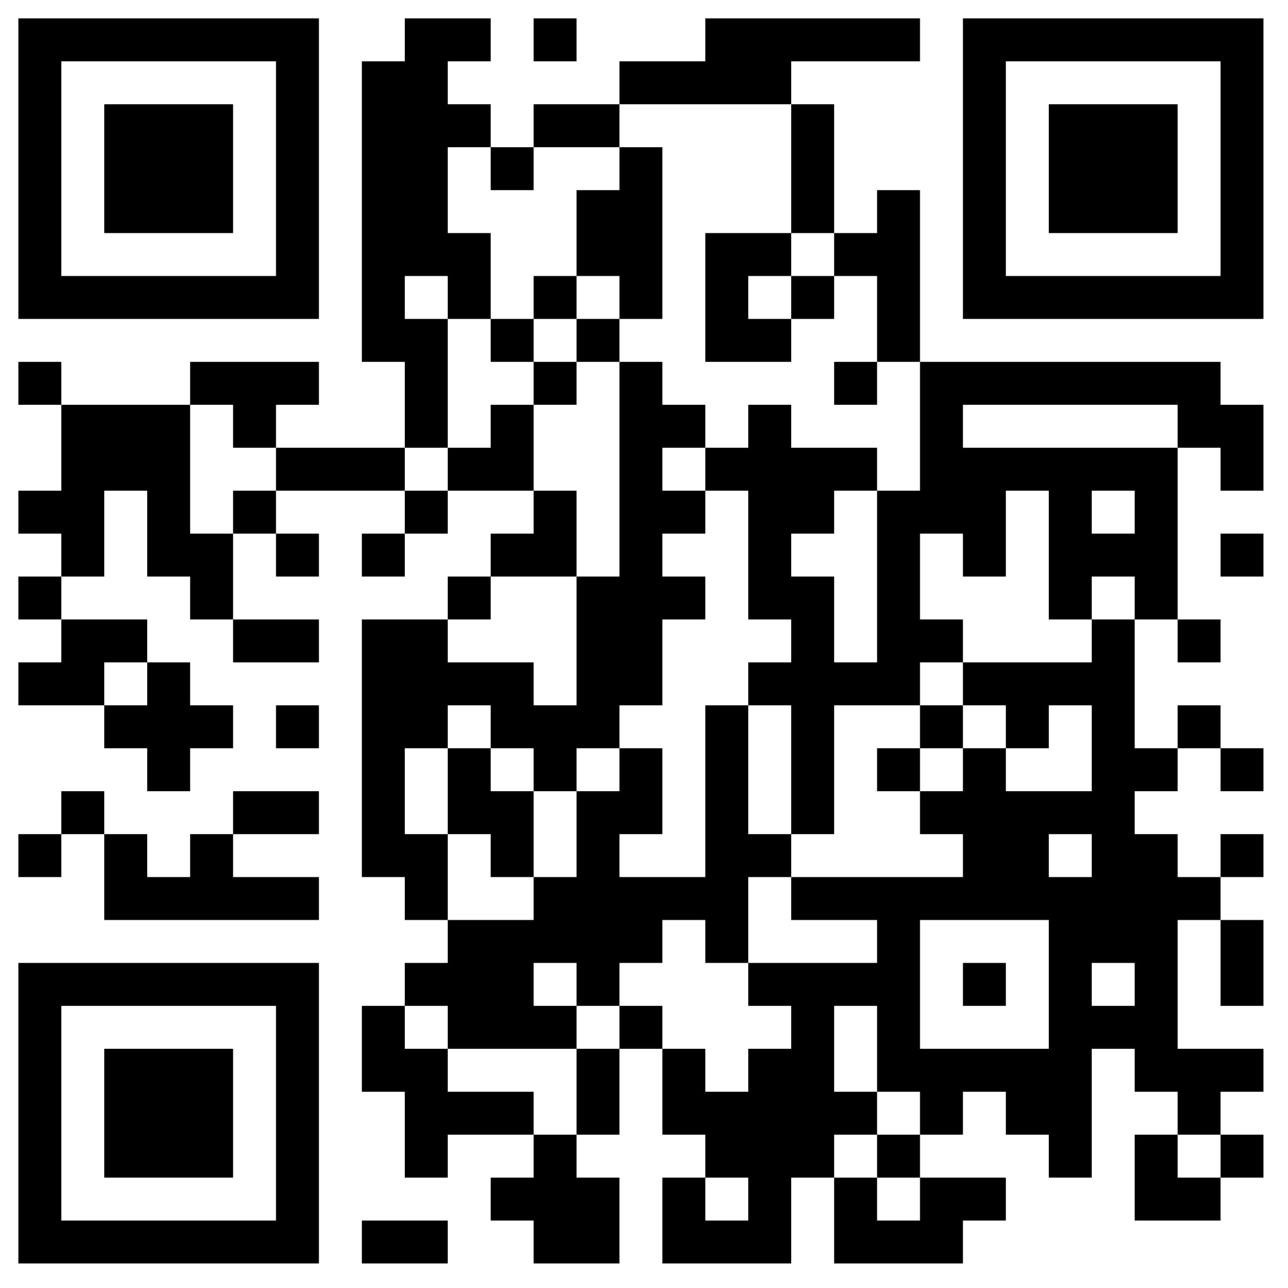

Slide 57
With God
As My Witness
Heather Thompson Day

Slide 58
The church does not have a theology problem we have a communication problem.

Slide 59
Cross Communication

Slide 60
“You shall be witnesses of me”
Acts 1:8

Slide 61
“you will be a witness for him to all people of what you have seen and heard.”
Acts 22:15

Slide 62
Words mean things

Slide 63
What does it mean to be a witness?

Slide 64
In court, eyewitness testimony is sworn testimony from someone who claims to have witnessed events relevant to a case, providing first-hand accounts under oath to help establish facts. Generally, witnesses can only offer facts within their personal knowledge
Anjelica Cappellino, Lay Witnesses vs. Expert Witnesses: Key differences and takeaways, April 16, 2024

Slide 65
“The primary difference between a lay witness and an expert witness is that a lay witness’s testimony is personal and directly related to the primary facts of the case, whereas expert witnesses use their scientific, technical, or other specialized knowledge or skill to draw conclusions.”
Anjelica Cappellino, Lay Witnesses vs. Expert Witnesses: Key differences and takeaways, April 16, 2024

Slide 66
The average secular thinker, is not reading NT Wright our other expert witness testimony. But they are listening to the lay witness testimony of their neighbor.

Slide 67
We must teach lay witnesses, the value and importance of their role in the body of Christ.

Slide 68
We must share what we have seen and heard

Slide 69
“That which was from the beginning, which we have heard, which we have seen with our eyes, which we have looked at and our hands have touched—this we proclaim concerning the Word of life.”
1 John 1:1

Slide 70
“The life appeared; we have seen it and testify to it, and we proclaim to you the eternal life, which was with the Father and has appeared to us. We proclaim to you what we have seen and heard, so that you also may have fellowship with us.”
1 John 1:2-3

Slide 71
“God, whom I serve in my spirit in preaching the gospel of his Son, is my witness”
Romans 1:9

Slide 72
Papias was a 2nd-century Bishop in Asia Minor, considered an Apostolic Father, and a significant witness to early Christian oral tradition and the origins of the Gospels.

Slide 73
He writes “for I did not think that information from books would profit me as much as information from a living and surviving voice.”
Eusebius, Hist. Eccl. 3.39.3-4

Slide 74
“In order to understand Papias’s preference for the ‘living voice’ over written sources we must first recognize that it was an ancient topos or commonplace.”
Jesus and the Eyewitnesses, Richard Bauckham

Slide 75
“Seneca applied it to philosophy, meaning that personal experience of a teacher made for much more effective teaching than writing: ‘you will gain more from the living voice and sharing someone’s daily life than from any other treatise.’”
Jesus and the Eyewitnesses, Richard Bauckham

Slide 76
And so many scholars believe this is why some people are named in healing miracles or narratives in the gospel and others are not.

Slide 77
The hypothesis is that those that are named, went on to join the Christian movement, going from house to house telling people what they had personally seen and heard. They are named because the gospel writer knew the audience would recognize them.

Slide 78
“Why should one of the two disciples on the road to Emmaus be named (Cleopas) and the other not? While most beneficiaries of Jesus’ healings and resuscitation miracles are anonymous, Jairus (whose daughter was raised) is named in Mark and Luke, Bartimaeus in Mark, Lazarus in John.”
Jesus and the Eyewitnesses, Richard Bauckham

Slide 79
“If the names are persons well known in the Christian communities, then it also becomes likely that many of these people were themselves the eyewitnesses who first told and doubtless continued to tell the stories in which they appear to which their names are attached.”
Jesus and the Eyewitnesses, Richard Bauckham

Slide 80
Bauckham says that a good example is Clopas in Luke 24:18.
“One of them, named Cleopas, asked him, “Are you the only one visiting Jerusalem who does not know the things that have happened there in these days?”
Jesus and the Eyewitnesses, Richard Bauckham

Slide 81
Bauckham writes “the story does not require him to be named and his companion remains anonymous.. He is very probably the same person Clopas, whose wife Mary appears among the women at the cross in John 19:25.”
Jesus and the Eyewitnesses, Richard Bauckham

Slide 82
Bauckham explains that Clopas is a very rare semitic form of the Greek name Cleopas. The name is so rare, that he argues that this is probably the same Clopas that historians say is the brother of Jesus’s father Joseph and the father of Simon, who would become the successive leader of the church in Jerusalem.
Jesus and the Eyewitnesses, Richard Bauckham

Slide 83
The eyewitness testimony, or living voice, of the women at the cross must be crucial to the gospel writers. Because all three synoptic gospels emphasize what the women were eyewitnesses to.
Jesus and the Eyewitnesses, Richard Bauckham

Slide 84
“They ‘saw’ the events as Jesus died (Matt 27:55, Mark 15:40, Luke 23:49) they ‘saw’ where he was laid in the tomb (Matt 28:1).”
Jesus and the Eyewitnesses, Richard Bauckham

Slide 85
“They ‘saw’ the stone rolled away (Mark 16:4), they ”saw” the young man sitting on the right side (Mark 16:5), and the angel invited them to ‘see’ the empty space where Jesus’s body had lain (Matt 28:6, Mark 16:6)“
Jesus and the Eyewitnesses, Richard Bauckham

Slide 86
“It can hardly be clearer that the Gospels are appealing to their role as eyewitnesses.”
Jesus and the Eyewitnesses, Richard Bauckham

Slide 87
It is only natural to assume that these women were named because they were well known living voices, telling their stories as long as they lived.
Jesus and the Eyewitnesses, Richard Bauckham

Slide 88
Where have all the witnesses gone?

Slide 89
Our witness cannot be our arguments. Our witness must be what we have seen and heard.

Slide 90
According to a Stanford study, the self identifying characteristics that Americans hold dear are things like their racial heritage, their language, and their religion.
Stanford Report, 2017

Slide 91
But today, the strongest attachment, more than their race, more than their language, more than their religion, is their connection to their political party.
Stanford Report, 2017

Slide 92
At Cross Communication,
we believe that the more complicated the problems, the simpler our answers.

Slide 93
Tell people what you have seen and heard.

Slide 94
Stop arguing your theology. Let the expert witnesses write their books and publish their bible studies and hold their seminars doing this.
But teach your lay people to be lay witnesses.

Slide 95
In Persuasion there is a rule for your communication:
“We don't win arguments, we win affection”

Slide 96
We like to think of ourselves as logical, but no human being is all that logical. Most of our decision making is actually emotional. We now know that up to 90 percent of the decisions we make are based on emotion.

Slide 97
This is why you can have all the facts, all the figures, and all the logical information necessary to convince someone you are right, and it very rarely will matter if they simply don't like you.

Slide 98
This is why I want us to win people's hearts by training our lay witnesses to stop focusing so much on how to win people’s minds.
Because the heart comes first.

Slide 99
Storytelling and Oxytocin

Slide 100
A recent brain imaging study revealed what regions of the brain are activated when one processes sight, sound, taste, or movement in real life. It was found that the same areas of the brain were activated when participants were engrossed in a compelling story.

Slide 101
We place ourselves inside a story cognitively. Our brains experience stories as if they were part of real life and as if they were happening to us.

Slide 102
When readers read one sentence, our senses interact with 11,000,000 pieces of information. Our conscious is only capable of registering approximately 40 pieces of that information. Of that 40, we will focus on approximately five pieces.

Slide 103
Storytelling became the primal solution for how to take tons of data and map it to key points that we could transmit to others so they could remember what we said.

Slide 104
A Stanford study found that we remember stories up to 22x better than facts alone

Slide 105
Short-term memory: the ability to hold a small amount of information in the mind for a brief period of time — typically less than 30 seconds.

Slide 106
To be a witness means to share what we have seen and heard.

Slide 107
Remind your people that their testimonies are not behind them. Their testimonies are always the unfolding experience they are continuing to have as Christ lives in them right now

Slide 108
We must encourage people to see their lives as an unfolding opportunity to co-labor with Christ, to have experiences by which they will be witnesses, so they can continue to testify to others of what they have seen and heard.

Slide 109
When the disciples of John the Baptist ask Jesus, a deeply theologically debated talking point, if he is the one who is to come, or should they wait for someone else, Jesus responds by saying:

Slide 110
"Go and report to John what you have seen and heard..”
Luke 7:22

Slide 111
Essentially, Jesus is saying, ‘I have now made you my witnesses’

Slide 113
With God
As My Witness
Heather Thompson Day

