Slide 1
Introduction to the Old Testament: Class 9 - Joshua, Judges & Ruth
June 29th, 2025
Tim Theiss & Derek Dunbar

Slide 2
Class schedule
1 | Introduction/Creation | Tim | May 4th
2 | The Fall & flood | Tim | May 11th
3 | Abram/Abraham | Derek | May 18th
4 | Jacob & Issac | Derek | May 25th
5 | Joseph | Derek | June 1st
6 | Moses – the Exodus | Tim | June 8th
7 | Moses – The Law | Derek | June 15th
8 | Wilderness wanderings – the Pentateuch | Derek | June 22nd
9 | Joshua, Judges & Ruth | Tim | June 29th
10 | Samuel, Saul & David’s anointing | Tim | July 6th
11 | King David and Soloman | Tim | July 13th
12 | Wisdom Literature (poetry) | Bill Brosey | July 20th
13 | The Divided Kingdom | Tim | July 27th
14 | Major & Minor prophets | Tim | Aug 3rd
15 | Daniel – the Exile | Derek | Aug 10th
16 | Ezra/Nehemiah – return from Exile | Derek | Aug 17th
17 | Q&A – wrap up | Both | Aug 24th

Slide 3
Last week/Recap … Torah
Israel has been delivered from slavery in Egypt - Exodus
YHWH has made a Covenant with Israel at Sinai
Israel needs a way to be in relationship with YHWH
Leviticus details the rituals, sacrifices and priests needed to be close to YHWH
After wandering in the wilderness, a new generation of Israel receives the Law (Deuteronomy)
“Listen, O Israel! YHWH is our God, YHWH alone. And you must love YHWH your God with all your heart, all your soul, and all your strength. And you must commit yourselves wholeheartedly to these commands that I am giving you today.
In this second law, YHWH details the rewards for following His law and curses for disobedience
Israel is just east of the Jordan river poised to enter the “promised land”
YHWH is calling Israel to reflect His character in their new land

Slide 4
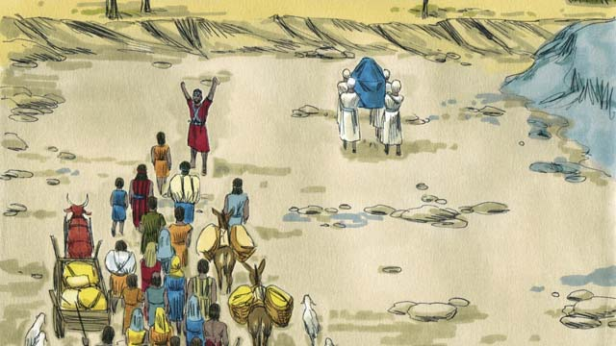
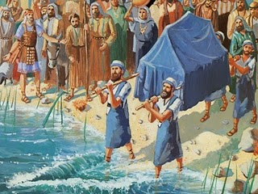
Joshua
This Photo by Unknown Author is licensed under CC BY-NC-ND
This Photo by Unknown Author is licensed under CC BY-SA

Slide 5
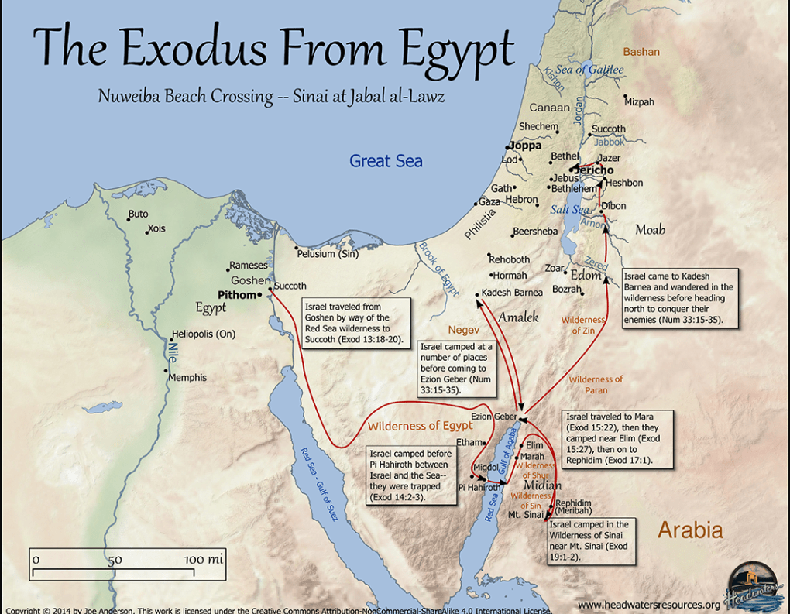
Context & Location
Exodus way:
The way out – crossing the Red Sea out of slavery
The way through – wandering through the wilderness
The way in – crossing the Jordan into the promised land

Slide 6
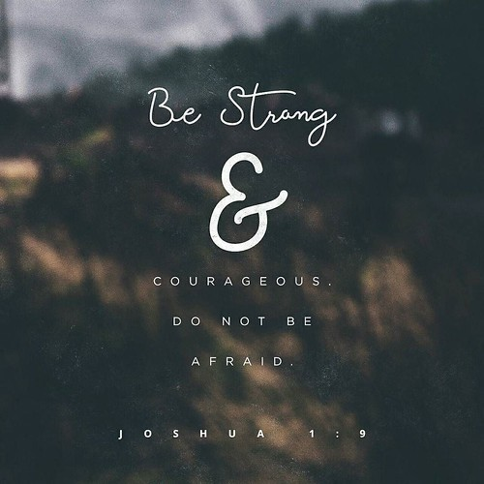
Joshua - strong and courageous
Joshua was an aide or understudy to Moses for years
Joshua was one of the two spies sent into Canan who believed YHWH (Caleb the other)
God installs Joshua as the new leader to take Israel into the promised land
God tells Joshua He will be with him as He was with Moses
Gives this charge, “⁶Be strong and courageous, because you will lead these people to inherit the land I swore to their ancestors to give them. 7“Be strong and very courageous. Be careful to obey all the law my servant Moses gave you; do not turn from it to the right or to the left, that you may be successful wherever you go…”
This Photo by Unknown Author is licensed under CC BY

Slide 7
Joshua as a new Moses
Sends spies into Canan (like Moses had done)
Rahab the prostitute acknowledges YHWH
Joshua prepares the people to cross the Jordan river near Jerico
As the Israelite priests carrying the ark of the Covenant touch the Jordan river, the river stops flowing and they cross on dry ground
God’s rationale is the same as the miracles performed in Egypt
Sets up a memorial of 12 stones
Joshua has encounter with commander of the army of the Lord who claims not to be for Israel or their enemies (holy ground)
YHWH is not “on their side” but is righteous and Israel is called to follow Him!
Time to conquer Cannan
²¹He [Joshua] said to the Israelites, “In the future when your descendants ask their parents, ‘What do these stones mean?’ ²²tell them, ‘Israel crossed the Jordan on dry ground.’ ²³For the Lord your God dried up the Jordan before you until you had crossed over. The Lord your God did to the Jordan what he had done to the Red Sea when he dried it up before us until we had crossed over. ²⁴He did this so that all the peoples of the earth might know that the hand of the Lord is powerful and so that you might always fear the Lord your God.”

Slide 8
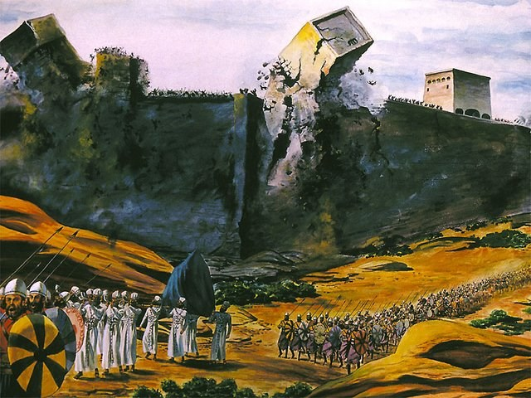
A tale of two cities
Jerico
Ai
March around Jerico for 6 days (waiting for any to follow)
On 7th day, marched around Jerico for 7 times
During 7th march, shouted to the Lord
Completely destroyed Jerico with only their shouts and trumpets (and YHWH’s help!)
Rahab and her family were spared
Rousing success!
This Photo by Unknown Author is licensed under CC BY-NC-ND
Israel went to conquer nearby city of Ai
Not well defended so entire army not needed
Israel routed by men of Ai
Joshua inquires of God and determine that Achen has sinned
Achen had taken loot for himself and he & his family are stoned
Then Ai is defeated

Slide 9
The point
Obedience and reliance on YHWH is required, not military prowess
Other battles take place
A few Canaanite kings repent; some deceive Joshua but most resist and are defeated
Joshua 11: 23 So Joshua took the entire land, just as the Lord had directed Moses, and he gave it as an inheritance to Israel according to their tribal divisions. Then the land had rest from war.

Slide 10
A word about genocide
Yes, Joshua was told to destroy people groups in Canaan
YHWH had declared that these religious practices were vile and corrupting
YHWH is righteous and able to make those determinations
Joshua 13:1 When Joshua had grown old, the Lord said to him, “You are now very old, and there are still very large areas of land to be taken over.
God did not intend for Israel to take over the entire promised land at one time
Forbidden to assimilate with the Canaanites due to their religious practices
Some of the Canaanites acknowledged YHWH and were spared (Rahab)
Others were moved out of the promised land

Slide 11
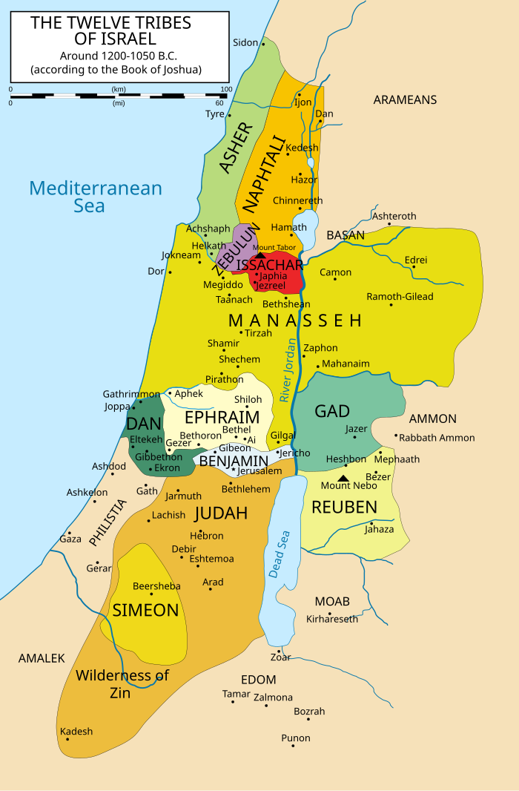
Tribal divisions
Land was allocated by tribe and clan
Tribes received land according to their needs
2-1/2 tribes stayed east of the Jordan (Trans – Jordanian tribes)
These tribal allocations were from God and were very important to Israel
Directed to clear more land and drive the Canaanites out
Tribe of Levi received no land, only cities spread across each tribe
Cities of refuge also distributed among the allocations
This Photo by Unknown Author is licensed under CC BY-SA

Slide 12
Joshua’s farewell Joshua 23
¹⁴“Now I am about to go the way of all the earth. You know with all your heart and soul that not one of all the good promises the Lord your God gave you has failed. Every promise has been fulfilled; not one has failed. ¹⁵But just as all the good things the Lord your God has promised you have come to you, so he will bring on you all the evil things he has threatened, until the Lord your God has destroyed you from this good land he has given you.
Joshua assembles the tribes of Israel
Reminds them that YHWH is driving the Canaanites out
They are not to associate with them nor their false gods
Admonishes them to serve YHWH as they have so far!
YHWH has kept all His promises!
But He will punish if you do not obey!
¹After a long time had passed and the Lord had given Israel rest from all their enemies around them, Joshua, by then a very old man, ²summoned all Israel—their elders, leaders, judges and officials—and said to them: “I am very old. ³You yourselves have seen everything the Lord your God has done to all these nations for your sake; it was the Lord your God who fought for you…⁵The Lord your God himself will push them out for your sake. He will drive them out before you, and you will take possession of their land, as the Lord your God promised you. ⁶“Be very strong; be careful to obey all that is written in the Book of the Law of Moses, without turning aside to the right or to the left. ⁷Do not associate with these nations that remain among you; do not invoke the names of their gods or swear by them. You must not serve them or bow down to them. ⁸But you are to hold fast to the Lord your God, as you have until now….

Slide 13
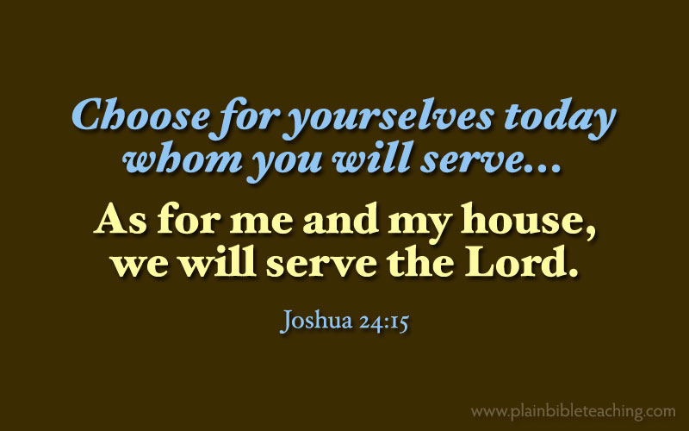
Covenant renewal Joshua 24
This Photo by Unknown Author is licensed under CC BY-SA-NC
Joshua recounts the Lords’ history of Israel and how YWHW fulfilled His promises (the Exodus way)
Gives the nation a charge and choice, a warning
Israel chooses YHWH
Joshua renews the Covenant
Joshua dies and is buried
¹⁴“Now fear the Lord and serve him with all faithfulness. Throw away the gods your ancestors worshiped beyond the Euphrates River and in Egypt, and serve the Lord. ¹⁵But if serving the Lord seems undesirable to you, then choose for yourselves this day whom you will serve, whether the gods your ancestors served beyond the Euphrates, or the gods of the Amorites, in whose land you are living. But as for me and my household, we will serve the Lord.”
¹⁶Then the people answered, “Far be it from us to forsake the Lord to serve other gods!

Slide 14
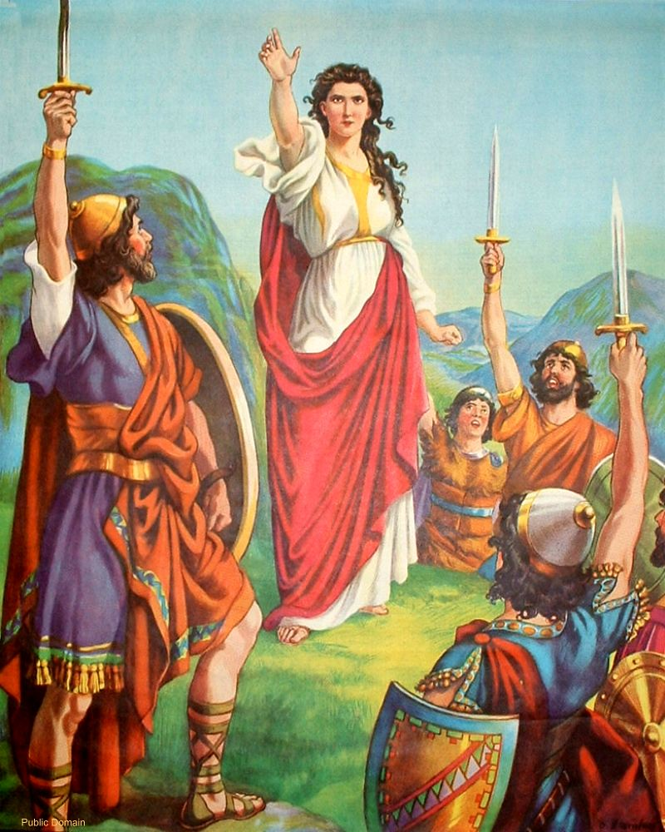
Judges
This Photo by Unknown Author is licensed under CC BY-SA

Slide 15
Judges - a difficult period Judges 1 -2
Judges 1 recounts death of Joshua
Israel was able to drive out some of the remaining Canaanites but not all …
¹⁰After that whole generation had been gathered to their ancestors, another generation grew up who knew neither the Lord nor what he had done for Israel. ¹¹Then the Israelites did evil in the eyes of the Lord and served the Baals. ¹²They forsook the Lord, the God of their ancestors, who had brought them out of Egypt. They followed and worshiped various gods of the peoples around them. They aroused the Lord’s anger ¹³because they forsook him and served Baal and the Ashtoreths. ¹⁴In his anger against Israel the Lord gave them into the hands of raiders who plundered them. He sold them into the hands of their enemies all around, whom they were no longer able to resist. ¹⁵Whenever Israel went out to fight, the hand of the Lord was against them to defeat them, just as he had sworn to them. They were in great distress.
¹⁶Then the Lord raised up judges, who saved them out of the hands of these raiders. ¹⁷Yet they would not listen to their judges but prostituted themselves to other gods and worshiped them. They quickly turned from the ways of their ancestors, who had been obedient to the Lord’s commands.

Slide 16
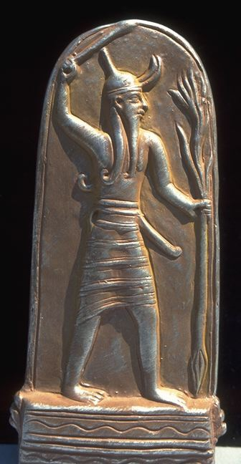
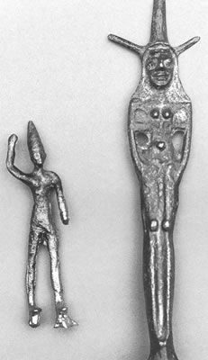
The Judges - context
Baal is a pagan male god associated with depraved sexual sins – Canaanites considered him the god of fertility, sun and storm
Ashtereth/Asherah is a female fertility god, usually depicted as a Asherah pole
A “Judge” refers to miliary leader of the confederation of tribes not our concept of a judge
Judges were usually appointed by God or became self-appointed
This Photo by Unknown Author is licensed under CC BY-NC-ND
This Photo by Unknown Author is licensed under CC BY-NC

Slide 17
The Judges cycle
Israel sins; follows false gods
YHWH gives them over to an enemy
Israel cries out to YHWH for relief
YHWH appoints a Judge for military victory
Israel recommits to YHWH and prospers
Rinse and repeat!
The Judges cycle becomes a downward spiral with Israel falling deeper into moral decline
And yet, YHWH continues to provide relief!

Slide 18
The Israelite Judges
1. Othniel (Judg. 3:7-11)
2. Ehud (Judg. 3:12-30)
4. Deborah (also a prophetess) (Judg. 4-5) – actually quite good
5. Gideon (Judg. 6-8) – coward who comes around
5b. Abimelek (Judg. 9)
8. Jephthah (Judg. 10:6-12:7) – makes a rash vow
12. Samson (Judg. 13-16) – woefully self-absorbed
3. Shamgar (Judg. 3:31)
6. Tola (Judg. 10:1-2)
7. Jair (Judg. 10:3-5)
9. Ibzan (Judg. 12:8-10)
10. Elon (Judg. 12:11-12)
11. Abdon (Judg. 12:13-15)
Total of 12 Judges (6 have more extensive information)
Judges themselves are depicted as (deeply) flawed people
In fact, the final Judges seem to have no real knowledge of or interest in YHWH and leading Israel

Slide 19
Judges concludes
The final two stories in Judges are deeply disturbing
Micah (Ephraimite) sets up his own shrine (complete with idol) and hires his own Levite as personal priest
Danites are looking for a land of their own who plunder Micah’s shrine and annihilate the city of Laish
The final story is worse and involves sexual assault, desecration of a body, mass murder → depravity
Also leads to the first civil war in Israel
Point is to illustrate the depths of Israel’s (and mankind’s) sin without God
“In those days, Israel had no king and everyone did what was right in their own eyes” (Judg. 17:6; Judg. 18:1; Judg. 19:1, and 21:25).

Slide 20
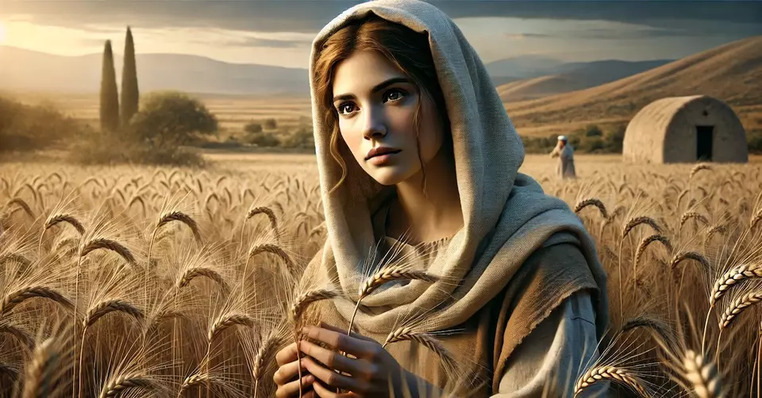
Ruth

Slide 21
Ruth 1: 1 – 5 - An ominous setting
This is set in a dark time in Israel’s history spiritually … “In those days Israel had no King and everyone did as they pleased”
Famine was an indication of God’s discipline of Israel
But this family of believers goes to Moab - a wicked nation east of Israel
The sons marry Moabite women - not a good idea
In time, all 3 husbands die leaving Naomi [Israelite], Ruth and Orpah [Moabites] destitute
In the days when the judges ruled, there was a famine in the land. So a man from Bethlehem in Judah, together with his wife and two sons, went to live for a while in the country of Moab… ³ Now Elimelek, Naomi’s husband, died, and she was left with her two sons. ⁴ They married Moabite women, one named Orpah and the other Ruth. After they had lived there about ten years, ⁵ both Mahlon and Kilion also died, and Naomi was left without her two sons and her husband.

Slide 22
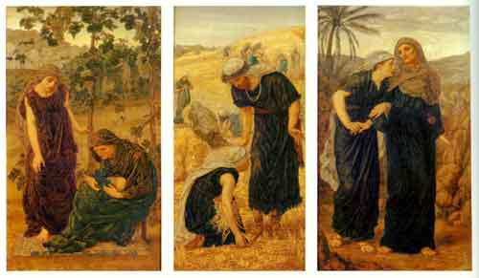
Ruth’s bold decision
Naomi decides to return to her homeland, Judah
Urges her daughters-in-law to stay and remarry in Moab – some back and forth
Orpah decides to stay in her homeland but Ruth decides to go to Judah with Naomi
Ruth’s decision to remain with Naomi is startling!
Ruth is giving up on her own family, her homeland and her religion
Moab engaged in a wicked, vile form of idolatry
Ruth acknowledges that YHWH is the true God!
They return to quite the stir … at harvest time
Thomas Rooke, The Story of Ruth, 1878 - 77
¹⁶ But Ruth replied, “Don’t urge me to leave you or to turn back from you. Where you go I will go, and where you stay I will stay. Your people will be my people and your God my God. ¹⁷ Where you die I will die, and there I will be buried. May the Lord [YHWH] deal with me, be it ever so severely, if even death separates you and me.”
¹⁸ When Naomi realized that Ruth was determined to go with her, she stopped urging her. ¹⁹ So the two women went on until they came to Bethlehem. When they arrived in Bethlehem, the whole town was stirred because of them, and the women exclaimed, “Can this be Naomi?”

Slide 23
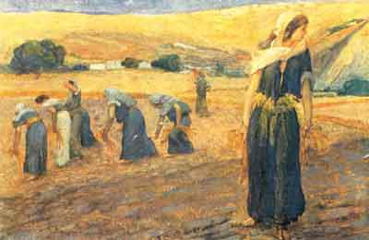
Ruth gleans and meets Boaz
Now Naomi had a relative on her husband’s side, a man of standing from the clan of Elimelek, whose name was Boaz.
² And Ruth the Moabite said to Naomi, “Let me go to the fields and pick up the leftover grain behind anyone in whose eyes I find favor.”
Naomi said to her, “Go ahead, my daughter.”³ So she went out, entered a field and began to glean behind the harvesters. As it turned out, she was working in a field belonging to Boaz, who was from the clan of Elimelek.
⁵ Boaz asked the overseer of his harvesters, “Who does that young woman belong to?” ⁶ The overseer replied, “She is the Moabite who came back from Moab with Naomi. ⁷ She said, ‘Please let me glean and gather among the sheaves behind the harvesters.’ She came into the field and has remained here from morning till now, except for a short rest in the shelter.”
James Tissot, Ruth gleaning, 1896 - 1900
Ruth goes to glean in a field
God commanded that the fields be harvested once and somewhat poorly
That allowed those in need to come and collect unharvested grain for themselves – gleaning
Not stealing, but God’s welfare system for the nation
Emphasis on Ruth as a foreigner, a Moabite
And just so happens Ruth gleans in Boaz’s [a relative] field and he notices her

Slide 24
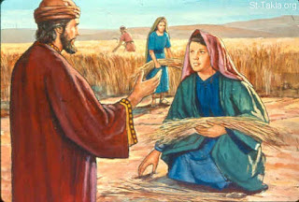
Boaz – a kinsman redeemer
Boaz reveals his innate goodness, gives Ruth advice and protection
Boaz is one of their kinsman-redeemers!
The redeemer is someone who can alleviate debt for more than immediate family – take ownership of property in debt
Another way God provided for the protection of families in Israel
Ruth indicates her interest to Boaz
Boaz acknowledges his responsibility as a guardian-redeemer for the family
Boaz expresses his interest in Ruth
Boaz acquires the rights to Elimelek’s land which includes the right to marry Ruth
This Photo by Unknown Author is licensed under CC BY
Ruth 3: 11 And now, my daughter, don’t be afraid. I will do for you all you ask. All the people of my town know that you are a woman of noble character.
This phrase is only used twice in OT – Proverbs 31

Slide 25
From Ruth to David
¹⁸ This, then, is the family line of Perez: Perez was the father of Hezron, ¹⁹ Hezron the father of Ram, Ram the father of Amminadab, ²⁰ Amminadab the father of Nahshon, Nahshon the father of Salmon,^{[d]} ²¹ Salmon the father of Boaz, Boaz the father of Obed, ²² Obed the father of Jesse, and Jesse the father of David.
¹³ So Boaz took Ruth and she became his wife. When he made love to her, the Lord enabled her to conceive, and she gave birth to a son. ¹⁴ The women said to Naomi: “Praise be to the Lord, who this day has not left you without a guardian-redeemer. May he become famous throughout Israel! ¹⁵ He will renew your life and sustain you in your old age. For your daughter-in-law, who loves you and who is better to you than seven sons, has given him birth.”
¹⁶ Then Naomi took the child in her arms and cared for him. ¹⁷ The women living there said, “Naomi has a son!” And they named him Obed. He was the father of Jesse, the father of David.
So, Boaz marries Ruth and they have a son!
Ruth and Naomi have a guardian - a new family
Naomi’s son is Obed, who is the grandfather of King David!
So, David King of Israel was of mixed heritage

Slide 26
Enduring lessons from Ruth
It is a story of how things were supposed to work – Israel’s welfare system
Stark contrast with Judges and illustrates the impact of a nation that adheres to God’s plans
Character matters! Good character is worth more than ethnicity
The frequent mentions of Ruth as a Moabite highlights her unlikely journey recognizing the true God, God’s compassion for the foreigner and David’s mixed heritage
A story of love and loyalty but hardly a mention of God
Provides a powerful example of a guardian-redeemer (foreshadowing of Christ)
For all of time, during the worst of times, God has always cared about his people
Even during worst of times, good people exist, willing to do what is right

Slide 27
The Big Picture
YHWH is fulfilling His Covenant – the Israelites have now entered the promised land
YHWH continues to support Joshua and Israel and gives them military success over the pagan nations living in the land – tribal boundaries are set
But the Israelites do not continue to drive out the Canaanites as commanded … and adopt their vile pagan practices
Israel falls into an ever-increasing spiral of idolatry and departure of God’s commands → leading to depravity
The book of Judges points to a need for a righteous leader
Ruth provides a counterpoint that all is not lost – good character can prevail
And details how Ruth, a Moabite becomes an ancestor of King David

Slide 28
Backup slides

Slide 29
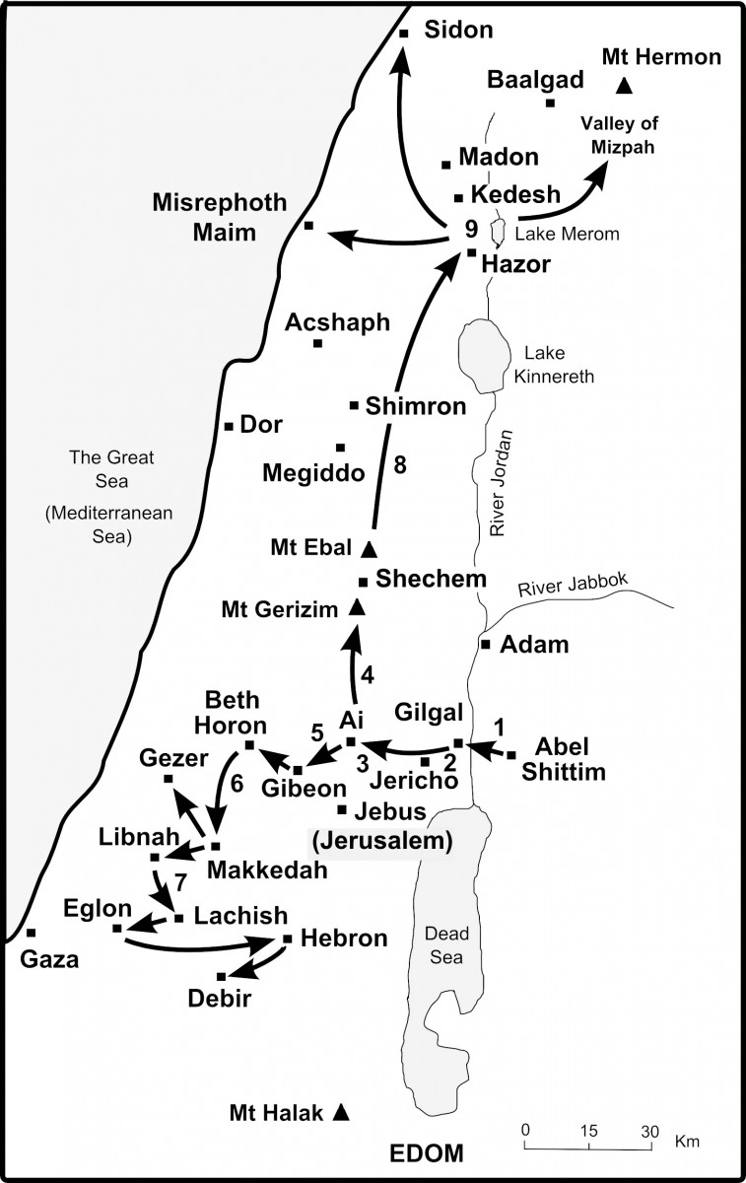
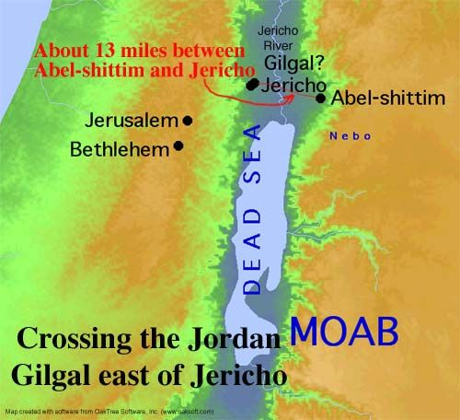
MOAB

