Slide 1
In the Wilderness
Leviticus, Numbers, and Deuteronomy

Slide 2
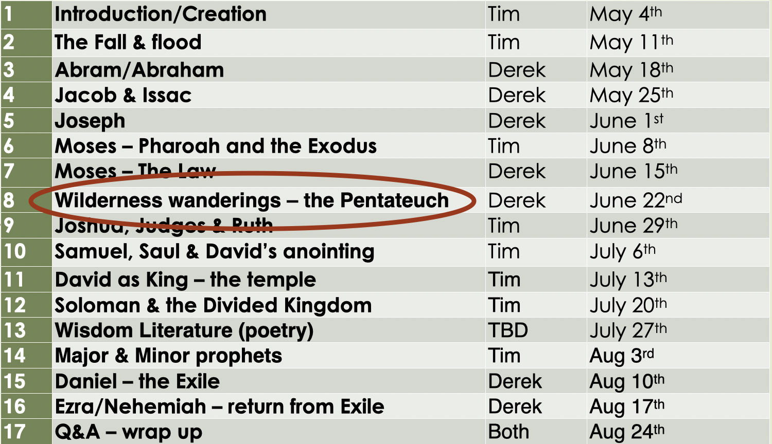
Recap
Yahweh reveals Himself at Sinai and enters a marriage-like covenant with Israel
Israel says they want in, but they rebel; Yahweh sticks with them anyway

Slide 3
Leviticus
“Yahweh spoke to Moses from the tent”
Israel desperately needs a way to be in relationship with Yahweh and to properly represent Him to the rest of the world

Slide 4
Leviticus
Rituals (sacrifices)
Priests (ordination story)
Purity (ritual)
Day of Atonement
Purity (moral)
Priests (list of qualifications)
Rituals (feasts/holidays)

Slide 5
In the Wilderness (Numbers)
“Yahweh spoke to Moses in the tent”
Sinai - Census
Travel (complaints)

Slide 6
In the Wilderness (Numbers)
Wilderness of Paran
12 Spies (Caleb and Joshua)
Yahweh “punishes” this generation by… giving them what they asked for: they do not “have to” go into the Promised Land
Travel again (more complaints)
Moses loses his patience (Ex 2) & equates himself with Yahweh
The bronze snake

Slide 7
In the Wilderness (Numbers)
Moab
Balaam hired to curse Israel, but he can’t
He even predicts the Messiah
The book ends with Moses begging the next generation to choose life.

Slide 8
New Leviticus (Deuteronomy)
After the “wilderness generation” dies, we need to reiterate, change, add laws
“Listen*, O Israel! Yhwh is our God, Yhwh alone. And you must love Yhwh your God with all your heart, all your soul, and all your strength. And you must commit yourselves wholeheartedly to these commands that I am giving you today. Repeat them again and again to your children. Talk about them when you are at home and when you are on the road, when you are going to bed and when you are getting up. Tie them to your hands and wear them on your forehead as reminders. Write them on the doorposts of your house and on your gates.”

Slide 9
New Leviticus (Deuteronomy)
The laws in Exodus, Leviticus, & Deuteronomy both reveal Yahweh’s eternal character and speak to a specific people group with a specific calling at a specific place and time
Comparison to other ancient near-eastern laws is key
Moses again begs the people to obey and devote themselves to Yahweh; he warns them that not doing so will lead to exile

Slide 10
The End of the Torah
Then Moses went up to Mount Nebo from the plains of Moab and climbed Pisgah Peak, which is across from Jericho. And Yhwh showed him the whole land, from Gilead as far as Dan; all the land of Naphtali; the land of Ephraim and Manasseh; all the land of Judah, extending to the Mediterranean Sea; the Negev; the Jordan Valley with Jericho—the city of palms—as far as Zoar. Then Yhwh said to Moses, “This is the land I promised on oath to Abraham, Isaac, and Jacob when I said, ‘I will give it to your descendants.’ I have now allowed you to see it with your own eyes, but you will not enter the land.”
So Moses, the servant of Yhwh, died there in the land of Moab, just as Yhwh had said. Yhwh buried him in a valley near Beth-peor in Moab, but to this day no one knows the exact place. Moses was 120 years old when he died, yet his eyesight was clear, and he was as strong as ever. The people of Israel mourned for Moses on the plains of Moab for thirty days, until the customary period of mourning was over.
Now Joshua son of Nun was full of the spirit of wisdom, for Moses had laid his hands on him. So the people of Israel obeyed him, doing just as Yhwh had commanded Moses.
There has never been another prophet in Israel like Moses, whom Yhwh knew face to face. Yhwh sent him to perform all the miraculous signs and wonders in the land of Egypt against Pharaoh, and all his servants, and his entire land. With mighty power, Moses performed terrifying acts in the sight of all Israel.

