Slide 1
The Torah
Exodus 15b-40

Slide 2
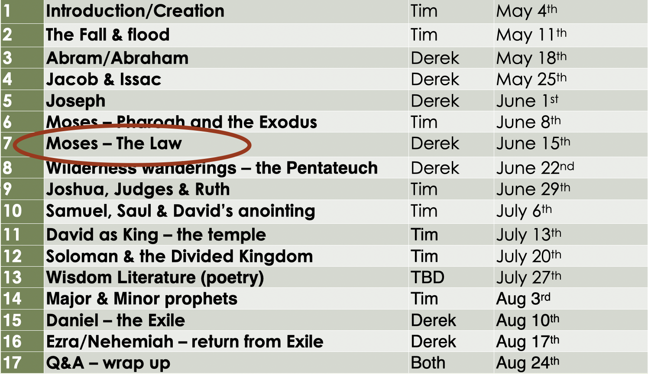
Recap
Yahweh rescues His people from slavery
Yahweh insists on showing Egypt, Israel, and the world who He is.

Slide 3
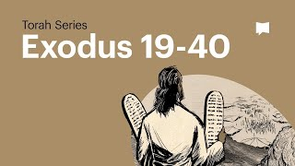

Slide 4
The Road to Sinai (Exodus 15b-18)
Water at Mara
Manna and quail
Water from the rock
Israel defeats Amalek
Jethro gives advice

Slide 5
The Covenant (Exodus 19-32)
The people arrive at Sinai
Yahweh’s presence comes down on the mountain
Good = Dangerous
At every turn, the people agree to follow Him
The Ten Words

Slide 6
The Ten Words
No other gods
No idols (images)
Do not take (up) Yahweh’s name in vain (flippantly)
Keep the Sabbath holy
Honor your father and mother
Do not murder
Do not commit adultery
Do not steal
Do not bear false witness
Do not covet

Slide 7
The Covenant (Exodus 19-32)
The people arrive at Sinai
Yahweh’s presence comes down on the mountain
Good = Dangerous
At every turn, the people agree to follow Him
The Ten Words
More specific laws
Moses goes up on Sinai for 40 days and nights
Yahweh gives him instructions for the tabernacle
The golden calf

Slide 8
The Golden Calf (Exodus 32)
When the people saw how long it was taking Moses to come back down the mountain, they gathered around Aaron. “Come on,” they said, “make us some gods who can lead us. We don’t know what happened to this fellow Moses, who brought us here from the land of Egypt.”
So Aaron said, “Take the gold rings from the ears of your wives and sons and daughters, and bring them to me.”
All the people took the gold rings from their ears and brought them to Aaron. Then Aaron took the gold, melted it down, and molded it into the shape of a calf. When the people saw it, they exclaimed, “O Israel, these are the gods who brought you out of the land of Egypt!”
Aaron saw how excited the people were, so he built an altar in front of the calf. Then he announced, “Tomorrow will be a festival to Yhwh!”
The people got up early the next morning to sacrifice burnt offerings and peace offerings. After this, they celebrated with feasting and drinking, and they indulged in pagan revelry*.

Slide 9
The Golden Calf (Exodus 32)
Yhwh told Moses, “Quick! Go down the mountain! Your people whom you brought from the land of Egypt have corrupted themselves. How quickly they have turned away from the way I commanded them to live! They have melted down gold and made a calf, and they have bowed down and sacrificed to it. They are saying, ‘These are your gods, O Israel, who brought you out of the land of Egypt.’ ”
Then Yhwh said, “I have seen how stubborn and rebellious these people are. Now leave me alone so my fierce anger can blaze against them, and I will destroy them. Then I will make you, Moses, into a great nation.”
But Moses tried to pacify Yhwh his God. “O Yhwh!” he said. “Why are you so angry with your own people whom you brought from the land of Egypt with such great power and such a strong hand? Why let the Egyptians say, ‘Their God rescued them with the evil intention of slaughtering them in the mountains and wiping them from the face of the earth’? Turn away from your fierce anger. Change your mind about this terrible disaster you have threatened against your people! Remember your servants Abraham, Isaac, and Jacob. You bound yourself with an oath to them, saying, ‘I will make your descendants as numerous as the stars of heaven. And I will give them all of this land that I have promised to your descendants, and they will possess it forever.’ ”
So Yhwh changed his mind* about the terrible disaster he had threatened to bring on his people.

Slide 10
The Golden Calf (Exodus 32)
The next day Moses said to the people, “You have committed a terrible sin, but I will go back up to Yhwh on the mountain. Perhaps I will be able to obtain forgiveness for your sin.”
So Moses returned to Yhwh and said, “Oh, what a terrible sin these people have committed. They have made gods of gold for themselves. But now, if you will only forgive their sin—but if not, erase my name from the record you have written!”
But Yhwh replied to Moses, “No, I will erase the name of everyone who has sinned against me. Now go, lead the people to the place I told you about. Look! My angel will lead the way before you. And when I come to call the people to account, I will certainly hold them responsible for their sins.”
Then Yhwh sent a great plague upon the people because they had worshiped the calf Aaron had made.

Slide 11
Leaving Sinai (Exodus 33-40)
Yahweh tells Moses to take the people to the Promised Land (he intercedes again)
Moses sees Yahweh’s back
The stone tablets
“Yahweh! Yahweh! The God of compassion and mercy! I am slow to anger and overflowing with unfailing love and faithfulness. I lavish unfailing love to a thousand generations. I forgive rebellion and sin. But I do not excuse the guilty. I lay the sins of the parents upon their children and grandchildren; the entire family is affected— even to the third and fourth generation.”
The tabernacle and ark of the covenant are built; the priestly clothes are made
Everything is done exactly as Yahweh commanded earlier
Moses cannot enter the tabernacle

