Slide 1
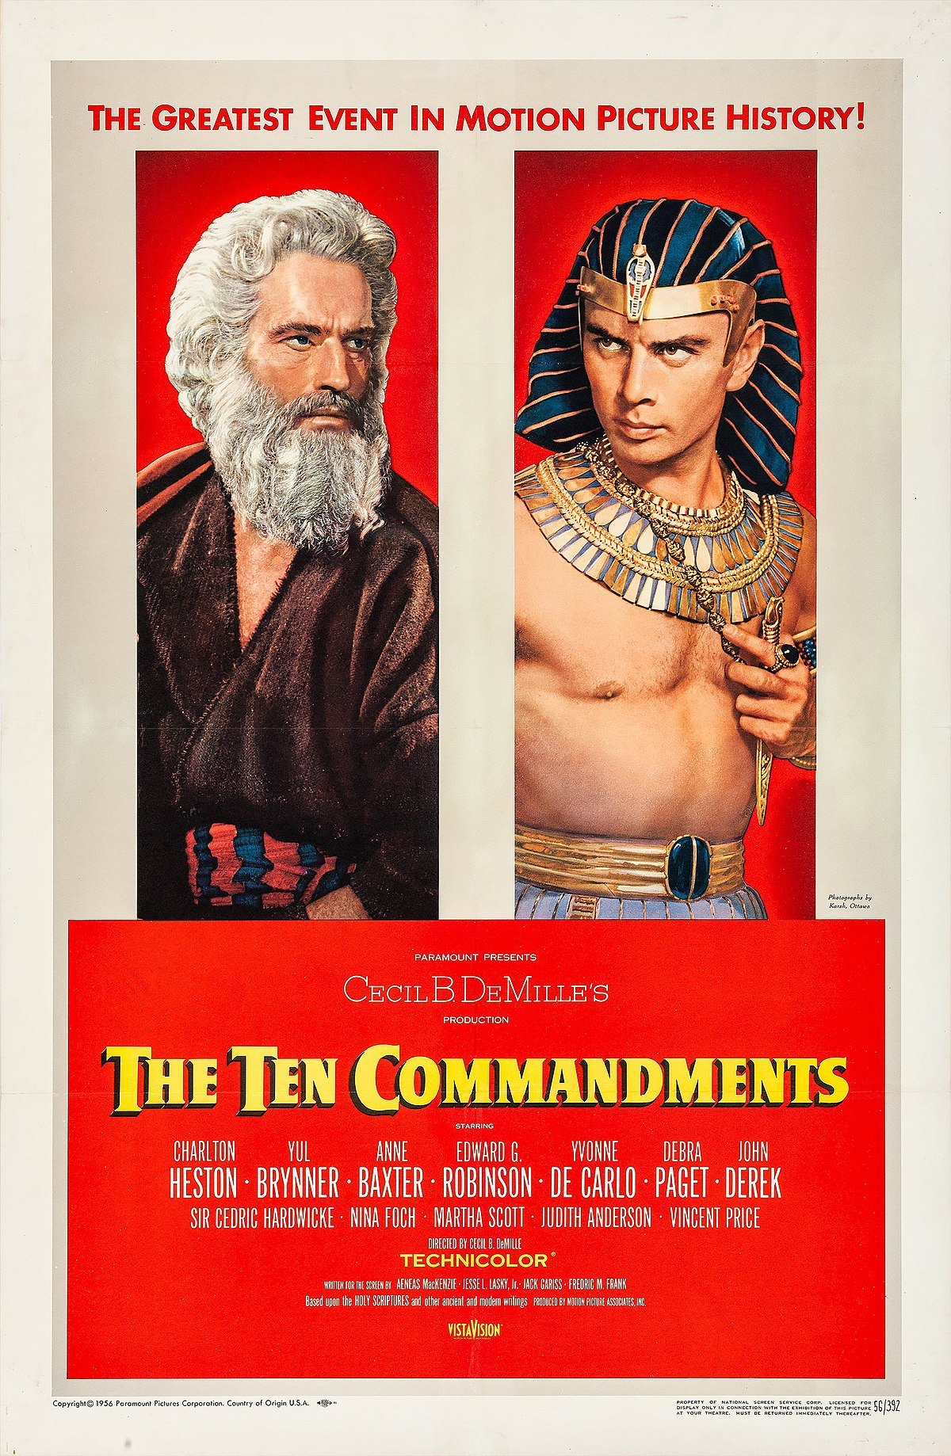
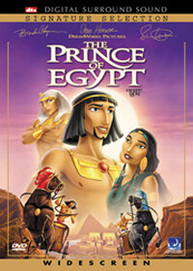
Introduction to the Old Testament:
Lesson 6 – The Exodus (Exodus 1 - 15)
June 8th 2025
Tim Theiss & Derek Dunbar
This Photo by Unknown Author is licensed under CC BY-SA-NC

Slide 2
Class schedule
1 | Introduction/Creation | Tim | May 4th
2 | The Fall & flood | Tim | May 11th
3 | Abram/Abraham | Derek | May 18th
4 | Jacob & Issac | Derek | May 25th
5 | Joseph | Derek | June 1st
6 | Moses – the Exodus | Tim | June 8th
7 | Moses – The Law | Derek | June 15th
8 | Wilderness wanderings – the Pentateuch | Derek | June 22nd
9 | Joshua, Judges & Ruth | Tim | June 29th
10 | Samuel, Saul & David’s anointing | Tim | July 6th
11 | David as King – the temple | Tim | July 13th
12 | Wisdom Literature (poetry) | Bill Brosey | July 20th
13 | Soloman & the Divided Kingdom | Tim | July 27th
14 | Major & Minor prophets | Tim | Aug 3rd
15 | Daniel – the Exile | Derek | Aug 10th
16 | Ezra/Nehemiah – return from Exile | Derek | Aug 17th
17 | Q&A – wrap up | Both | Aug 24th

Slide 3
The setting – Egyptian slavery
Ex. 1
The Hebrews have thrived in Egypt
But a new king (Pharoah) is ruling that does not remember nor care about how Joseph saved the land and people “Then a new king, to whom Joseph meant nothing, came to power in Egypt.”
Pharoah is scared that Hebrews will rebel
They are being oppressed and treated ruthlessly
Pharoah has ordered all newborn baby boys killed – specifically ordered this of Hebrew midwives
But they trust God and have defied his order
But Pharoah’s wickedness and fear continues
Note – Pharoah is not named but the Hebrew midwives are (Shiphrah and Puah)!

Slide 4
Moses is born
Ex. 2
A Levite and his wife have a son – a death sentence
They hid him and then made a basket (or, ark) for him and take him to the Nile
Pharoah’s daughter and her maid find him and raise him, she names him Moses (“drawn out”)
After Moses is grown, he identifies as Hebrew and rescues a Hebrew being beaten by an Egyptian and kills the Egyptian
The next day, Moses intervenes with two Hebrews fighting and is asked if he is going to kill one of them as well?
Pharoah wanted to kill Moses (who he would have known) but Moses fled to Midian (desert east of Red Sea)
Moses meets a priest of Midian (Reuel or Jethro) and marries Zipporah one of his 7 daughters

Slide 5
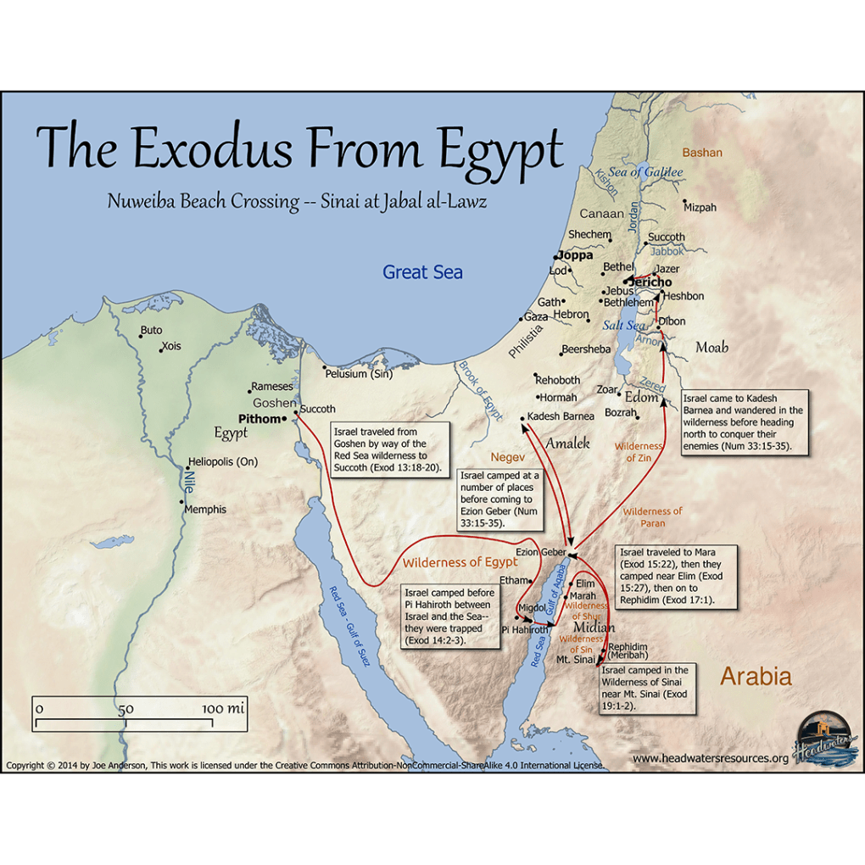

Slide 6
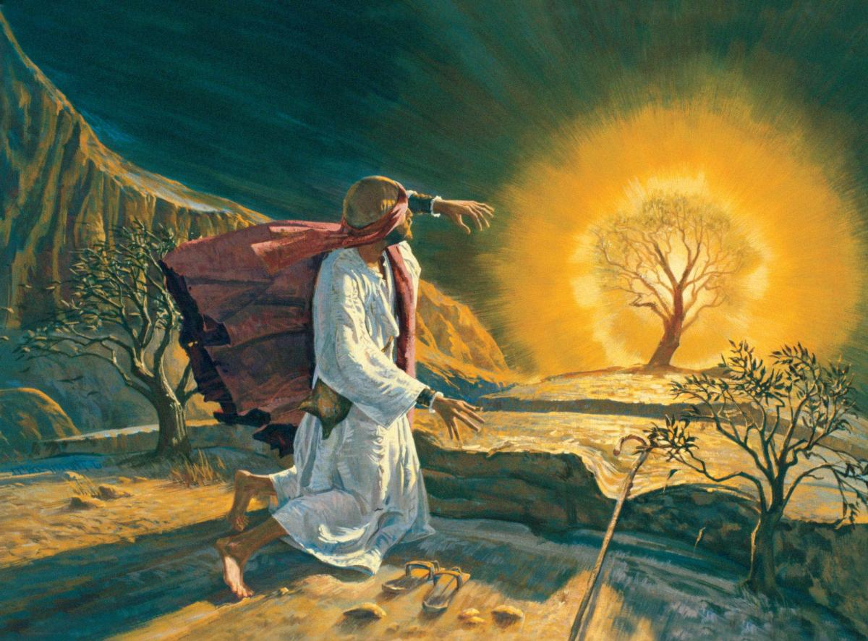
Moses and the burning bush
Ex. 3: 1 - 5
Now Moses was tending the flock of Jethro his father-in-law, the priest of Midian, and he led the flock to the far side of the wilderness and came to Horeb, [aka, Sinai] the mountain of God. ² There the angel of the Lord appeared to him in flames of fire from within a bush. Moses saw that though the bush was on fire it did not burn up.³ So Moses thought, “I will go over and see this strange sight—why the bush does not burn up.”
⁴ When the Lord saw that he had gone over to look, God called to him from within the bush, “Moses! Moses!”
And Moses said, “Here I am.”
This Photo by Unknown Author is licensed under CC BY-NC
⁵ “Do not come any closer,” God said. “Take off your sandals, for the place where you are standing is holy ground.” ⁶ Then he said, “I am the God of your father,^{[a]} the God of Abraham, the God of Isaac and the God of Jacob.” At this, Moses hid his face, because he was afraid to look at God.

Slide 7
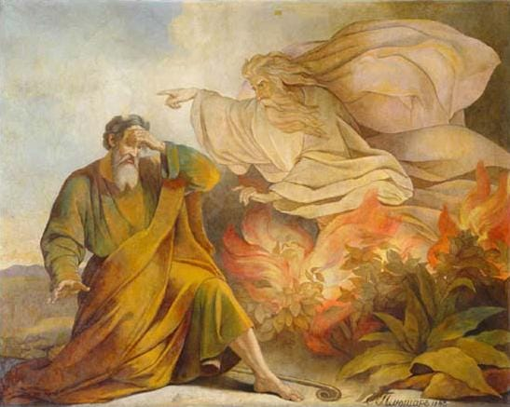
I have heard their cry
Ex. 3: 7 - 10
⁷ The Lord said, “I have indeed seen the misery of my people in Egypt. I have heard them crying out because of their slave drivers, and I am concerned about their suffering. ⁸ So I have come down to rescue them from the hand of the Egyptians and to bring them up out of that land into a good and spacious land, a land flowing with milk and honey—the home of the Canaanites, Hittites, Amorites, Perizzites, Hivites and Jebusites. ⁹ And now the cry of the Israelites has reached me, and I have seen the way the Egyptians are oppressing them. ¹⁰ So now, go. I am sending you to Pharaoh to bring my people the Israelites out of Egypt.”
This Photo by Unknown Author is licensed under CC BY-SA-NC
Manifestation of God as fire
Angel of the Lord refers to God
Introduction to the concept that the Holiness of God requires physical separation
Land “flowing with milk and honey” indicates fertility
God gives Moses a directive!

Slide 8
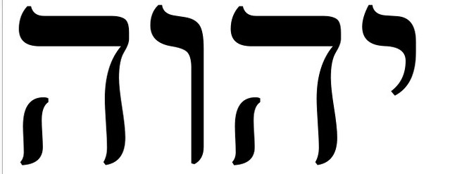
YHWH introduces Himself
Ex. 3:11 -15
This Photo by Unknown Author is licensed under CC BY
¹¹ But Moses said to God, “Who am I that I should go to Pharaoh and bring the Israelites out of Egypt?”
¹² And God said, “I will be with you. And this will be the sign to you that it is I who have sent you: When you have brought the people out of Egypt, you^{[b]} will worship God on this mountain.”
¹³ Moses said to God, “Suppose I go to the Israelites and say to them, ‘The God of your fathers has sent me to you,’ and they ask me, ‘What is his name?’ Then what shall I tell them?”
¹⁴ God said to Moses, “I am who I am [I will be what I will be] This is what you are to say to the Israelites: ‘I am has sent me to you.’”
¹⁵ God also said to Moses, “Say to the Israelites, ‘The Lord [YHWH] the God of your fathers—the God of Abraham, the God of Isaac and the God of Jacob—has sent me to you.’
“This is my name forever,
the name you shall call me
from generation to generation.

Slide 9
Moses continues to resist YHWH
Ex. 4
¹ Moses answered, “What if they do not believe me or listen to me and say, ‘The Lord did not appear to you’?”
  ⁵ “This,” said the Lord, “is so that they may believe that the Lord, the God of their fathers—the God of Abraham, the God of Isaac and the God of Jacob—has appeared to you.”
¹⁰ Moses said to the Lord, “Pardon your servant, Lord. I have never been eloquent, neither in the past nor since you have spoken to your servant. I am slow of speech and tongue.”
  ¹¹ The Lord said to him, “Who gave human beings their mouths? … ¹² Now go; I will help you speak and will teach you what to say.”
¹³ But Moses said, “Pardon your servant, Lord. Please send someone else.”
  ¹⁴ Then the Lord’s anger burned against Moses and he said, “What about your brother, Aaron the Levite? I know he can speak well. He is already on his way to meet you, and he will be glad to see you.

Slide 10
Moses returns to Egypt (finally)
Ex 4: 18-30
God provides multiple signs for Moses (staff/snake, leprous hand)
First account of God’s anger
Moses secures Jethro’s blessing
God warns Moses of Pharoah’s response, says he will not let them go easily but He will convince Pharoah
Zipporah rescues Moses from God’s anger and circumcises her sons (weird story in Ex. 4: 24-26)
Moses Meets Aaron along the way – updates him
²⁹ Moses and Aaron brought together all the elders of the Israelites,³⁰ and Aaron told them everything the Lord had said to Moses. He also performed the signs before the people, ³¹ and they believed. And when they heard that the Lord was concerned about them and had seen their misery, they bowed down and worshiped.

Slide 11
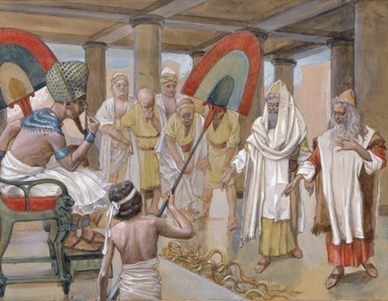
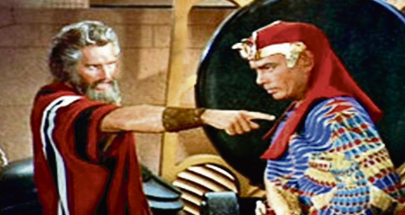
Moses confronts Pharoah
Ex. 5 - 7
Moses and Aaron go to Pharoah and tell him the LORD wants his people to go and worship “Let my people go”
Pharoah replies with ”Who is the Lord (YHWH)?
Pharoah considered himself a god
Pharoah increases workload and punishes the Israelites
Israelites complain to Moses
God repeats “ I am the Lord” and will free you …
Moses and Aaron again go to Pharoah – turn staff into snake but magicians do same (but Aaron’s snake eats theirs)
Pharoah’s heart is hard
This Photo by Unknown Author is licensed under CC BY-SA
This Photo by Unknown Author is licensed under CC BY

Slide 12
The Plagues
Ex. 7 - 9
Plague | Result | Magicians? | Pharoah’s response?
1 | Water (Nile) turned to blood | Yes | Heart hardened
2 | Frogs | Yes | Asked for relief then hardened his heart
3 | Gnats | No | Pharoah’s heart was hard
4 | Flies (not in Goshen) | No | Pharoah initially agrees then hardens his heart
5 | Livestock dies (not in Goshen) | No | Pharoah investigates but his heart is hard
These plagues appear designed to show dominance over the gods of Egypt
God makes a distinction and plagues do not impact the Israelites

Slide 13
More plagues
Ex. 9 - 10
Plague | Result | Magicians? | Pharoah’s response?
6 | Boils | No – could not stand it | God hardens Pharoah’s heart
7 | Hail (worst ever in Egypt), not in Goshen | No | Pharoah acknowledges his sin and YWHW; then he hardened his heart
8 | Locusts | No – plead with Pharoah | Pharoah initially asks for forgiveness; God hardens Pharoah’s heart
9 | Darkness for 3 days (not on the Israelites) | No | God hardens Pharoah’s heart – I do not want to see you again!
Then the Lord said to Moses, “Go to Pharaoh, for I have hardened his heart and the hearts of his officials so that I may perform these signs of mine among them ² that you may tell your children and grandchildren how I dealt harshly with the Egyptians and how I performed my signs among them, and that you may know that I am the Lord.”

Slide 14
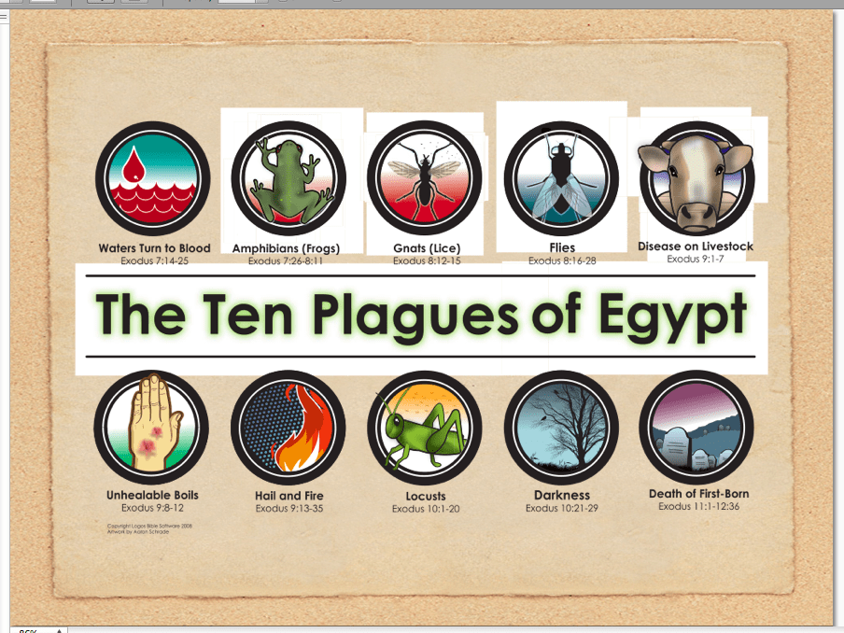
The final plague
Ex. 11-12
God explains the next plague to Moses and Aaron – one more and Pharoah will let you go
Plague on the firstborn – God will strike dead all Egyptian firstborn males and livestock
The Israelites will not be struck
This Photo by Unknown Author is licensed under CC BY-NC-ND

Slide 15
Passover and Festival of Unleavened Bread (Ex. 12)
God resets the Israelite calendar
Families are to offer a perfect lamb as sacrifice – specific instructions
Take the blood and cover the door frame
¹² “On that same night I will pass through Egypt and strike down every firstborn of both people and animals, and I will bring judgment on all the gods of Egypt. I am the Lord. ¹³ The blood will be a sign for you on the houses where you are, and when I see the blood, I will pass over you. No destructive plague will touch you when I strike Egypt.
Christ becomes the perfect sacrificial lamb offered for sin!
Institutes the festival of unleavened bread (annual festival)
Specific instructions on bread without yeast
At midnight, the Lord carries out the plague; spares Israel, strikes Egypt
²⁵ When you enter the land that the Lord will give you as he promised, observe this ceremony. ²⁶ And when your children ask you, ‘What does this ceremony mean to you?’ ²⁷ then tell them, ‘It is the Passover sacrifice to the Lord, who passed over the houses of the Israelites in Egypt and spared our homes when he struck down the Egyptians.’” Then the people bowed down and worshiped.
Passover was used by Jesus to institute the Communion observance during the Last Supper with his disciples

Slide 16
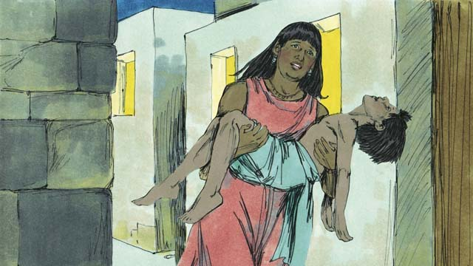
The response
Ex. 12 - 13
God strikes Egypt and the results are devasting
Pharoah summons Moses and Aaron and relents and allows the Israelites to leave
He also asks for blessings
The Egyptians encouraged the Israelites to leave
Israelites asked for gold and silver and the Egyptians gave it to them (as God said)
More restrictions on the Passover meal and the consecration of the firstborn
God describes the purpose – and details that it is to be communicated
This Photo by Unknown Author is licensed under CC BY-SA
¹⁴ “In days to come, when your son asks you, ‘What does this mean?’ say to him, ‘With a mighty hand the Lord brought us out of Egypt, out of the land of slavery. ¹⁵ When Pharaoh stubbornly refused to let us go, the Lord killed the firstborn of both people and animals in Egypt. This is why I sacrifice to the Lord the first male offspring of every womb and redeem each of my firstborn sons.’ ¹⁶ And it will be like a sign on your hand and a symbol on your forehead that the Lord brought us out of Egypt with his mighty hand.”

Slide 17
YHWH leads the Israelites
Ex. 12 - 14
The Lord gives specific directions to Moses (not a direct path) – leads them to the sea
They take Joseph’s bones with them
God manifests Himself as a pillar of cloud by day or pillar of fire by night
Pharoah changes his mind, the Lord hardens his heart
The Egyptian army and Pharoah pursue the Israelites
They were terrified and cried out to the Lord. ¹¹ They said to Moses, “Was it because there were no graves in Egypt that you brought us to the desert to die? What have you done to us by bringing us out of Egypt? ¹² Didn’t we say to you in Egypt, ‘Leave us alone; let us serve the Egyptians’? It would have been better for us to serve the Egyptians than to die in the desert!”
¹³ Moses answered the people, “Do not be afraid. Stand firm and you will see the deliverance the Lord will bring you today. The Egyptians you see today you will never see again. ¹⁴ The Lord will fight for you; you need only to be still.”
¹⁵ Then the Lord said to Moses, “Why are you crying out to me? Tell the Israelites to move on. ¹⁶ Raise your staff and stretch out your hand over the sea to divide the water so that the Israelites can go through the sea on dry ground.

Slide 19
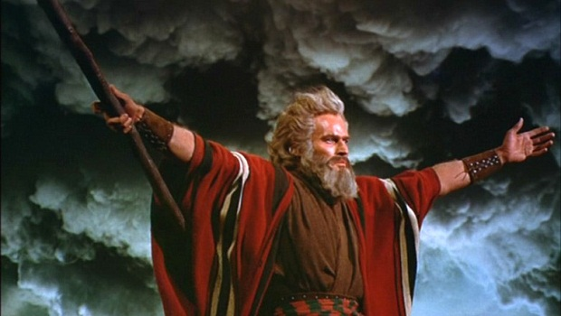
Parting of the Sea Ex. 14
²¹ Then Moses stretched out his hand over the sea, and all that night the Lord drove the sea back with a strong east wind and turned it into dry land. The waters were divided, ²² and the Israelites went through the sea on dry ground, with a wall of water on their right and on their left.
This Photo by Unknown Author is licensed under CC BY-NC-ND
²³ The Egyptians pursued them, and all Pharaoh’s horses and chariots and horsemen followed them into the sea. ²⁴ During the last watch of the night the Lord looked down from the pillar of fire and cloud at the Egyptian army and threw it into confusion. ²⁵ He jammed^{[b]} the wheels of their chariots so that they had difficulty driving. And the Egyptians said, “Let’s get away from the Israelites! The Lord [YHWH] is fighting for them against Egypt.”
²⁶ Then the Lord said to Moses, “Stretch out your hand over the sea so that the waters may flow back over the Egyptians and their chariots and horsemen.” ²⁷ Moses stretched out his hand over the sea, and at daybreak the sea went back to its place. The Egyptians were fleeing toward^{[c]} it, and the Lord swept them into the sea. ²⁸ The water flowed back and covered the chariots and horsemen—the entire army of Pharaoh that had followed the Israelites into the sea. Not one of them survived.

Slide 20
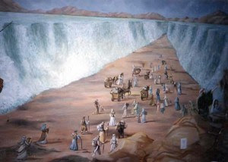
Crossing the sea
Ex. 14
²⁹ But the Israelites went through the sea on dry ground, with a wall of water on their right and on their left. ³⁰ That day the Lord saved Israel from the hands of the Egyptians, and Israel saw the Egyptians lying dead on the shore. ³¹ And when the Israelites saw the mighty hand of the Lord displayed against the Egyptians, the people feared the Lord and put their trust in him and in Moses his servant.
This Photo by Unknown Author is licensed under CC BY

Slide 21
Songs of Moses and Miriam
Ex. 15
Then Moses and the Israelites sang this song to the Lord:
“I will sing to the Lord,
for he is highly exalted.
Both horse and driver
he has hurled into the sea.
² “The Lord is my strength and my defense^{[a]};
he has become my salvation.
He is my God, and I will praise him,
my father’s God, and I will exalt him.
³ The Lord is a warrior;
the Lord is his name.
…
“The Lord reigns
for ever and ever.”
¹⁹ When Pharaoh’s horses, chariots and horsemen^{[e]} went into the sea, the Lord brought the waters of the sea back over them, but the Israelites walked through the sea on dry ground. ²⁰ Then Miriam the prophet, Aaron’s sister, took a timbrel in her hand, and all the women followed her, with timbrels and dancing. ²¹ Miriam sang to them:
“Sing to the Lord,
for he is highly exalted.
Both horse and driver
he has hurled into the sea.”

Slide 22
But it doesn’t last long …
Ex. 15
²² Then Moses led Israel from the Red Sea and they went into the Desert of Shur. For three days they traveled in the desert without finding water. ²³ When they came to Marah, they could not drink its water because it was bitter. (That is why the place is called Marah.^{[f]})²⁴ So the people grumbled against Moses, saying, “What are we to drink?”
²⁵ Then Moses cried out to the Lord, and the Lord showed him a piece of wood. He threw it into the water, and the water became fit to drink.
There the Lord issued a ruling and instruction for them and put them to the test. ²⁶ He said, “If you listen carefully to the Lord your God and do what is right in his eyes, if you pay attention to his commands and keep all his decrees, I will not bring on you any of the diseases I brought on the Egyptians, for I am the Lord, who heals you.”
²⁷ Then they came to Elim, where there were twelve springs and seventy palm trees, and they camped there near the water.
Moses leads the Israelites back to his former homeland
Water is an issue
Grumbling begins/continues
God delivers … again!
But issues a test

Slide 23
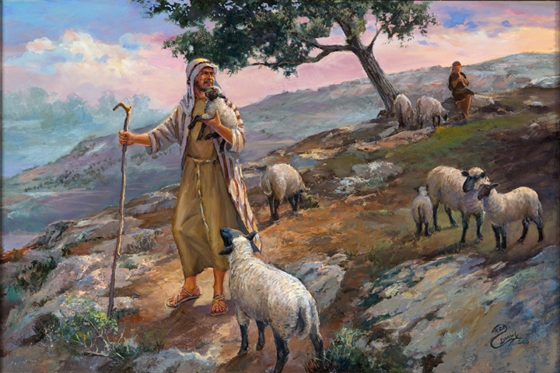
Timeline and preparation
Note that the Hebrews were in Egypt for roughly 400 years
Moses very survival doubtful outside God’s providence – through others
Moses received the best education in the world through his childhood in Egypt – through adulthood
Moses also learned about desert conditions while in Midian – 40 years
Moses had to accept advice and input from Jethro
Moses had to be prepared and was not eager to accept his role
Moses early relationship with God was rocky at best
This Photo by Unknown Author is licensed under CC BY-NC-ND

Slide 24
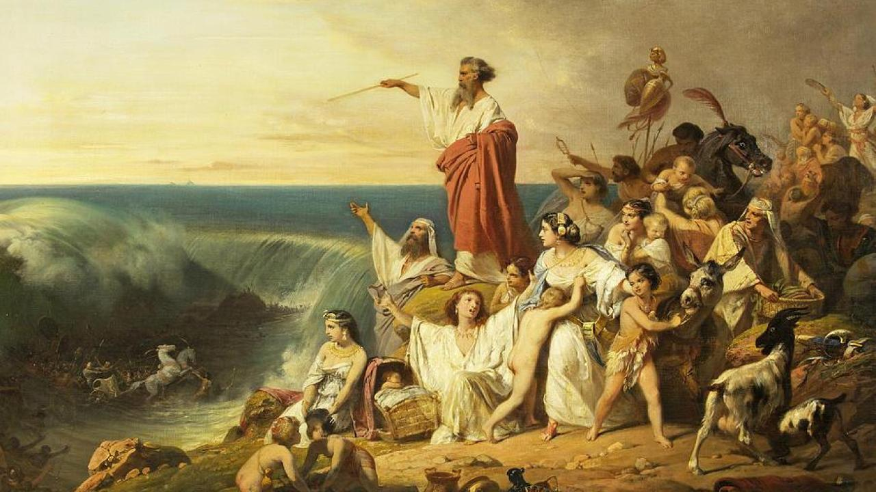
The Big Picture - Exodus
One of the most impactful events in the OT (history)
Introduction to Moses one of the most influential characters in the OT
This Photo by Unknown Author is licensed under CC BY
God fulfilling His promise to Abraham – He is true to His covenants
Story of deliverance from bondage (sin)
YHWH show his supremacy over false gods (Egypt) and the elements (sea, water)
Foundation for Israelite festival of Passover which is the foundation for Communion
Origin of the concept of the sacrificial Passover lamb, which ultimately is Christ
Passing through the waters for salvation is an indirect connection to baptism
Insight into how God works, His timelines and movements through people, events

Slide 25
Backup slides

Slide 26
Key steps
Slavery in Egypt; death to baby boys – 1st person (Ex 1: 1-22)
Moses is rescued and raised by Pharoah’s daughter – 1st person (Ex. 2: 1-8)
Moses kills an Egyptian; flees to Midian – 1st person (Ex. 2: 11-22)
Israelites cry out and God is concerned – 1st person (Ex. 2: 23-25)
Moses and the burning bush (meeting God) – scripture (Ex. 3:1 – 4: 17)
Moses and Aaron confront Pharoah – Moses perspective? (Ex. 5: 1-21)
The 10 plagues; summarize - (Ex. 7:8 – 10:29)
Passover ( the 10th plague) – scripture (Ex. 11:1 – 12:30)
Leaving Egypt – scripture (Ex. 12:31 – 41)
The Exodus & crossing the Red Sea! – scripture (Ex. 13: 17 – 31)

