Slide 1
The Sons of Jacob
Genesis 37-50

Slide 2
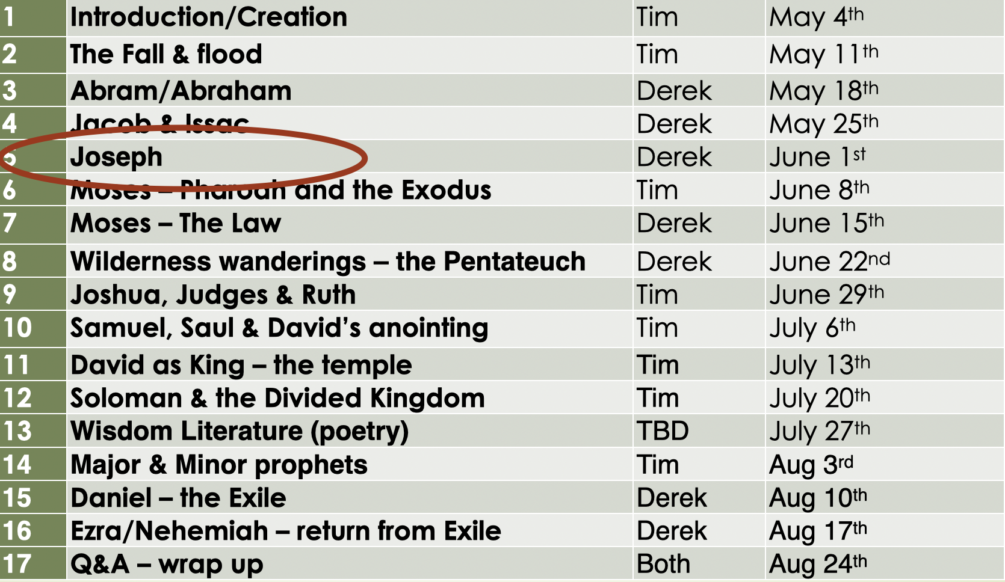
Recap
Jacob is the chosen human representative, but he is also the snake
His story tells in miniature the story of all humanity, wrestling with God

Slide 3
Outline and Overview
Act I
Joseph’s Dreams & Betrayal
Judah & Tamar
Joseph in Egypt
Act II
Joseph’s Brothers Go to Egypt
Judah’s Sacrifice
Joseph Reveals Himself
Act III
Judah Leads Jacob’s Family to Egypt
Joseph Rescues Israel and Egypt
Jacob’s Blessings (especially for Judah and Joseph) and Death

Slide 4
Act I - Scene 1
Jacob singles Joseph out from among his brothers
Joseph dreams TWO dreams with the SAME meaning:
Joseph is going to be elevated over his brothers (all creation?)
Jacob sends Joseph to his brothers
The brothers plan to kill Joseph, but Reuben says to throw him in a pit instead
Judah sees a way to get rich quick and sells Joseph to Ishmaelites for 20 pieces of silver
The brothers kill an animal and use its blood to fool Jacob

Slide 5
Act I - Scene 2
Judah has 3 sons
His first born marries Tamar, then dies
His second born marries Tamar, but refuses to give her children, then dies
Judah tells Tamar she can marry his third born when he’s old enough (but he’s lying)
Judah’s wife dies, he immediately goes to a party
Tamar disguises herself as a prostitute
Judah sleeps with her and gets her pregnant
When he tries to pay her and get his stuff back, she can’t be found
When Judah finds out she’s pregnant, he wants to kill her (until she shows everyone his stuff)
Tamar gives birth to twins

Slide 6
Act I - Scene 3 (Genesis 39)
Yhwh was with Joseph, so he succeeded in everything he did as he served in the home of his Egyptian master. Potiphar noticed this and realized that Yhwh was with Joseph, giving him success in everything he did. This pleased Potiphar, so he soon made Joseph his personal attendant. He put him in charge of his entire household and everything he owned. From the day Joseph was put in charge of his master’s household and property, Yhwh began to bless Potiphar’s household for Joseph’s sake. All his household affairs ran smoothly, and his crops and livestock flourished. So Potiphar gave Joseph complete administrative responsibility over everything he owned. With Joseph there, he didn’t worry about a thing—except what kind of food to eat!
Joseph was a very handsome and well-built young man, and Potiphar’s wife soon began to look at him lustfully. “Come and sleep with me,” she demanded. But Joseph refused. “Look,” he told her, “my master trusts me with everything in his entire household. No one here has more authority than I do. He has held back nothing from me except you, because you are his wife. How could I do such a wicked thing? It would be a great sin against God.”

Slide 7
Act I - Scene 3
Joseph is put in Potiphar’s house and excels
Potiphar’s wife tries to sleep with Joseph, but he refuses
She accuses him and Potiphar throws him in prison
In prison, Joseph is elevated again, just like he was in slavery
Pharaoh’s baker and cupbearer are thrown in prison with him
They have TWO dreams (one each)
God interprets them through Joseph
Pharaoh restores the cupbearer and executes the baker
TWO years later, Pharaoh has TWO dreams with the SAME meaning:
There will be 7 years of feast and then 7 years of famine
Pharaoh elevates Joseph over all Egypt

Slide 8
Act II - Scene 1
The famine has come, so Jacob sends his sons (NOT Benjamin) down to Egypt for food
Joseph recognizes his brothers, but disguises himself
Joseph tests his brothers, seeing if they will sacrifice one brother
The brothers (correctly) realize they’re being punished for what they did to Joseph
Simeon is put in prison
He will be released if they bring Benjamin
The brothers go back up to Canaan

Slide 9
Act II - Scene 2
Jacob refuses to send Benjamin down
Reuben offers the life of his sons as a guarantee of Benjamin’s safety
Finally, the famine is so severe that Benjamin will starve if he stays, so Jacob sends them all down

Slide 10
Act II - Scene 2 (Genesis 44)
When his brothers were ready to leave, Joseph gave these instructions to his palace manager: “Fill each of their sacks with as much grain as they can carry, and put each man’s money back into his sack. Then put my personal silver cup at the top of the youngest brother’s sack, along with the money for his grain.” So the manager did as Joseph instructed him.
…
“What are you talking about?” the brothers responded. “We are your servants and would never do such a thing! Didn’t we return the money we found in our sacks? We brought it back all the way from the land of Canaan. Why would we steal silver or gold from your master’s house? If you find his cup with any one of us, let that man die. And all the rest of us, my lord, will be your slaves.”
“That’s fair,” the man replied. “But only the one who stole the cup will be my slave. The rest of you may go free.” They all quickly took their sacks from the backs of their donkeys and opened them. The palace manager searched the brothers’ sacks, from the oldest to the youngest. And the cup was found in Benjamin’s sack! When the brothers saw this, they tore their clothing in despair. Then they loaded their donkeys again and returned to the city.

Slide 11
Act II - Scene 2 (Genesis 44)
Judah answered, “Oh, my lord, what can we say to you? How can we explain this? How can we prove our innocence? God is punishing us for our sins. My lord, we have all returned to be your slaves—all of us, not just our brother who had your cup in his sack.”
“No,” Joseph said. “I would never do such a thing! Only the man who stole the cup will be my slave. The rest of you may go back to your father in peace.”
Then Judah stepped forward and said, “Please, my lord, let your servant say just one word to you. Please, do not be angry with me, even though you are as powerful as Pharaoh himself.
…
“And now, my lord, I cannot go back to my father without the boy. Our father’s life is bound up in the boy’s life. If he sees that the boy is not with us, our father will die. We, your servants, will indeed be responsible for sending that grieving, white-haired man to his grave. My lord, I guaranteed to my father that I would take care of the boy. I told him, ‘If I don’t bring him back to you, I will bear the blame forever.’
“So please, my lord, let me stay here as a slave instead of the boy, and let the boy return with his brothers. For how can I return to my father if the boy is not with me? I couldn’t bear to see the anguish this would cause my father!”

Slide 12
Act II - Scene 2
Jacob refuses to send Benjamin down
Reuben offers the life of his sons as a guarantee of Benjamin’s safety
Finally, the famine is so severe that Benjamin will starve if he stays, so Jacob sends them all down
Joseph tests his brothers again
This time, Judah (the one who sold him into slavery) offers himself as a substitute sacrifice for Benjamin

Slide 13
Act II - Scene 3
Joseph reveals himself to his brothers
They reconcile
He sends them back to Canaan to get Jacob (and everyone else)
The brothers will live in Goshen*

Slide 14
Act III - Scenes 1&2
Judah leads the family of Jacob down out of Canaan and into Egypt
Joseph’s wisdom ensures that his family lives in Goshen
Joseph’s wisdom ensures that everyone in Egypt (and beyond) survives the severe famine
Jacob meets not only Joseph, but Joseph’s TWO sons
Jacob blesses the younger son, Ephraim, over the older son, Manasseh
Ephraim means fruitfulness/blessing

Slide 15
Act III - Scene 3 Blessings (Genesis 49)
Jacob curses Reuben, Simeon, and Levi (his first 3 sons)
Jacob blesses Judah:
“Judah, your brothers will praise you. You will grasp your enemies by the neck. All your relatives will bow before you. Judah, my son, is a young lion that has finished eating its prey. Like a lion he crouches and lies down; like a lioness—who dares to rouse him? The scepter will not depart from Judah, nor the ruler’s staff from his descendants, until the coming of the one to whom it belongs, the one whom all nations will honor. He ties his foal to a grapevine, the colt of his donkey to a choice vine. He washes his clothes in wine, his robes in the blood of grapes. His eyes are darker than wine, and his teeth are whiter than milk.”
Judah is associated here with military victory (lion), royal rule (scepter and staff), and ridiculous abundance (grapes and wine)

Slide 16
Act III - Scene 3 Blessings (Genesis 49)
Jacob speaks over his other sons
Jacob blesses Joseph:
“Joseph is the foal of a wild donkey, the foal of a wild donkey at a spring— one of the wild donkeys on the ridge. Archers attacked him savagely; they shot at him and harassed him. But his bow remained taut, and his arms were strengthened by the hands of the Mighty One of Jacob, by the Shepherd, the Rock of Israel. May the God of your father help you; May the Almighty bless you with the blessings of the heavens above, and blessings of the watery depths below, and blessings of the breasts and womb. May my fatherly blessings on you surpass the blessings of my ancestors, reaching to the heights of the eternal hills. May these blessings rest on the head of Joseph, who is a prince among his brothers.”
Joseph is associated here with military victory (taut bow and strong arm), royal rule (prince of his brothers), and ridiculous abundance (blessing surpassing ancestors)

Slide 17
Who Is this Story about?
Joseph or Judah?
The TWO are the SAME
The divided kingdom
Again a message came to me from the Lord: “Son of man, take a piece of wood and carve on it these words: ‘This represents Judah and its allied tribes.’ Then take another piece and carve these words on it: ‘This represents Ephraim and the northern tribes of Israel.’ Now hold them together in your hand as if they were one piece of wood. When your people ask you what your actions mean, say to them, ‘This is what the Sovereign Lord says: I will take Ephraim and the northern tribes and join them to Judah. I will make them one piece of wood in my hand.’ -Ezekiel 37:15-19

Slide 18
Who Is this Story about?
What has Judah done in this story?
Offered himself as a substitution sacrifice
What has Joseph done in this story?
Betrayed by his own
Sold for 20 pieces of silver
Descended into a pit
Only to rise again
Rule over the world
Save many lives

Slide 19
Who Is this Story about?
Jesus
Born into the royal line of Judah through Mary (Luke 3)
Adopted into the royal line of Judah through Joseph (Matthew 1)
Adopted father - Joseph (son of Jacob)
Born in Bethlehem (Ephratah)
Recall the dreams and doubling - the TWO are the SAME

Slide 20
Genesis 50
After Jacob’s death, Joseph’s brothers question his forgiveness
Joseph’s response summarizes this story, the whole Genesis scroll, and the whole Biblical story:
But Joseph replied, “Don’t be afraid of me. Am I God, that I can punish you? You intended evil against me, but God intended it all for good. He brought me to this position so I could save the lives of many people.”

