Slide 1
Abraham
Genesis 11b-25a

Slide 2
Recap/Introduction
Fall - Curse on two areas of productivity (barrenness and famine)
Flood - One man's righteousness saves his entire family
Babylon (Babel)
Today’s Theme - TRUST

Slide 3
TRUST - Genesis 12:1-9
Yhwh had said to Abram, “Leave your native country, your relatives, and your father’s family, and go to the land that I will show you. I will make you into a great nation. I will bless you and make you famous, and you will be a blessing to others. I will bless those who bless you and curse those who treat you with contempt. All the families on earth will be blessed through you.”
So Abram departed as the Lord had instructed, and Lot went with him. Abram was seventy-five years old when he left Haran. He took his wife, Sarai, his nephew Lot, and all his wealth—his livestock and all the people he had taken into his household at Haran—and headed for the land of Canaan.

Slide 4
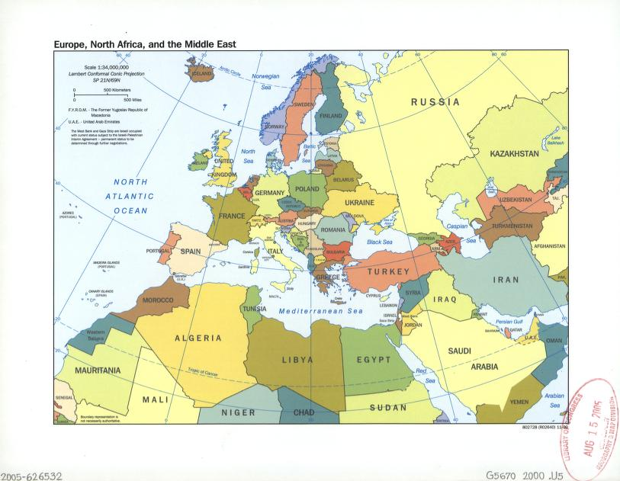

Slide 5
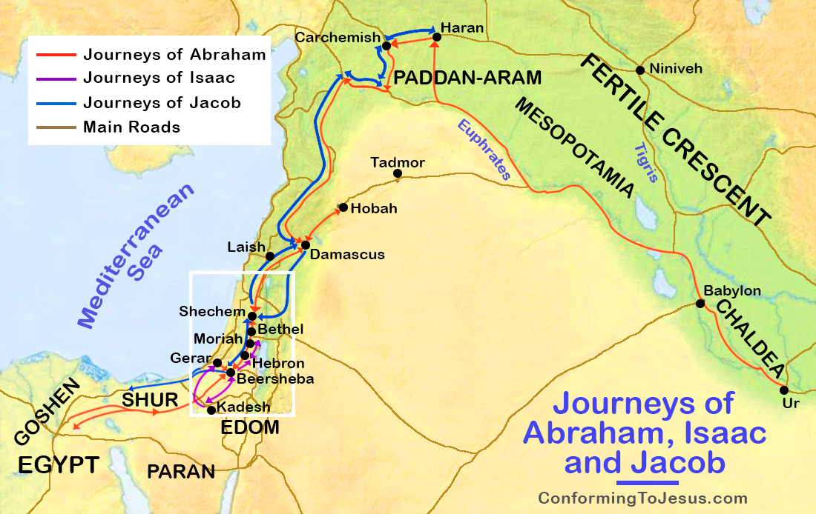

Slide 6
TRUST - Genesis 12:10-14:24
Famine in Canaan
Abram goes to Egypt
Abram is scared for his life, so he lies about his wife
Pharaoh takes Sarai (and Abram gets rich in the process)
God sends plagues on Pharaoh
Pharaoh lets both Abram and Sarai go (along with all their new stuff)
Abram and Lot separate (because they have too much stuff and too many people)
Abram has to rescue Lot
Abram meets Melchizedek

Slide 7
TRUST - Genesis 15
Some time later, Yhwh spoke to Abram in a vision and said to him, “Do not be afraid, Abram, for I will protect you, and your reward will be great.”
But Abram replied, “O Sovereign Lord, what good are all your blessings when I don’t even have a son? Since you’ve given me no children, Eliezer of Damascus, a servant in my household, will inherit all my wealth. You have given me no descendants of my own, so one of my servants will be my heir.”
Then Yhwh said to him, “No, your servant will not be your heir, for you will have a son of your own who will be your heir.” Then Yhwh took Abram outside and said to him, “Look up into the sky and count the stars if you can. That’s how many descendants you will have!”

Slide 8
TRUST - Genesis 15
And Abram trusted Yhwh, and Yhwh counted him as righteous because of his faith.

Slide 9
TRUST - Genesis 15
Abram trusts God, but…
He wants it “in writing”
God tells Abram to cut animals in half
God puts Abram to sleep
God Himself walks between the severed animals
Abram merely observes

Slide 10
TRUST - Genesis 16
Now Sarai, Abram’s wife, had not been able to bear children for him. But she had an Egyptian servant named Hagar*. So Sarai said to Abram, “Yhwh has prevented me from having children. Go and sleep with my servant. Perhaps I can have children through her.” And Abram agreed with Sarai’s proposal. So Sarai, Abram’s wife, took Hagar the Egyptian servant and gave her to Abram as a wife. (This happened ten years after Abram had settled in the land of Canaan.)
So Abram had sexual relations with Hagar, and she became pregnant. But when Hagar knew she was pregnant, she began to treat her mistress, Sarai, with contempt. Then Sarai said to Abram, “This is all your fault! I put my servant into your arms, but now that she’s pregnant she treats me with contempt. Yhwh will show who’s wrong—you or me!”
Abram replied, “Look, she is your servant, so deal with her as you see fit.” Then Sarai treated Hagar so harshly that she finally ran away.

Slide 11
TRUST - Genesis 16
The angel of Yhwh found Hagar beside a spring of water in the wilderness, along the road to Shur. The angel said to her, “Hagar, Sarai’s servant, where have you come from, and where are you going?”
“I’m running away from my mistress, Sarai,” she replied.
The angel of Yhwh said to her, “Return to your mistress, and submit to her authority.” Then he added, “I will give you more descendants than you can count.”
And the angel also said, “You are now pregnant and will give birth to a son. You are to name him Ishmael (which means ‘God hears’*), for Yhwh has heard your cry of distress. This son of yours will be a wild man, as untamed as a wild donkey! He will raise his fist against everyone, and everyone will be against him. Yes, he will live in open hostility against all his relatives.”
Thereafter, Hagar used another name to refer to Yhwh, who had spoken to her. She said, “You are the God who sees me.” She also said, “Have I truly seen the One who sees me?” So that well was named Beer-lahai-roi (which means “well of the Living One who sees me”). It can still be found between Kadesh and Bered.
So Hagar gave Abram a son, and Abram named him Ishmael. Abram was eighty-six years old when Ishmael was born.

Slide 12
TRUST - Genesis 17-21
God comes back to renegotiate their contract
Now Abram has to be circumcised
God changes his name to Abraham and Sarai’s name to Sarah
God spells out that Sarah will be the mother of the promised son
Abraham intercedes for Sodom
Sodom is destroyed, but Lot is saved
Abraham lies to Abimelech (again!) in Gerar
Isaac is born (finally!)
Sarah sends Hagar away
God pays attention to Hagar in the wilderness (again) and saves her life
Abraham deals peacefully with Abimelech

Slide 13
TEST - Genesis 22
Some time later, God tested Abraham’s faith.
“Abraham!” God called.
“Yes,” he replied. “Here I am.”
“Take your son, your only son—yes, Isaac, whom you love so much—and go to the land of Moriah. Go and sacrifice him as a burnt offering on one of the mountains, which I will show you.”
The next morning Abraham got up early. He saddled his donkey and took two of his servants with him, along with his son, Isaac. Then he chopped wood for a fire for a burnt offering and set out for the place God had told him about. On the third day of their journey, Abraham looked up and saw the place in the distance. “Stay here with the donkey,” Abraham told the servants. “The boy and I will travel a little farther. We will worship there, and then we will come right back.”
So Abraham placed the wood for the burnt offering on Isaac’s shoulders, while he himself carried the fire and the knife. As the two of them walked on together, Isaac turned to Abraham and said, “Father?”
“Yes, my son?” Abraham replied.
“We have the fire and the wood,” the boy said, “but where is the sheep for the burnt offering?”
“God will provide a sheep for the burnt offering, my son,” Abraham answered. And they both walked on together. When they arrived at the place where God had told him to go, Abraham built an altar and arranged the wood on it. Then he tied his son, Isaac, and laid him on the altar on top of the wood. And Abraham picked up the knife to kill his son as a sacrifice.

Slide 14
TEST - Genesis 22
At that moment the angel of Yhwh called to him from heaven, “Abraham! Abraham!”
“Yes,” Abraham replied. “Here I am!”
“Don’t lay a hand on the boy!” the angel said. “Do not hurt him in any way, for now I know that you truly fear God. You have not withheld from me even your son, your only son.”
Then Abraham looked up and saw a ram caught by its horns in a thicket. So he took the ram and sacrificed it as a burnt offering in place of his son. Abraham named the place Yahweh-Yireh (which means “Yhwh will provide”). To this day, people still use that name as a proverb: “On the mountain of Yhwh it will be provided.”
Then the angel of Yhwh called again to Abraham from heaven. “This is what Yhwh says: Because you have obeyed me and have not withheld even your son, your only son, I swear by my own name that I will certainly bless you. I will multiply your descendants beyond number, like the stars in the sky and the sand on the seashore. Your descendants will conquer the cities of their enemies. And through your descendants all the nations of the earth will be blessed—all because you have obeyed me.”
Then they returned to the servants and traveled back to Beersheba, where Abraham continued to live.

Slide 15
TRUST - Genesis 23-25a
Sarah dies
Abraham buys land in Canaan to bury her
Abraham sends a servant to get a wife for Isaac from his homeland
Abraham dies and is buried with Sarah

Slide 16
Who Is this Story about?
Abraham takes Isaac to Mount Moriah (just west of the Mount of Olives)
Isaac, the beloved only son, carries the wood on which he will be executed up the mountain
His life is ultimately spared thanks to a substitute sacrifice
Abraham, Yahweh’s chosen, human representative, trusts Yahweh (sometimes), and when he does, amazing things happen
Wouldn't it be wonderful if Yahweh had a chosen, human representative who trusted Him completely all of the time?

Slide 17
Next Week’s Class
Jacob
The heel-grabbing trickster who gets tricked himself
The one named Israel
The one who wrestled with Yhwh (and lived to tell the tale)

