Slide 1
Introduction to the Old Testament:
2 – The Fall, the Flood and Tower of Babel
May 11th 2025
Tim Theiss & Derek Dunbar

Slide 2
Class schedule
1 | Introduction/Creation | Tim | May 4th
2 | The Fall & flood | Tim | May 11th
3 | Abram/Abraham | Derek | May 18th
4 | Jacob & Issac | Derek | May 25th
5 | Joseph | Derek | June 1st
6 | Moses – Pharoah and the Exodus | Tim | June 8th
7 | Moses – The Law | Derek | June 15th
8 | Wilderness wanderings – the Pentateuch | Derek | June 22nd
9 | Joshua, Judges & Ruth | Tim | June 29th
10 | Samuel, Saul & David’s anointing | Tim | July 6th
11 | David as King – the temple | Tim | July 13th
12 | Wisdom Literature (poetry) | TBD | July 20th
13 | Soloman & the Divided Kingdom | Tim | July 27th
14 | Major & Minor prophets | Tim | Aug 3rd
15 | Daniel – the Exile | Derek | Aug 10th
16 | Ezra/Nehemiah – return from Exile | Derek | Aug 17th
17 | Q&A – wrap up | Both | Aug 24th

Slide 3
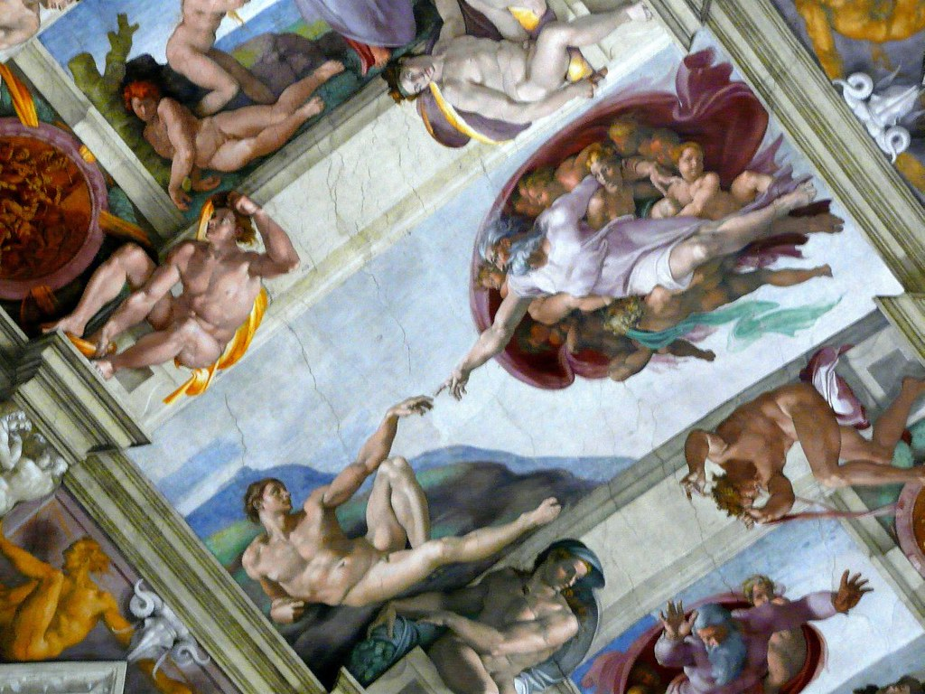
Last week … Creation!
The process of creation is described as moving from chaos to order
God spoke the world and all within it into existence
The creation was declared “good” but man was declared “very good”
This Photo by Unknown Author is licensed under CC BY-SA-NC
God is shown as more active and personal in the second Creation account (formed … breathed … placed … made … caused)
Man and woman were created In God’s image to rule over the world with God (we have purpose!)
These narratives are in stark contrast to other ancient creation narratives from surrounding civilizations
  Their gods are not noble in purpose; the gods are erratic in nature
  Constantly fighting with their creation over supremacy
  Man is created to serve their gods

Slide 4
Some things to remember about Eden
Genesis 2: 8-9; 15-17; 25
⁸ Now the Lord God had planted a garden in the east, in Eden; and there he put the man he had formed. ⁹ The Lord God made all kinds of trees grow out of the ground—trees that were pleasing to the eye and good for food. In the middle of the garden were the tree of life and the tree of the knowledge of good and evil.
God planted a garden - Eden
God made plants and fruit trees spring up – all for Adam and Eve
In the middle of Eden are two trees:
tree of life &
tree of knowledge of good and evil (commanded not to eat)
Woman created as a helper and companion
Adam & Eve lived in innocence
¹⁵ The Lord God took the man and put him in the Garden of Eden to work it and take care of it. ¹⁶ And the Lord God commanded the man, “You are free to eat from any tree in the garden; ¹⁷ but you must not eat from the tree of the knowledge of good and evil, for when you eat from it you will certainly die.”
²⁵ Adam and his wife were both naked, and they felt no shame.

Slide 5

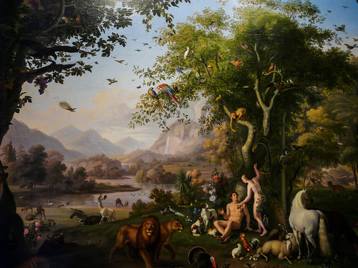
The Fall
Genesis 3:1-7
Now the serpent was more crafty than any of the wild animals the Lord God had made. He said to the woman, “Did God really say, ‘You must not eat from any tree in the garden’?”
This Photo by Unknown Author is licensed under CC BY
² The woman said to the serpent, “We may eat fruit from the trees in the garden, ³ but God did say, ‘You must not eat fruit from the tree that is in the middle of the garden, and you must not touch it, or you will die.’”
⁴ “You will not certainly die,” the serpent said to the woman. ⁵ “For God knows that when you eat from it your eyes will be opened, and you will be like God, knowing good and evil.”
⁶ When the woman saw that the fruit of the tree was good for food and pleasing to the eye, and also desirable for gaining wisdom, she took some and ate it. She also gave some to her husband, who was with her, and he ate it.⁷ Then the eyes of both of them were opened, and they realized they were naked; so they sewed fig leaves together and made coverings for themselves.

Slide 6
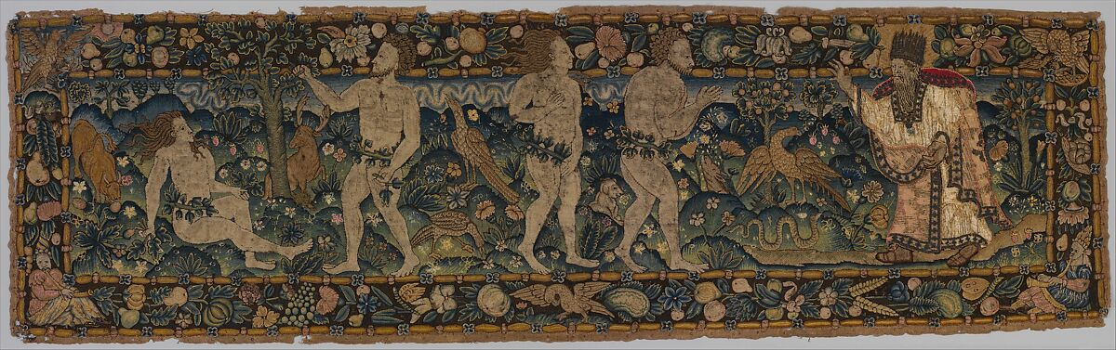
Confrontation
Genesis 3: 8 - 13
⁸ Then the man and his wife heard the sound of the Lord God as he was walking in the garden in the cool of the day, and they hid from the Lord God among the trees of the garden. ⁹ But the Lord God called to the man, “Where are you?”
¹⁰ He answered, “I heard you in the garden, and I was afraid because I was naked; so I hid.”
¹¹ And he said, “Who told you that you were naked? Have you eaten from the tree that I commanded you not to eat from?”
¹² The man said, “The woman you put here with me—she gave me some fruit from the tree, and I ate it.”
¹³ Then the Lord God said to the woman, “What is this you have done?”

Slide 7
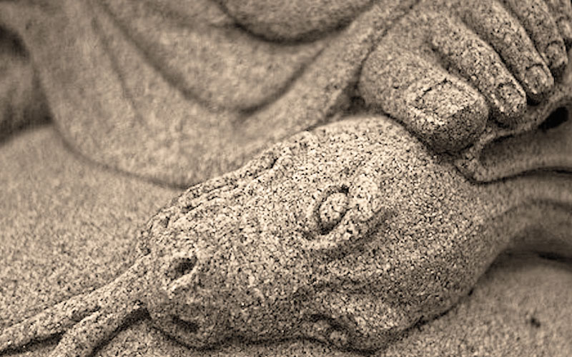
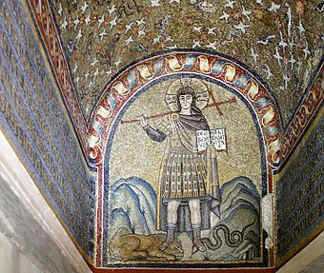
Punishment
Genesis 3: 14 - 16
The woman said, “The serpent deceived me, and I ate.”
¹⁴ So the Lord God said to the serpent, “Because you have done this,
“Cursed are you above all livestock
and all wild animals!
You will crawl on your belly
and you will eat dust
all the days of your life.
¹⁵ And I will put enmity
between you and the woman,
and between your offspring^{[a]} and hers;
he will crush^{[b]} your head,
and you will strike his heel.”
This Photo by Unknown Author is licensed under CC BY-SA-NC
This Photo by Unknown Author is licensed under CC BY-SA

Slide 8
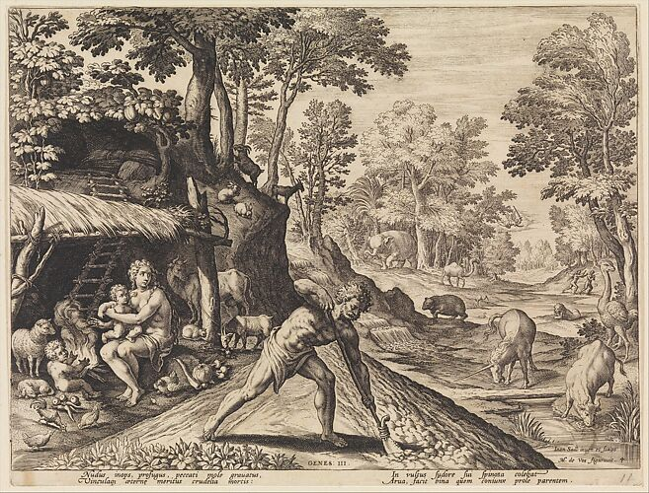
Woman and Man punished
Genesis 3: 16 - 19
¹⁶ To the woman he said,
“I will make your pains in childbearing very severe;
with painful labor you will give birth to children.
Your desire will be for your husband,
and he will rule over you.”
¹⁷ To Adam he said, “Because you listened to your wife and ate fruit from the tree about which I commanded you, ‘You must not eat from it,’
“Cursed is the ground because of you;
through painful toil you will eat food from it
all the days of your life.
¹⁸ It will produce thorns and thistles for you,
and you will eat the plants of the field.
¹⁹ By the sweat of your brow
you will eat your food
until you return to the ground,
since from it you were taken;
for dust you are
and to dust you will return.”

Slide 9
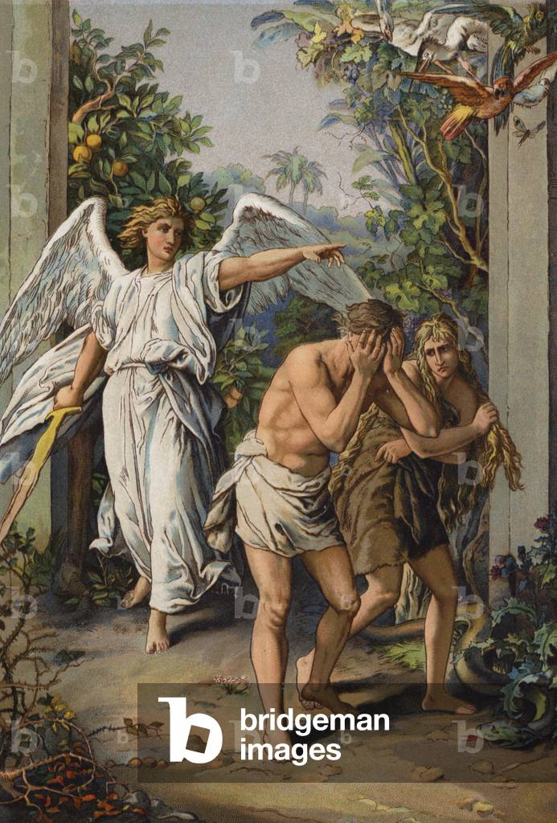
Banished
Genesis 3: 20 - 24
²⁰ Adam^{[c]} named his wife Eve,^{[d]} because she would become the mother of all the living.
²¹ The Lord God made garments of skin for Adam and his wife and clothed them. ²² And the Lord God said, “The man has now become like one of us, knowing good and evil. He must not be allowed to reach out his hand and take also from the tree of life and eat, and live forever.” ²³ So the Lord God banished him from the Garden of Eden to work the ground from which he had been taken. ²⁴ After he drove the man out, he placed on the east side^{[e]} of the Garden of Eden cherubim and a flaming sword flashing back and forth to guard the way to the tree of life.

Slide 10
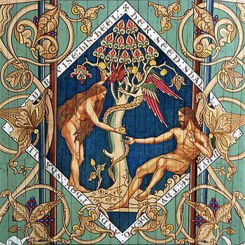
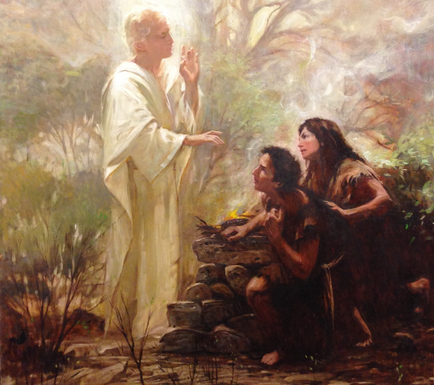
Observations …
Begin with mysterious and crafty creature, Serpent (aka, Satan or deceiver)
Uses deception and lies to Eve (actually, twists God’s words)
Eve saw … desired … took, then she and Adam tried to hide their sin
They defined good in their own eyes
So, they then lost their innocence and covered themselves
Adam tried to blame Eve and God; Eve blamed the serpent (blame shifting is still a thing)
This Photo by Unknown Author is licensed under CC BY-NC-ND

Slide 11
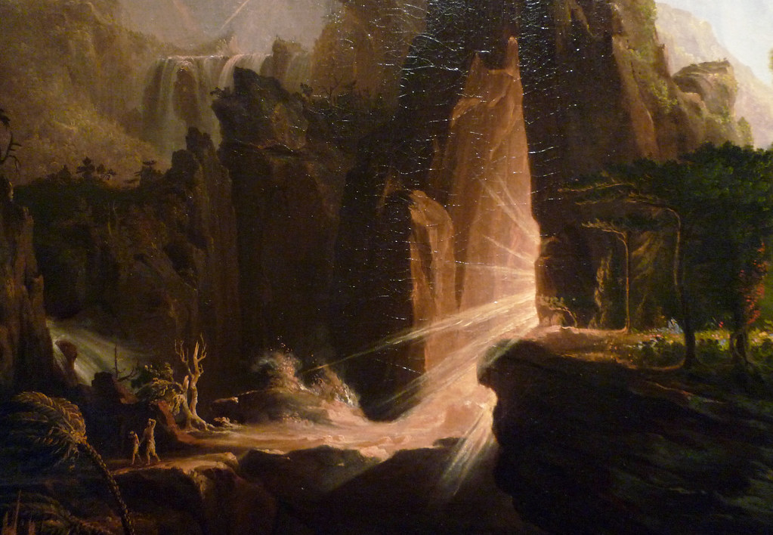
More observations …
God punishes the serpent, woman, man
Declares that Satan and mankind will always be at odds, but an offspring of woman will prevail (a foreshadowing of Christ)
  God provides a way out
God clothed Adam and Eve (use of animal skins implies a sacrifice had to occur)
Now with the knowledge of good/evil, God did not want man to have access to the tree of life
God banished Adam & Eve from Eden with the entrance guarded by heavenly beings (cherubim)
This Photo by Unknown Author is licensed under CC BY-SA-NC

Slide 12
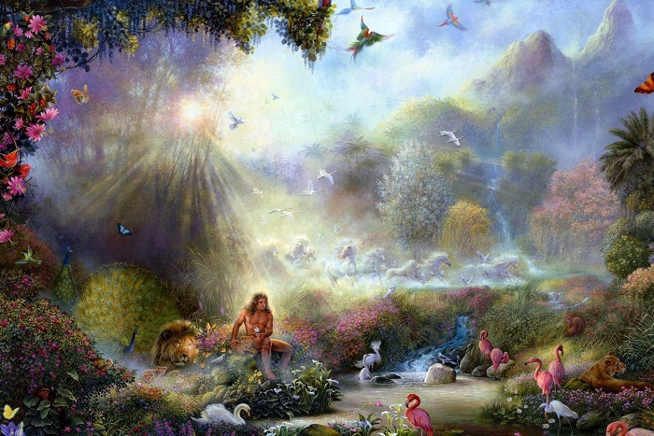
The Big Picture
Eden was a place created by God for man and God to be together, a kind of temple
A deceiver appears and tempts the woman, who partakes and convinces the man to do the same – the fall
This Photo by Unknown Author is licensed under CC BY-NC-ND
Man and woman and the deceiver are punished
God declares that strife will occur between mankind and the deceiver
God promises that someone will come who will prevail over the deceiver (a snake crusher)
Man and woman are now banished from Eden; thus tarnishing the close relationship between God and man

Slide 13
Cain, Abel, Lamech, Genealogies
Genesis 4 – 5
After they leave Eden Adam and Eve have 2 sons: Cain and Abel
Cain is a gardener; Abel is a shepherd
Cain and Abel both offer sacrifices to God
Abel’s sacrifice is acceptable but Cain’s is not (don’t really know why)
God tells Cain that he can offer a pleasing sacrifice
Cain choses instead to kill Abel – tries to conceal his sin
God banishes Cain and sends him to wander but also protects him from vengeance
Cain marries and has children and becomes the ancestor of Lamech (first to take two wives) – wicked lineage
Adam and Eve have another son – Seth (and other children)
The lineage from Adam to Noah is given (long lives)

Slide 14
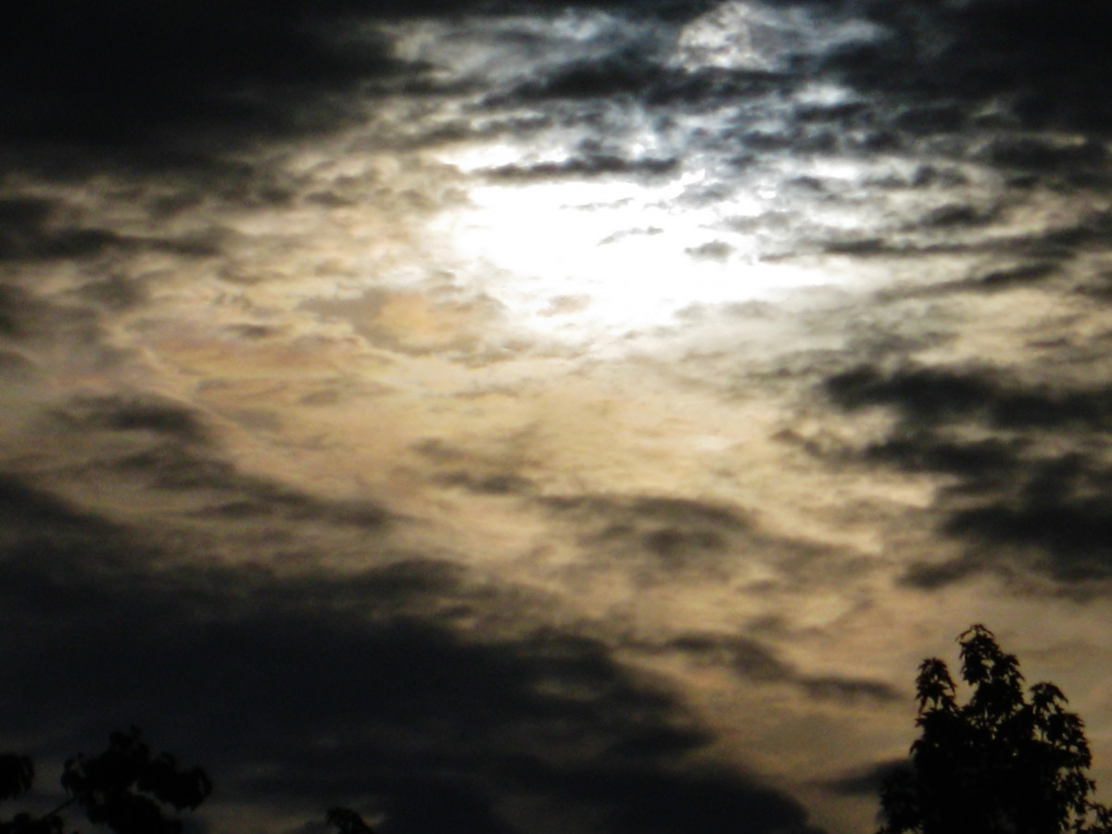
The flood (Genesis 6 – 10)
Motivation (Gen. 6: 5-8)
⁵ The Lord saw how great the wickedness of the human race had become on the earth, and that every inclination of the thoughts of the human heart was only evil all the time. ⁶ The Lord regretted that he had made human beings on the earth, and his heart was deeply troubled. ⁷ So the Lord said, “I will wipe from the face of the earth the human race I have created—and with them the animals, the birds and the creatures that move along the ground—for I regret that I have made them.” ⁸ But Noah found favor in the eyes of the Lord.
Wickedness was rampant
God regretted He made mankind
Decides to destroy His creation and start over
But Noah is righteous

Slide 15
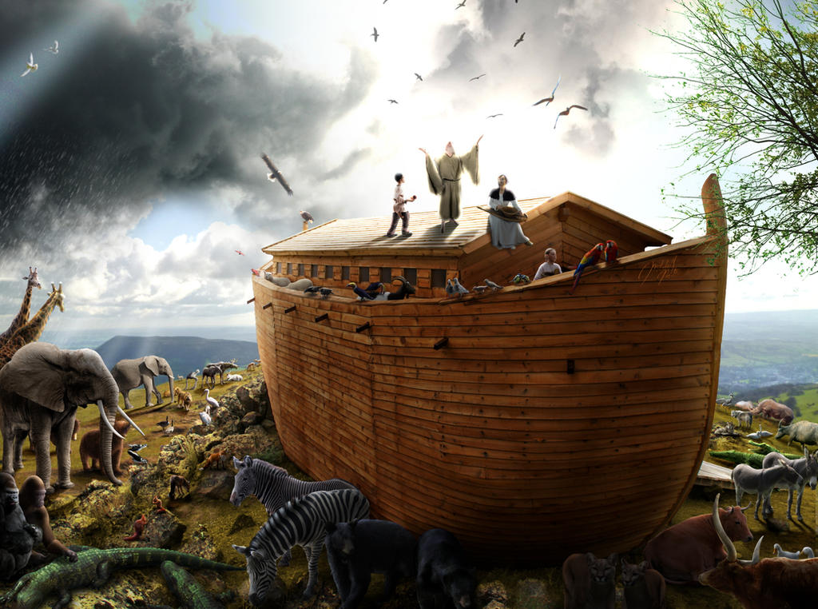
Noah and the Flood
Genesis 6 - 10
God tells Noah to build an ark because He is going to destroy the earth with a flood
God promises to protect Noah and his family (6: 18 – covenant)
This Photo by Unknown Author is licensed under CC BY-ND
Noah obeys and fills the ark with all animals (7 pairs of clean, 1 pair of unclean animals)
The ark contains Noah, his wife, his sons (Shem, Ham & Japeth) and their wives
God seals them in the ark and the flood begins
Everything on earth is destroyed
After several months, the water begins to recede
Another month or so later, the water is gone
Noah and his family are rescued and with the animals are released

Slide 16
God’s covenant with Noah
Genesis 9: 8 - 17
⁸ Then God said to Noah and to his sons with him, ⁹ “Behold, I establish my covenant with you and your offspring after you, ¹⁰ and with every living creature that is with you, the birds, the livestock, and every beast of the earth with you, as many as came out of the ark; it is for every beast of the earth. ¹¹ I establish my covenant with you, that never again shall all flesh be cut off by the waters of the flood, and never again shall there be a flood to destroy the earth.” ¹² And God said, “This is the sign of the covenant that I make between me and you and every living creature that is with you, for all future generations: ¹³ I have set my bow in the cloud, and it shall be a sign of the covenant between me and the earth. ¹⁴ When I bring clouds over the earth and the bow is seen in the clouds, ¹⁵ I will remember my covenant that is between me and you and every living creature of all flesh. And the waters shall never again become a flood to destroy all flesh. ¹⁶ When the bow is in the clouds, I will see it and remember the everlasting covenant between God and every living creature of all flesh that is on the earth.” ¹⁷ God said to Noah, “This is the sign of the covenant that I have established between me and all flesh that is on the earth.”

Slide 17
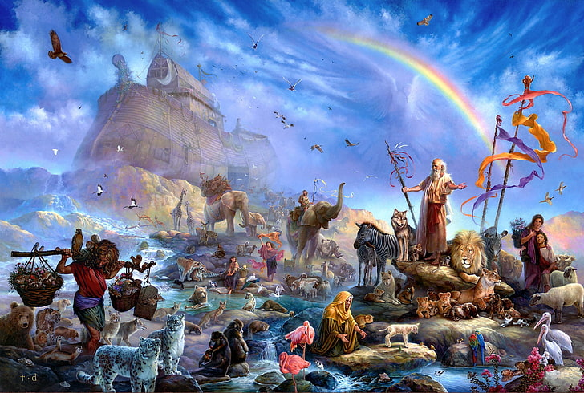
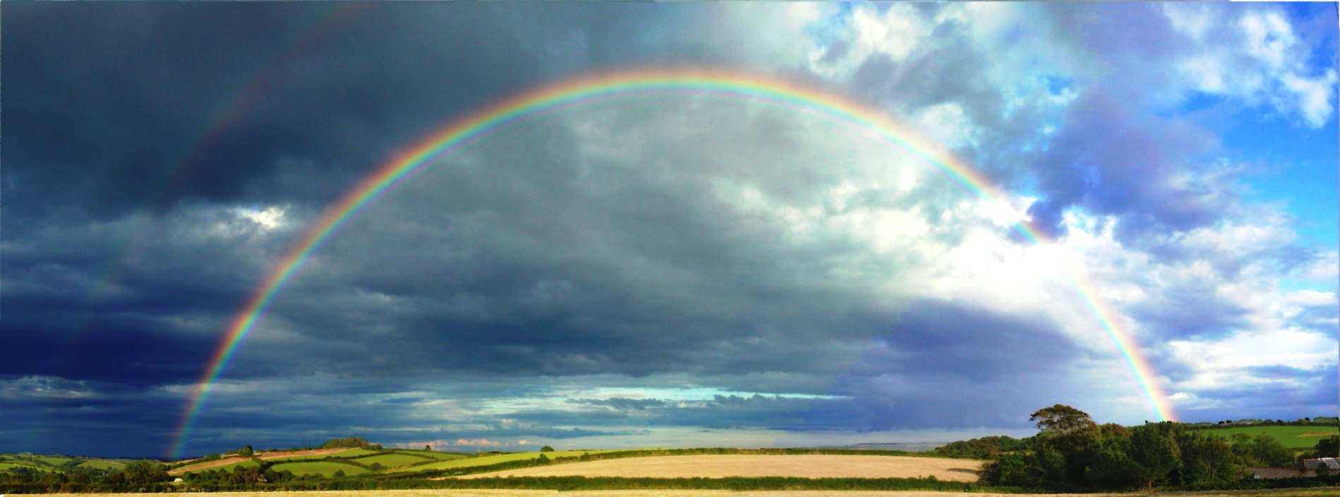
The first covenant
God establishes the first recorded covenant with Noah
An unconditional covenant (Noah does not have to do anything)
It is an eternal covenant
And God provides a visible sign of this covenant
Never again will the earth be destroyed by water

Slide 18
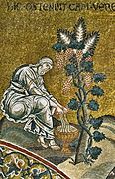
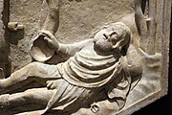
Prologue to the Noah and the flood
Genesis 9: 18 - 28
The land was repopulated from the descendants of Shem, Ham and Japeth
Noah grew a vineyard, became drunk in his tent
What happens next is difficult to translate and interpret but clearly not good (“sketchy”)
Ham dishonored his father and as a result his son, Canaan is cursed by Noah
This Photo by Unknown Author is licensed under CC BY-SA
This Photo by Unknown Author is licensed under CC BY-SA

Slide 19
Genesis 11: 1– 9
The Tower of Babel
Now the whole earth had one language and the same words. ² And as people migrated from the east, they found a plain in the land of Shinar and settled there. ³ And they said to one another, “Come, let us make bricks, and burn them thoroughly.” And they had brick for stone, and bitumen for mortar.⁴ Then they said, “Come, let us build ourselves a city and a tower with its top in the heavens, and let us make a name for ourselves, lest we be dispersed over the face of the whole earth.” ⁵ And the Lord came down to see the city and the tower, which the children of man had built. ⁶ And the Lord said, “Behold, they are one people, and they have all one language, and this is only the beginning of what they will do. And nothing that they propose to do will now be impossible for them. ⁷ Come, let us go down and there confuse their language, so that they may not understand one another's speech.” ⁸ So the Lord dispersed them from there over the face of all the earth, and they left off building the city. ⁹ Therefore its name was called Babel, because there the Lord confused^{[a]} the language of all the earth. And from there the Lord dispersed them over the face of all the earth.

Slide 20
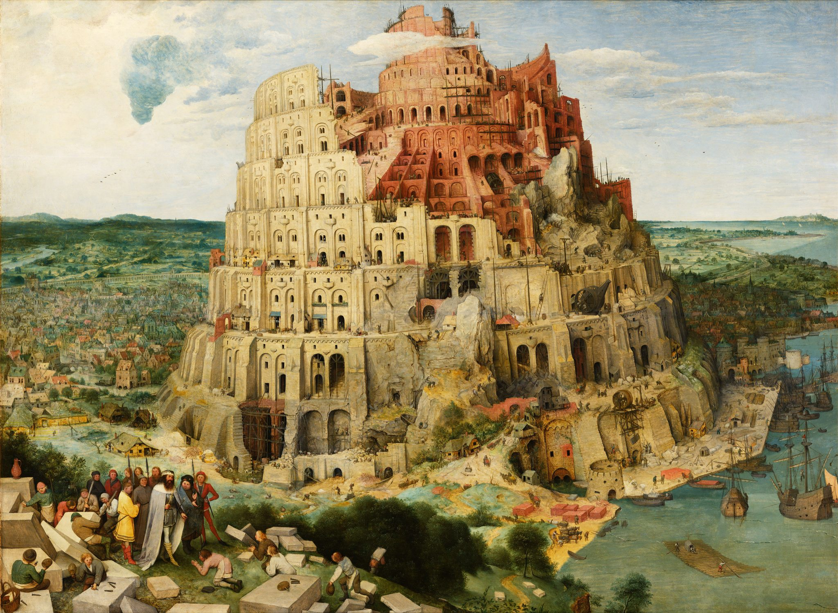
Details on the story of Babel
This is the origin story for the city of Babylon (plain of Shinar)
Desire for them to make themselves a city for themselves with a tower leading to heaven
Thus, the city and its residents were dispersed by God
Babel is in fact Babylon and becomes the archetype of a city devoted to itself and evil
This Photo by Unknown Author is licensed under CC BY-NC

Slide 21
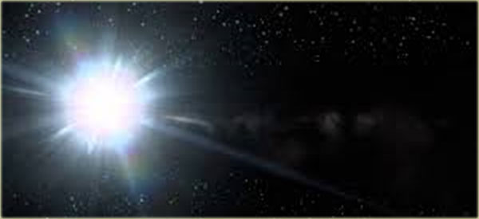
The Big Picture
This Photo by Unknown Author is licensed under CC BY-NC-ND
The fall of Eve and Adam begins a pattern of mankind’s sin (see, desire, take)
It shows God’s punishment for sin & a willingness to provide a way out
In the flood, God regrets He made man and decides to destroy all creation
But God saves Noah, a righteous man, and his family
God shows a willingness to make binding covenants with mankind for man’s benefit
Mankind continues their trend of devotion to themselves and not God
This overview previews man’s tendency for sin and destruction but God’s willingness to provide an(other) way of escape

Slide 22
Next week’s class – Abram (Derek)

