Slide 1
Introduction to the Old Testament: Class 17 – Wrap up/Apocrypha
Aug 31st , 2025
Tim Theiss & Derek Dunbar

Slide 2
Class schedule
Aug 31st – The Intertestamental period and Apocrypha
1 | Introduction/Creation | Tim | May 4th
2 | The Fall & flood | Tim | May 11th
3 | Abram/Abraham | Derek | May 18th
4 | Jacob & Issac | Derek | May 25th
5 | Joseph | Derek | June 1st
6 | Moses – the Exodus | Tim | June 8th
7 | Moses – The Law | Derek | June 15th
8 | Wilderness wanderings – the Pentateuch | Derek | June 22nd
9 | Joshua, Judges & Ruth | Tim | June 29th
10 | Samuel, Saul & David’s anointing | Tim | July 6th
11 | Kings David & Soloman | Tim | July 13th
12 | Wisdom Literature (poetry) | Bill Brosey | July 20th
13 | The Divided Kingdom | Tim | July 27th
14 | The Prophets | Tim | Aug 3rd
15 | Daniel – the Exile | Derek | Aug 10th
16 | Ezra/Nehemiah – return from Exile | Derek | Aug 24th
17 | Q&R – wrap up → submit questions! | Both | Aug 31st

Slide 3
The Big Picture – Summary of the OT (1/2)
YHWH (Yahweh) created mankind with a purpose (to preside over the rest of creation with Him)
Mankind does what is right in their own eyes and sin enters the world
Consequences follow but YHWH promises man to provide a future “snake crusher” to overcome sin
YHWH chooses one family (Abraham) to bless and promises to bless all nations through them
This family is flawed but YHWH blesses them anyway as the nation of Israel, although they are enslaved in Egypt
In YHWH’s time, He rescues (redeems) this nation and returns them to the land promised to Abraham
YHWH establishes a Covenant with Israel, binds Himself to them, and outlines how they should live as a nation and interact with those around them
The rules that YHWH outlines are effective – blessings follow when people and the nation follows them
However, Israel fails to consistently adhere to their terms of the Covenant and gets into a repeated cycle of YHWH’s correction and repentance
Righteous leadership is needed for this headstrong nation – Kings are anointed but that doesn’t fix the problem

Slide 4
The Big Picture – Summary of the OT (2/2)
YHWH continues to bless and work with Israel through flawed leaders and promises that all nations with be blessed through King David
The nation divides (Israel & Judah) but both nations fail to adhere to the Covenant and commit spiritual adultery (idolatry) and fail to care for each other as YHWH envisioned
These nations fall farther away from YHWH despite repeated warnings from His designated mouthpieces – the prophets
Israel becomes lost through exile but Judah continues its erratic path
Prophets warn of YHWH’s impending punishment (and refinement) for Judah but also offer hope in a coming Messiah
This refinement comes in the form of brutal conquest and exile but with hope for a return and hope in the future in the form of a Messiah
Upon return, Judah attempts to worship YHWH but these attempts also appear to miss the mark
Prophets continue to speak of a future Messiah and King who will set everything straight – YHWH’s promise to bless all mankind remains unfulfilled

Slide 5
3 Observations
Mankind’s inability to get it right; Godly leaders fail, ungodly leaders really fail miserably, and the nation itself repeatedly fails – an air of disappointment
God’s willingness to bind himself to Mankind and provide a way out
The promised “way out” takes on the form of a future Messiah
The Old Testament really is all about Jesus the Messiah!

Slide 6
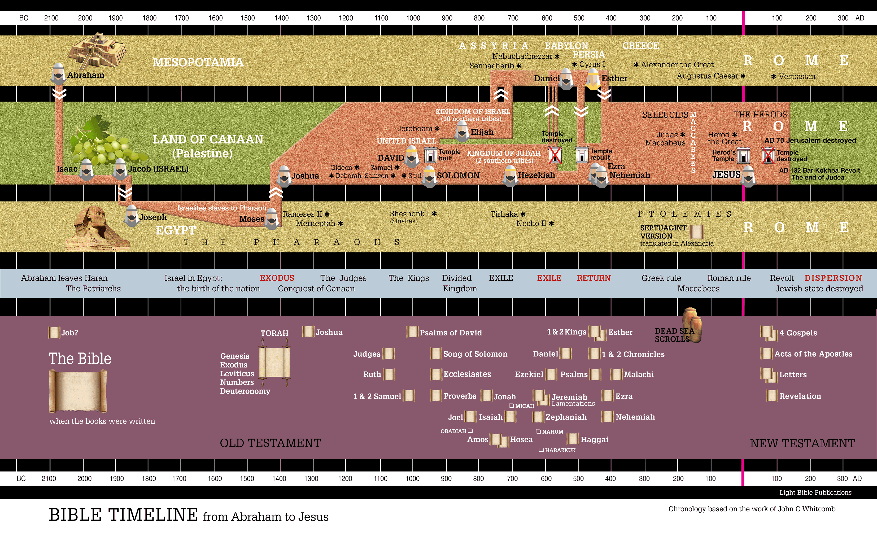

Slide 7
LXX/Greek

Slide 8
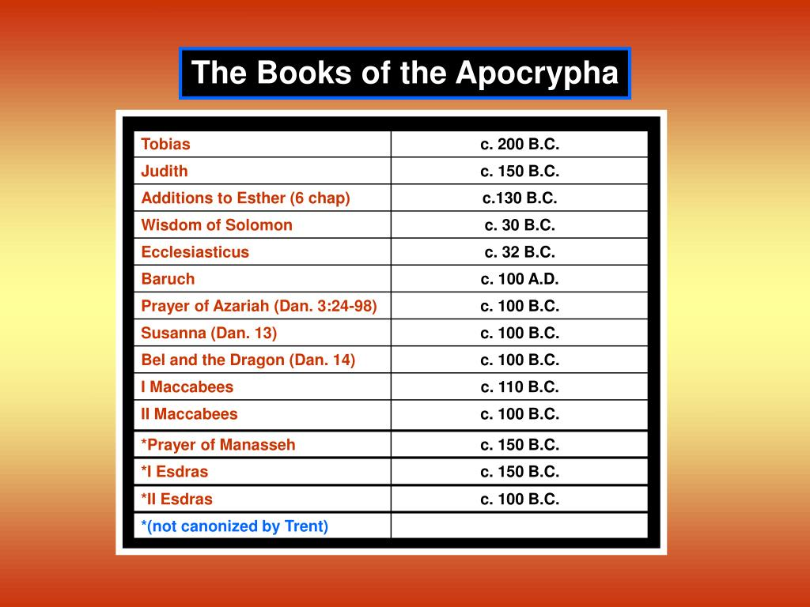

Slide 9
BibleProject overview of Apocrypha

Slide 10
Jonah
Only prophetic book written about the prophet and not of his teachings or writings – narrative style
Jonah was prophet during Jeroboam II (Israel) but commanded to preach to Israel’s enemies – Assyrians
Tried to run away from God but to no avail
Jonah reluctantly preaches in Ninevah
The Assyrians do repent much to Jonah’s disappointment and avoid God’s wrath and punishment
Claims he ran because he knew God would be merciful
God chastises Jonah for his hard heart and expresses his concern for the lost
And should I not have concern for the great city of Nineveh, in which there are more than a hundred and twenty thousand people who cannot tell their right hand from their left—and also many animals?

Slide 11
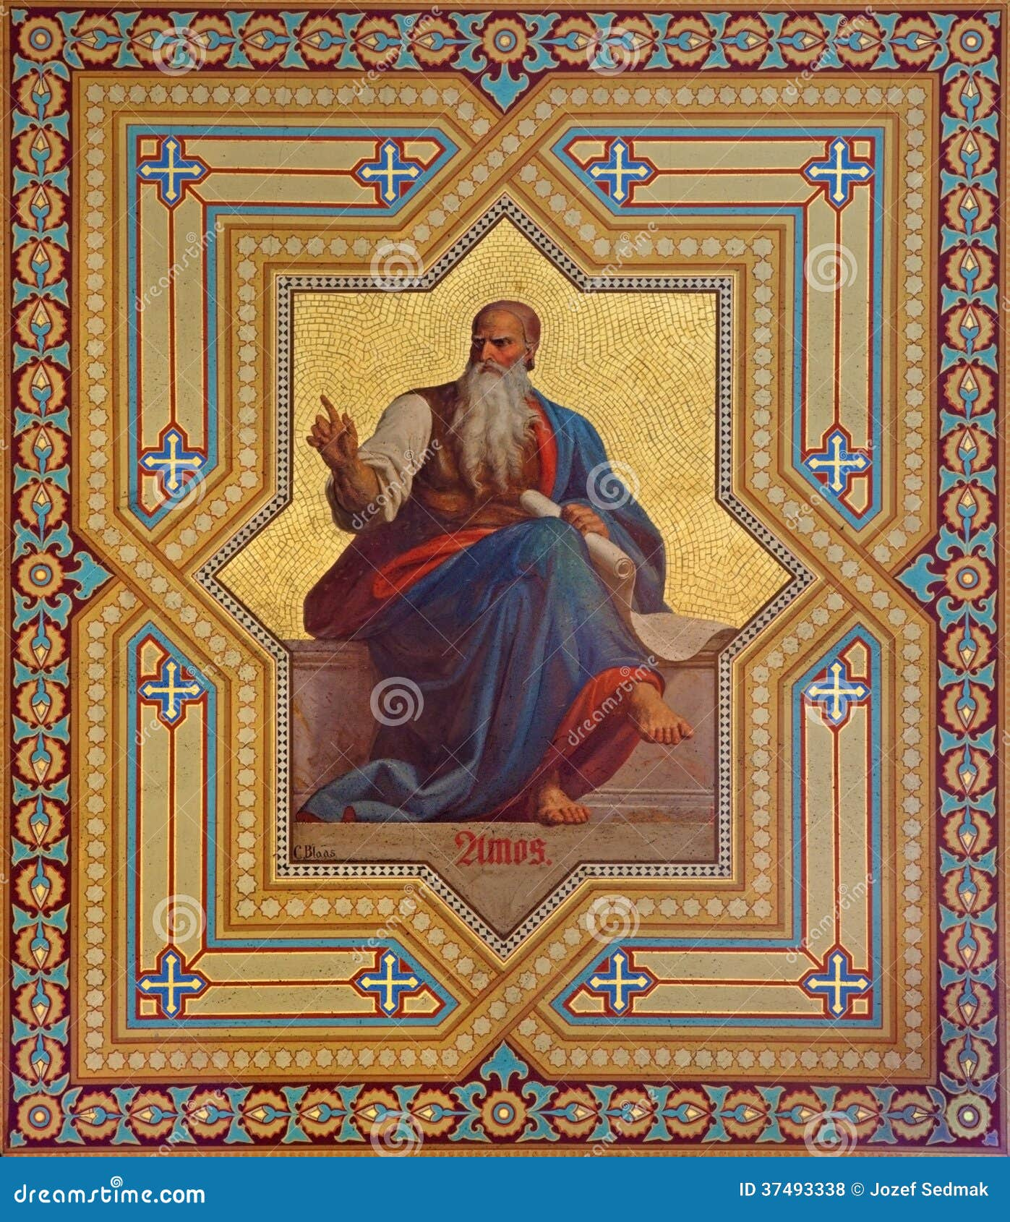
Amos
^{5:1} Woe to you who long for the day of the Lord! Why do you long for the day of the Lord? That day will be darkness, not light.
Shepard and fig grower in Judah near border with Israel – called during Jeroboam II
Begins by calling out surrounding kingdoms but targets Israel
Calls out the social injustice that was prevalent
Highlights the idolatry that was prevalent – not acceptable
Amos sees visions of the LORD a plumb line meaning true judgement is coming
Prophesies Israel will be taken into exile by Assyria
The high priest of Israel tries to have Amos sent back to Judah; Amos prophesies against him
Predicts Israel’s destruction but ultimate restoration through a Messiah
²²Even though you bring me burnt offerings and grain offerings, I will not accept them.
^{9:14} … and I will bring my people Israel back from exile. “They will rebuild the ruined cities and live in them. They will plant vineyards and drink their wine; ¹⁵I will plant Israel in their own land, never again to be uprooted from the land I have given them,”

