Slide 1
The Second Temple
Ezra-Nehemiah

Slide 2
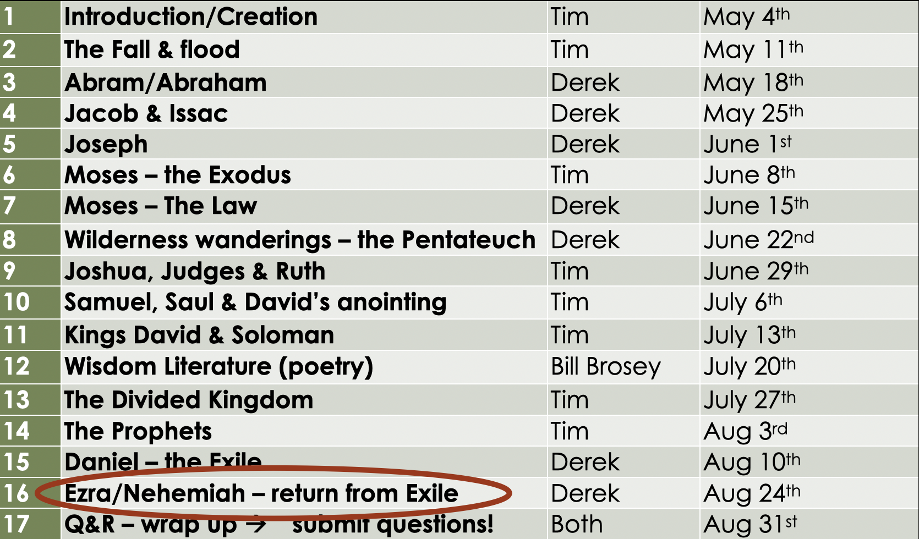

Slide 3
Creation
Family of Abraham
The Nation
of Israel
Exile
2nd Temple
Genesis 1-11
The Biblical story begins with all of humanity, our origins, our problems, and the promise of a human who will one day solve them (Gen 3:15)
Genesis 12- Deuteronomy
God singles out one man’s family to bless and to bring blessing to the rest of the world
Joshua-
Chronicles
That family becomes a country that is meant to represent God to the world, but continually fails to do so, ignoring the law and the prophets
Daniel, Esther, some Prophets
God (finally) allows Israel to face the consequences of their actions. They are led away in exile by foreign empires and the Temple is destroyed
Ezra-Nehemiah
Some are allowed to return to the Land. They rebuild the Temple and start taking the prophets and the law seriously, combining them into the OT we have today

Slide 4
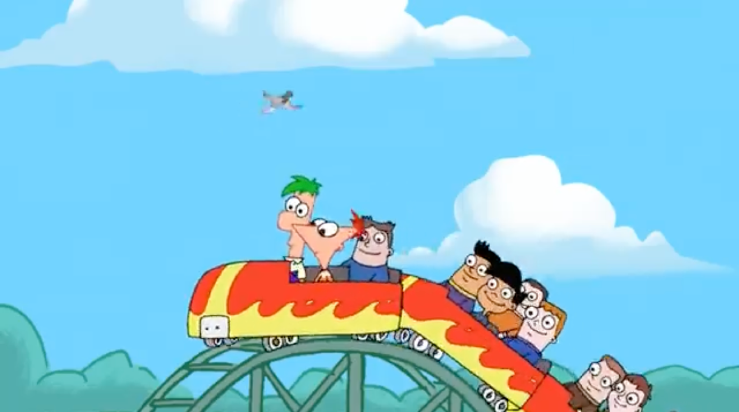

Slide 5
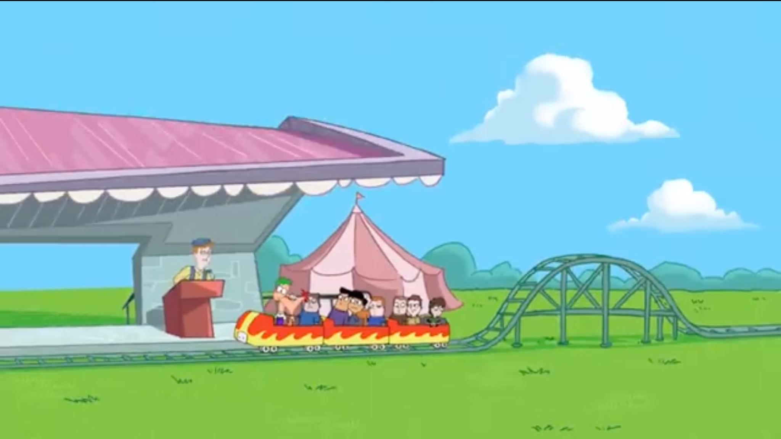
Please exit to your right

Slide 6
Three Expectations
God’s Presence in the Temple
The Blessing will go to all nations (Unity)
The Messiah will come

Slide 7
Three Expectations
God’s Presence in the Temple
  Exodus 19:16-18
On the morning of the third day, thunder roared and lightning flashed, and a dense cloud came down on the mountain. There was a long, loud blast from a ram’s horn, and all the people trembled. Moses led them out from the camp to meet with God, and they stood at the foot of the mountain. All of Mount Sinai was covered with smoke because Yahweh had descended on it in the form of fire. The smoke billowed into the sky like smoke from a brick kiln, and the whole mountain shook violently.

Slide 8
Three Expectations
God’s Presence in the Temple
  Exodus 19:16-18, Leviticus 9:22-24
After that, Aaron raised his hands toward the people and blessed them. Then, after presenting the sin offering, the burnt offering, and the peace offering, he stepped down from the altar. Then Moses and Aaron went into the Tabernacle, and when they came back out, they blessed the people again, and the glory of Yahweh appeared to the whole community. Fire blazed forth from Yahweh’s presence and consumed the burnt offering and the fat on the altar. When the people saw this, they shouted with joy and fell face down on the ground.

Slide 9
Three Expectations
God’s Presence in the Temple
  Exodus 19:16-18, Leviticus 9:22-24, 1 Kings 8:10-11
When the priests came out of the Holy Place, a thick cloud filled the Temple of Yahweh. The priests could not continue their service because of the cloud, for the glorious presence of Yahweh filled the Temple of Yahweh.

Slide 10
Three Expectations
God’s Presence in the Temple
  Exodus 19:16-18, Leviticus 9:22-24, 1 Kings 8:10-11, Zechariah 2:4-5
The other angel said, “Hurry, and say to that young man, ‘Jerusalem will someday be so full of people and livestock that there won’t be room enough for everyone! Many will live outside the city walls. Then I, myself, will be a protective wall of fire around Jerusalem, says Yahweh. And I will be the glory inside the city!

Slide 11
Three Expectations
God’s Presence in the Temple
  Exodus 19:16-18, Leviticus 9:22-24, 1 Kings 8:10-11, Zechariah 2:4-5
The Blessing will go to all nations (Unity)
  Zechariah 2:4-5, Genesis 12:3
I will bless those who bless you and curse those who treat you with contempt. All the families on earth will be blessed through you.

Slide 12
Three Expectations
God’s Presence in the Temple
  Exodus 19:16-18, Leviticus 9:22-24, 1 Kings 8:10-11, Zechariah 2:4-5
The Blessing will go to all nations (Unity)
  Zechariah 2:4-5, Genesis 12:3, Isaiah 2:2-4
In the last days, the mountain of Yahweh’s house will be the highest of all— the most important place on earth. It will be raised above the other hills, and people from all over the world will stream there to worship. People from many nations will come and say, “Come, let us go up to the mountain of Yahweh, to the house of Jacob’s God. There he will teach us his ways, and we will walk in his paths.” For Yahweh’s teaching will go out from Zion; his word will go out from Jerusalem. Yahweh will mediate between nations and will settle international disputes. They will hammer their swords into plowshares and their spears into pruning hooks. Nation will no longer fight against nation, nor train for war anymore.

Slide 13
Three Expectations
God’s Presence in the Temple
  Exodus 19:16-18, Leviticus 9:22-24, 1 Kings 8:10-11, Zechariah 2:4-5
The Blessing will go to all nations (Unity)
  Zechariah 2:4-5, Genesis 12:3, Isaiah 2:2-4, Isaiah 11:1, 10-13
Out of the stump of David’s family will grow a shoot— yes, a new Branch bearing fruit from the old root… In that day the heir to David’s throne will be a banner of salvation to all the world. The nations will rally to him, and the land where he lives will be a glorious place. In that day Yahweh will reach out his hand a second time to bring back the remnant of his people— those who remain in Assyria and northern Egypt; in southern Egypt, Ethiopia, and Elam; in Babylonia, Hamath, and all the distant coastlands. He will raise a flag among the nations and assemble the exiles of Israel. He will gather the scattered people of Judah from the ends of the earth. Then at last the jealousy between Israel and Judah will end. They will not be rivals anymore.

Slide 14
Three Expectations
God’s Presence in the Temple
  Exodus 19:16-18, Leviticus 9:22-24, 1 Kings 8:10-11, Zechariah 2:4-5
The Blessing will go to all nations (Unity)
  Zechariah 2:4-5, Genesis 12:3, Isaiah 2:2-4, Isaiah 11:1, 10-13
The Messiah will come
  Isaiah 11:1, 10-13, Genesis 3:15
And I will cause hostility between you [the snake] and the woman, and between your offspring and her offspring. He will strike your head, and you will strike his heel.

Slide 15
Three Expectations
God’s Presence in the Temple
When the builders completed the foundation of Yahweh’s Temple, the priests put on their robes and took their places to blow their trumpets. And the Levites, descendants of Asaph, clashed their cymbals to praise Yahweh, just as King David had prescribed. With praise and thanks, they sang this song to Yahweh:
“He is so good! His faithful love for Israel endures forever!”
Then all the people gave a great shout, praising Yahweh because the foundation of Yahweh’s Temple had been laid. But many of the older priests, Levites, and other leaders who had seen the first Temple wept aloud when they saw the new Temple’s foundation. The others, however, were shouting for joy. The joyful shouting and weeping mingled together in a loud noise that could be heard far in the distance.

Slide 16
Three Expectations
God’s Presence in the Temple
The Blessing will go to all nations (Unity)
“Many of the people of Israel, and even some of the priests and Levites, have not kept themselves separate from the other peoples living in the land. They have taken up the detestable practices of the Canaanites, Hittites, Perizzites, Jebusites, Ammonites, Moabites, Egyptians, and Amorites. For the men of Israel have married women from these people and have taken them as wives for their sons. So the holy race has become polluted by these mixed marriages. Worse yet, the leaders and officials have led the way in this outrage.”

Slide 17
Three Expectations
God’s Presence in the Temple
The Blessing will go to all nations (Unity)
While Ezra prayed and made this confession, weeping and lying face down on the ground in front of the Temple of God, a very large crowd of people from Israel—men, women, and children—gathered and wept bitterly with him. Then Shecaniah son of Jehiel, a descendant of Elam, said to Ezra, “We have been unfaithful to our God, for we have married these pagan women of the land. But in spite of this there is hope for Israel. Let us now make a covenant with our God to divorce our pagan wives and to send them away with their children. We will follow the advice given by you and by the others who respect the commands of our God. Let it be done according to the Law of God. Get up, for it is your duty to tell us how to proceed in setting things straight. We are behind you, so be strong and take action.”

Slide 18
Three Expectations
God’s Presence in the Temple
The Blessing will go to all nations (Unity)
While Ezra prayed and made this confession, weeping and lying face down on the ground in front of the Temple of God, a very large crowd of people from Israel—men, women, and children—gathered and wept bitterly with him. Then Shecaniah son of Jehiel, a descendant of Elam, said to Ezra, “We have been unfaithful to our God, for we have married these pagan women of the land. But in spite of this there is hope for Israel. Let us now make a covenant with our God to divorce our pagan wives and to send them away with their children. We will follow the advice given by you and by the others who respect the commands of our God. Let it be done according to the Law of God. Get up, for it is your duty to tell us how to proceed in setting things straight. We are behind you, so be strong and take action.”

Slide 19
Three Expectations
God’s Presence in the Temple
The Blessing will go to all nations (Unity)
The Messiah will come
About the same time I realized that some of the men of Judah had married women from Ashdod, Ammon, and Moab. Furthermore, half their children spoke the language of Ashdod or of some other people and could not speak the language of Judah at all. So I confronted them and called down curses on them. I beat some of them and pulled out their hair. I made them swear in the name of God that they would not let their children intermarry with the pagan people of the land…
Remember this in my favor, O my God.

Slide 20
Three Expectations
God’s Presence is not in the Temple
The Blessing has not gone to all nations (There isn’t even unity in Israel)
The leaders we have are no Messiah
Ezra-Nehemiah is the anti-climactic conclusion of the Biblical story
The people of Israel may be back from physical exile, but the real exile from Eden is as big of a problem as it ever was
The Old Testament ends on a cliffhanger. It’s a story that leaves the reader desperate for resolution: resolution that Jesus provides

