Slide 1
Introduction to the Old Testament:
Class 13 –The Divided Kingdom
July 27th, 2025
Tim Theiss & Derek Dunbar

Slide 2
Class schedule
Aug 31st – The Intertestamental period and Apocrypha
1 | Introduction/Creation | Tim | May 4th
2 | The Fall & flood | Tim | May 11th
3 | Abram/Abraham | Derek | May 18th
4 | Jacob & Issac | Derek | May 25th
5 | Joseph | Derek | June 1st
6 | Moses – the Exodus | Tim | June 8th
7 | Moses – The Law | Derek | June 15th
8 | Wilderness wanderings – the Pentateuch | Derek | June 22nd
9 | Joshua, Judges & Ruth | Tim | June 29th
10 | Samuel, Saul & David’s anointing | Tim | July 6th
11 | Kings David & Soloman | Tim | July 13th
12 | Wisdom Literature (poetry) | Bill Brosey | July 20th
13 | The Divided Kingdom | Tim | July 27th
14 | The Prophets | Tim | Aug 3rd
15 | Daniel – the Exile | Derek | Aug 10th
16 | Ezra/Nehemiah – return from Exile | Derek | Aug 17th
17 | Q&R – wrap up → submit questions! | Both | Aug 24th
Next week our class will meet in Room 115 (in Auditorium) for the remainder of this class and New Testament class

Slide 3
Recent Recaps …
Reviewed Wisdom literature (Proverbs, Song of Soloman, Ecclesiastes, Job)
These are intended to provide general wisdom (advise) for good living not universal promises from God (sometimes bad things happen to good people)
Previously, we studied the Kingships of Saul, David and Soloman
Each had some positive attributes but all had critical lapses
The Kingdom was taken from Saul and his family for disobedience
David had terrible lapses in judgement and flaws but remained a “man after God’s own heart”
Soloman received wisdom, wealth and fame from God but squandered it all and allowed his many wives to lead him into evil idolatry (including setting up alters to pagan gods associated with child sacrifice)
However, God promised David that his lineage would continue and ultimately bless all nations

Slide 4
God’s promise to Jeroboam
Rehoboam, Soloman’s son succeeds him as King, however …
Jeroboam, an official of Soloman is promised the (Northern) Kingdom of Israel
Punishment for Israel’s (Soloman) disobedience
But one tribe will remain with the House of David
God also promises to bless Jeroboam IF he obeys
The promise to Jeroboam also foretells Christ
³⁷However, as for you, I will take you, and you will rule over all that your heart desires; you will be king over Israel. ³⁸If you do whatever I command you and walk in obedience to me and do what is right in my eyes by obeying my decrees and commands, as David my servant did, I will be with you. I will build you a dynasty as enduring as the one I built for David and will give Israel to you. ³⁹I will humble David’s descendants because of this, but not forever.’ ”

Slide 5
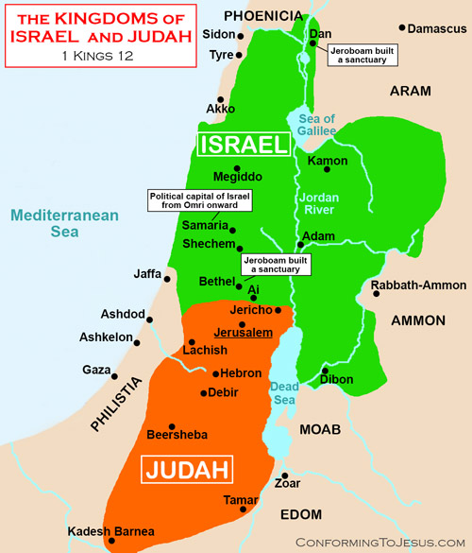
The Kingdom divides
Jeroboam and others ask Rehoboam for harsh labor under Soloman to be reduced
Elder advisors suggest Rehoboam lighten the labor
Younger advisors suggest the opposite – which is what Rehoboam does!
Israel rebels with the 10 northern tribes selecting Jeroboam as King
Judah (and Benjamin) remain loyal to the House of David – Rehoboam
Jeroboam is worried that his Kingdom will revert to Rehoboam if they continue to worship in Jerusalem
Jeroboam sets up shrines with golden calves for worship in Dan and Bethel
Eventually Samaria becomes the capital of Israel

Slide 6
Jeroboam & Rehoboam’s sin
I Kings 14
¹⁴“The Lord will raise up for himself a king over Israel who will cut off the family of Jeroboam. Even now this is beginning to happen. ¹⁵And the Lord will strike Israel, so that it will be like a reed swaying in the water. He will uproot Israel from this good land that he gave to their ancestors and scatter them beyond the Euphrates River, because they aroused the Lord’s anger by making Asherah poles. ¹⁶And he will give Israel up because of the sins Jeroboam has committed and has caused Israel to commit.”
²²Judah did evil in the eyes of the Lord. By the sins they committed they stirred up his jealous anger more than those who were before them had done. ²³They also set up for themselves high places, sacred stones and Asherah poles on every high hill and under every spreading tree. ²⁴There were even male shrine prostitutes in the land; the people engaged in all the detestable practices of the nations the Lord had driven out before the Israelites.
Jeroboam also corrupts the festivals and appointed his own priests (not from Levi)
This is sin in God’s eyes
Jeroboam is warned by an unnamed man of God and warned by the prophet Abijah
Abijah also foretells of the end of Jeroboam’s dynasty
And pending exile of Northern tribes of Israel
But in Judah, Rehoboam is not much better
Rehoboam adopts pagan worship of the Canaanites
Civil war between Israel and Judah ensues

Slide 7
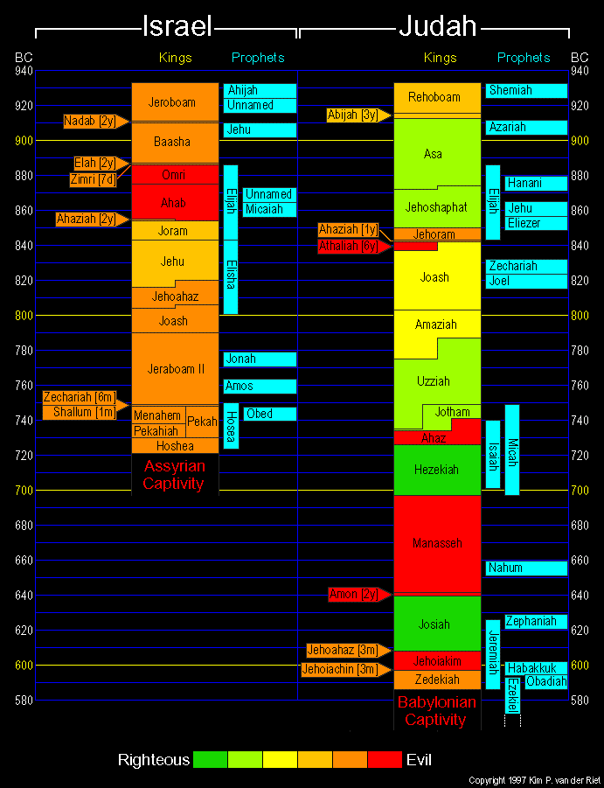
Timeline
Kingdom of Israel lasts 200 years
Judah lasts almost 350 years
All the Kings of Israel do “evil in the sight of the Lord” – “followed after the ways of Jeroboam”
Northern Kingdom has multiple coups and violent dynasty overthrows
Noteworthy kings of Israel: Jeroboam, Omri, Ahab, Jehu, Jeroboam II
Kingdom of Israel is eventually taken into exile by the Assyrians
Judah was more righteous but not fully devoted
Scripture gives analysis of each King Judah: they did evil/good and they did/did not remove the high places
Noteworthy kings of Judah : Rehoboam, Asa, Jehoshophat, Hezekiah, Manasseh (evil), Josiah, Zedekiah
Judah will eventually be taken captive by the Babylonians
Prophets provide warning - some writing prophets

Slide 8
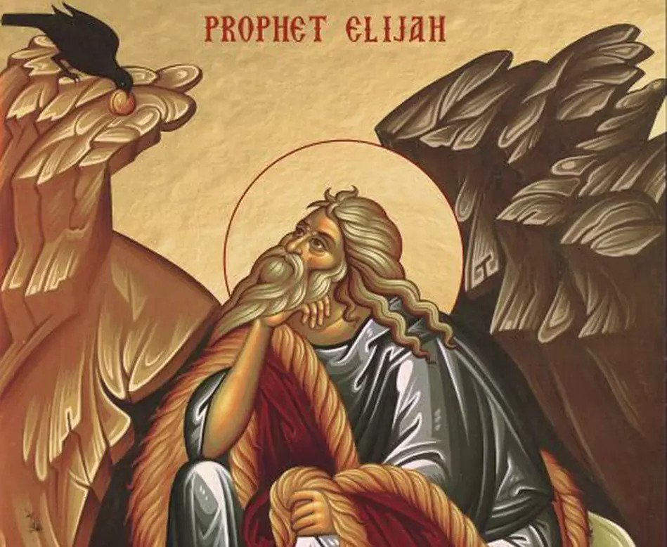
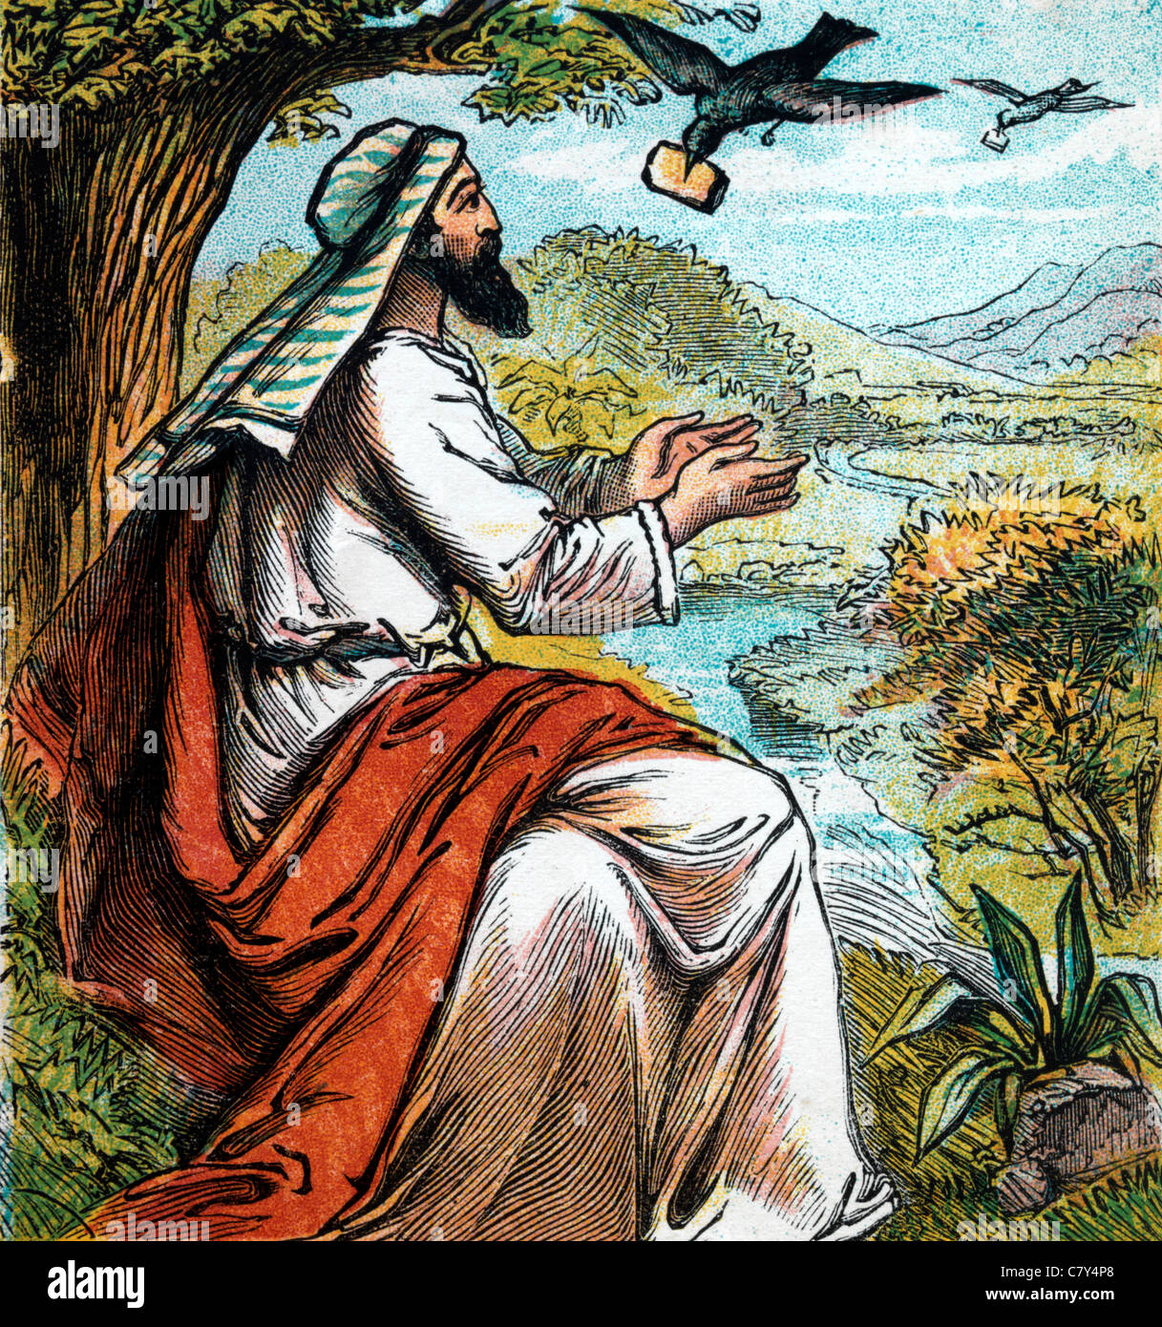
Elijah – the prophet of fire!
Elijah comes on the scene during the reign of King Ahab of Israel who was evil
Ahab married Jezebel a Sidonian princess and (re)introduces Baal/Asherah worship to Israel
Elijah (YHWH is my god) confronts Ahab and declares that drought will prevail in Israel until he says otherwise
Elijah then goes east of Jordan and is fed by ravens
Then Elijah goes to Sidonia and lives with a widow – extends her oil and water for his visit
Elijah heals the widow’s son who had stopped breathing
After 3 years, God tells Elijah to confront Ahab again
Meets Obediah, an official of Ahab (and believer)

Slide 9
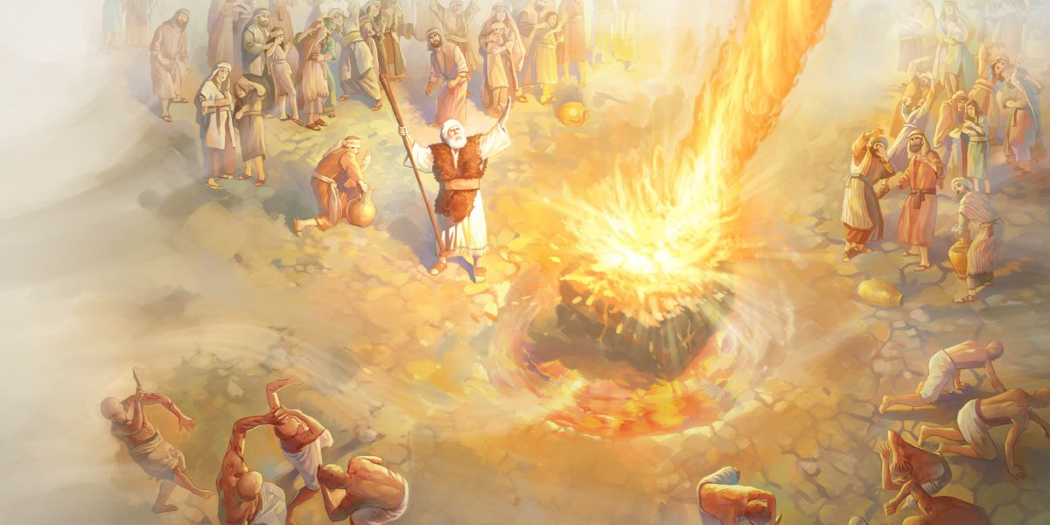
Elijah at Mount Carmel
After 3 years of drought, Elijah confronts Ahab again
Elijah challenges Ahab to assemble Israel and bring prophets of Baal and Asherah to Mt Carmel (hundreds)
Challenge: two alters, call on your god and the god who answers by fire is the real God
The prophets of Baal are unsuccessful
Finally, Elijah prepares his alter, soaks it completely and calls on YHWH
Fire consumes the alter completely
The prophets of Baal are then killed
Elijah then predicts rain, which occurs
Elijah outruns Ahab in his chariot
This Photo by Unknown Author is licensed under CC BY-NC-ND
“How long will you waver between two opinions? If YHWH is God, follow him; but if Baal is God, follow him.”
When all the people saw this, they fell prostrate and cried, “The Lord [YHWH] —he is God! The Lord—he is God!”

Slide 10
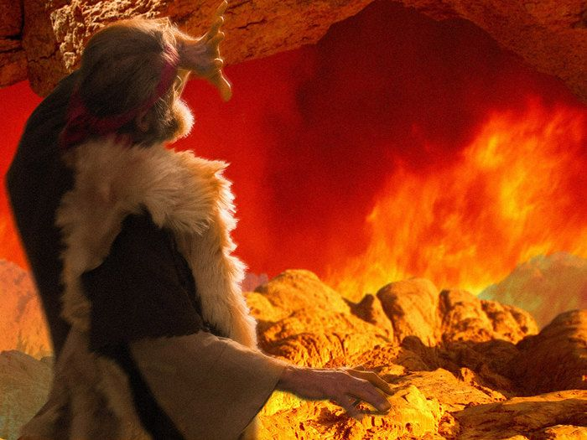
Elijah flees to Mt. Horeb
Ahab tells Jezebel who vows to kill Elijah – Elijah is afraid and runs
He travels south into Judah, prays that his life end and is even aided by the angel of YHWH
Goes to Mt. Horeb [Sinai] and speaks with YHWH
Elijah complains that Israel has rejected the Covenant and he is only prophet left (contrast with Moses)
YHWH passes by but not in wind, earthquake or fire but in small whisper
YHWH instructs Elijah to anoint kings of Aram & Israel and his successor, Elisha [god is my salvation]
YHWH tells Elijah that not all have turned away
Elijah returns and finds Elisha, who becomes his servant and protege

Slide 11
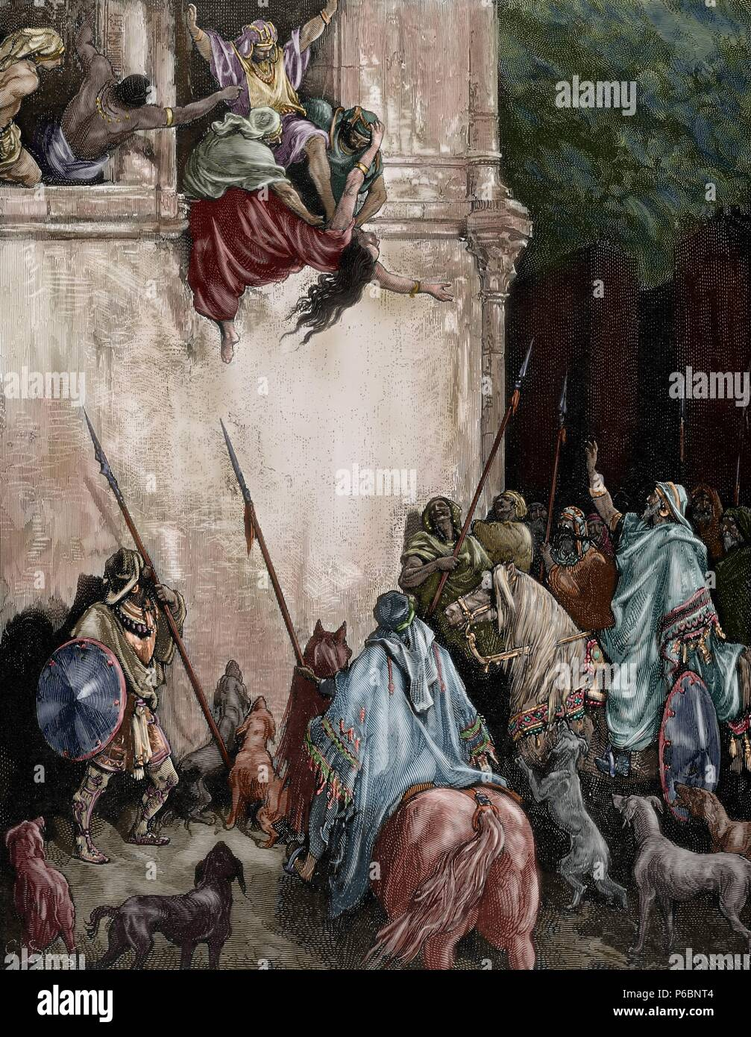
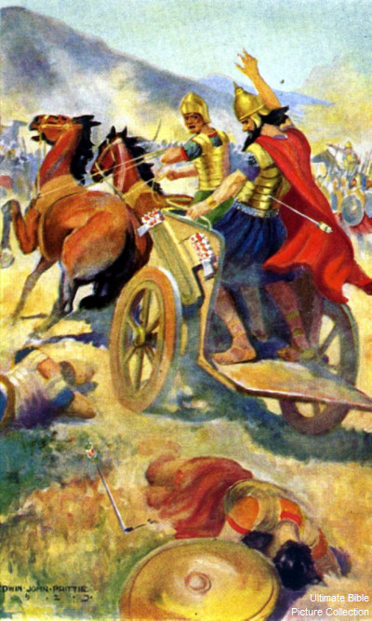
Death of Ahab & Jezebel
Several stories are included about Ahab and Jezebel – prevalent wickedness
They (actually Jezebel) had Naboth murdered to take his vineyard
Micaiah issues prophesy against Ahab (but we see prophets willing to give false prophesies to garner favor)
Ahab is killed in battle and his son Ahaziah succeeds him (also wicked)
Jehu has Jezebel and the rest of Ahab’s family killed - gruesome stories
Jehu then kills prophets of Baal (as God commanded) but did not follow YHWH with all his heart

Slide 12
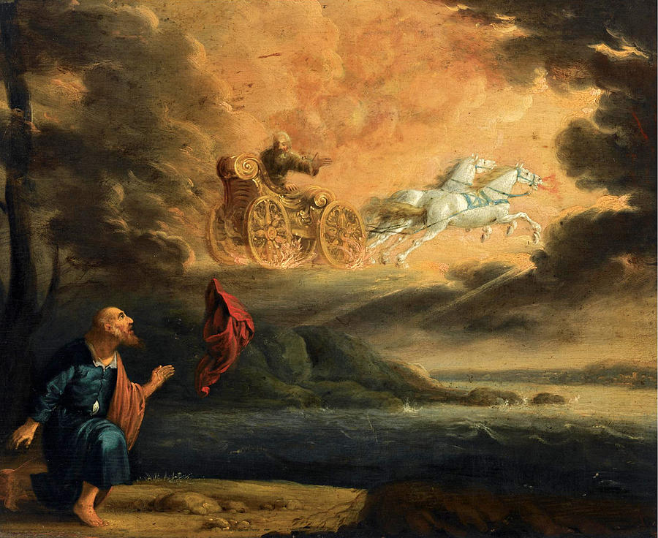
Elijah is taken
II Kings 3
¹When the Lord was about to take Elijah up to heaven in a whirlwind, Elijah and Elisha were on their way from Gilgal.
Everyone knew what was going to happen!
Elijah causes the Jordan river to part; he and Elisha cross on dry ground
Elisha asks for a double portion of his spirit (rights of firstborn inheritance)
Elijah is taken (only one other person did not experience death) in fiery chariot
Elisha parts the Jordan river as he crosses over
Scripture records Elisha performing 2X the miracles as Elijah
¹¹As they were walking along and talking together, suddenly a chariot of fire and horses of fire appeared and separated the two of them, and Elijah went up to heaven in a whirlwind. ¹²Elisha saw this and cried out, “My father! My father! The chariots and horsemen of Israel!” And Elisha saw him no more. Then he took hold of his garment and tore it in two.

Slide 13
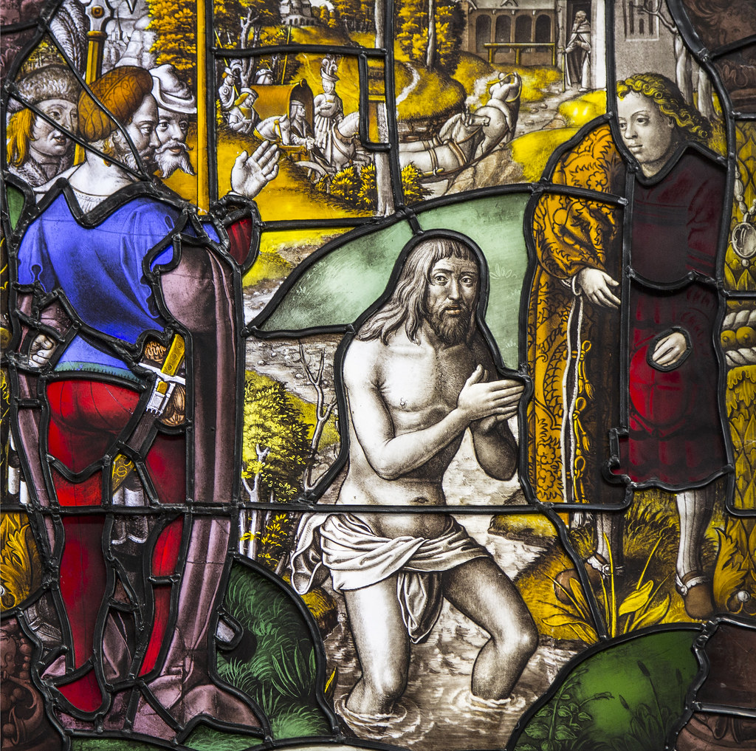
Elisha & Naaman
II Kings 5
Naaman was an Army commander for Aram (Syria) who came down with leprosy
Learns of prophet in Israel from Israelite slave girl
King of Aram sends gifts to King of Israel asking for healing for Naaman
Elisha hears of request and calls for Naaman
Sends messenger for Naaman to dip into the Jordan river 7 times
After coaxing, Naaman complies, dips in the Jordan 7X and is healed
Naaman acknowledges YHWH
Offers to pay Elisha but Elisha refuses
Then confides that he may have to enter to the temple of Rimmon with his master and bow (asks for YHWH’s forgiveness)
Elisha tells him to go in peace
Elisha’s servant goes back and asks for some payment (for others?), tries to conceal his deception and is struck with leprosy
This Photo by Unknown Author is licensed under CC BY-NC-ND
“Why have you torn your robes? Have the man come to me and he will know that there is a prophet in Israel.”
¹⁵Then Naaman and all his attendants went back to the man of God. He stood before him and said, “Now I know that there is no God in all the world except in Israel.

Slide 14
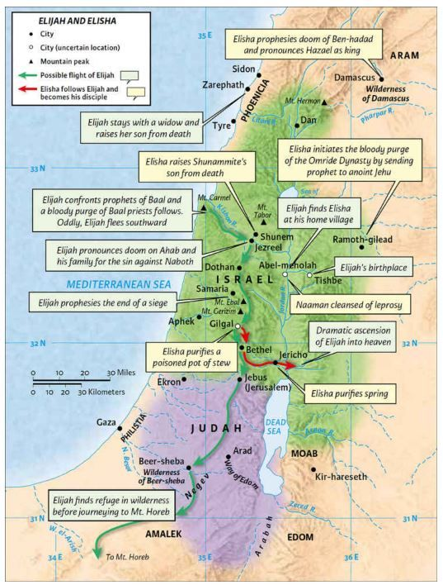
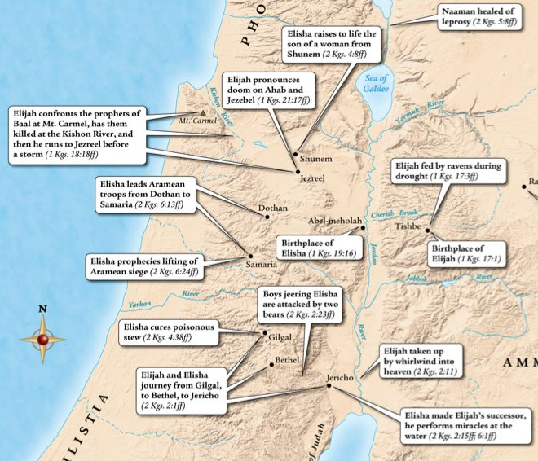
Context & Location

Slide 15
Israel in exile
II Kings 17
⁷All this took place because the Israelites had sinned against the Lord their God, who had brought them up out of Egypt from under the power of Pharaoh king of Egypt. They worshiped other gods ⁸and followed the practices of the nations the Lord had driven out before them, as well as the practices that the kings of Israel had introduced…
¹³The Lord warned Israel and Judah through all his prophets and seers: “Turn from your evil ways.
¹⁷They sacrificed their sons and daughters in the fire. They practiced divination and sought omens and sold themselves to do evil in the eyes of the Lord, arousing his anger.
^{23b}So the people of Israel were taken from their homeland into exile in Assyria, and they are still there.
³³They worshiped the Lord, but they also served their own gods in accordance with the customs of the nations from which they had been brought.
The trend continues, evil King after evil King
Finally, the king of Assyria attacks, lays siege and captures Israel
Assyrians are brutal and build huge empire
They displace conquered people and bring bring in others – mixing of peoples and pagan practices
Many of those faithful to YHWH (including Levites) went to Judah
Lions attack and Assyria brings in priest to teach ways of YHWH
People begin worship of all gods (including YHWH) which is clear violation of Covenant
This is the rise of the Samaritans (“half-Jews”)

Slide 16
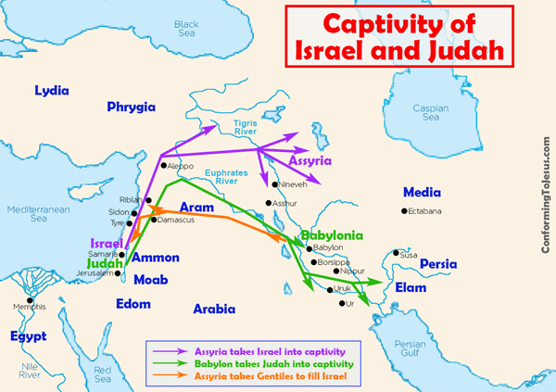
Assyrian & Babylonian captivity
Assyria would partially displace conquered people and replace with people from other conquered lands – complete mixing
Babylonia would keep people groups largely intact but take elites and ruling class to Babylonia for training and leave the poorer to work the land

Slide 17
Meanwhile back in Judah
II Kings 19
Judah is ruled by successive descendants of David; thus House of David stays intact - some close calls
Judah had a mix of good/evil Kings, but the good kings have ruled longer so not all bad
Hezekiah (a very good King) was ruling Judah when Israel was taken into exile
Assyria attacks Judah and forces Hezekiah to pay tribute
Assyrian commander chides Judah for resisting and trusting YHWH (no one has resisted before)
Hezekiah seeks Isaiah wisdom who prophesies that Assyria will not prevail
Hezekiah prays to YHWH (not political alliances)
That night, YHWH kills 185,000 Assyrian soldiers and they return to Nineveh!
Jerusalem is spared!
⁵Hezekiah trusted in the Lord, the God of Israel. There was no one like him among all the kings of Judah, either before him or after him. ⁶He held fast to the Lord and did not stop following him; he kept the commands the Lord had given Moses. ⁷And the Lord was with him; he was successful in whatever he undertook. He rebelled against the king of Assyria and did not serve him.
“Lord, the God of Israel, enthroned between the cherubim, you alone are God over all the kingdoms of the earth. You have made heaven and earth… ¹⁷“It is true, Lord, that the Assyrian kings have laid waste these nations and their lands. ¹⁸They have thrown their gods into the fire and destroyed them, for they were not gods but only wood and stone, fashioned by human hands. ¹⁹Now, Lord our God, deliver us from his hand, so that all the kingdoms of the earth may know that you alone, Lord, are God.”

Slide 18
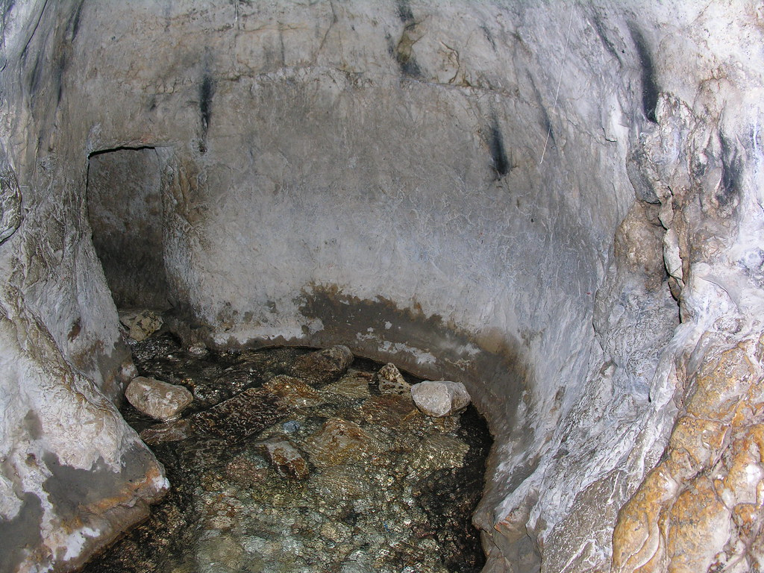
Hezekiah to Manasseh
Hezekiah became ill but prays to YHWH and is granted 15 more years to live
But Hezekiah receives envoys from Babylon and shows them all the treasures of the temple
Isaiah condemns this and declares that these will be carried off to Babylonia
Hezekiah builds a tunnel under Jerusalem (II Kings 20: 20)
Manasseh became King at 12 and reigned 55 years
Manasseh was evil, undid all previous reforms and was considered the most evil King of Judah
This Photo by Unknown Author is licensed under CC BY-NC-ND
¹¹“Manasseh king of Judah has committed these detestable sins. He has done more evil than the Amorites who preceded him and has led Judah into sin with his idols. ¹²Therefore this is what the Lord, the God of Israel, says: I am going to bring such disaster on Jerusalem and Judah that the ears of everyone who hears of it will tingle.

Slide 19
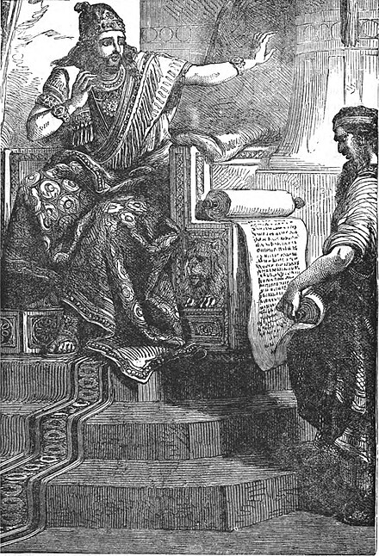
Josiah – righteous King
Manasseh’s long and evil reign is followed by Amon short and evil reign
Josiah, who follows YHWH is next King
A Book of the Law is read which reveals Judah’s sin
Josiah humbles himself and asks the prophetess, Huldah, to inquire of YHWH
Judah will be destroyed but Josiah will not have to witness
Josiah embarks on an exhaustive spiritual renewal; purges and defiles pagan temples, removes high places
Embarks on a complete Covenant renewal with YWHW (biggest celebration since Soloman)
²⁵Neither before nor after Josiah was there a king like him who turned to the Lord as he did—with all his heart and with all his soul and with all his strength, in accordance with all the Law of Moses.
This Photo by Unknown Author is licensed under CC BY-SA
²⁶Nevertheless, the Lord did not turn away from the heat of his fierce anger, which burned against Judah because of all that Manasseh had done to arouse his anger.

Slide 20
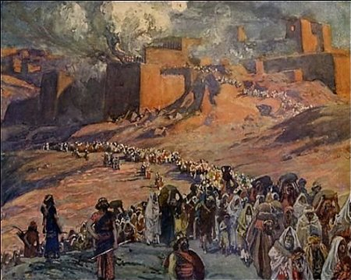
Babylonian captivity & exile
II Kings 25
Josiah is followed by a series of evil Kings
Nebuchadnezzar, King of Babylon made the King of Judah a vassal but he rebelled
Judah tries to resist
Nebuchadnezzar took the temple treasures and seized Jerusalem
After a long siege, Jerusalem fell and the temple is completely destroyed
The residents of Judah are taken captive to Babylon in waves from 587-597 BC
The poorest remain
Judah is Exiled (70 years)!
This Photo by Unknown Author is licensed under CC BY-NC-ND
After 37 years in captivity, the exiled King of Judah is released from prison and eats at the King’s table

Slide 21
The Big Picture
Numbers 14: 18 ‘The Lord is slow to anger, abounding in love and forgiving sin and rebellion. Yet he does not leave the guilty unpunished; he punishes the children for the sin of the parents to the third and fourth generation.’
II Chron. 36:15 The Lord, the God of their ancestors, sent word to them through his messengers again and again, because he had pity on his people and on his dwelling place. ¹⁶But they mocked God’s messengers, despised his words and scoffed at his prophets until the wrath of the Lord was aroused against his people and there was no remedy.
Looking for a righteous leader of Israel but few measure up
Goes back to Israel’s initial failure eto drive the Canaanites from the land
Seeing the same story played over and over of the consequences of Israel’s failure to follow God’s commandments
God fulfills His promise to continue the lineage of David but most of the Kingdom is lost due to Soloman
God is exacting his punishment on Israel (and Judah)

Slide 22
Comparison of Samuel/Kings & Chronicles
I/II Samuel & I/II Kings
I/II Chronicles
Longer description of events of Israel
Gives details on Northern and Southern Kingdoms
Details the idolatry leading to the exile(s)
POV before the Babylonian exile
How did we get in the mess?
Shorter
Focused on the Southern Kingdom
POV from after return from exile
More favorable description of David and Soloman – avoids David’s sin
Gives more detail on the temple
Highlights the continuing lineage of David
How do we proceed from here?

Slide 23
Backup slides

Slide 24
I/II Kings topics
The Lord’s Judgment on Ahaziah
Elijah taken to heaven/ Elisha
Naaman healed – II Kings 5
Jeru – II Kings 10
Joash repairs the temple
Amaziah/Jeroboam II
Israel exile – II Kings 17
Hezekiah – II Kings 18-20
Manasseh
Josiah – II Kings 22
Jehoahaz/Jehoiakim
Nebuchadnezzar conquers Israel
Jehoiachin released – II Kings 25 end
II Chronicles 36 end
Israel Rebels Against Rehoboam
Golden Calves at Bethel and Dan
The Man of God From Judah
Ahijah’s Prophecy Against Jeroboam
Rehoboam King of Judah
Abijah King of Judah
Asa King of Judah
Nadab King of Israel
Baasha King of Israel
Omri King of Israel
Ahab Becomes King of Israel
Elijah – I Kings 17-19
Ahab & Nabath’s vineyard
Jehoshaphat – I Kings 22

