Slide 1
Introduction to the Old Testament:
Class 11 – Kings David & Soloman
July 13th, 2025
Tim Theiss & Derek Dunbar

Slide 2
Class schedule
Aug 31st – The Intertestamental period and Apocrypha
1 | Introduction/Creation | Tim | May 4th
2 | The Fall & flood | Tim | May 11th
3 | Abram/Abraham | Derek | May 18th
4 | Jacob & Issac | Derek | May 25th
5 | Joseph | Derek | June 1st
6 | Moses – the Exodus | Tim | June 8th
7 | Moses – The Law | Derek | June 15th
8 | Wilderness wanderings – the Pentateuch | Derek | June 22nd
9 | Joshua, Judges & Ruth | Tim | June 29th
10 | Samuel, Saul & David’s anointing | Tim | July 6th
11 | Kings David & Soloman | Tim | July 13th
12 | Wisdom Literature (poetry) | Bill Brosey | July 20th
13 | The Divided Kingdom | Tim | July 27th
14 | The Prophets - Hosea | Tim | Aug 3rd
15 | Daniel – the Exile | Derek | Aug 10th
16 | Ezra/Nehemiah – return from Exile | Derek | Aug 17th
17 | Q&R – wrap up → submit questions! | Both | Aug 24th

Slide 3
Last week/Recap … I Sam.
Samuel, a godly man, is appointed as the last Judge of Israel
The nation struggles with their devotion to YHWH and is continually turned toward pagan idolatry
Israel has rejected YHWH as their sovereign and asked for a King “like the other nations”
Saul appeared to be a good candidate but did not have a heart devoted to YHWH
I Samuel details Saul’s anointing, his initial rise, his sins and his ultimate demise
Thus, YHWH is giving the Kingdom of Israel to one whose heart is devoted - David, son of Jessee
Through David’s actions and his writings, we see a future King who is ”a man after God’s own heart”
I Samuel concludes with the death of Saul at the hand of the Philistines and David on the run from Saul

Slide 4
David hears of Saul’s death
II Sam. 1
An Amalekite informs David of King Saul’s death (and Jonathan)
In fact, he claims to have killed him after Saul fell on his sword
He brings Saul’s crown and royal arm band (thinks he will be rewarded)
David has him killed
David writes a lament for Saul and Jonathan
“A gazelle^{[a]} lies slain on your heights, Israel.
How the mighty have fallen!
²⁰ “Tell it not in Gath,
proclaim it not in the streets of Ashkelon,
lest the daughters of the Philistines be glad,
lest the daughters of the uncircumcised rejoice.
…
²⁷ “How the mighty have fallen!
The weapons of war have perished!”

Slide 5
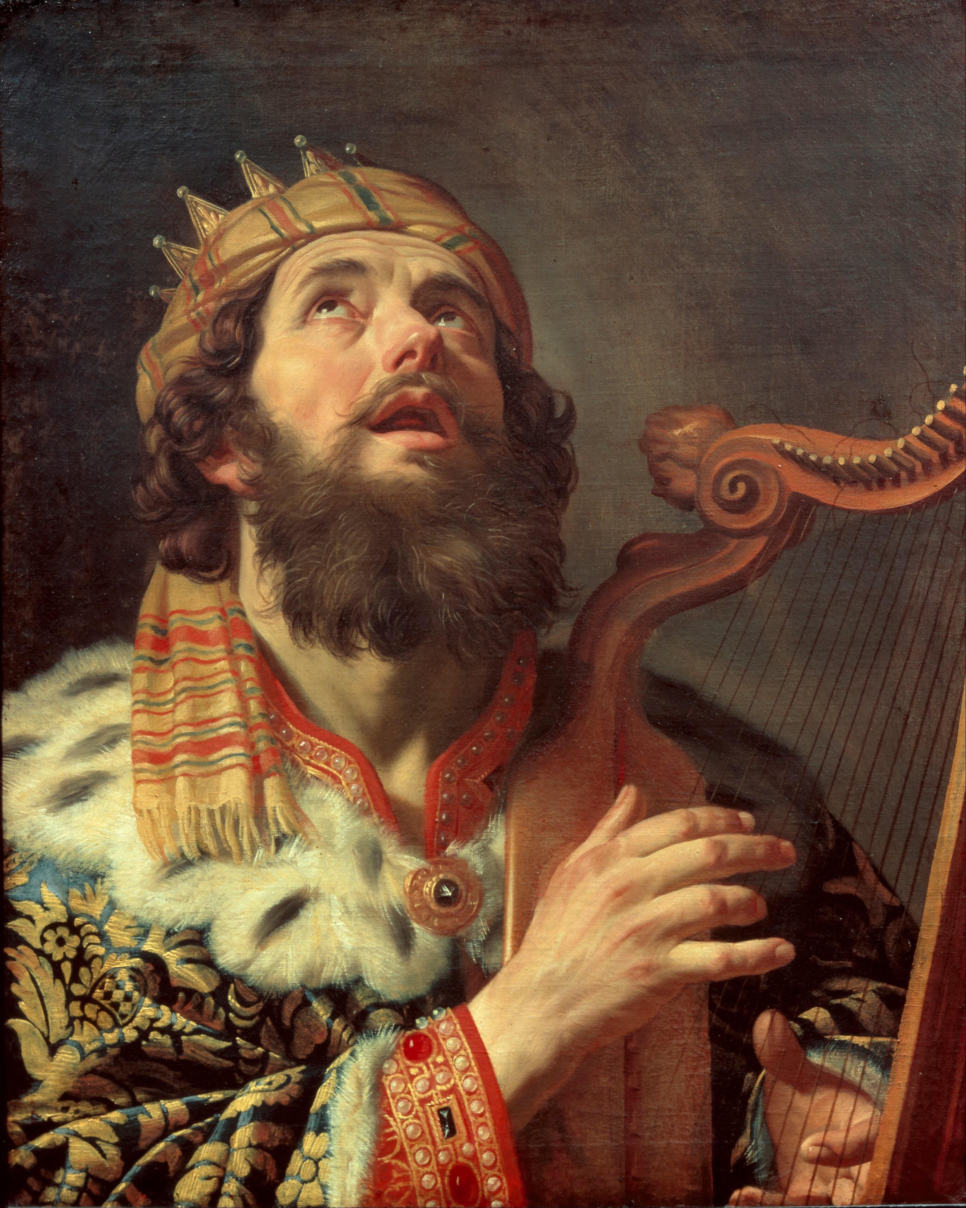
David King of Judah
II Sam. 2-4
David is then anointed and the King of Judah (not all of Israel)
Saul’s military commander make Ish-Bosheth, Saul’s son as King of Israel
Recall: Saul was a Benjamite; David from Judah
Civil war ensues
Fair amount of deceit and trickery
Finally, Ish-Bosheth is murdered
The murderers come to David and deliver the news about Ish-Bosheth and David has them killed as well

Slide 6
David - King of Israel & Judah
II Sam. 5
⁹ David then took up residence in the fortress and called it the City of David. He built up the area around it, from the terraces^{[b]} inward. ¹⁰ And he became more and more powerful, because the Lord God Almighty was with him.
¹¹ Now Hiram king of Tyre sent envoys to David, along with cedar logs and carpenters and stonemasons, and they built a palace for David. ¹² Then David knew that the Lord had established him as king over Israel and had exalted his kingdom for the sake of his people Israel.
¹³ After he left Hebron, David took more concubines and wives in Jerusalem, and more sons and daughters were born to him. ¹⁴ These are the names of the children born to him there: Shammua, Shobab, Nathan, Solomon, ¹⁵ Ibhar, Elishua, Nepheg, Japhia, ¹⁶ Elishama, Eliada and Eliphelet.
The elders of all Israel meet in Hebron
David is anointed King of all Israel and David establishes a covenant
David then conquers Jerusalem, believed to be impenetrable, and names the city Zion
David expands his palace and take on more wives …
The Philistines assemble, David attacks and conquers them (with YHWH help)

Slide 7
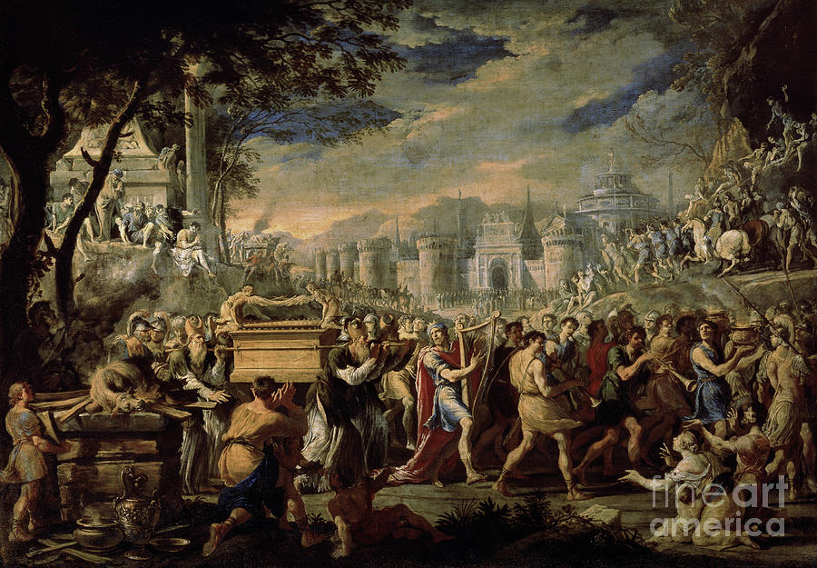
The Ark of YHWH comes to Jerusalem
II Sam. 6
David attempts to bring the Ark from the house of Abinadab to Jerusalem
The ark is not moved properly and Uzzah is killed trying to steady it (the ark is Holy and powerful – treat it properly)
After a respite, David tries again following God’s commands (successful)
David leads the celebration and sacrifice – all Israel join
Michal, Saul’s daughter and David’s wife, thinks David’s celebration is undignified but David doesn’t care!

Slide 8
David offers to build a temple to YHWH
II Sam. 7
David enjoys a period of peace and decides he wants to build a temple [house] to YHWH
Informs Nathan his prophet
YHWH gives Nathan different instructions
YHWH says He did not ask for a temple
He has been with David and blessed him & promises to make his name great
And promises that his house [lineage] will live forever
Not only is this a promise for a family dynasty but also a Messianic prophesy
“‘The Lord declares to you that the Lord himself will establish a house for you: ¹² When your days are over and you rest with your ancestors, I will raise up your offspring to succeed you, your own flesh and blood, and I will establish his kingdom. ¹³ He is the one who will build a house for my Name, and I will establish the throne of his kingdom forever. ¹⁴ I will be his father, and he will be my son. When he does wrong, I will punish him with a rod wielded by men, with floggings inflicted by human hands. ¹⁵ But my love will never be taken away from him, as I took it away from Saul, whom I removed from before you. ¹⁶ Your house and your kingdom will endure forever before me^{[b]}; your throne will be established forever.’”

Slide 9
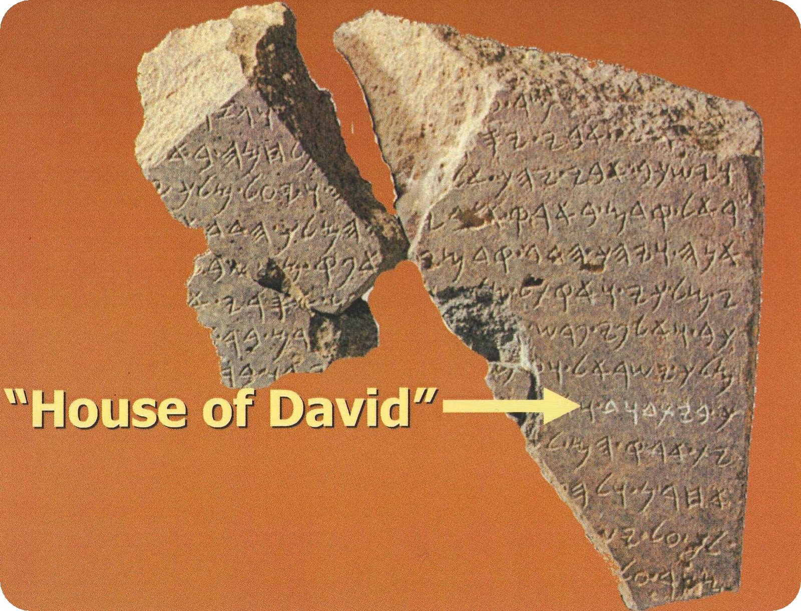
The Covenants
Abrahamic covenant (Gen. 12):
  Land – specific territory
  Great nation
  Name will be great
  All nations blessed through Abraham
Mosaic covenant (Ex. 19-):
  Given at Mt. Sinai to nation of Israel
  Nation will be set apart – a special treasure
  A kingdom of priests and example to other nations
  Includes the 10 Commandments
  Includes blessings and curses
Davidic covenant (II Sam. 7):
  Reaffirmed the land
  David’s offspring will build the temple
  David’s dynasty will continue forever
  The Messiah to bless all nations will be a descendant of David

Slide 10
David’s prayer
II Sam. 7
^{18b}“Who am I, Sovereign Lord, and what is my family, that you have brought me this far? ¹⁹ And as if this were not enough in your sight, Sovereign Lord, you have also spoken about the future of the house of your servant—and this decree, Sovereign Lord, is for a mere human!^{[c] …}
²² “How great you are, Sovereign Lord! There is no one like you, and there is no God but you, as we have heard with our own ears. ²³ And who is like your people Israel—the one nation on earth that God went out to redeem as a people for himself, and to make a name for himself, and to perform great and awesome wonders by driving out nations and their gods from before your people, whom you redeemed from Egypt?^{[d]} ²⁴ You have established your people Israel as your very own forever, and you, Lord, have become their God. …
²⁷ “Lord Almighty, God of Israel, you have revealed this to your servant, saying, ‘I will build a house for you.’ So your servant has found courage to pray this prayer to you. ²⁸ Sovereign Lord, you are God! Your covenant is trustworthy, and you have promised these good things to your servant. ²⁹ Now be pleased to bless the house of your servant, that it may continue forever in your sight; for you, Sovereign Lord, have spoken, and with your blessing the house of your servant will be blessed forever.”

Slide 11
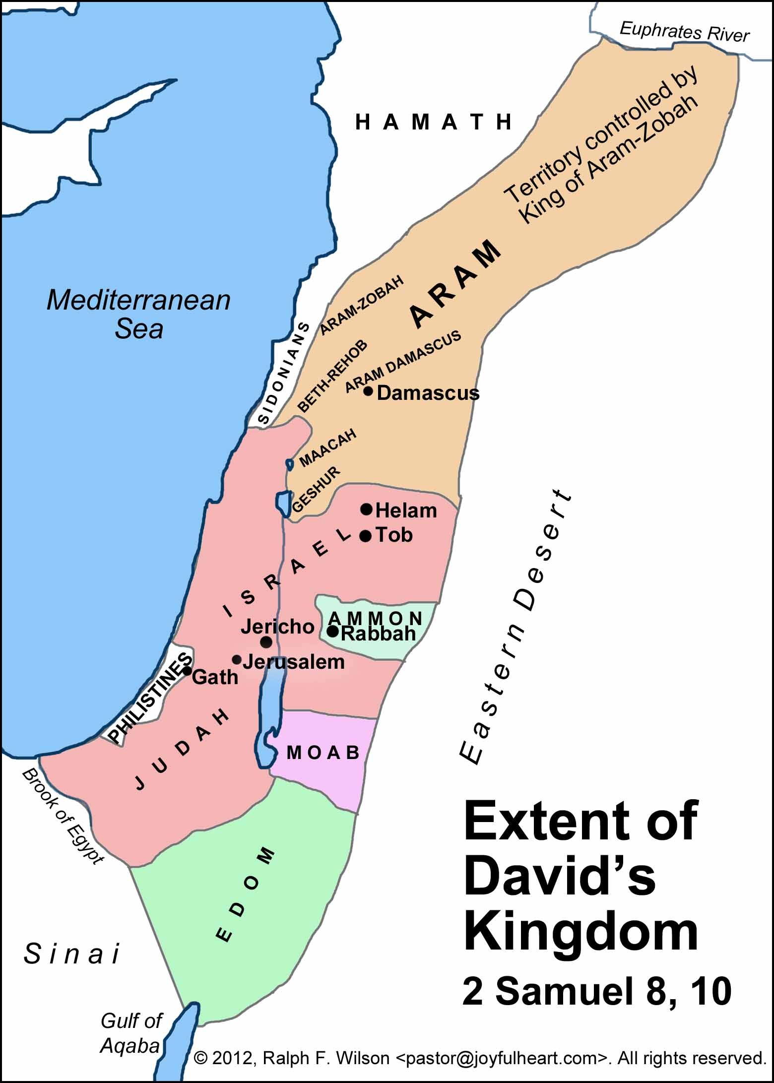
David as Righteous King
II Sam. 8-10
David ruled as a just and righteous King
During his reign David defeats the Philistines, Moabites, Arameans, Edomites & Ammonites
The Lord gave David victory wherever he went.
David asked, “Is there anyone still left of the house of Saul to whom I can show kindness for Jonathan’s sake?”
Jonathan had a son, Mephibosheth who became disabled at a young age
David brings Mephibosheth and his entire family to “eat at David’s table”

Slide 12
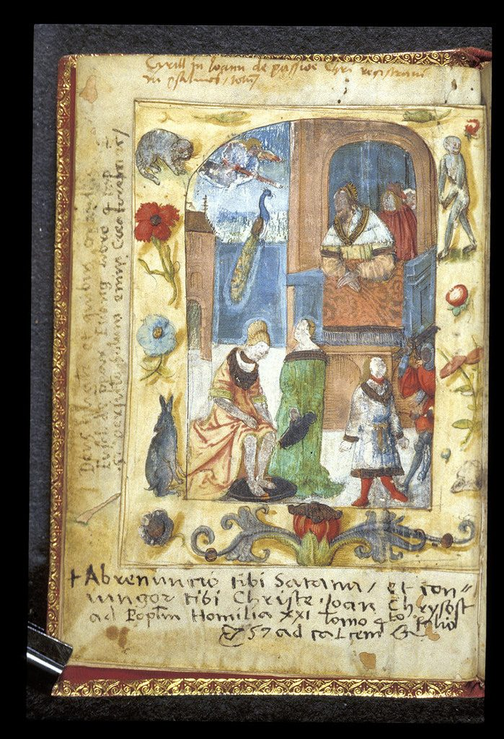
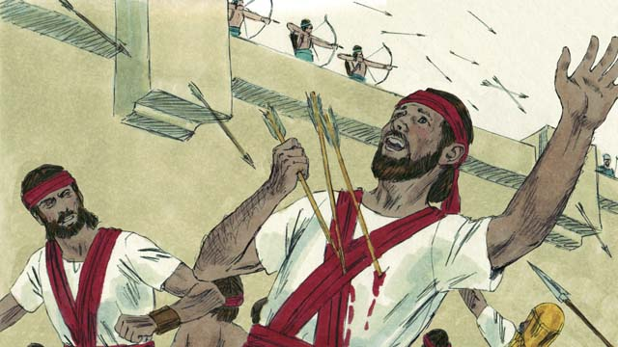
David and Bathsheba
II Sam. 11
In the spring, at the time when kings go off to war, David sent Joab out with the king’s men and the whole Israelite army… but David remained in Jerusalem
David sees Bathsheba bathing, sends officials who take her and sleeps with her (Gen 2)
Bathsheba becomes pregnant and sends word to David
David attempts to cover up his sin by having Uriah her husband spend the night with Bathsheba
Failing this, David has Uriah killed in battle (involves Joab in conspiracy)
Then David takes Bathsheba as a wife
This Photo by Unknown Author is licensed under CC BY
This Photo by Unknown Author is licensed under CC BY-SA

Slide 13
David is rebuked
II Sam. 12
‘It is I who anointed you king over Israel and it is I who delivered you from the hand of Saul. ⁸ I also gave you your master’s house and your master’s wives into your care, and I gave you the house of Israel and Judah; and if that had been too little, I would have added to you many more things like these! ⁹ Why have you despised the word of the Lord by doing evil in His sight? You have struck down Uriah the Hittite with the sword, have taken his wife to be your wife, and have killed him with the sword of the sons of Ammon. ¹⁰ Now therefore, the sword shall never depart from your house, because you have despised Me and have taken the wife of Uriah the Hittite to be your wife.’ ¹¹ Thus says the Lord, ‘Behold, I will raise up evil against you from your own household; I will even take your wives before your eyes and give them to your companion, and he will lie with your wives in broad daylight. ¹² Indeed you did it secretly, but I will do this thing before all Israel, and under the sun.’” ¹³ Then David said to Nathan, “I have sinned against the Lord.” And Nathan said to David, “The Lord also has taken away your sin; you shall not die. ¹⁴ However, because by this deed you have given occasion to the enemies of the Lord to blaspheme, the child also that is born to you shall surely die.”
Nathan uses a parable to rebuke David – why have you done this?
David shows remorse but acknowledges his sin
The Lord issues his punishment
David will not die but the unborn child will
David will also experience rebellion from within his house
David laments the loss of his child

Slide 14
Family trouble begins
II Sam. 13-14
Amnon one of David’s sons lusts after his half-sister, Tamar and eventually rapes her
David is angry but does nothing
Absolom, Tamar’s full brother plots and has Amnon killed
Absolom flees Jerusalem and goes to Geshur for 3 years
Joab (David’s army commander) convinces David to allow Absolom to return, which he does
But another 2 years pass before Absolom they finally reconcile
³⁹ The heart of King David longed to go out to Absalom; for he was comforted concerning Amnon, since he was dead.
³³ So when Joab came to the king and told him, he called for Absalom. Thus he came to the king and prostrated himself on his face to the ground before the king, and the king kissed Absalom.

Slide 15
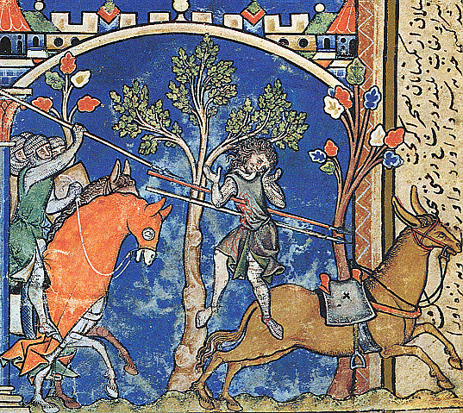
Absolom’s coup
Absolom deliberately (years) wins over the hearts of Israel under the nose of David
He asks David for permission to go to Hebron and further strengthens his following
Absolom then initiates a coup
David is informed and flees Jerusalem with his household, advisors and army (except 10 concubines)
David goes into hiding (again)
Absolom returns to Jerusalem and sleeps with David’s concubines (sign of rebellion)
Absolom also attacks his father – war ensues but David tells his army not to harm Absolom
Joab eventually kills Absolom
David returns to Jerusalem – a broken man
³⁰ But David continued up the Mount of Olives, weeping as he went; his head was covered and he was barefoot. All the people with him covered their heads too and were weeping as they went up.
³³ The king was shaken. He went up to the room over the gateway and wept. As he went, he said: “O my son Absalom! My son, my son Absalom! If only I had died instead of you—O Absalom, my son, my son!”^{[g]}

Slide 16
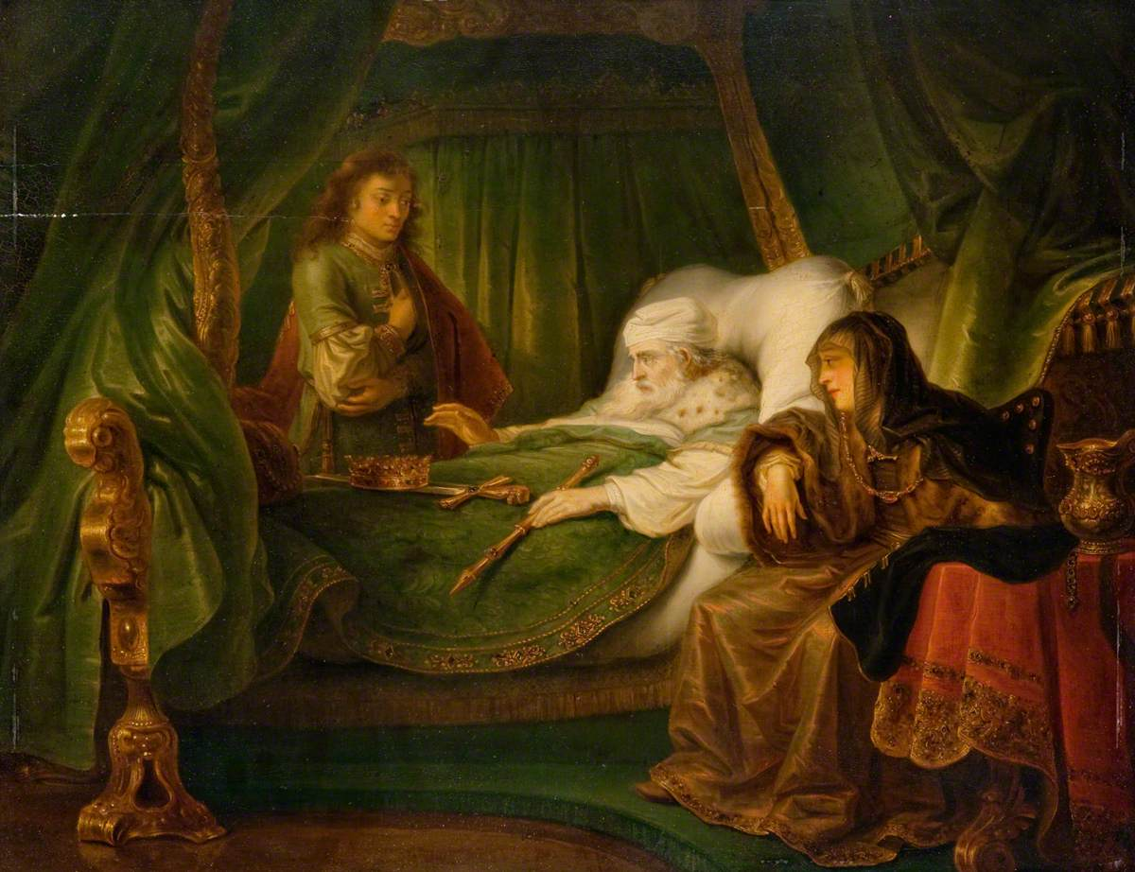
David makes Soloman King
In David’s final days, Adonijah sets himself up as the next King
Nathan advises Bathsheba, Soloman’s mother of the situation
Palace intrigue ensues
David names Soloman as the next King
More palace intrigue but Soloman has Adonijah killed
On his death bed, David admonishes Soloman to follow YHWH’s commands (so I will always have a successor on the throne)
David also settles old scores and convinces Soloman to kill Joab among others
Soloman takes over as King of the united Kingdom

Slide 17
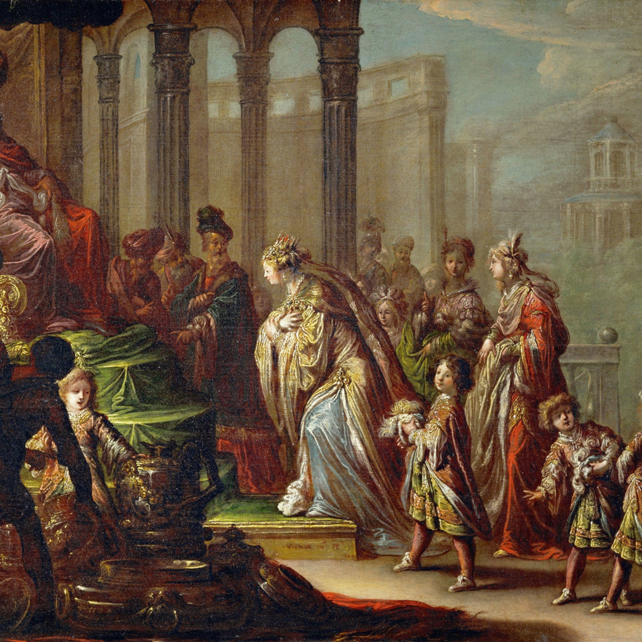
Soloman asks for wisdom – his rise
YHWH appears to Soloman in a dream and offers to give him whatever he wants
Soloman chooses discernment (wisdom) to govern Israel
God grants his request but also gives Soloman wealth and honor (stories included that illustrate this)
And IF he follows the ways of his father, a long life
Soloman rules with wisdom and knowledge - Proverbs
He also accumulates wealth and levees heavy taxes
His Kingdom was Israel’s zenith and his rule was largely peaceful

Slide 18
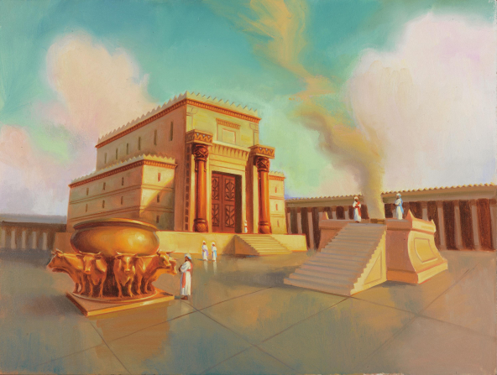
Soloman builds the temple
Soloman follows up on David’s initiative and collects timber and other material
He also conscripted laborers
YHWH promises to live among His people if Soloman remains faithful
Soloman takes 7 years to build a magnificent temple, grounds, and furnishings
Soloman dedicates the temple with a massive offering and celebration
But Soloman also spends more time building his palace and grounds, while accumulating chariots and horses …
This Photo by Unknown Author is licensed under CC BY-SA-NC

Slide 19
YHWH’s promise
I Kings 9
When Solomon had finished building the temple of the Lord and the royal palace, and had achieved all he had desired to do, ² the Lord appeared to him a second time, as he had appeared to him at Gibeon. ³ The Lord said to him:
“I have heard the prayer and plea you have made before me; I have consecrated this temple, which you have built, by putting my Name there forever. My eyes and my heart will always be there.
⁴ “As for you, if you walk before me faithfully with integrity of heart and uprightness, as David your father did, and do all I command and observe my decrees and laws, ⁵ I will establish your royal throne over Israel forever, as I promised David your father when I said, ‘You shall never fail to have a successor on the throne of Israel.’
⁶ “But if you^{[a]} or your descendants turn away from me and do not observe the commands and decrees I have given you^{[b]} and go off to serve other gods and worship them, ⁷ then I will cut off Israel from the land I have given them and will reject this temple I have consecrated for my Name. Israel will then become a byword and an object of ridicule among all peoples. ⁸ This temple will become a heap of rubble. All^{[c]} who pass by will be appalled and will scoff and say, ‘Why has the Lord done such a thing to this land and to this temple?’ ⁹ People will answer, ‘Because they have forsaken the Lord their God, who brought their ancestors out of Egypt, and have embraced other gods, worshiping and serving them—that is why the Lord brought all this disaster on them.’”

Slide 20
Soloman’s tragic downfall
I Kings 11
Soloman turned away!
Did not follow as David had done
He eventually built alters to gods associated with child sacrifice!
YHWH raised up adversaries – including Jeroboam who was an official
Soloman tries to kill Jeroboam
Soloman dies after a relatively long reign
King Solomon, however, loved many foreign women besides Pharaoh’s daughter—Moabites, Ammonites, Edomites, Sidonians and Hittites.² They were from nations about which the Lord had told the Israelites, “You must not intermarry with them, because they will surely turn your hearts after their gods.” Nevertheless, Solomon held fast to them in love. ³ He had seven hundred wives of royal birth and three hundred concubines, and his wives led him astray. ⁴ As Solomon grew old, his wives turned his heart after other gods, and his heart was not fully devoted to the Lord his God, as the heart of David his father had been. ⁵ He followed Ashtoreth the goddess of the Sidonians, and Molek the detestable god of the Ammonites. ⁶ So Solomon did evil in the eyes of the Lord; he did not follow the Lord completely, as David his father had done.
⁷ On a hill east of Jerusalem, Solomon built a high place for Chemosh the detestable god of Moab, and for Molek the detestable god of the Ammonites. ⁸ He did the same for all his foreign wives, who burned incense and offered sacrifices to their gods.

Slide 21

The Big Picture
The nation of Israel has been given the promised land
But they have not followed YHWH’s commands and adopt pagan practices
They ask for a King – they need a Godly leader
Saul – who outwardly appears fit for the role is not suitable and has the Kingdom take away
David – is not outwardly noteworthy is selected
David is a man after God’s own heart, falls to the trappings of power and sins badly
Solomon - initially appears on the right path, achieving wisdom, fame and wealth
Soloman also disobeys and falls away – initiating pagan worship in the Kingdom
God continues to support His people in spite of their rebellion – begin to see hints of a future Messiah

Slide 22
Comparison of Samuel/Kings & Chronicles
I/II Samuel & I/II Kings
I/II Chronicles
Longer description of events of Israel
Gives details on Northern and Southern Kingdoms
Details the idolatry leading to the exile(s)
POV before the Babylonian exile
Shorter
Focused on the Southern Kingdom
POV from after return from exile
More favorable description of David and Soloman – avoids David’s sin
Gives more detail on the temple
Highlights the continuing lineage of David

Slide 23
Backup slides

Slide 24
II Samuel topics
David and Bathsheba
David rebuked by Nathan
Amnon and Tamar/Absalom
Absalom returns to Jerusalem
Absalom conspiracy/David flees
David on run
Absalom death
David mourns
David returns to Jerusalem
Sheba rebels against David
Wars against Philistines
David’s song of praise
David’s last words/Mighty men
David builds alter
David Laments for Saul
David anointed King of Judah; Civil war
Abner goes over to David/Joab murders Abner
Ish-Bosheth murdered
David King of Israel/Conquers Jerusalem
David brings the ark to Jerusalem
God’s covenant with David
David’s victories
David and Mephibosheth
David defeats Ammonites

