Slide 1
Introduction to the Old Testament: Class 10 – I Samuel (Samuel, Saul & David)
July 6th, 2025
Tim Theiss & Derek Dunbar

Slide 2
Class schedule
1 | Introduction/Creation | Tim | May 4th
2 | The Fall & flood | Tim | May 11th
3 | Abram/Abraham | Derek | May 18th
4 | Jacob & Issac | Derek | May 25th
5 | Joseph | Derek | June 1st
6 | Moses – the Exodus | Tim | June 8th
7 | Moses – The Law | Derek | June 15th
8 | Wilderness wanderings – the Pentateuch | Derek | June 22nd
9 | Joshua, Judges & Ruth | Tim | June 29th
10 | Samuel, Saul & David – I Samuel | Tim | July 6th
11 | David as King & Soloman | Tim | July 13th
12 | Wisdom Literature (poetry) | Bill Brosey | July 20th
13 | The Divided Kingdom | Tim | July 27th
14 | Major & Minor prophets | Tim | Aug 3rd
15 | Daniel – the Exile | Derek | Aug 10th
16 | Ezra/Nehemiah – return from Exile | Derek | Aug 17th
17 | Q&A – wrap up | Both | Aug 24th

Slide 3
Last week/Recap … Joshua, Judges & Ruth
YHWH is fulfilling His Covenant – the Israelites have now entered the promised land
YHWH continues to support Joshua and Israel and gives them military success over the pagan nations living in the land – tribal boundaries are set
But the Israelites do not continue to drive out the Canaanites as commanded … and adopt their vile pagan practices
Israel falls into an ever-increasing spiral of idolatry and departure of God’s commands
Judges points to a need for a righteous leader
Ruth provides a counterpoint that all is not lost – good character can prevail
And details how Ruth, a Moabite becomes an ancestor of King David

Slide 4
The birth of Samuel I Sam. 1
Elkanah has two wives: Peninnah & Hannah
Peninnah has children but Hannah does not and is provoked because of it
Where have we seen his already?
Hannah takes her petition to the Lord and begs for a child and pledges to dedicate him to the Lord (Nazarite vow – same as Samson)
The Lord grants her request, and Hannah has a son, named Samuel
Hannah honors her vow and takes young Samuel to Eli, the priest, who raises Samuel
Hannah later has 3 more sons and 2 daughters

Slide 5
Hannah’s prayer 1 Sam. 2
⁸“For the foundations of the earth are the Lord’s; on them he has set the world. ⁹ He will guard the feet of his faithful servants, but the wicked will be silenced in the place of darkness.
“It is not by strength that one prevails; ¹⁰ those who oppose the Lord will be broken. The Most High will thunder from heaven; the Lord will judge the ends of the earth.
“He will give strength to his king and exalt the horn of his anointed.”
“My heart rejoices in the Lord; in the Lord my horn^{[a]} is lifted high. My mouth boasts over my enemies, for I delight in your deliverance.
² “There is no one holy like the Lord; there is no one besides you; there is no Rock like our God.
³ “Do not keep talking so proudly or let your mouth speak such arrogance, for the Lord is a God who knows, and by him deeds are weighed.
…

Slide 6
Samuel becomes the priest I Sam. 2-4
Eli’s sons who are slated to be priests are wicked and corrupt – disregard for their task and God
God curses them and the house of Eli (all descendants to die) – his sons are prophesied to die the same day
Samuel grew and continued to minister to the Lord ^{3:26} And the boy Samuel continued to grow in stature and in favor with the Lord and with people.
Samuel is called by YHWH ^{4:19} The Lord was with Samuel as he grew up, and he let none of Samuel’s words fall to the ground. ²⁰ And all Israel from Dan to Beersheba recognized that Samuel was attested as a prophet of the Lord. ²¹ The Lord continued to appear at Shiloh, and there he revealed himself to Samuel through his word.

Slide 7
Capture of the Ark of YHWH I Sam. 4 -
Israel is warring with the Philistines
The Philistines won a battle causing Israel to bring the Ark of the Covenant out with them at their next battle – Eli’s sons are implicated
When they learned that the ark of the Lord had come into the camp, ⁷ the Philistines were afraid. “A god has^{[a]} come into the camp,” they said. “Oh no! Nothing like this has happened before. ⁸ We’re doomed! Who will deliver us from the hand of these mighty gods? They are the gods who struck the Egyptians with all kinds of plagues in the wilderness. ⁹ Be strong, Philistines! Be men, or you will be subject to the Hebrews, as they have been to you. Be men, and fight!”
But the Philistines rally and prevail over Isreal (decisively) and capture the ark of YHWH
Eli’s sons and both killed and Eli also dies when told about his sons and the Ark

Slide 8
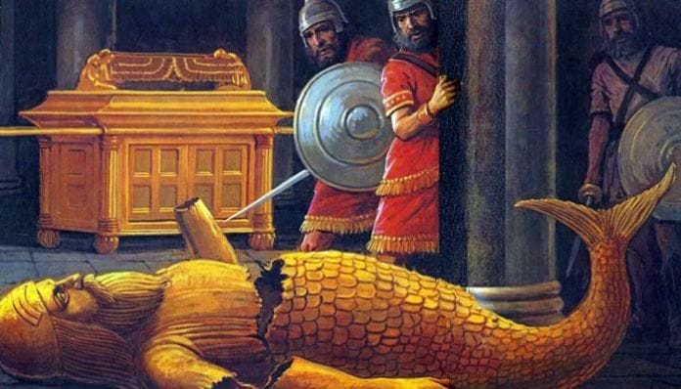
The Ark of YHWH in Philistia - I Sam. 5-6
The Philistines carry the Ark of YWHW to Ashdod and place it in the temple of their God, Dagon
This Photo by Unknown Author is licensed under CC BY-NC-ND
YHWH destroys the idol of Dagon and strikes the Philistines with plagues of tumors
The Ark of YHWH was then moved to Gath, then Ekron – same story!
The Philistines are ready to get rid of the ark & their priests give specific instructions
The ark is sent to the Israelite town of Beth Shemesh – Levites take control and offer sacrifices to YWHW
But many in Beth Shemesh are struck down because they looked within the ark
The ark is then sent to Kiriath Jearim who consecrate a priest to guard the ark, where it remains for 20 years

Slide 9
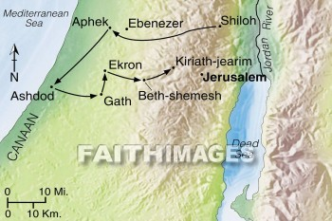
Key points!
The Ark of YHWH is YHWH’s resting place on earth and is Holy and is to be treated as such – both Israel and Philistia learn this the hard way
God has established a Covenant with Israel but is not on “their” side; they are to fulfill their Covenant obligations
YHWH shows His dominance over the pagan gods of the region
But it also looks as if Israel is not giving the Ark of YHWH the respect it deserves!

Slide 10
Israel prevails over the Philistines I Sam. 7
^{2b} Then all the people of Israel turned back to the Lord. ³ So Samuel said to all the Israelites, “If you are returning to the Lord with all your hearts, then rid yourselves of the foreign gods and the Ashtoreths and commit yourselves to the Lord and serve him only, and he will deliver you out of the hand of the Philistines.” ⁴ So the Israelites put away their Baals and Ashtoreths, and served the Lord only.
Samuel intercedes for Israel and defeat the Philistines
¹³ So the Philistines were subdued and they stopped invading Israel’s territory. Throughout Samuel’s lifetime, the hand of the Lord was against the Philistines. ¹⁴ The towns from Ekron to Gath that the Philistines had captured from Israel were restored to Israel, and Israel delivered the neighboring territory from the hands of the Philistines. And there was peace between Israel and the Amorites.
¹⁵ Samuel continued as Israel’s leader all the days of his life.

Slide 11
Israel asks for a King I Sam. 8
When Samuel grew old, he appointed his sons as Israel’s leaders.^{[a]} ² The name of his firstborn was Joel and the name of his second was Abijah, and they served at Beersheba. ³ But his sons did not follow his ways. They turned aside after dishonest gain and accepted bribes and perverted justice.
⁴ So all the elders of Israel gathered together and came to Samuel at Ramah. ⁵ They said to him, “You are old, and your sons do not follow your ways; now appoint a king to lead^{[b]} us, such as all the other nations have.”
At least part of the reason, Israel asked for a King is because Samuel’s son’s were wicked
⁶ But when they said, “Give us a king to lead us,” this displeased Samuel; so he prayed to the Lord. ⁷ And the Lord told him: “Listen to all that the people are saying to you; it is not you they have rejected, but they have rejected me as their king. ⁸ As they have done from the day I brought them up out of Egypt until this day, forsaking me and serving other gods, so they are doing to you. ⁹ Now listen to them; but warn them solemnly and let them know what the king who will reign over them will claim as his rights.”
Samuel tries to convince Israel but they persist
²² The Lord answered, “Listen to them and give them a king.”

Slide 12
Samuel anoints Saul as King of Israel I Sam. 9-10
YHWH informs Samuel that he is to meet Saul, a Benjamite, and anoint him as King – which he does
Kish had a son named Saul, as handsome a young man as could be found anywhere in Israel, and he was a head taller than anyone else.
Samuel gives Saul specific instructions on what to do next and prophesies the spirit of God will come upon him
⁹ As Saul turned to leave Samuel, God changed Saul’s heart, and all these signs were fulfilled that day
¹⁷ Samuel summoned the people of Israel to the Lord at Mizpah ¹⁸ and said to them, “This is what the Lord, the God of Israel, says: ‘I brought Israel up out of Egypt, and I delivered you from the power of Egypt and all the kingdoms that oppressed you.’ ¹⁹ But you have now rejected your God, who saves you out of all your disasters and calamities. And you have said, ‘No, appoint a king over us.’ So now present yourselves before the Lord by your tribes and clans.”
Saul was shown (by lot) as King but was hiding when selected
These texts are difficult to interpret but it appears that Saul is not stepping up as expected as King, although he does have military success

Slide 13
Samuel’s farewell address I Sam. 12
Samuel addresses Israel in his old age
All agree that Samuel has not been corrupt
Samuel gives history of Isreal and deliverance from several enemies
Chastises Israel for asking for a king (YHWH is supposed to be your king)
Samuel calls on YHWH to bring thunder and rain, which causes Israel to repent
Outlines blessings and curses for Israel
Israel asks for YHWH’s mercy
²⁰ “Do not be afraid,” Samuel replied. “You have done all this evil; yet do not turn away from the Lord, but serve the Lord with all your heart. ²¹ Do not turn away after useless idols. They can do you no good, nor can they rescue you, because they are useless. ²² For the sake of his great name the Lord will not reject his people, because the Lord was pleased to make you his own.²³ As for me, far be it from me that I should sin against the Lord by failing to pray for you. And I will teach you the way that is good and right. ²⁴ But be sure to fear the Lord and serve him faithfully with all your heart; consider what great things he has done for you. ²⁵ Yet if you persist in doing evil, both you and your king will perish.”

Slide 14
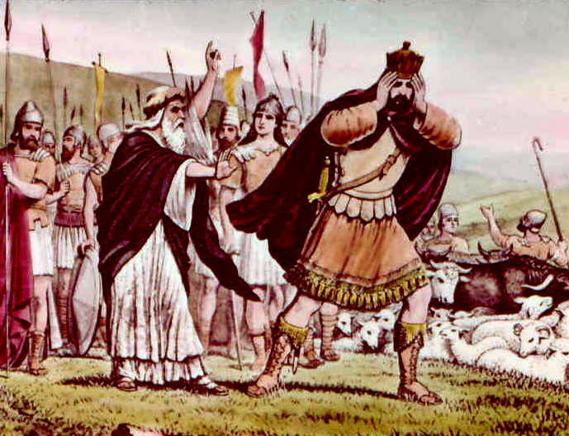
Samuel rebukes Saul I Sam. 13-14
Saul and his son, Jonathan are battling the Philistines
Israel becomes afraid and hides
Saul eventually offers sacrifices himself instead of waiting for Samuel
Saul and Jonathan continue to fight the Philistines
Samuel rebukes Saul
¹³ “You have done a foolish thing,” Samuel said. “You have not kept the command the Lord your God gave you; if you had, he would have established your kingdom over Israel for all time. ¹⁴ But now your kingdom will not endure; the Lord has sought out a man after his own heart and appointed him ruler of his people, because you have not kept the Lord’s command.”

Slide 15
Saul rejected as King I Sam. 15
Saul instructed to totally destroy the Amalekites
Saul attacks them but spares the life of their King and choice livestock
Samuel confronts Saul who blames his men
Samuel tells Saul that the Kingdom will leave his family
Saul begs for forgives but appears more concerned with his reputation with man than with God
Saul’s behavior goes from bad to worse as he spirals out of control
¹⁰ Then the word of the Lord came to Samuel: ¹¹ “I regret that I have made Saul king, because he has turned away from me and has not carried out my instructions.” Samuel was angry, and he cried out to the Lord all that night.
“Saul has gone to Carmel. There he has set up a monument in his own honor and has turned and gone on down to Gilgal.”
³⁴ Then Samuel left for Ramah, but Saul went up to his home in Gibeah of Saul. ³⁵ Until the day Samuel died, he did not go to see Saul again, though Samuel mourned for him. And the Lord regretted that he had made Saul king over Israel.

Slide 16
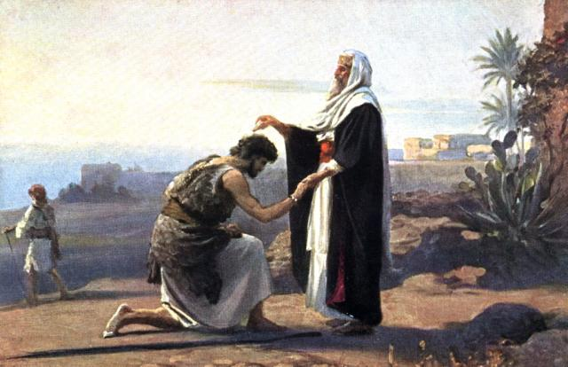
Samuel anoints David I Sam. 16
Samuel instructed to go to house of Jesse and anoint the new King
David, the youngest selected – unusual but we have seen this pattern before!
YHWH looks upon the heart!
David then called up to comfort Saul by playing the lyre
Skipping David and Goliath … Chp. 17
This Photo by Unknown Author is licensed under CC BY-NC-ND
The Lord said to Samuel, “How long will you mourn for Saul, since I have rejected him as king over Israel? Fill your horn with oil and be on your way; I am sending you to Jesse of Bethlehem. I have chosen one of his sons to be king.”
⁷ But the Lord said to Samuel, “Do not consider his appearance or his height, for I have rejected him. The Lord does not look at the things people look at. People look at the outward appearance, but the Lord looks at the heart.”
¹³ So Samuel took the horn of oil and anointed him in the presence of his brothers, and from that day on the Spirit of the Lord came powerfully upon David.

Slide 17
Saul fears David I Sam. 18-19
¹⁰ The next day an evil^{[a]} spirit from God came forcefully on Saul. He was prophesying in his house, while David was playing the lyre, as he usually did. Saul had a spear in his hand ¹¹ and he hurled it, saying to himself, “I’ll pin David to the wall.” But David eluded him twice.
¹² Saul was afraid of David, because the Lord was with David but had departed from Saul.
²⁸ When Saul realized that the Lord was with David and that his daughter Michal loved David, ²⁹ Saul became still more afraid of him, and he remained his enemy the rest of his days.
David and Jonathan develop a deep friendship – establish a covenant
David has military success which makes Saul jealous
Saul’s jealousy turns to fear, then rage – tries to kill David (multiple times)
David’s military prowess grows
David marries Saul’s daughter, Michal (David proves his worth by slaying 200 Philistines)
Saul’s fear grows, David’s humility remains and his success grows
This cycle continues – Jonathan and Michal both aid David

Slide 18
David flees Saul I Sam. 20 - 23
David goes to Nob and takes consecrated bread from Ahimelek the priest – clear violation of law but mentioned by Jesus as acceptable
An Edomite witnesses this and tells Saul, who orders the priest killed
The guards refuse but the Edomite kills 85 priests and the entire town of Nob (Abiathar escapes)
David goes to Gath in Philistia and pretends to be insane
David flees and hides in a cave
Cat and mouse game continues …
Psalm 57
Have mercy on me, my God, have mercy on me, for in you I take refuge. I will take refuge in the shadow of your wings until the disaster has passed.
…
I will praise you, Lord, among the nations; I will sing of you among the peoples. ¹⁰ For great is your love, reaching to the heavens; your faithfulness reaches to the skies.
¹¹ Be exalted, O God, above the heavens; let your glory be over all the earth.

Slide 19
David spares Saul’s life – twice! I Sam. 24, 26
Saul pursues David in En Gedi and enters the cave with David deep inside
David cuts off a corner of Saul’s robe but spares his life
Saul leaves but David calls out to him and reveals he could’ve killed him
Saul claims David is more righteous
David has a similar encounter at Gibeah
Again, spares Saul life and promises not to harm Saul’s family
¹⁶ When David finished saying this, Saul asked, “Is that your voice, David my son?” And he wept aloud. ¹⁷ “You are more righteous than I,” he said. “You have treated me well, but I have treated you badly. ¹⁸ You have just now told me about the good you did to me; the Lord delivered me into your hands, but you did not kill me. ¹⁹ When a man finds his enemy, does he let him get away unharmed? May the Lord reward you well for the way you treated me today. ²⁰ I know that you will surely be king and that the kingdom of Israel will be established in your hands. ²¹ Now swear to me by the Lord that you will not kill off my descendants or wipe out my name from my father’s family.”
²² So David gave his oath to Saul.

Slide 20
David among the Philistines I Sam. 27-30
David has married Abigail, widow of Nabal and Ahinoam (Michal was given to another man)
David decides to live among the Philistines and winds up in Ziklag
David and his band of men raid various nearby towns
Achish (king of Gath) thinks that David is an ally
Achish includes David to battle against Israel
Philistine military object and David is sent back
While away, the Amelekites raid Ziklag, destroy the town and take many hostages
David inquires of YHWH and pursues the Amelekites
David destroys the Amelekites and takes plunder

Slide 21
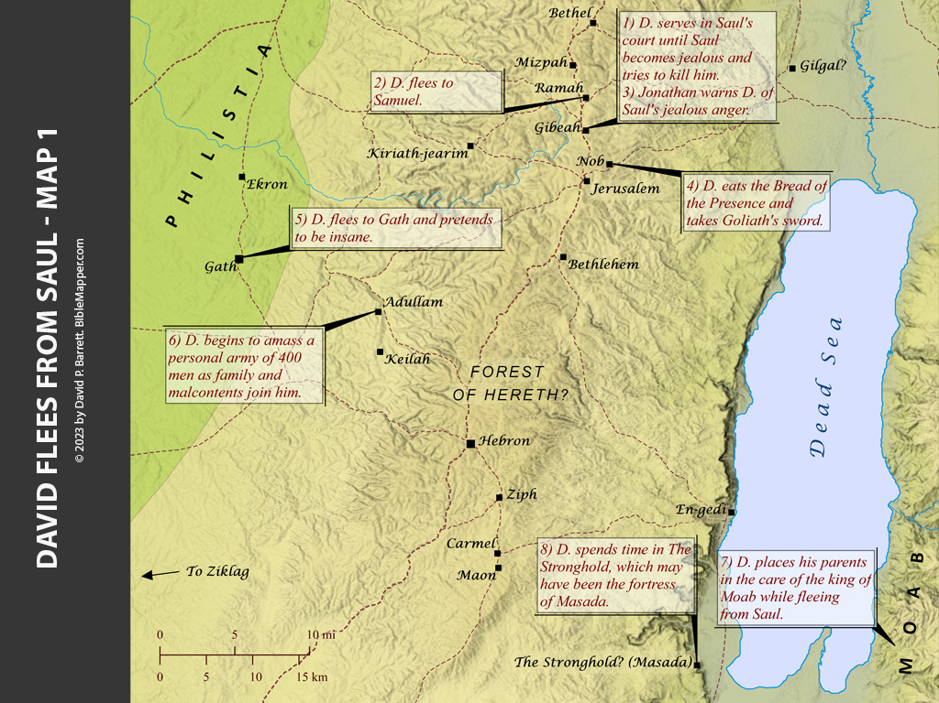

Slide 22
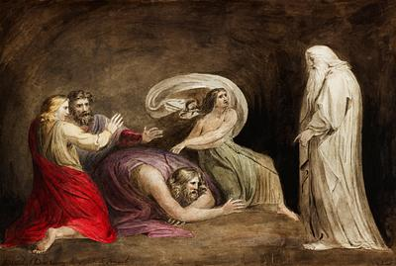
Saul and the medium of Endor I Sam. 28
Samuel has died
Saul is about to battle the Philistines and inquires of YHWH but does not receive an answer
Saul then asks if there is a spirit who he can consult – goes to Endor
The medium brings up Samuel (to her shock)
Saul asks if he will prevail
Samuel chastises Saul and foretells his death (and his sons)
Saul eats, then leaves
¹⁶ Samuel said, “Why do you consult me, now that the Lord has departed from you and become your enemy? ¹⁷ The Lord has done what he predicted through me. The Lord has torn the kingdom out of your hands and given it to one of your neighbors—to David.¹⁸ Because you did not obey the Lord or carry out his fierce wrath against the Amalekites, the Lord has done this to you today.¹⁹ The Lord will deliver both Israel and you into the hands of the Philistines, and tomorrow you and your sons will be with me. The Lord will also give the army of Israel into the hands of the Philistines.”

Slide 23
Saul’s demise I Sam. 31/I Chron. 10
Saul is engaged in battle with the Philistines
They kill his three sons, including Jonathan and wound Saul
Saul falls on his own sword to prevent the Philistines from killing him
Nearby Israelites abandoned their towns – Philistines moved in
Philistines cut off his head and take Saul’s body
Men from Jabesh Gilead take the bodies back and bury their bones
¹³ Saul died because he was unfaithful to the Lord; he did not keep the word of the Lord and even consulted a medium for guidance, ¹⁴ and did not inquire of the Lord. So the Lord put him to death and turned the kingdom over to David son of Jesse.

Slide 24
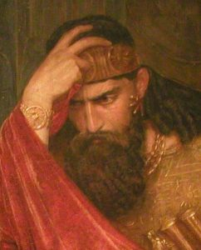
The tragedy of Saul
Saul’s reign seems troubled from the outset
His heart and outlook was flawed – not full devoted to YHWH
Did not follow instructions – defended what was right in his own eyes
Unable to accept criticism and repent
Became concerned with his appearance before man
Failed to obey God’s command to destroy the Amelekites
Grew more desperate as David’s fame and success grows
Tries to kill both David and his own son, Jonathan
Eventually even seeks a medium to try to consult with Samuel
This Photo by Unknown Author is licensed under CC BY

Slide 25
The Big Picture
Samuel, a godly man, is appointed as Judge & Prophet of Israel
The nation struggles with their devotion to YHWH and is continually turned toward pagan idolatry
Israel has rejected YHWH as their sovereign and asked for a King “like the other nations”
Saul appeared to be a good candidate outwardly but did not have a heart devoted to YHWH
I Samuel details Saul’s anointing, his initial rise, his sins and his ultimate demise
Thus, YHWH is giving the Kingdom of Israel to one whose heart is devoted - David, son of Jesse
Through David’s actions and his writings, we see a future King who is ”a man after God’s own heart”
YHWH is fulfilling His promises, but Israel struggles with faithfulness and finding a leader with a heart for YHWH

Slide 26
Backup slides

Slide 27
I Samuel Topics
Birth of Samuel (1-2)
Ark wanderings (I Sam 3, 4, 5)
Death of Eli (I Sam 3)
Philistines – repentance (I Sam 7)
Israel wants a King (I Sam 8)
Samuel anoints Saul (I Sam 9)
Saul made King (I Sam 10)
Saul rescues Jabesh (I Sam 11)
Samuel’s farewell (I Sam 12)
Samuel rebukes Saul (I Sam 13)
Jonathan attacks Philistines (I Sam 13, 14)
Saul rejected as King (I Sam 15)
Samuel anoints David (I Sam 16)
David serves Saul (I Sam 16)
David and Goliath (I Sam 17)
Saul’s fear of David (I Sam 18)
Saul tries to kill David (1 Sam 19)
David and Jonathan (I Sam 20)
David at Nob/Gath
David at Adullum/Saul kills Priests (22)
Saul pursues David (23)
David spares Saul (24/26)
David among the Philistines (27)
Saul and the witch of Endor (28)
Achish sends David to Ziklag (29)
David destroys the Amalekites (30)
Saul takes his life (31)

