Slide 1
An Introduction to the Old Testament
Lesson 1 (Introduction & Creation)
May 4th 2025
Tim Theiss & Derek Dunbar

Slide 2
Goals of this class
New series of classes – Foundations in Christianity
First in series: Introduction to the Old Testament (17 weeks)
Next class: Introduction to the New Testament (17 weeks)
Increase basic knowledge of the Old Testament
Study specific stories within the OT, not just a survey class
Examine the story of the OT and how it relates to the larger arc of the Bible (the meta-narrative or Big Picture)
Learn some of the tools necessary for deeper Bible study
Not a class on apologetics nor history of the Bible

Slide 3
Class schedule (subject to change)
1 | Introduction/Creation | Tim | May 4th
2 | The Fall & flood | Tim | May 11th
3 | Abram/Abraham | Derek | May 18th
4 | Jacob & Issac | Derek | May 25th
5 | Joseph | Derek | June 1st
6 | Moses – Pharoah and the Exodus | Tim | June 8th
7 | Moses – The Law | Derek | June 15th
8 | Wilderness wanderings – the Pentateuch | Derek | June 22nd
9 | Joshua, Judges & Ruth | Tim | June 29th
10 | Samuel, Saul & David’s anointing | Tim | July 6th
11 | David as King – the temple | Tim | July 13th
12 | Soloman & the Divided Kingdom | Tim | July 20th
13 | Wisdom Literature (poetry) | TBD | July 27th
14 | Major & Minor prophets | Tim | Aug 3rd
15 | Daniel – the Exile | Derek | Aug 10th
16 | Ezra/Nehemiah – return from Exile | Derek | Aug 17th
17 | Q&A – wrap up | Both | Aug 24th

Slide 4
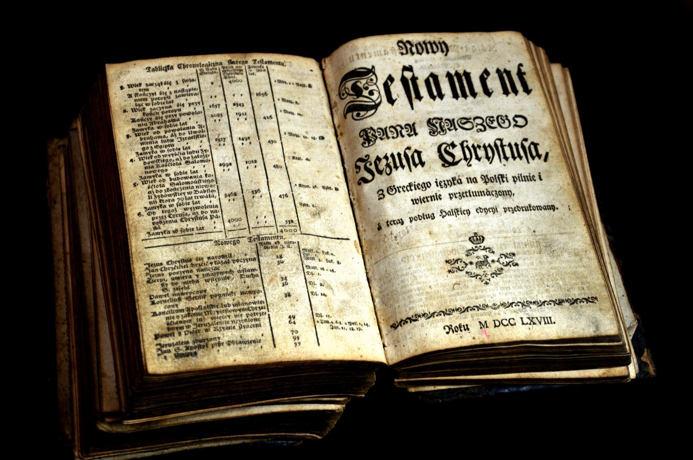
Why study the Old Testament?
Luke 24: 25 – 27
²⁵ Then Jesus said to them, “You foolish people! You find it so hard to believe all that the prophets wrote in the Scriptures. ²⁶ Wasn’t it clearly predicted that the Messiah would have to suffer all these things before entering his glory?” ²⁷ Then Jesus took them through the writings of Moses and all the prophets, explaining from all the Scriptures the things concerning himself.

Slide 5
Something to remember studying OT
We tend to examine OT as primarily a series of children’s stories – often glaze over adult themes
View characters as heros exhibiting strong moral character (like Aesop’s fables for adults)
Tend to focus on the specific stories and the moral lesson in them for us
This is incorrect … the true main character and hero of the OT is the LORD God!
  Given that the Bible is a “unified story that leads to Jesus”, the OT sets the foundation of that unifying event/person in telling us of God’s character, and His desires and plan to be close to His people!

Slide 6
Interpreting OT Hebrew texts
Context is critical! (don’t view as 21st century US)
View the text from perspective of original recipient (culture, language and history matter)
Chapters and verses are helpful but were added much later
Repetition is a tool frequently employed by Hebrew writers to underline important ideas
Narratives often skip over large periods of time and may accelerate or decelerate to highlight certain aspects.
Texts usually do not judge a character's actions as positive or negative, although the storyline may offer insights.
Think of scripture as “meditation literature” – there will always be things we don’t understand
Scripture helps interpret scripture – it is like an onion, not an avocado!

Slide 7
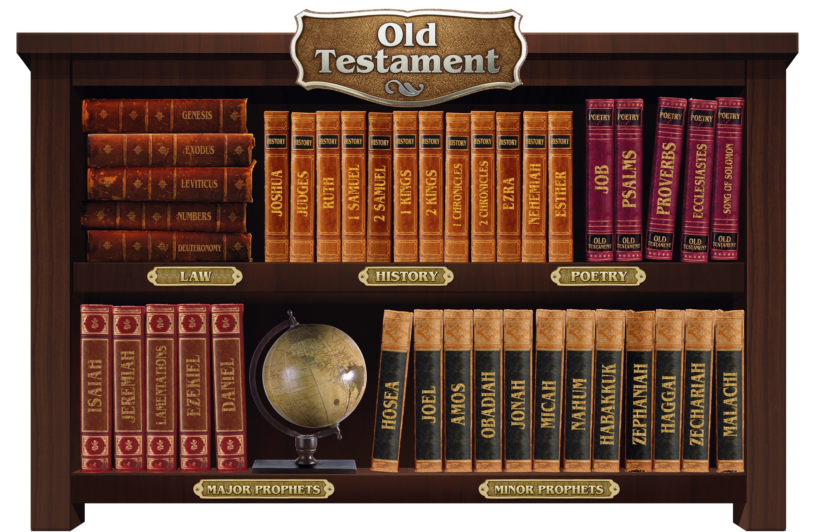
Structure of the Old Testament
OT written in Hebrew from 30+ authors
Over 2/3 of entire Bible
Mostly but not exactly chronological
Styles:
  Law (Pentateuch)
  Narrative (History, Prophets)
  Poetry (aka, Wisdom literature, Prophets)
This Photo by Unknown Author is licensed under CC BY-NC

Slide 8
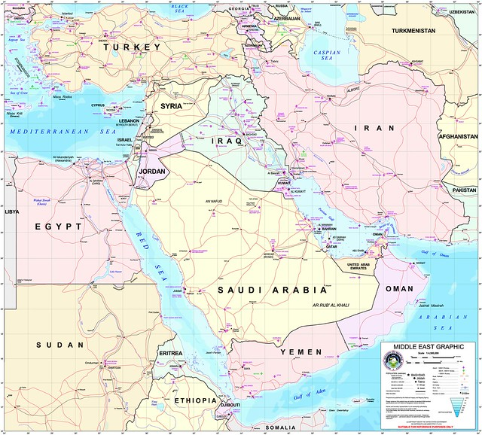
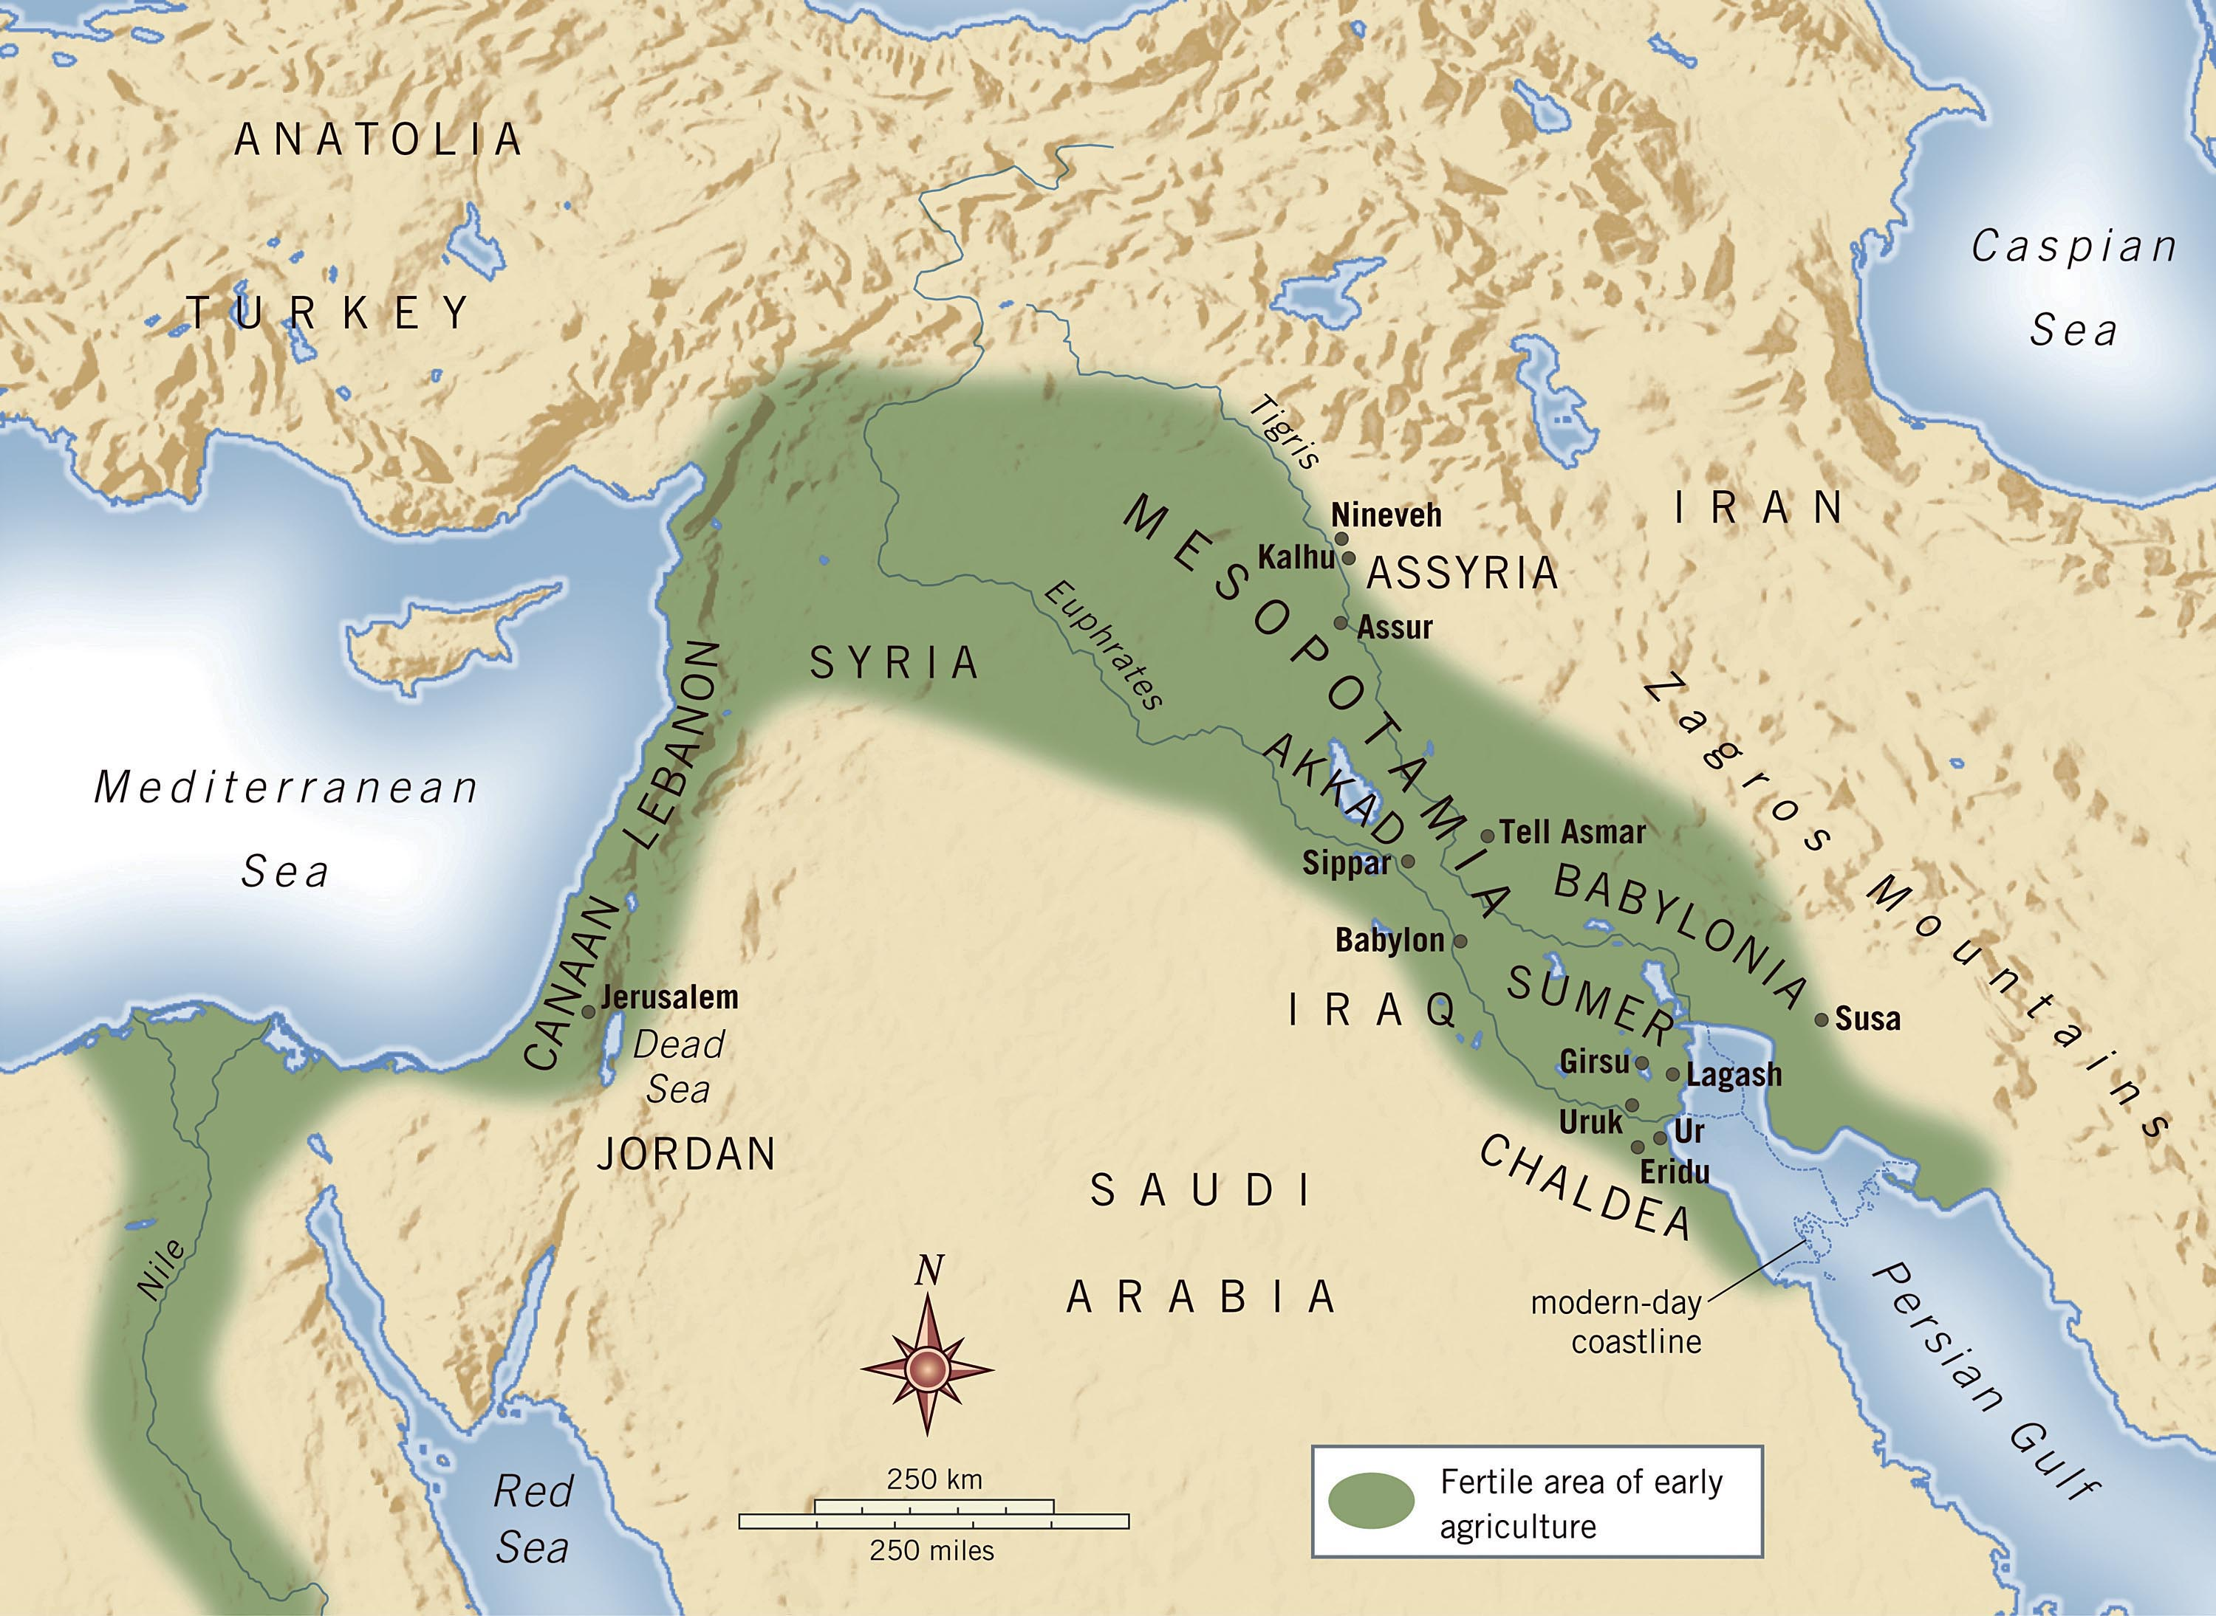
Location
This Photo by Unknown Author is licensed under CC BY
Ancient civilizations
Mostly desert except for land near rivers
  Tigris/Euphrates
  Jordan
  Nile
Assyria/Babylonia - major power of north
Egypt – major power of south
Major trade route – Canaan, Levant, Palestine
This Photo by Unknown Author is licensed under CC BY-SA-NC

Slide 9
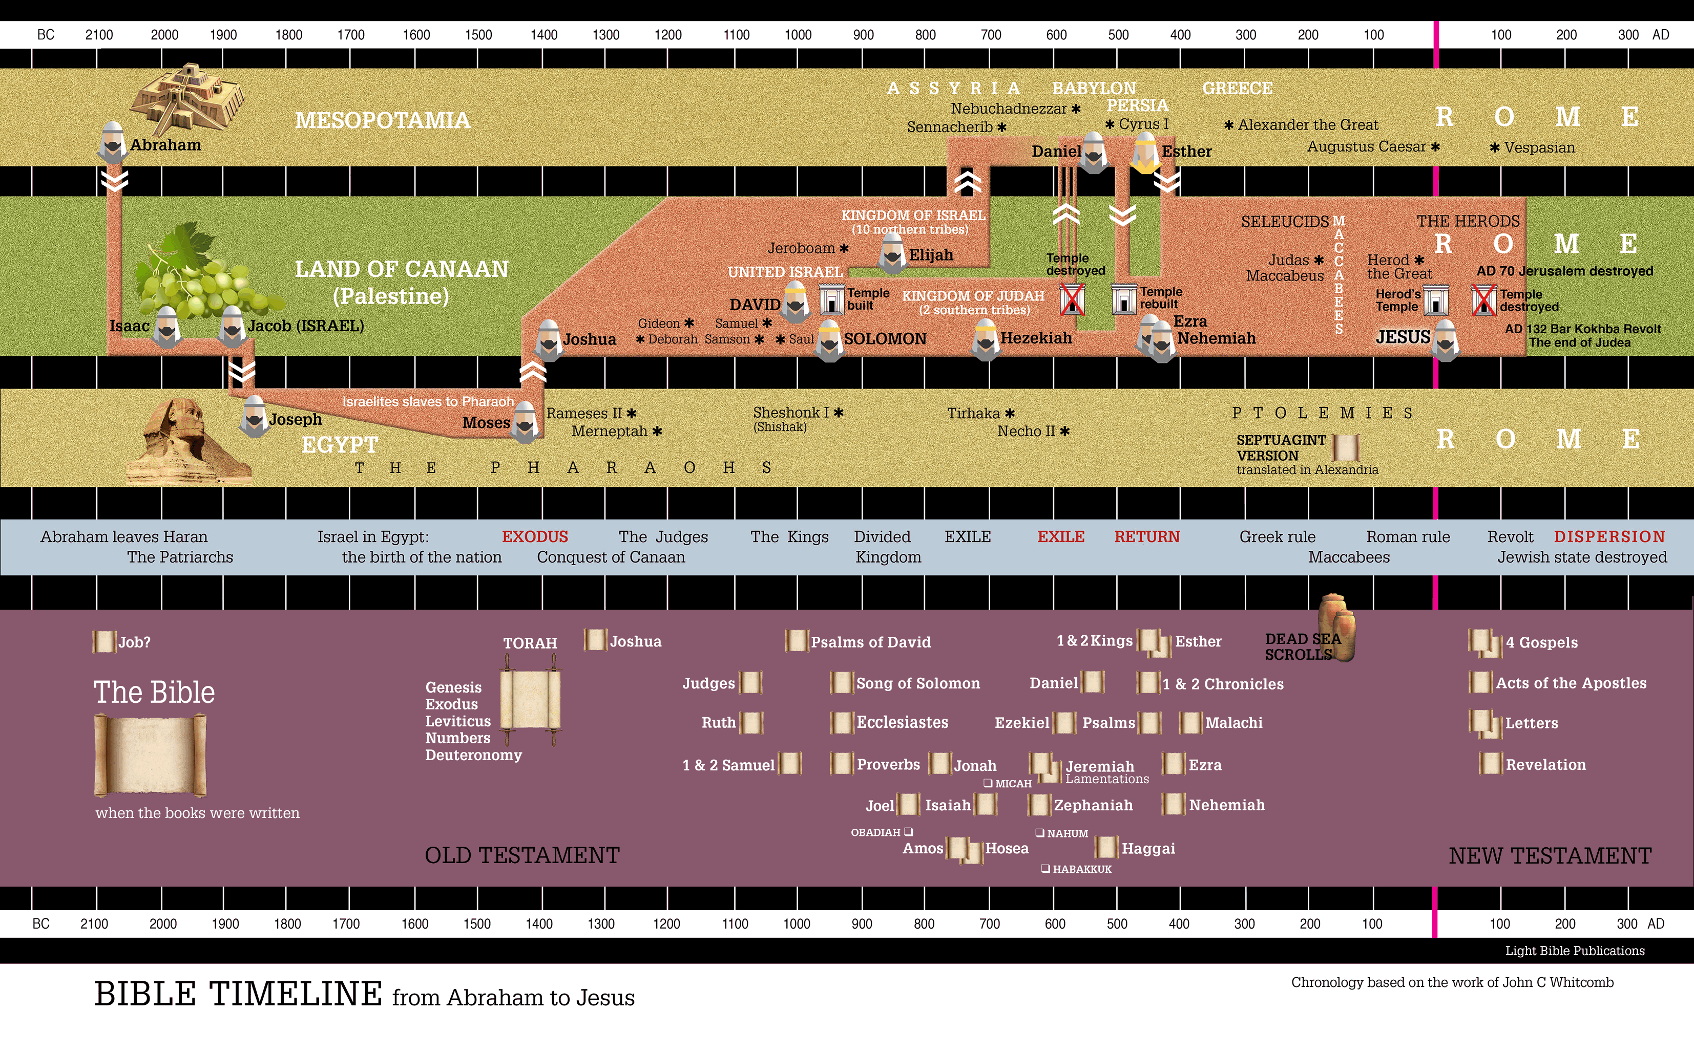

Slide 10
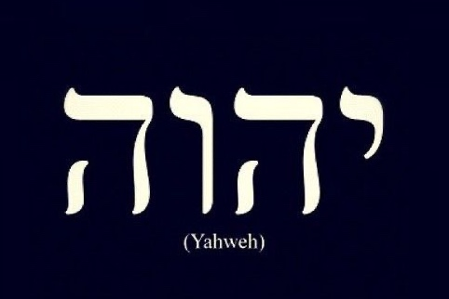
God, god, Lord or Lord
Polytheistic society – plurality of Gods (“country gods” - idols)
Lord/lord – term of respect (similar to British use of “governor”)
For the one true God
  Elohim (El) – Creator, Master, Judge → God
  Adoni – Lord, Master, Ruler → God/Lord
  YHWH (Yahweh) – God’s personal name (I AM) → LORD
  Several variants – LORD Almighty, LORD of Hosts, etc.

Slide 11


Additional resources
BibleProject (all free)
  Videos on themes, books
  Podcasts for deeper discussion
  Bible classes go deep!
The Bible Recap
  Read the Bible in a year plan
  Daily recap of main story
Creation – Rodney Plunkett sermon, Feb. 3, 2025
Classes recorded and available at HVCOC.org
Ask questions!
  theisstj@gmail.com
  Derek.dunbar2021@gmail.com

Slide 12
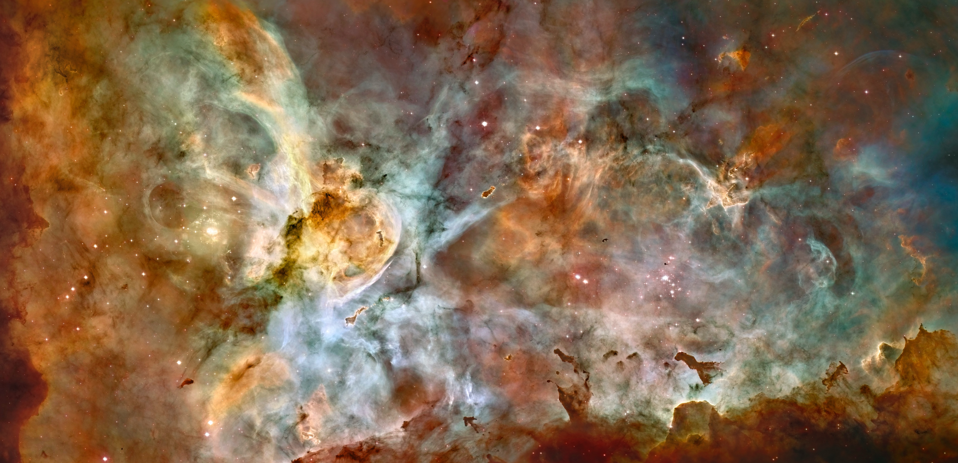
Creation!
Photo credit: NASA (also slides 13, 14, 16, 19, 25)

Slide 13

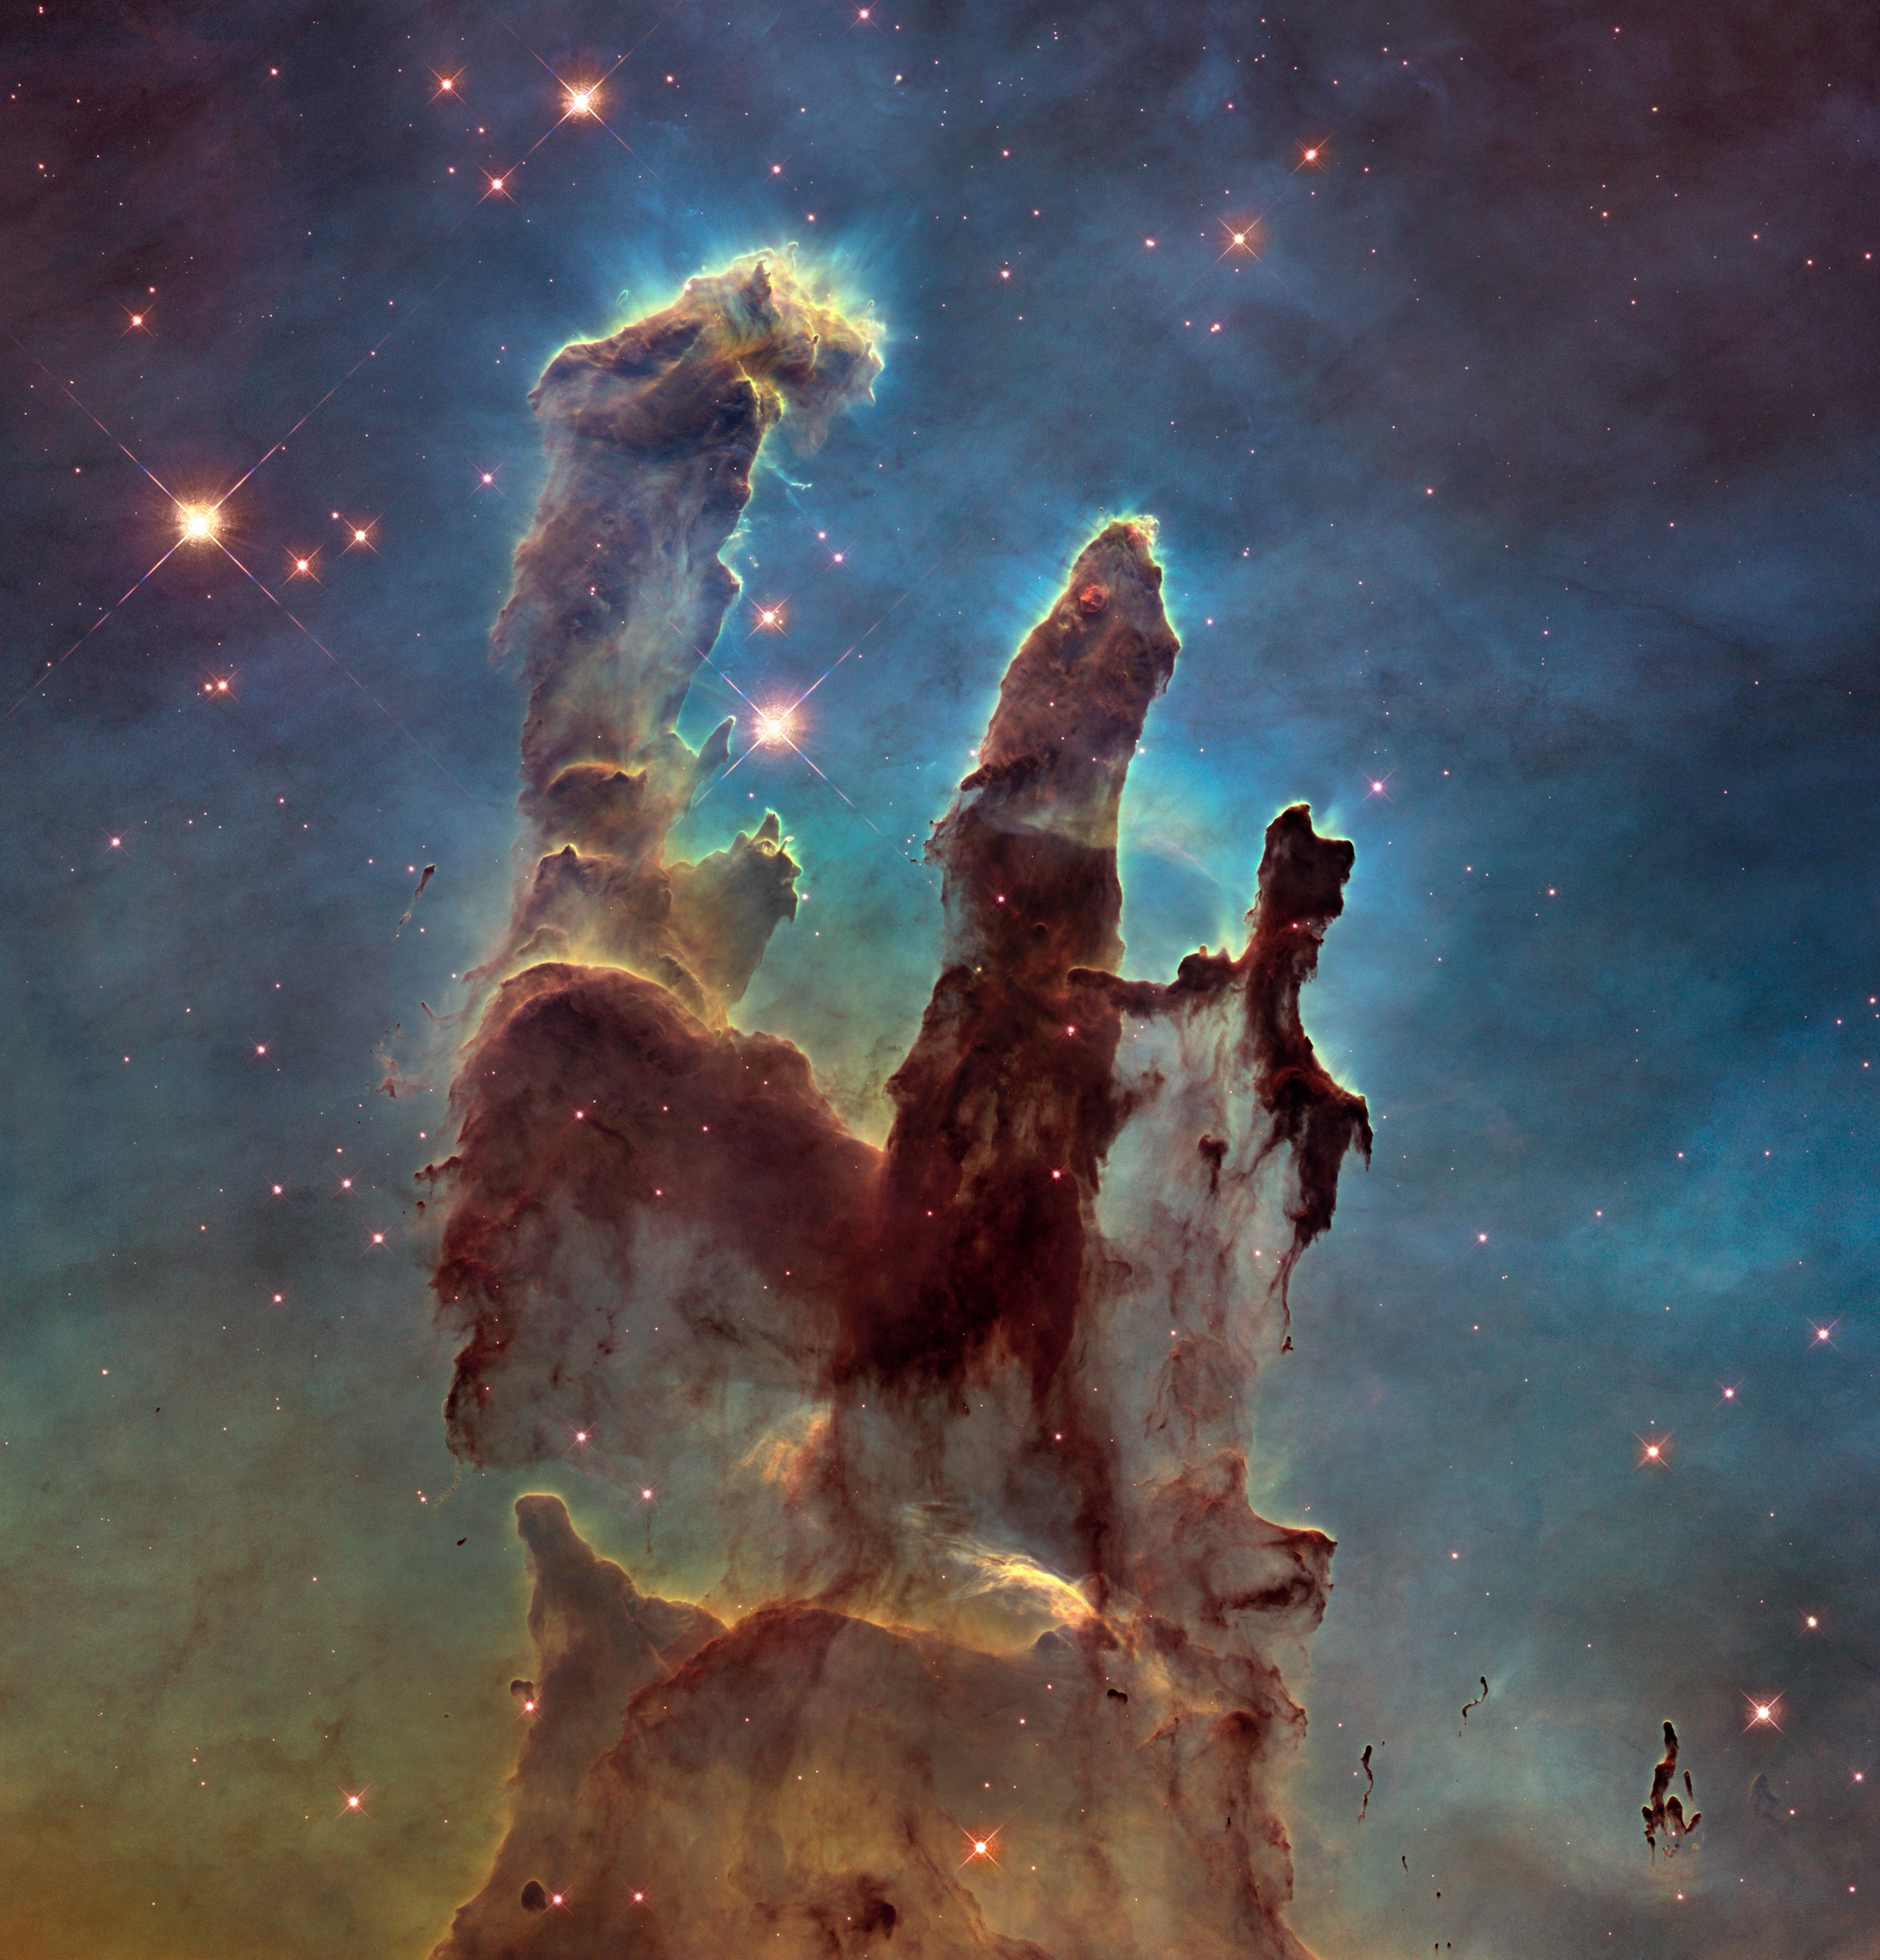
The Beginning!
(NIV Gen 1:1 - 2)
Two primary creation accounts:
  Genesis 1:1 – 2:3
  Genesis 2: 4 - 9
Different vantage points and perspectives of creation
There was a beginning
But a Creator God created all things who commanded the world into existence in series of orderly steps
In the beginning God created the heavens and the earth. ² Now the earth was formless and empty, darkness was over the surface of the deep, and the Spirit of God was hovering over the waters.

Slide 14
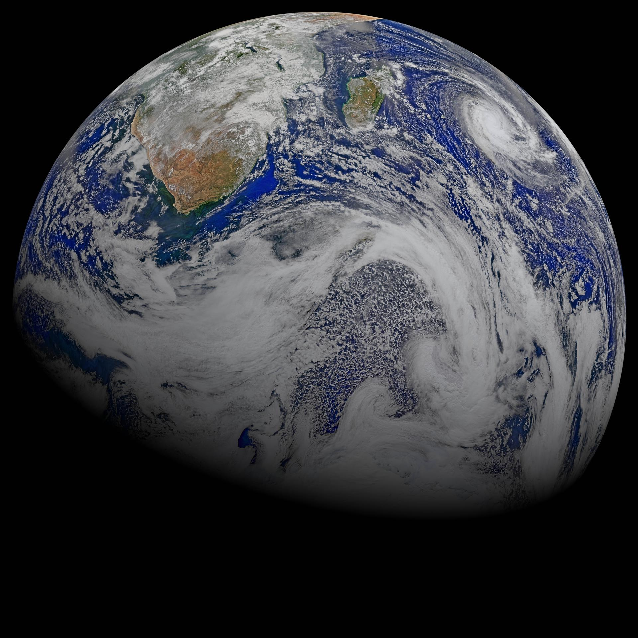
The first and second day
(Gen. 1: 3-8)
And God said, “Let there be light,” and there was light. ⁴ God saw that the light was good, and he separated the light from the darkness. ⁵ God called the light “day,” and the darkness he called “night.” And there was evening, and there was morning—the first day.
⁶ And God said, “Let there be a vault between the waters to separate water from water.” ⁷ So God made the vault and separated the water under the vault from the water above it. And it was so. ⁸ God called the vault “sky.” And there was evening, and there was morning—the second day.

Slide 15
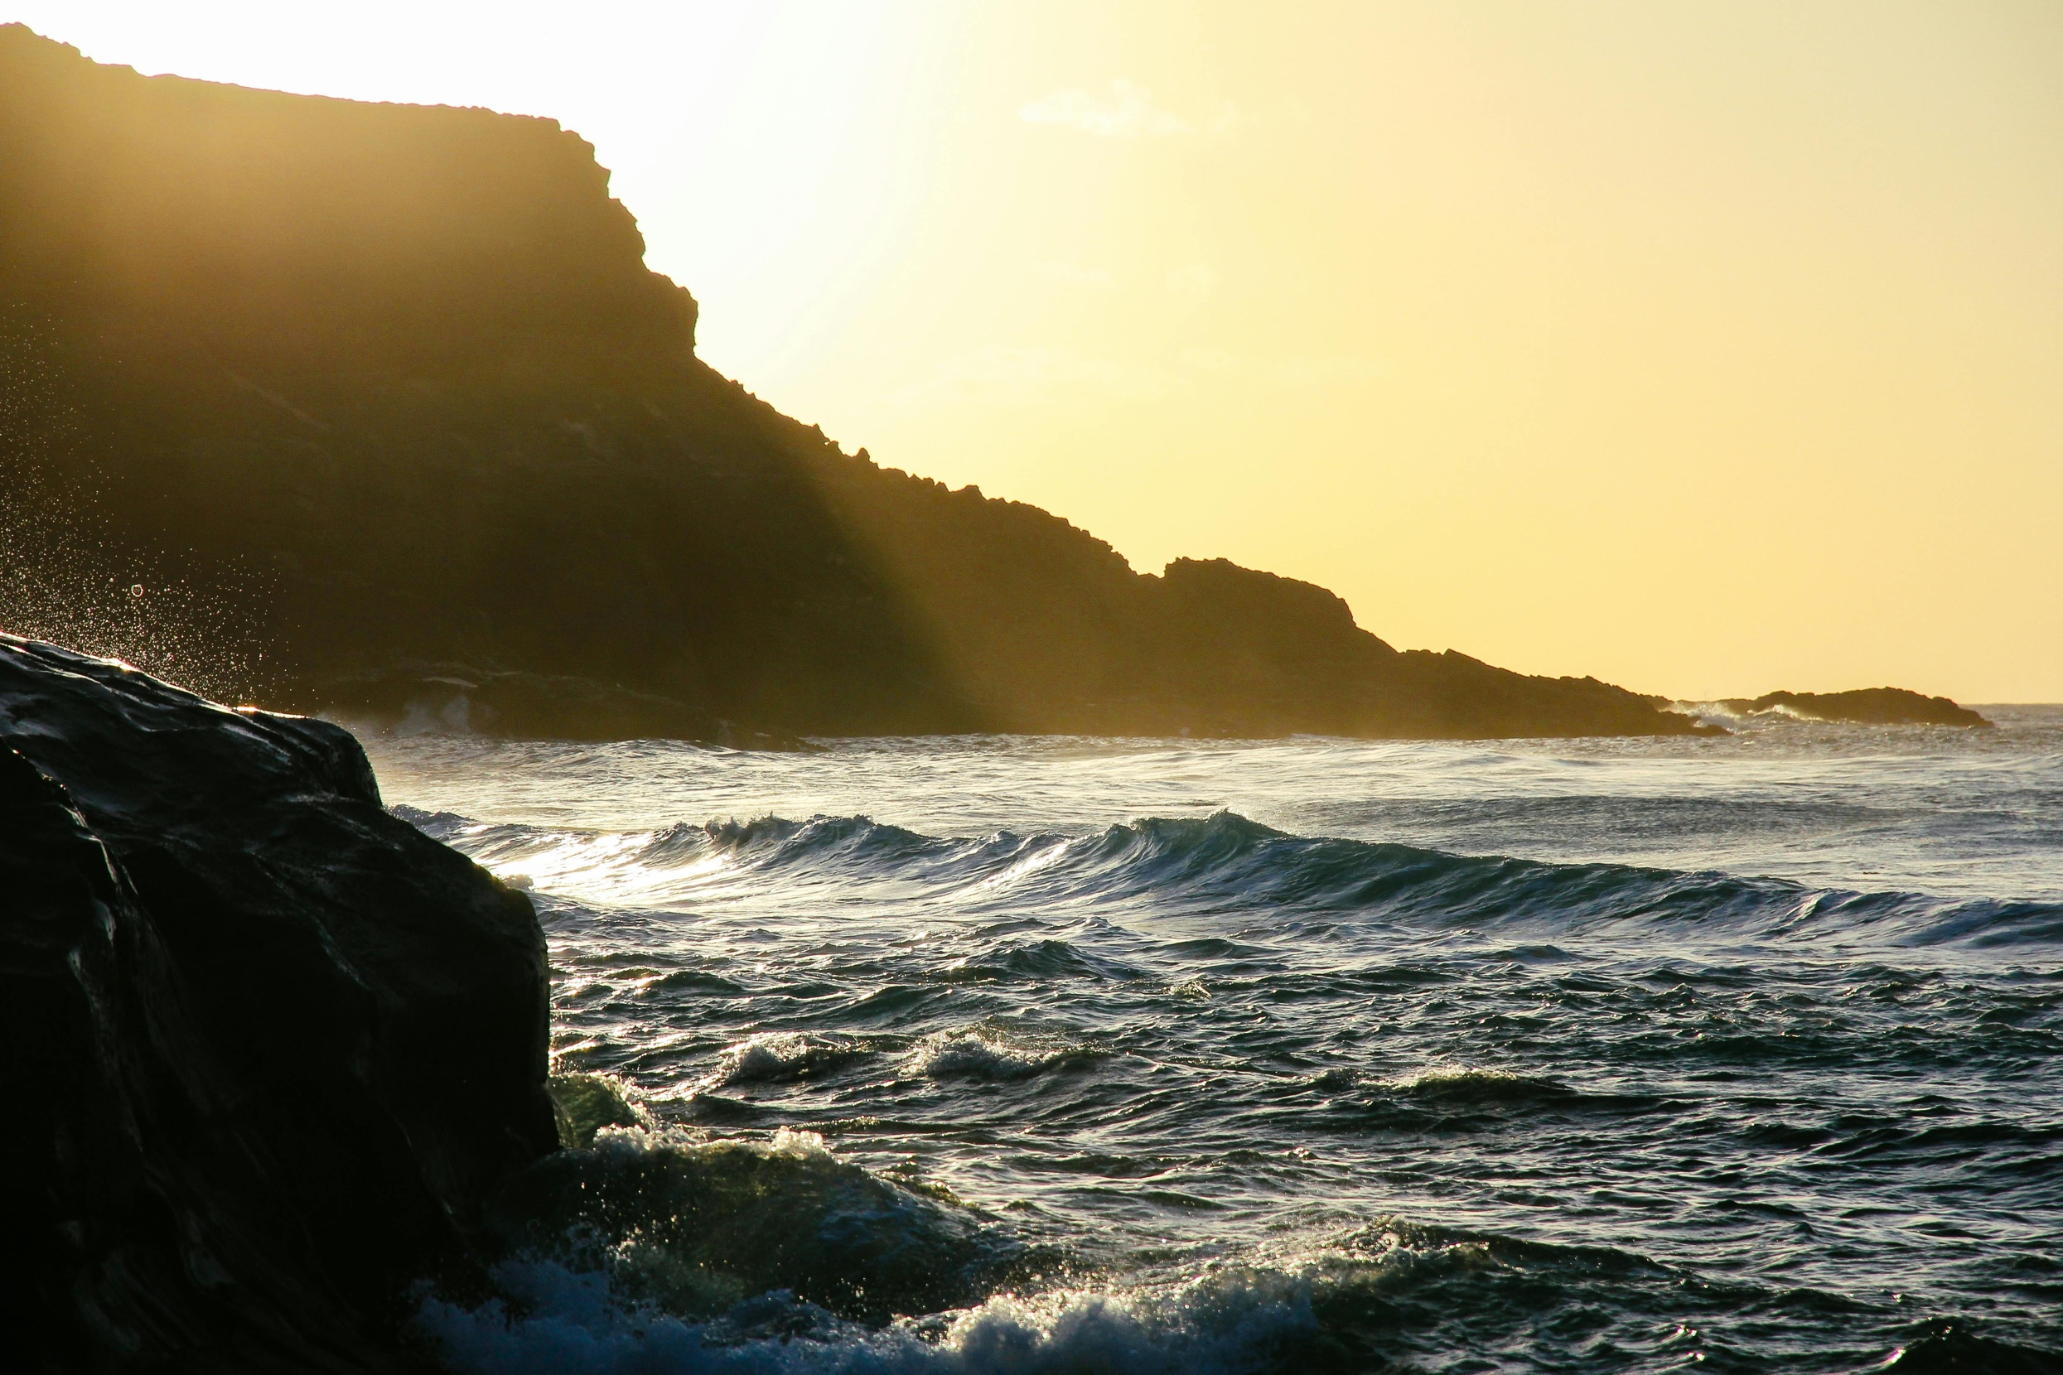
The third day (Gen. 1:9-13)
And God said, “Let the water under the sky be gathered to one place, and let dry ground appear.” And it was so. ¹⁰ God called the dry ground “land,” and the gathered waters he called “seas.” And God saw that it was good.
¹¹ Then God said, “Let the land produce vegetation: seed-bearing plants and trees on the land that bear fruit with seed in it, according to their various kinds.” And it was so. ¹² The land produced vegetation: plants bearing seed according to their kinds and trees bearing fruit with seed in it according to their kinds. And God saw that it was good. ¹³ And there was evening, and there was morning—the third day.

Slide 16
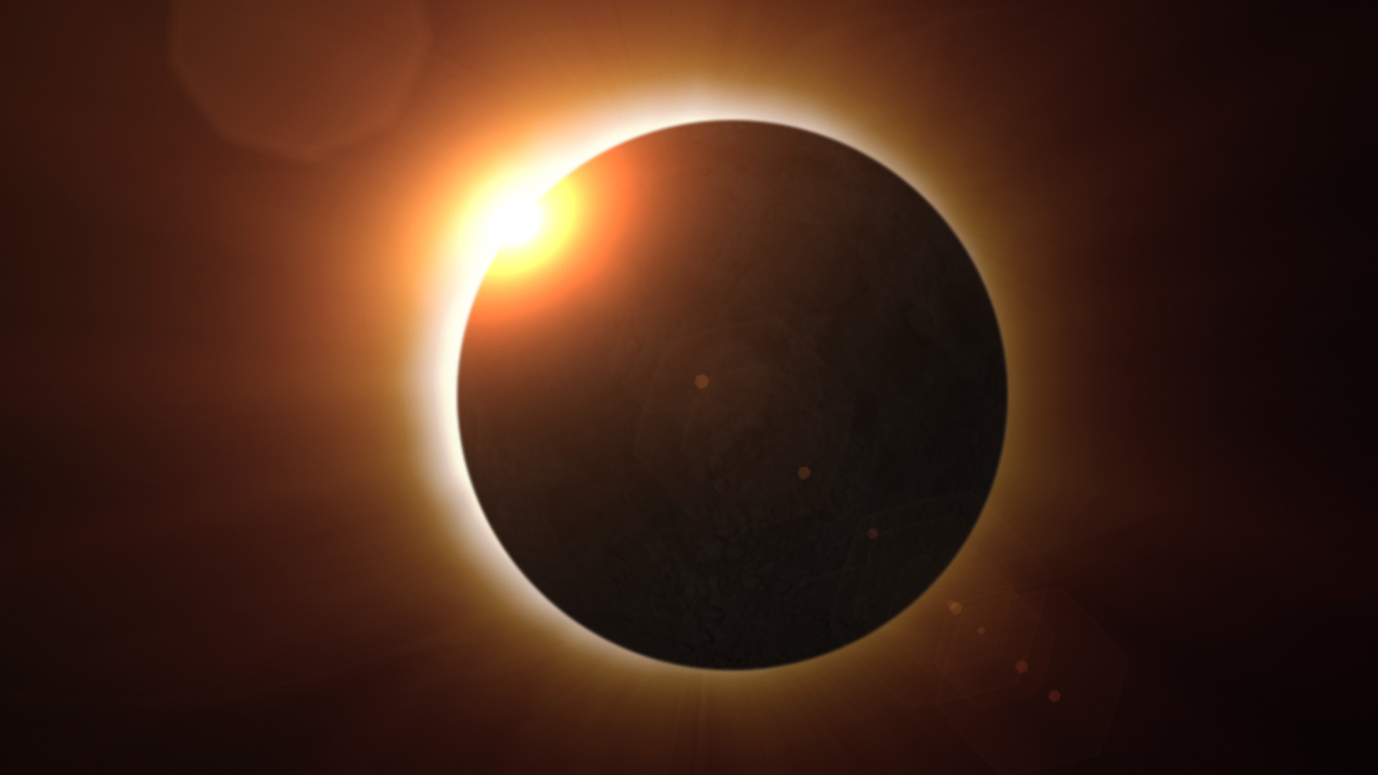
Sun, moon, stars – the fourth day (1: 14-19)
¹⁴ And God said, “Let there be lights in the vault of the sky to separate the day from the night, and let them serve as signs to mark sacred times, and days and years, ¹⁵ and let them be lights in the vault of the sky to give light on the earth.” And it was so. ¹⁶ God made two great lights—the greater light to govern the day and the lesser light to govern the night. He also made the stars. ¹⁷ God set them in the vault of the sky to give light on the earth, ¹⁸ to govern the day and the night, and to separate light from darkness. And God saw that it was good.¹⁹ And there was evening, and there was morning—the fourth day.

Slide 17
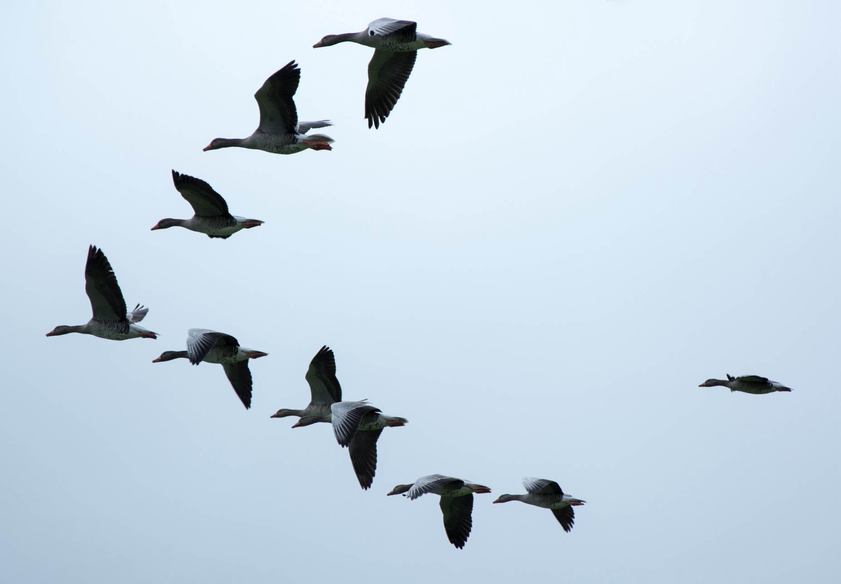
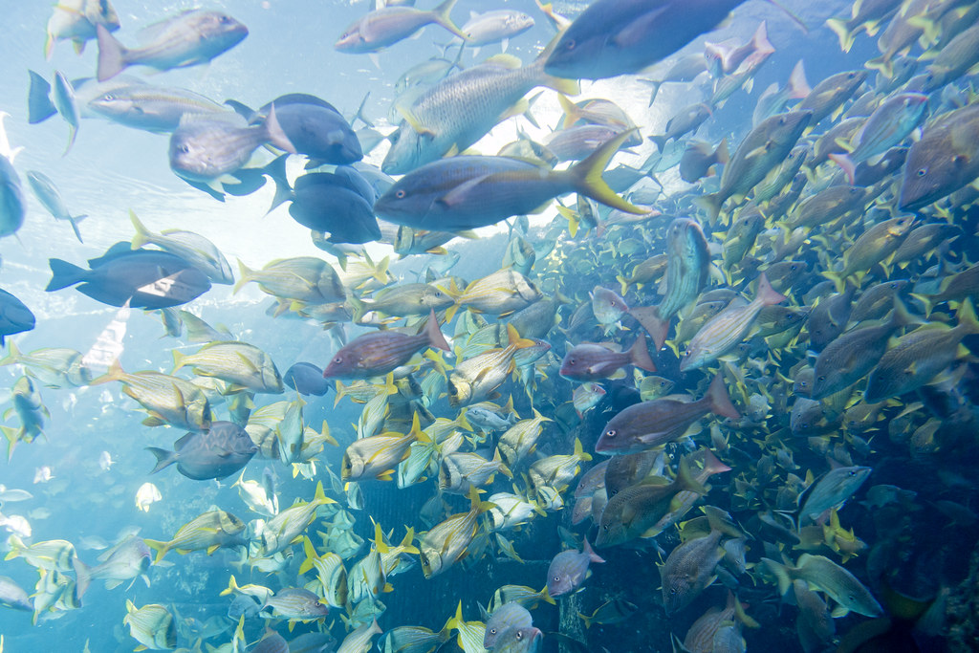
Birds & fish (1: 20-23)
²⁰ And God said, “Let the water teem with living creatures, and let birds fly above the earth across the vault of the sky.” ²¹ So God created the great creatures of the sea and every living thing with which the water teems and that moves about in it, according to their kinds, and every winged bird according to its kind. And God saw that it was good. ²² God blessed them and said, “Be fruitful and increase in number and fill the water in the seas, and let the birds increase on the earth.” ²³ And there was evening, and there was morning—the fifth day.
This Photo by Unknown Author is licensed under CC BY-ND

Slide 18
Day 6 - Animals, humans (1:24-31)
²⁸ God blessed them and said to them, “Be fruitful and increase in number; fill the earth and subdue it. Rule over the fish in the sea and the birds in the sky and over every living creature that moves on the ground.”
²⁹ Then God said, “I give you every seed-bearing plant on the face of the whole earth and every tree that has fruit with seed in it. They will be yours for food. ³⁰ And to all the beasts of the earth and all the birds in the sky and all the creatures that move along the ground—everything that has the breath of life in it—I give every green plant for food.” And it was so.
³¹ God saw all that he had made, and it was very good. And there was evening, and there was morning—the sixth day.
²⁴ And God said, “Let the land produce living creatures according to their kinds: the livestock, the creatures that move along the ground, and the wild animals, each according to its kind.” And it was so. ²⁵ God made the wild animals according to their kinds, the livestock according to their kinds, and all the creatures that move along the ground according to their kinds. And God saw that it was good.
²⁶ Then God said, “Let us make mankind in our image, in our likeness, so that they may rule over the fish in the sea and the birds in the sky, over the livestock and all the wild animals,^{[a]} and over all the creatures that move along the ground.”
²⁷ So God created mankind in his own image,
in the image of God he created them;
male and female he created them.

Slide 19
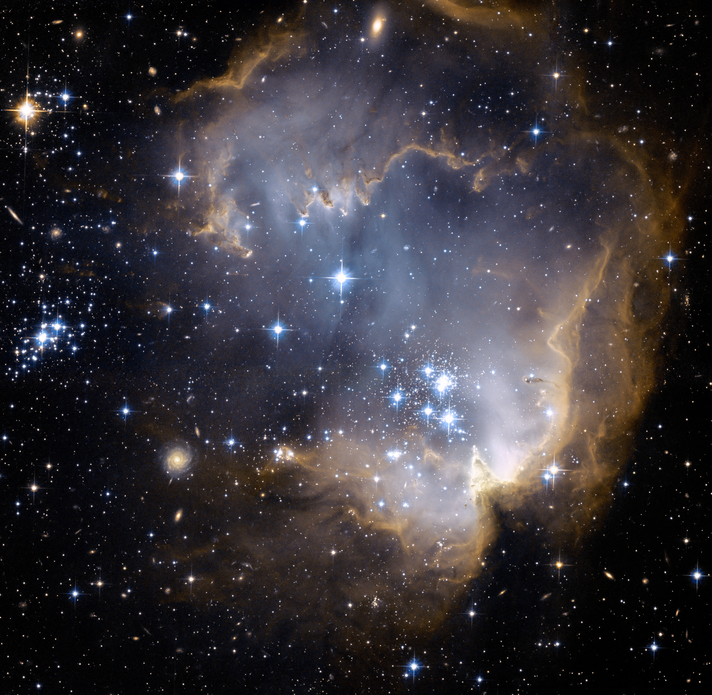
Creation is completed
(Gen 2: 1 – 3)
Thus the heavens and the earth were completed in all their vast array.
² By the seventh day God had finished the work he had been doing; so on the seventh day he rested from all his work. ³ Then God blessed the seventh day and made it holy, because on it he rested from all the work of creating that he had done.

Slide 20
Summary of Creation!
Day | Form | Declaration | Day | Fill | Declaration
1 | Light | good | 4 | Sun, moon, stars | good
2 | Sky |  | 5 | Fish, birds | good
3 | Land, seas, vegetation | good good | 6 | Animals, humans | good very good
7 | Creation ceases
7 days of creation described – ”and God said … and it was so”
Process of forming and then filling
7 times God declares creation as good or very good
Period of creating is no more
Creation becomes a process of moving from chaos to order
Humans were created in God’s image to reign over creation with God!
God in His creation is setting Himself apart from humans (aka, Holy)

Slide 21
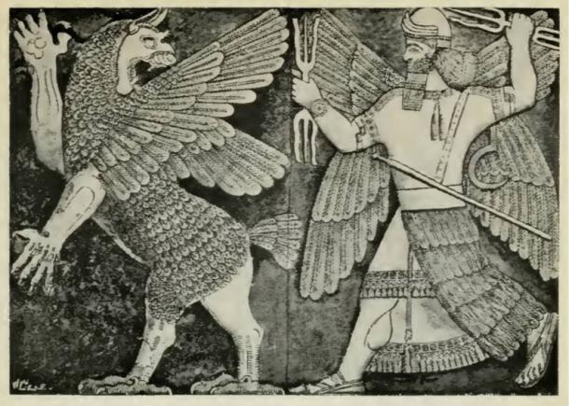
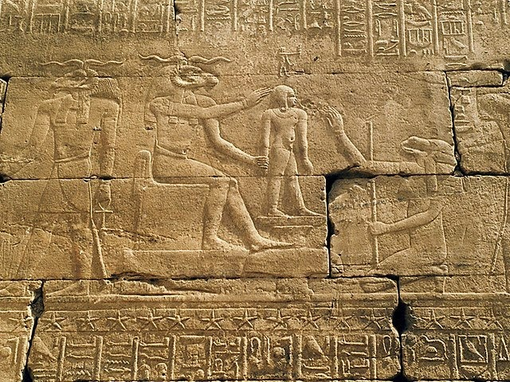
A stark contrast
The biblical narrative is quite distinct from other ancient creation myths of surrounding cultures.
  The gods portrayed are not inherently good; instead, their actions are erratic.
  They are constantly at odds with their creation for control.
  Humans exist mainly to serve these deities.
This Photo by Unknown Author is licensed under CC BY-ND

Slide 22
Another perspective of Creation
Genesis 2: 4 - 9
⁴ This is the account of the heavens and the earth when they were created, when the Lord God made the earth and the heavens.
⁵ Now no shrub had yet appeared on the earth^{[a]} and no plant had yet sprung up, for the Lord God had not sent rain on the earth and there was no one to work the ground, ⁶ but streams^{[b]} came up from the earth and watered the whole surface of the ground. ⁷ Then the Lord God formed a man^{[c]} from the dust of the ground and breathed into his nostrils the breath of life, and the man became a living being.
⁸ Now the Lord God had planted a garden in the east, in Eden; and there he put the man he had formed. ⁹ The Lord God made all kinds of trees grow out of the ground—trees that were pleasing to the eye and good for food. In the middle of the garden were the tree of life and the tree of the knowledge of good and evil.
Before vegetation
God formed Adam from His breath of life
God planted a garden - Eden
God made plants and fruit trees spring up
In the middle of Eden are two trees:
tree of life and
tree of knowledge of good and evil.

Slide 23
Genesis 2: 10 - 17
¹⁰ A river watering the garden flowed from Eden; from there it was separated into four headwaters. ¹¹ The name of the first is the Pishon; it winds through the entire land of Havilah, where there is gold. ¹² (The gold of that land is good; aromatic resin^{[d]} and onyx are also there.) ¹³ The name of the second river is the Gihon; it winds through the entire land of Cush.^{[e]} ¹⁴ The name of the third river is the Tigris; it runs along the east side of Ashur. And the fourth river is the Euphrates.
¹⁵ The Lord God took the man and put him in the Garden of Eden to work it and take care of it. ¹⁶ And the Lord God commanded the man, “You are free to eat from any tree in the garden; ¹⁷ but you must not eat from the tree of the knowledge of good and evil, for when you eat from it you will certainly die.”

Slide 24
Genesis 2: 18 - 25
¹⁸ The Lord God said, “It is not good for the man to be alone. I will make a helper suitable for him.”
¹⁹ Now the Lord God had formed out of the ground all the wild animals and all the birds in the sky. He brought them to the man to see what he would name them; and whatever the man called each living creature, that was its name. ²⁰ So the man gave names to all the livestock, the birds in the sky and all the wild animals.
But for Adam^{[f]} no suitable helper was found. ²¹ So the Lord God caused the man to fall into a deep sleep; and while he was sleeping, he took one of the man’s ribs^{[g]}and then closed up the place with flesh. ²² Then the Lord God made a woman from the rib^{[h]} he had taken out of the man, and he brought her to the man.
²³ The man said,
“This is now bone of my bones
and flesh of my flesh;
she shall be called ‘woman,’
for she was taken out of man.”
²⁴ That is why a man leaves his father and mother and is united to his wife, and they become one flesh.
²⁵ Adam and his wife were both naked, and they felt no shame.

Slide 25
The Big Picture …
The process of creation is described as moving from chaos to order
God spoke the world and all within it into existence
The creation was declared “good” but man was declared “very good”
God is shown as more active and personal in the second Creation account (formed … breathed … placed … made … caused)
Man and woman were given all they needed to thrive but commanded to avoid the tree of knowledge of good and evil
Mankind was created In God’s image to rule over the world with God (we have purpose!)
This is in stark contrast to other ancient creation narratives from surrounding civilizations
  Their gods are not noble in purpose; the gods are erratic in nature
  Constantly fighting with their creation over supremacy
  Man was created to serve their gods

Slide 26
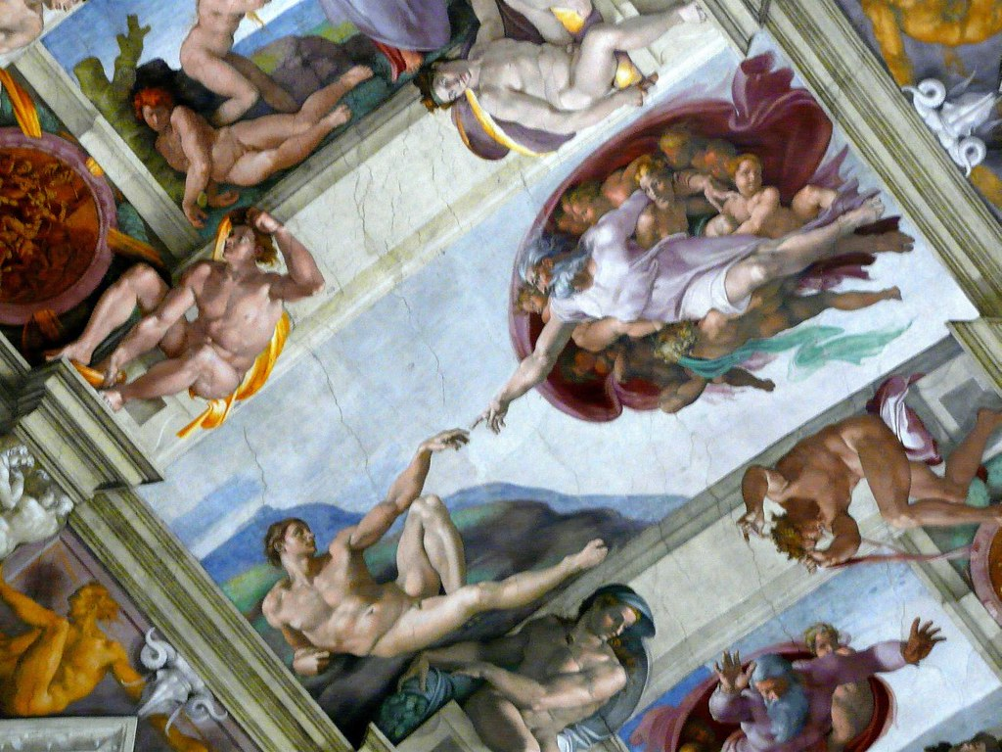
Next week’s class – the Genesis Overview
Adam, Eve and the Fall from Eden (Gen. chap 2 & 3)
The flood (Noah) – Gen. 6: 9 – 9:28 chap. 6 – 9)
Tower of Babel (Gen. 11: 1 – 9)
This Photo by Unknown Author is licensed under CC BY-SA-NC

