Slide 1
Fearfully & Wonderfully
The role of mental health in
God’s Kingdom

Slide 2
Substance Abuse Disorders
The use of one or more substances that leads to clinically significant impairment or distress.
Notes:
20.2 million
7.9 million w/cooccuring D/O

Slide 3
Addiction
Compulsive substance use despite harmful consequence
(Severe Substance Abuse Disorder)

Slide 4
Addictive Substances
Alcohol
Marijuana
Hallucinogens
Inhalants
Opioids
Sedatives, hypnotics and anxiolytics
Stimulants
Tobacco
Notes:
CDC-88K deaths/yr directly related to alcohol (50% from binge drinking: 5 drinks men; 3 drinks women)
40% of violent crime alcohol was involved
Caniboids vs Delta 9-THC (psycho-active)
THC exacerbates mental illness; delays cognitive development

Slide 5

Addiction Symptoms
Control- Proverbs 23:29-30
Tolerance and Withdraw
Cognitive Distortions
Loss of Emotional & Behavioral Control
Compulsion- Proverbs 23:30-31
Cravings
Drug-Seeking Behavior
Chronicity- Proverbs 23:32-35
Continued use despite harm/adverse consequences
Relapse

Slide 6
Understanding why people use
To feel good- feeling of pleasure, seeking a “high”
To feel better- relieve stress, relieve pain, relieve cravings
To do better- improve performance, minimize unwanted symptoms
Curiosity and Peer Pressure

Slide 7

Myths of Addictions- The BIG 6
Addiction is a lack of will or a character flaw
Addiction is genetic
Addiction is permanent
You have to hit “rock bottom”
You have to want help
Relapse means starting at Square One

Slide 8
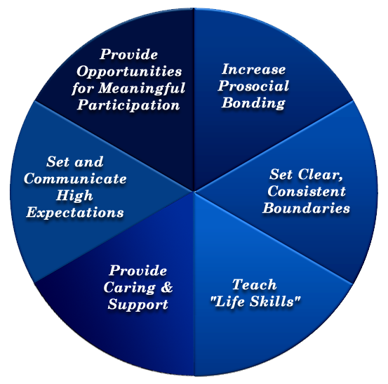
The Church’s Response
Bonnie Benard (2004)

Slide 9



865-524-1122
Tuesdays Supper 6:30pm Support Groups 7:00pm
Second Tuesday of each month
Supper 6:30pm
Bible Study 7:00pm

Slide 10

1-800-662-HELP (4357)

Slide 11
Schizophrenia Spectrum & Other Psychotic Disorders

Slide 12
Characteristic Symptoms
Positive Symptoms
Abnormal thoughts, perceptions and behaviors most individuals do not normally experience
Delusions
Hallucinations
Disorganized thinking
Disorganized behavior

Slide 13
Characteristic Symptoms
Negative Symptoms
The loss or decrease of an ability that is normally present
Flat affect (lack of emotional expression)
Avolition (low motivation)
Alogia (lack of speech)
Associality (lack of interest in social interaction)
Anhedonia (lack of ability to experience joy/pleasure)

Slide 14
Types and Subtypes
Delusional Disorder
King Saul- I Samuel 18:8-9
Brief Psychotic Disorder
Schizophreniform Disorder
Schizophrenia
Gadarene demoniac- Mark 5
Schizoaffective Disorder
Nebuchadnezzar- Daniel 4:28-33
Notes:
0.3-0.7% population

Slide 15
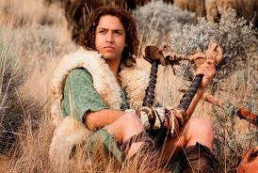
It really can’t be faked
I Samuel 21:10-15
But it really can be treated
Antipsychotics
Psychosocial Therapy
Notes:
I Sam 17:37

Slide 16
Personality Disorders
A personality disorder is a type of mental disorder in which you have a rigid and unhealthy pattern of thinking, functioning and behaving.
A person with a personality disorder has trouble perceiving and relating to situations and people. This causes significant problems and limitations in relationships, social activities, work and school.
(Mayo Clinic, 2013)
Notes:
In some cases, you may not realize that you have a personality disorder because your way of thinking and behaving seems natural to you. And you may blame others for the challenges you face.
9.1-14.8% population

Slide 17
Cluster A “Odd-Eccentric”
Paranoid-
distrust, suspiciousness, believe being victimized, highly critical yet hypersensitive to criticism
Schizoid-
long standing pattern detachment from social relationships, restricted range of emotions, rarely use non-verbal cues
Schizotypal-
acute discomfort in close relationships, hold odd beliefs and engage in eccentric behavior, below threshold for psychotic dx
Notes:
2.1-6.8%
Paranoid- distrust, suspiciousness, believe being victimized, highly critical yet hypersensitive to criticism
Schizoid- long standing pattern detachment from social relationships, restricted range of emotions, rarely use non-verbal cues
Schizotypal- acute discomfort in close relationships, hold odd beliefs and engage in eccentric behavior, below threshold for psychotic dx

Slide 18
Cluster B “Dramatic-Erratic”
Antisocial-
manipulation, exploitation, violation of rights of others, deceitful, lack remorse, unwilling to conform to laws/norms
Borderline-
persistent pattern of emotional instability, volatile relationships, self-destructive impulsive behavior
Histrionic-
excessive emotional expression, attention seeking, overly dramatic, excessive need for approval, provocative
Narcissistic-
extreme feelings of self importance, high need for admiration, lack of empathy, exploit others for personal gain and overly sensitive to criticism
Notes:
1.5-6.1%
Antisocial- manipulation, exploitation, violation of rights of others, deceitful, lack remorse, unwilling to conform to laws/norms
Borderline- persistent pattern of emotional instability, volitale relationships, self-destructive impulsive behavior
Histrionic- excessive emotional expression, attention seeking, overly dramatic, excessive need for approval, provacative
Narcissistic- extreme feelings of self importance, high need for admiration, lack of empathy, exploit others for personal gain and overly sensitive to criticism

Slide 19
Cluster C “Anxious-Fearful”
Avoidant-
Feelings of inadequacy, hypersensitivity to negative evaluation, fearful of rejection, choose to be lonely rather than face potential rejection
Dependent-
Submissive, clingy behavior, excessive need to be taken care of, strong feeling of helplessness and unable to cope independently, transfers personal responsibility to others
Obsessive Compulsive-
Preoccupation with orderliness, perfectionism, control. Preoccupied with details, rules, schedules- often to the point it interferes with their ability to complete tasks.
Notes:
Avoidant- feelings of inadequacy, hypersensitivity to negative evaluation, fearful of rejection, choose to be lonely rather than face potential rejection
Dependent- Submissive, clingy behavior, excessive need to be taken care of. Strong feeling of helplessness and unable to cope independently. Transfers personal responsibilty to others
Obsessive-Compulsive Preoccupation with orderliness, perfectionism, control. Preoccupied with details, rules, schedules- often to the point it interferes with their ability to complete tasks.

