Slide 1
Fearfully & Wonderfully
The role of mental health
in God’s Kingdom

Slide 2
Anxiety
“. . .My anxious thoughts multiply within me”
-Psalms 94:19

Slide 3
ANXIETY IS :
LOSS OR LACK OF CONTROL
INCREASED THREAT RESPONSE
FEAR
DREAD
UNCERTAINTY
AGGITATION
HUMAN RESPONSE TO STRESS (Baker, 1996)
Notes:
Baker’s Evangelical Dictionary of Biblical Theology

Slide 4
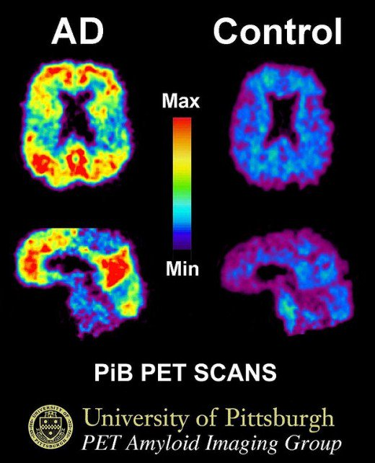
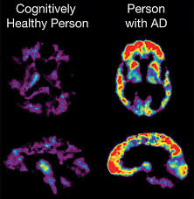

Slide 5
What is it like to live with anxiety?
Anxiety-Spoken Word

Slide 6
Types and Subtypes
Generalized Anxiety Disorder (GAD)
Specific Anxiety Disorder (SAD)
Social Anxiety
Phobias
Post-Traumatic Stress Disorder (PTSD)
Panic Disorder
Notes:
Most common Mental Illness
GAD 3-30%
Phobia 11%
Social Anxiety 2-16%
PTSD 7.8% (5%men 10.4% women)

Slide 7
Obsessive Compulsive Disorder (OCD)
Eating Disorders
Anorexia
Bulimia
Purging
Binging (Overeating)
Pica
Avoidant/Restrictive Food D/O
Orthoexia
Notes:
OCD 2%
Eating D/O 1.1-4.2%

Slide 8
Our Response
There is no mistaking what the Bible says about Anxiety
I John 4:18
Philippians 4:6

Slide 9
. . .OR is there!
I John 4:17 (cf 4:7-21)
Philippians 4:6b (cf4:6-9)
Notes:
II Tim 2:15

Slide 10
Our Perfect Example
Mark 14:32-42
Matthew 26:36-46
Luke 22:39-46

Slide 11

Seek out Refuge
Lk 22:39
Ps 46:1-3
Seek out Relationship
Mark 14:33
Ecc 4:9-10; Prv 17:17
Seek Solitude
Luke 22:41
Lam 3:25-28
Seek God’s Will
Mark 14:36
I Pet 5:6-7; Prv 3:5-6

Slide 12

Pray, Pray, Pray
Matt 26:44
Is 30:18; Is 40:28
Get ready, Get Set
Mark 14:41
Col 3:1-3
GO!
Matt 26:46
Is 58:8-12 (esp 10)

Slide 13
The world can be an overwhelming, scary place. . .
Isaiah 54:10
Romans 8:38-39
. . .But nothing can separate us from the love of God!

Slide 14
HE CARES FOR YOU!
Casting all your anxieties on Him because
Notes:
I Pet 5:7

Slide 15
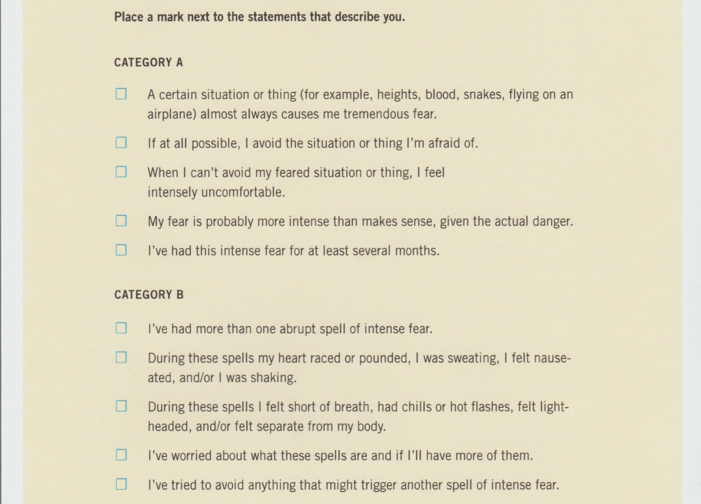
The Anxiety Checklist (Gillihan, 2016)

Slide 16
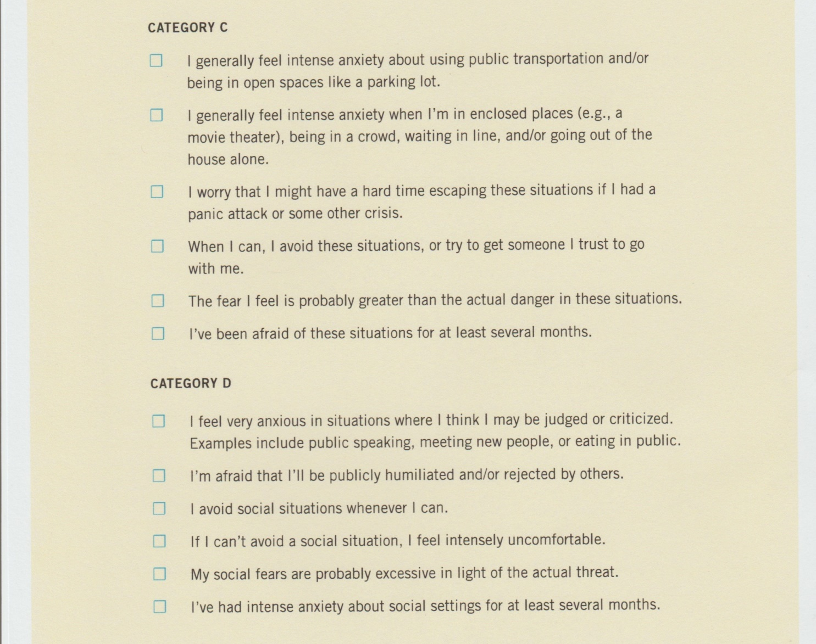
The Anxiety Checklist (Gillihan, 2016)

Slide 17
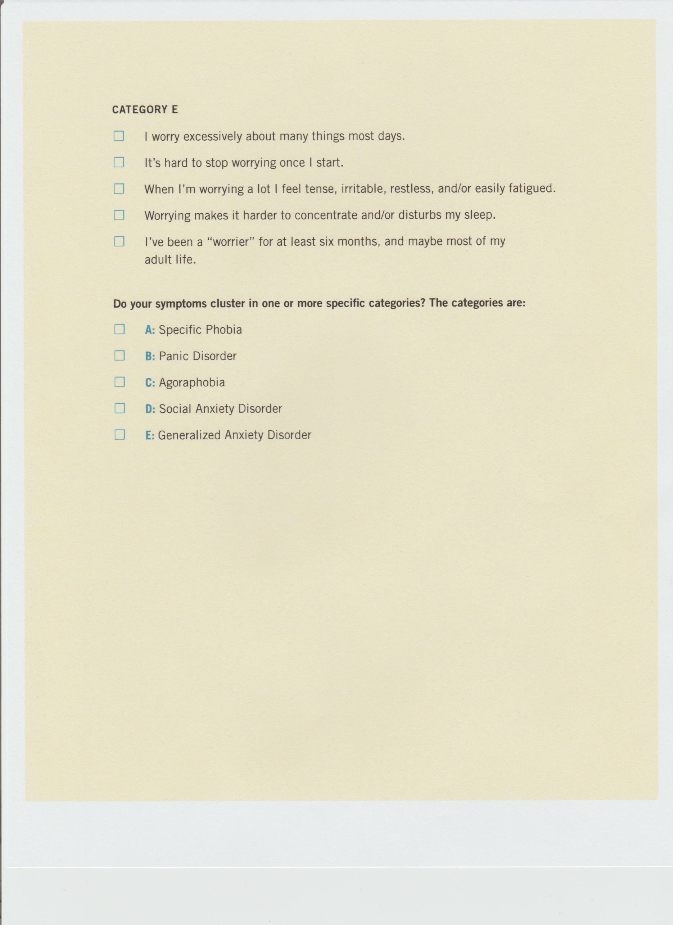
The Anxiety Checklist (Gillihan, 2016)

