Slide 1
Trauma Recovery
Safety & Stabilization
Remembrance & Mourning
Reconnection & Integration

Slide 2
Trauma Response
TRUST(worthy)
Competence
Reliability
Benevolence
Integrity
Rachel Botsman “Who can you trust?”
Notes:
Rachel Modsmin

Slide 3
For the Lamb in the midst of the throne will be their shepherd,
And He will guide them to springs of living water,
And God will wipe away every tear from their eyes.
Revelation 7:17

Slide 4
Local Resources- Immediate Crisis
Mobile Crisis
865/539-2409
Knox
Blount
Loudon
Monroe
Sevier
9-1-1

Slide 5
Domestic Violence Resources
Family Justice Center
(KCSO & KPD)
400 Harriet Tubman St.
Knoxville, TN 37915
865/215-6800
865/521-6336
Kent C. Withers Family Crisis Center
(Helen Ross McNabb)
901 E. Summit Hill Dr.
Knoxville, TN 37915
865/637-8000

Slide 6
Sexual Abuse and Assault
Sexual Assault Center of East Tennessee
2455 Sutherland Ave.
Bldg. B
Knoxville, TN 37919
865/522-7273
ChildHelp
2505 Kingston Pike
Knoxville, TN 37919
865/637-1753

Slide 7
Report Child Abuse & Neglect
Who is mandated to report suspected abuse and neglect?
EVERYONE
Tennessee Code Annotated 37-1-403(i)
1-877-237-0004

Slide 8
Fearfully & Wonderfully
The role of mental health in God’s Kingdom

Slide 9
Mood Disorders
Depression and Bipolar Disorder
Psalms 42:5-6
Why are you cast down, O my soul?
And why are you in turmoil within me?
Hope in God, for I shall again praise Him,
My Salvation and my God.

Slide 10
Mood Disorders
A psychological disorder characterized by the elevation or lowering of one’s mood
One’s general emotional state or mood is distorted or inconsistent with circumstances and interferes with one’s ability to function
- Mayo Clinic (1998)
Notes:
More than emotive symptoms
More than “depressed”

Slide 11
Understanding Depression
Understanding Depression Video
Notes:
ECT
TMS
Kitamine (Kaiser Permanente Johnson&Johnson)

Slide 12
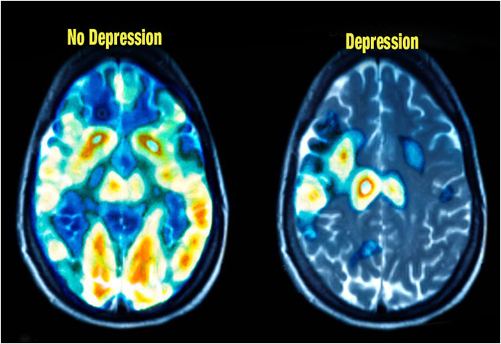
Understanding Depression

Slide 13
Types and Subtypes
Major Depressive
Dysthymia
Seasonal Affect
Situational/Adjustment
Physical Health
Post-Partum
Bipolar
Type I & Type II
Mixed Episode
Rapid Cycling
Cyclothymia
Psychotic features
Notes:
1/8 adolescents
1/12 adults
Maj Dep 6.9%
Dysthymia 1.5%
SAD 6% (14% winter blues)
Postpartum 10-15%
Bipolar 2.6%
20% dep develop psychotic features

Slide 14
Our Response
Romans 12:12
Rejoice in hope,
be patient in tribulation,
be constant in prayer

Slide 15
Our Response
Presence
Prayer
Physical Needs
Patience

Slide 16
Our Response
Presence
II Corinthians 1:3-4
“Blessed be the God and Father of our Lord Jesus Christ, the Father of mercies and the God of all comfort, who comforts us in all our affliction, so that we may be able to comfort those who are in any affliction, with the comfort with which we ourselves are comforted by God.”

Slide 17
Our Response
Prayer
Psalms 102:1
“A prayer of an afflicted person who has grown weak and pours out a lament before the Lord. Hear my prayer, Lord; let my cry for help come to you.”

Slide 18
Our Response
Physical Needs
Matthew 25:35-40
“‘. . .And when did we see you sick or in prison and visit you?’ And the King will answer them, ‘Truly, I say to you, as you did it to one of the least of these my brothers, you did it to me.’”

Slide 19
Our Response
Patience
Colossians 3:12-15
Ephesians 4:1-3
“I therefore, a prisoner for the Lord, urge you to walk in a manner worthy of the calling to which you have been called, with all humility and gentleness, with patience, bearing with one another in love. . .”

Slide 20
Depression Screening
Am I depressed or do I have Depression?
Notes:
2 weeks or more; months
2 years (cyclothymia)
Impact of symptoms

Slide 21
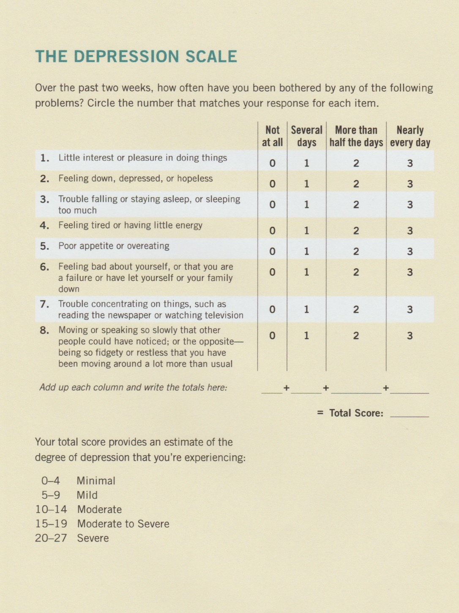
The Depression Scale
Seth Gillihan, Ph.D. (2016)

Slide 22
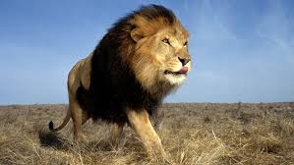
Let’s Be Clear
Depression is NOT a sin
Satan is more than willing to use Depression as a temptation
Jeremiah 20:7
Psalms 42:9-10

Slide 23
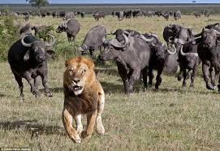
Psalms 40:1-3

Slide 24
JOY within the PAIN
Philippians 4:4
Psalms 42
¹¹ “Hope in God;
for I will again praise Him,
my salvation and my God.”

