Slide 1
Fearfully & Wonderfully
The role of mental health in God’s Kingdom

Slide 2
Trauma and Recovery
Psalms 31:18
The LORD is near to the brokenhearted and saves the crushed in spirit.

Slide 3
How do we reconcile trauma with
Romans 8:28

Slide 4
Trauma is
“An emotional response to a terrible event.”
  American Psychological Association (2007)
Loss of control Increase threat response
  Isolated –or- Recurrent
  Physical, Biological, Emotional, Psychological . . .
  Personal –or- Associative
  Perpetrated by other –or- Perpetrated by self

Slide 5
Trauma is
UNIFORM
PERSONAL

Slide 6
Impact of Trauma
Intense, unpredictable feelings
Changes in thought patterns
Changes in behavior
Sensitivity to environmental factors
Strain on relationships (Current and Future)
Heightened stress response

Slide 7
Impactful Trauma

Slide 8


Slide 9
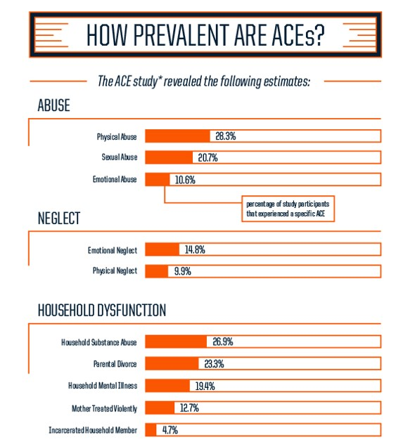
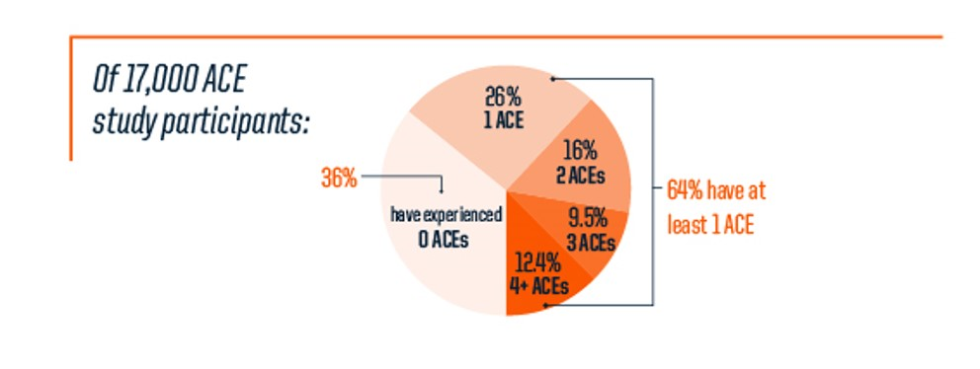

Slide 11
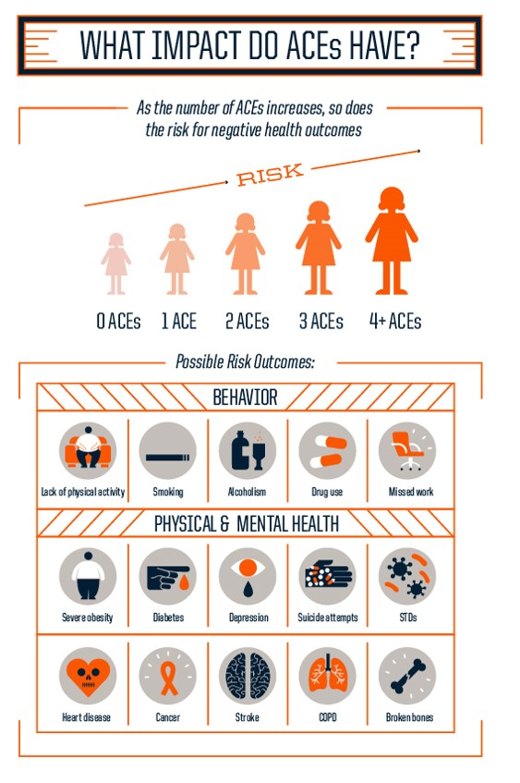

Slide 12
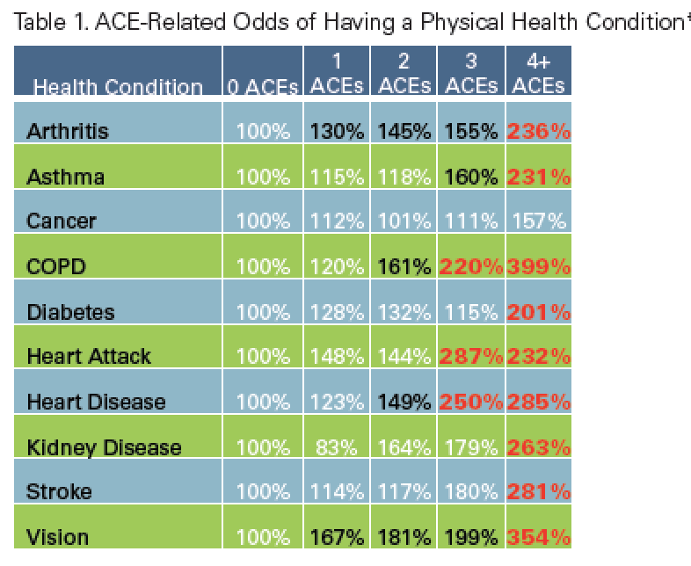

Slide 13
Trauma Recovery
Isaiah 61:1-2
¹ The Spirit of the Lord God is upon me,
Because the Lord has anointed me
To bring good news to the afflicted;
He has sent me to bind up the brokenhearted,
To proclaim liberty to captives
And freedom to prisoners;
² To proclaim the favorable year of the Lord
And the day of vengeance of our God;
To comfort all who mourn
Notes:
(cf Ezk 34:15-16)

Slide 14
. . . Today this Scripture has been
Luke 4:21

Slide 15
. . . Today this Scripture has been
FULFILLED
Luke 4:21

Slide 16
Trauma Recovery
Safety & Stabilization
Remembrance & Mourning
Reconnection & Integration

Slide 17
Trauma Response
TRUST(worthy)
Competence
Reliability
Benevolence
Integrity
Rachel Botsman “Who can you trust?”
Notes:
Rachel Modsmin

Slide 18
For the Lamb in the midst of the throne will be their shepherd,
And He will guide them to springs of living water,
And God will wipe away every tear from their eyes.
Revelation 7:17

Slide 19
Local Resources- Immediate Crisis
Mobile Crisis
865/539-2409
  Knox
  Blount
  Loudon
  Monroe
  Sevier
9-1-1

Slide 20
Domestic Violence Resources
Family Justice Center
(KCSO & KPD)
400 Harriet Tubman St.
Knoxville, TN 37915
865/215-6800
865/521-6336
Kent C. Withers Family Crisis Center
(Helen Ross McNabb)
901 E. Summit Hill Dr.
Knoxville, TN 37915
865/637-8000

Slide 21
Sexual Abuse and Assault
Sexual Assault Center of East Tennessee
2455 Sutherland Ave.
Bldg. B
Knoxville, TN 37919
865/522-7273
ChildHelp
2505 Kingston Pike
Knoxville, TN 37919
865/637-1753

Slide 22
Report Child Abuse & Neglect
Who is mandated to report suspected abuse and neglect?
EVERYONE
Tennessee Code Annotated 37-1-403(i)
1-877-237-0004

