Slide 1
Fearfully & Wonderfully
The role of mental health in God’s Kingdom

Slide 2
Stress & Coping
Matthew 11:28
Come to me, all who labor and are heavy laden, and I will give you rest.

Slide 3
Stress
Stress is a state of mental or emotional strain or tension resulting from adverse or very demanding circumstances.

Slide 4
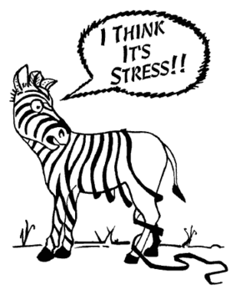
Stress is. . .
PRESSURE
  to meet
  EXPECTATIONS

Slide 5
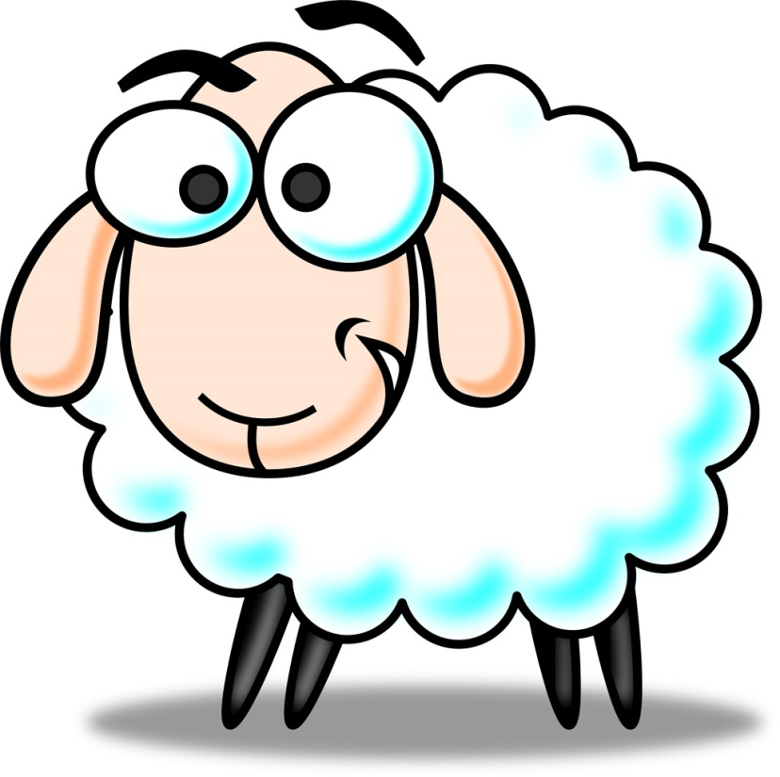
Stress can be a GOOD thing. . .
EUSTRESS

Slide 6
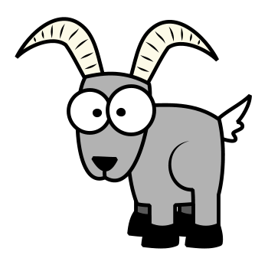
Stress can have an ugly side. . .
DISTRESS

Slide 7
The Effects of Stress
Murgia, M. Stress Talk

Slide 8
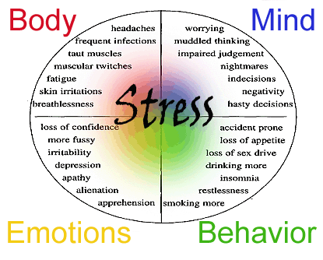
My stress is causing me STRESS

Slide 9
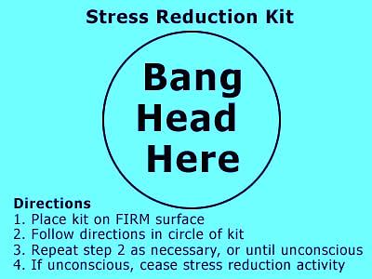
Coping & Management

Slide 10
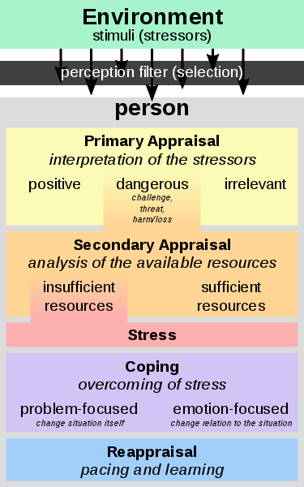

Slide 11
Cast all your anxieties on Him
I Peter 5:6-11
  Humble yourself
  Talk to your Father
  Choose wise responses
  Remember you are not alone
  Recall God’s promises (Ps. 55:22)

Slide 12
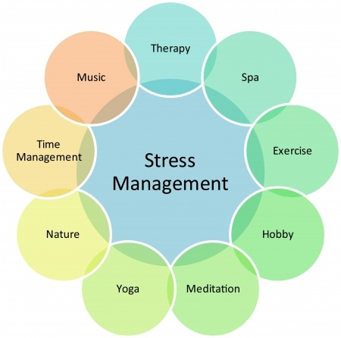

Slide 13






Unhealthy Coping

Slide 14
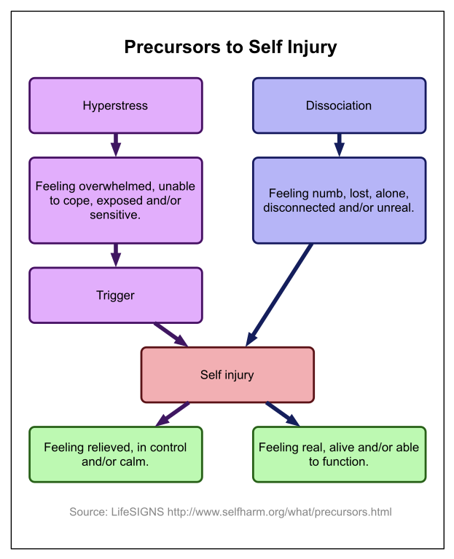
Self-Harm (DSH; NSSI)
Purposeful destruction of bodily tissue as a means to cope with stress.
17% of Adolescents (11-15)
  (60% female; 40% male)
NOT attention seeking-provides temporary relief
Notes:
Deliberate self-harm; Non-suicidal self injury

Slide 15
How to respond to Self-Harm
Remain calm and caring
Accept him or her even if you disagree with the behavior
Know that this represents a way of dealing with emotional pain
Listen with compassion
Avoid panic and overreaction

Slide 16
How to respond to Self-Harm
Do not show shock or revulsion at what they've done
Do not use threats in an attempt to stop the behavior
Do not allow him or her to recount the self injury experience in detail as it may trigger another session
Do get appropriate help for him or her from a qualified mental health professional

Slide 17
Local Resources
Focus Treatment Center
2210 Sutherland Ave
Suite 115
Knoxville, Tennessee 37919
(865) 685-5943
The Village Behavioral Health
2431 Jones Bend Road
Louisville, Tennessee 37777
(855) 801-8212

Slide 18

The LORD your GOD is in your midst,
A mighty One who will save.
He will rejoice over you with gladness,
He will quiet you by His love;
He will exult over you with loud singing.
-Zephaniah 3:17

