Slide 1
Fearfully & Wonderfully
The Role of Mental Health
in God’s Kingdom

Slide 2

Behavior
Matthew 5:16-
In the same way, let your light shine before others, so that they may see your good works and give glory to your Father who is in heaven.

Slide 3
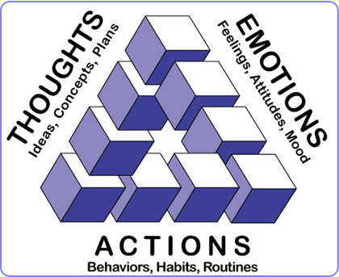

Slide 4
Behavior is- The way in which one acts or conducts themselves, especially toward others

Slide 5

Human Interaction
“Every human interaction involves one person elevating or lowering their level of dominance or submission with respect to the other.” -Keith Johnstone
“For by the grace given to me I say to everyone among you not to think of himself more highly than he ought to think, but to think with sober judgment, each according to the measure of faith that God has assigned.” -Romans 12:3 (cf Phil 2:4-11)

Slide 6
Personality Traits

Slide 7

Personality Traits

Slide 8
Personality Traits
O
C
E
A
N

Slide 9
Personality Traits
Openness
Conscientiousness
Extroversion
Agreeableness
Neuroticism

Slide 10
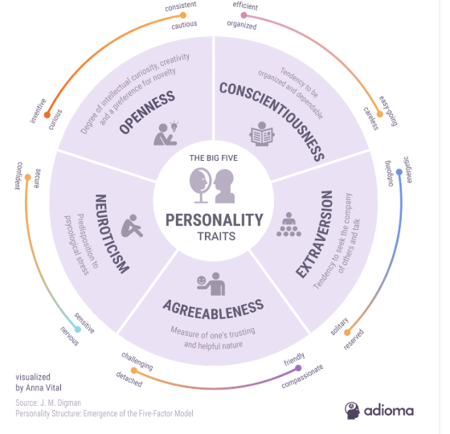

Slide 11
Personality Traits
https://openpsychometrics.org/tests/IPIP-BFFM/

Slide 12
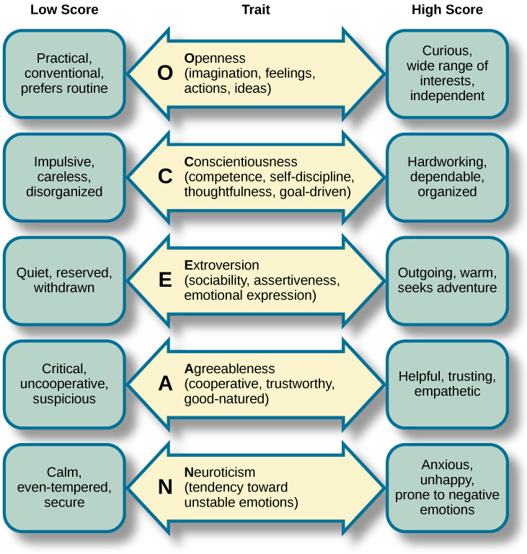

Slide 13
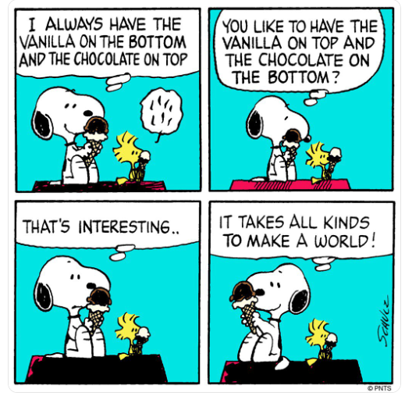
Handling Conflict

Slide 14
Handling Conflict
Glorify God
Colossians 3:17
Hebrews 12:14
Ephesians 5:1
Get the Log Out
Attitude- Prov 19:11
Sin- James 4:1-4
Gently Restore
Galatians 6:1
II Timothy 2:24-25
Matthew 18:15
Proverbs 29:11
Go and be Reconciled
Colossians 3:12-14
Luke 17:3-4
Notes:
“Peacemakers” Ken Sande

Slide 15


It takes all kinds to make a world
Notes:
“In the end, it is about truly caring for every precious human being whose life we touch. It is about including everybody, not just the fortunate few or exceptionally talented. It is about living with an abundance mindset: an abundance of patience, love, hope and opportunity.” -Bob Chapman

