Slide 1
Fearfully & Wonderfully
The role of mental health in God’s Kingdom

Slide 2
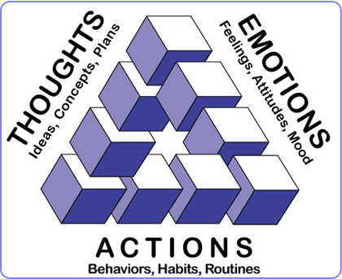
EMOTIONS

Slide 3
EMOTIONS
Proverbs 14:13
Even in laughter the heart may ache,
and the end of joy may be grief.
Ecclesiastes 3:4
A time to weep and a time to laugh;
A time to mourn and a time to dance

Slide 4
We were created to FEEL
Compassion (Matthew 9:36; 14:14; 20:34; Mark 1:40-41; 8:2; Luke 7:13)
Amazement (Matthew 8:10; Mark 6:5-6)
Anger (Mark 3:5; 10:4)
Grief (Matthew 26:38; John 11:33-38; 13:21)
Joy (Luke 10:21; John 15:11; 17:13)
Love (Mark 10:21; John 11:3; 15:13-14)
Notes:
Jesus’ Emotions
Strong’s Greek Lexicon compassion= splagchnizomai To be moved in the inward parts Bowels seat of emotion

Slide 5

Emotions
Response
Reaction
Interpretation

Slide 6
Emotions and the Brain

Slide 7
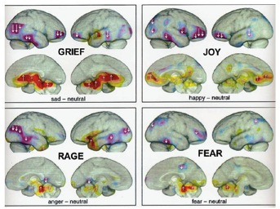
It starts in the brain. . .

Slide 8
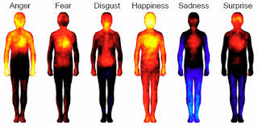
. . . and moves to a physical response
Anger
Fear
Disgust
Happiness
Sadness
Surprise

Slide 9
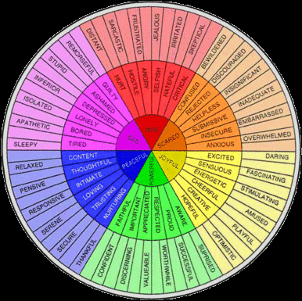
EMOTIONS

Slide 10

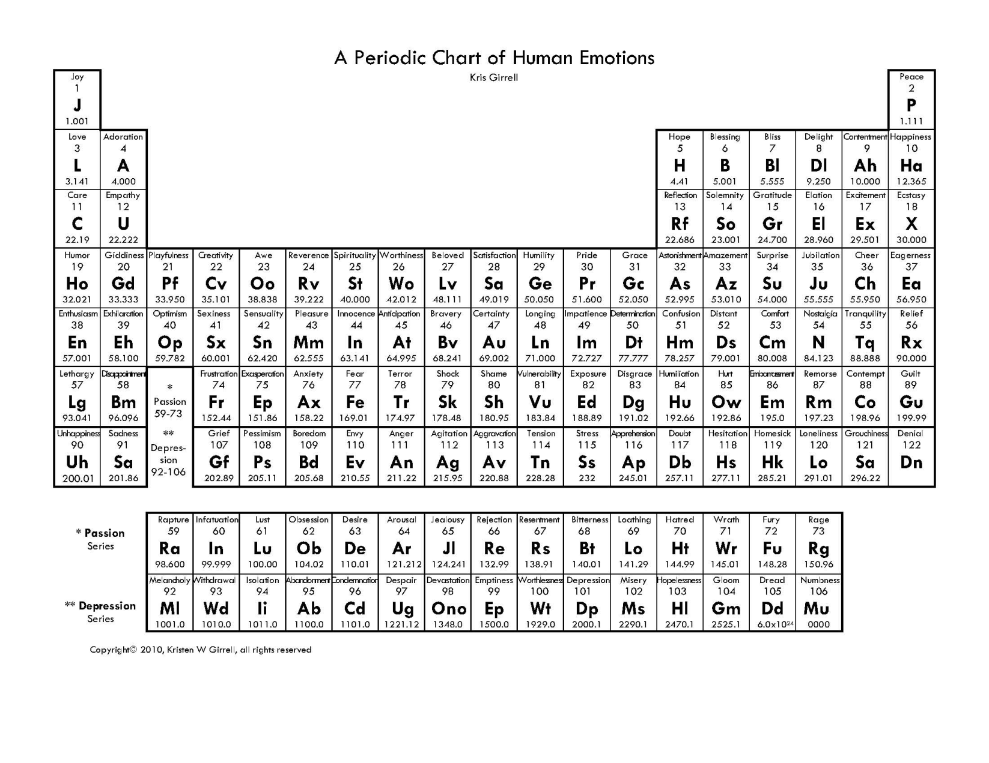

Slide 11

PRIMARY
Joy
Fear
Sadness
Hurt/Shame
Notes:
Robert Plutchick

Slide 12
Where’s Anger?
SECONDARY
JOY | SADNESS | FEAR | HURT/SHAME
Happy | Glum | Worried | Embarrassed
Excited | Blue | Nervous | Ashamed
Satisfied | Down-in-the-dumps | Anxious | Humiliated
Good | Discouraged | Apprehensive | Heartbroken
Smug | Depressed | Cautious | Punished
Confident | Despondent | Skeptical | Shunned
Calm | Bored | Afraid | Bad
Relaxed | Apathetic | Terrified | Dirty
Rested | Lonely | Scared | Worthless

Slide 13
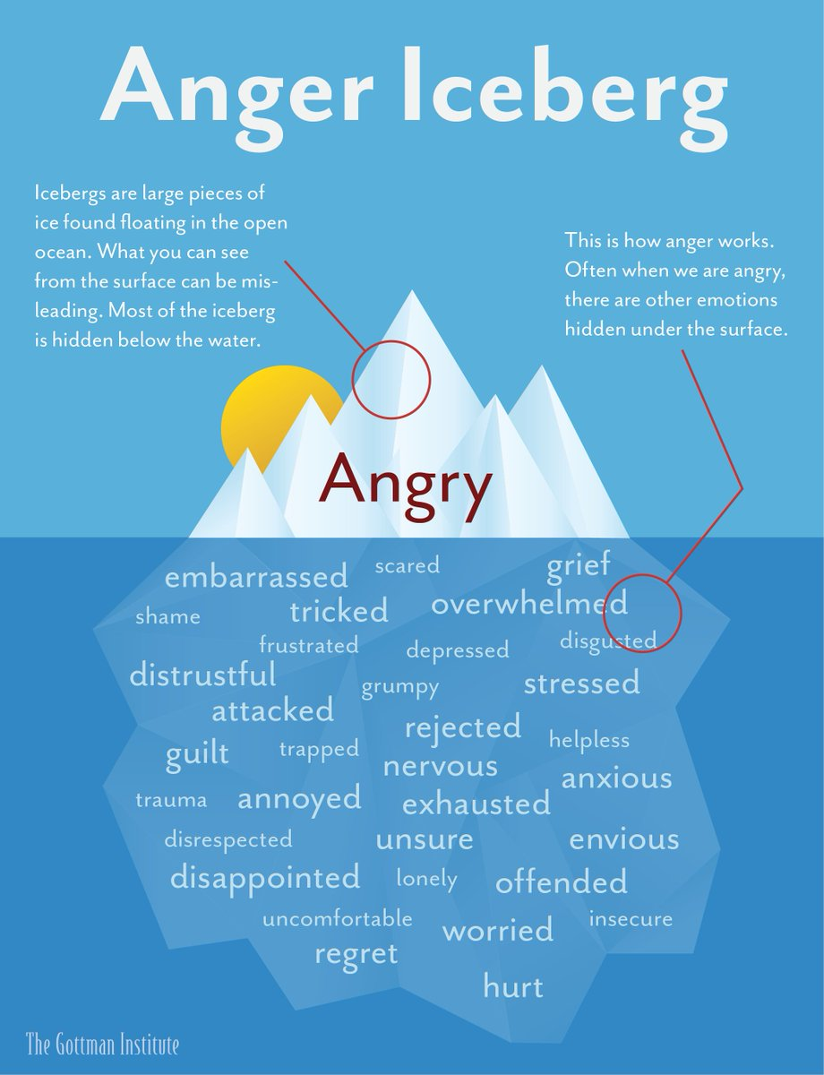

Slide 14
Emotion Regulation Questionnaire
1----------------2-----------------3-----------------4-----------------5-----------------6-----------------7 strongly agree neutral strongly disagree
____ When I want to feel more positive emotion (such as joy or amusement), I change what I’m thinking about.
2. ____ I keep my emotions to myself.
3. ____ When I want to feel less negative emotion (such as sadness or anger), I change what I’m thinking about.
4. ____ When I am feeling positive emotions, I am careful not to express them.
5. ____ When I’m faced with a stressful situation, I make myself think about it in a way that
helps me stay calm.
6. ____ I control my emotions by not expressing them.
7. ____ When I want to feel more positive emotion, I change the way I’m thinking about the situation.
8. ____ I control my emotions by changing the way I think about the situation I’m in.
9. ____ When I am feeling negative emotions, I make sure not to express them.
10. ____ When I want to feel less negative emotion, I change the way I’m thinking about the situation.
Notes:
JJ Gross; OP John 2003
Reappraisal Items: 1, 3, 5, 7, 8, 10; Suppression Items: 2, 4, 6, 9.

Slide 15
Managing Emotions
Select the Situation- Prov 22:3
Modify the Situation- Prov 3:5-6
Shift your Focus- Col 3:2; Heb 13:6
Change your Thoughts- Phil 4:7
Change your Response- Ps 33:20-21
Notes:
Pslams 37:1-8

Slide 16
PSALMS 37
¹ Do not fret because of those who are evil
or be envious of those who do wrong;
² for like the grass they will soon wither,
like green plants they will soon die away.
³ Trust in the Lord and do good;
dwell in the land and enjoy safe pasture.
⁴ Take delight in the Lord,
and he will give you the desires of your heart.
⁵ Commit your way to the Lord;
trust in him and he will do this:
⁶ He will make your righteous reward shine like the dawn,
your vindication like the noonday sun.
⁷ Be still before the Lord
and wait patiently for him;
do not fret when people succeed in their ways,
when they carry out their wicked schemes.
⁸ Refrain from anger and turn from wrath;
do not fret—it leads only to evil.
(NIV)

