Slide 1
Fearfully & Wonderfully
The Role of Mental Health
in God’s Kingdom

Slide 2
THOUGHTS

Slide 3
Romans 8:6
For to set the mind on the flesh is death,
but to set the mind on the Spirit is

Slide 4
Romans 8:6
For to set the mind on the flesh is death,
but to set the mind on the Spirit is life

Slide 5
Romans 8:6
For to set the mind on the flesh is death,
but to set the mind on the Spirit is life and peace.

Slide 6

THOUGHTS
Cognitions
Messages
Motivators

Slide 7

THOUGHTS
“HEART” in Scripture

Slide 8
Notes:
Conversion is
Belief
Repentance
Confession

Slide 9
What are your guiding thoughts?

Slide 10
What are your guiding thoughts?
I am ___________
God is ___________
My family is _________
I am ___________
People are ___________
The Church is __________
My job is ___________
The future is __________
Jesus is ___________
Mistakes are __________

Slide 11
What are your guiding thoughts?
I am ___________
Conflict is __________
Grace is ___________
People are ________
The Spirit is ___________
Feelings are __________
Sin is ___________
Life is ___________
God is ___________
Scripture is ___________

Slide 12
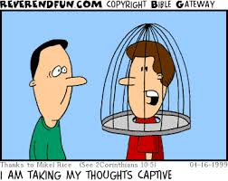
Discernment
Healthy Thoughts
Unhealthy Thoughts

Slide 13

Errors in Thinking
Irrational-
Doesn’t make sense
Dysfunctional-
Doesn’t serve us well
Biased-
Doesn’t give equal weight
Distorted-
Doesn’t accurately reflect reality

Slide 14
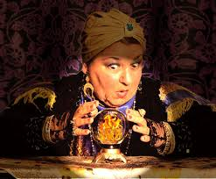
Cognitive Distortions
All or Nothing
  “If you ain’t first, you’re last!”
Personalization
  “If I had just been there that wouldn’t have happened!”
Overgeneralization
  “Always!” “Never!”
Fortune Telling
  “Anything that can go wrong WILL go wrong!”

Slide 15

Cognitive Distortions
Labeling
  “I’m so ______________!”
Unrealistic Expectations
  Should Statements
Emotional Reasoning
  “I feel like he’s lying to me. What is he hiding?”
Catastrophizing/Magnification
  “When it rains, it pours!”

Slide 16

Cognitive Distortions
Blaming (Victim-stance)
  “It is all her fault!”
Mind Reading
  “I just know they won’t believe me.”
Minimizing/ Discounting the Positive
  “I’m not that great. Anyone could do it.”
Jumping to Conclusions
  “No news is bad news!”

Slide 17
Thought Replacement
Psalms 139:23-24

Slide 18
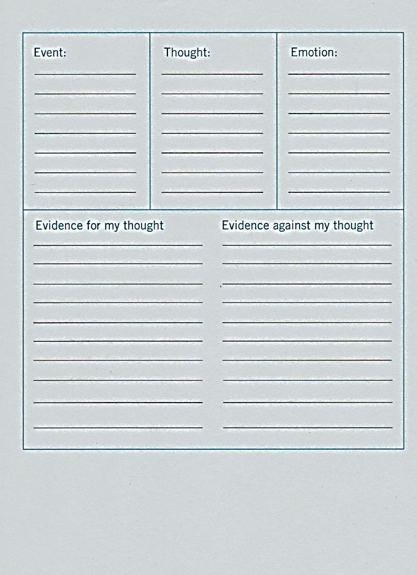
Thought Examination
Seth Gillihan (2016)

Slide 19

Identify
Challenge
Replace

