Slide 1
Fearfully & Wonderfully
The role of mental health in God’s Kingdom

Slide 2
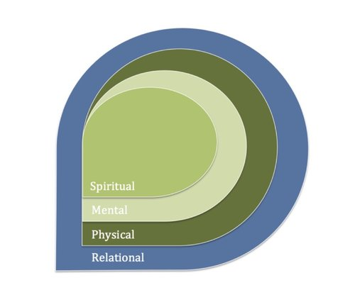
Pursuing Mental Wellness

Slide 3
Pursuing Mental Wellness
SPIRITUAL
Grow in Relationship with you Creator
II Peter 3:18; Isaiah 30:18
Know your Identity
Romans 8:14
Discover Hope
Lamentations 3:21-23
Find your Purpose
I Peter 4:10

Slide 4
Pursuing Mental Wellness
MENTAL/EMOTIONAL
Develop healthy thought patterns
Ephesians 4:22-24

Slide 5
Pursuing Mental Wellness
MENTAL/EMOTIONAL
Develop healthy thought patterns
Ephesians 4:22-24
Positive Attribute/Skill | Discounting “But” | Add a refuting “But”
I can be kind. | I snapped at my kids last night. | I also watched “Paw Patrol” with them.
“The CBT Toolbox” (2013) Jeff Riggenabch

Slide 6
Pursuing Mental Wellness
MENTAL/EMOTIONAL
Recognize cycles & triggers
The first time I remember feeling ____________________________ (belief) was ________________________.
The people in my life that influenced me to feel that way were:
(family members) _______________________________________________
(friends/peers) __________________________________________________
(other significant people) _________________________________________
The experiences in my life that influenced me to feel that way were:
(early childhood) _________________________________________________
(adolescence) ___________________________________________________
(early adulthood) ________________________________________________
(current experiences) _____________________________________________

Slide 7
Pursuing Mental Wellness
MENTAL/EMOTIONAL
Develop healthy coping skills
Just because __________________________________________________
doesn’t mean _________________________________________________.
Notes:
Just because I make a mistake
Doesn’t mean I’m a failure
Just because he yells at me
Doesn’t mean I’m worthless

Slide 8
Pursuing Mental Wellness
MENTAL/EMOTIONAL
Develop healthy coping skills
Just because __________________________________________________
doesn’t mean _________________________________________________.
The next time I catch myself wanting to ____________________________
instead of ________________________,
I will: _________________________________________________________.
Notes:
The next time I catch myself wanting to withdraw
Instead of saying how I really feel
I will remind myself my opinions matter
The next time I catch myself wanting to be snarky
Instead of being compassionate
I will take a moment to empathize

Slide 9
Pursuing Mental Wellness
MENTAL/EMOTIONAL
Develop healthy coping skills
Just because __________________________________________________
doesn’t mean _________________________________________________.
The next time I catch myself wanting to ____________________________
instead of ________________________,
I will: _________________________________________________________.
When I feel ____________________________________________________
I can: ________________________________________________________.
Notes:
When I feel overwhelmed
I can take a breath
When I feel defeated
I can remind myself how far I’ve come

Slide 10
Pursuing Mental Wellness
MENTAL/EMOTIONAL
Develop healthy coping skills
Mastery- Performance/Accomplishment
Pleasure- Joy/Peace
Meaning- Faith/Relationships
Notes:
Mastery- Cleaning a room in my house; gardening; knitting; paying bills; volunteering; think about past achievements
Pleasure- Buying flowers, giving/asking for a hug, going for a walk, Look at photos from a past trip, reading a book
Meaning- Pray; Call my grandchildren; Perform an act of service; Research something interesting to you

Slide 11

Pursuing Mental Wellness
MENTAL/EMOTIONAL
Develop healthy coping skills
Be willing to ask for help
Notes:
“Refusing to ask for help
when you need it is refusing
someone the chance to be
helpful.” -Ric Ocasek

Slide 12
Pursuing Mental Wellness
PHYSICAL
Sleep Well
Learn to Relax
Eat Healthier
Increase Activity
Take Medication
II Kings 20:7; Isaiah 38:21

Slide 13
Pursuing Mental Wellness
RELATIONAL
Develop Healthy, Supportive Relationships
Proverbs 27:6; Proverbs 27:9
Develop Effective Communication Skills
Proverbs 12:18; Proverbs 17:27
Develop Health Conflict Resolution Skills
Romans 12:18; James 1:19ff
Forgive
Ephesians 4:32; I Peter 4:8
Learn to have FUN
Ecclesiastes 5:18; Proverbs 17:22; Deuteronomy 24:5
Notes:
The Jesus Habits –Jay Dennis

Slide 14
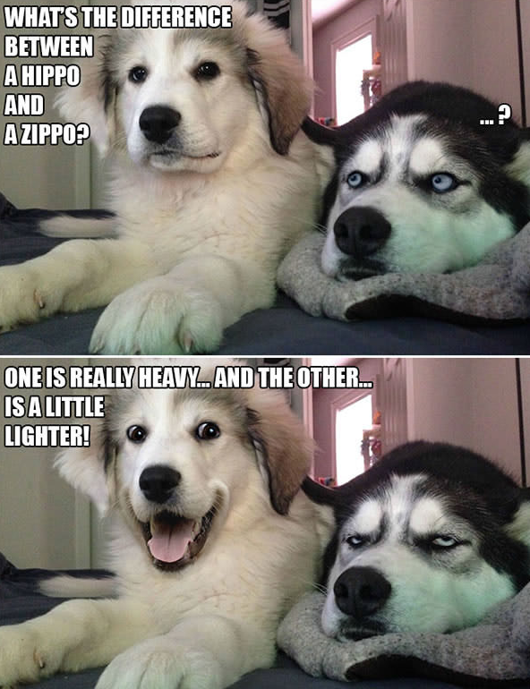

Slide 15
The Role of the Church

Slide 16
Meeting mental health needs
C ollaborate
H elp with Practical Needs
U nleash Volunteers
R emove Stigma
C are & Support
H ope
Notes:
Collaborate
Help w/practical needs- I John 3:17
Unleash Volunteers
Remove Stigma Romans 15:7; Ezk 34 (safe place, authentic)
Care & Support- Ps 69:20; Luke 6:36; John 15
Hope- Hosea 2:15

Slide 17
Colossians 3:12-15

Slide 18


