Slide 1
Fearfully & Wonderfully
The role of mental health in God’s Kingdom

Slide 2
Suicide

Slide 3
Facts about Self-Inflicted Death
It is an upward trend

Slide 4

Tennessee Suicide Rates- 10 year
 | 2007 | 2008 | 2009 | 2010 | 2011 | 2012 | 2013 | 2014 | 2015 | 2016
TN | 833 | 965 | 939 | 932 | 938 | 956 | 1017 | 945 | 1065 | 1110
10-24 | 86 | 103 | 117 | 111 | 91 | 97 | 116 | 118 | 131 | 133
Knox | 67 | 63 | 71 | 76 | 72 | 77 | 57 | 66 | 67 | 72
Notes:
Estimated 479 unreported in 2016
22nd in Nation

Slide 5
Facts about Self-Inflicted Death
It is an upward trend
10th leading cause of death in Tennessee
2nd among Adolescents
The suicide rate for the elderly (85+) is higher than any other age group
Men are more likely to die of suicide
Women are more likely to attempt suicide
Suicide cuts across all demographic categories
Notes:
Men x4 more likely to die
Women x3 more likely to attempt

Slide 6
Facts about Self-Inflicted Death
Surviving family members are at higher risk of dying by suicide
Talking about suicide will NOT increase the risk of suicide
Suicide is preventable
Notes:
2/3 depressed

Slide 7
Clearing Up Misconceptions
Myth: “People who complete suicide always leave notes.” Fact: Most people don’t leave notes.
Myth: “People who die from suicide don’t warn others.” Fact: Out of 10 people who kill themselves, eight have given definite clues to their intentions. They leave numerous clues and warnings to others, although some of their clues may be nonverbal or difficult to detect.

Slide 8
Clearing Up Misconceptions
Myth: “People who talk about suicide are only trying to get attention.” Fact: Over 70% who do threaten to carry out a suicide either make an attempt or complete the act. Few people die by suicide without first letting someone else know how they feel.

Slide 9
Clearing Up Misconceptions
Myth: “Once someone has already decided on suicide, nothing is going to stop them. Suicidal people clearly want to die.” Fact: Most suicidal individuals don’t want death; they just want the pain to stop.

Slide 10
Clearing Up Misconceptions
Myth: “After a person has attempted suicide, it is unlikely he/she will try again.” Fact: People who have attempted suicide are very likely to try again. 80% of the people who die from suicide have made at least one previous attempt.
Myth: “If someone survives a suicide attempt, they weren’t serious about ending their life.” Fact: The attempt in and of itself is the most important factor, not the effectiveness of the method.

Slide 11
Clearing Up Misconceptions
Myth: “You shouldn’t mention suicide to someone who’s showing signs of severe depression. It will plant the idea in their minds, and they will act on it.” Fact: Many depressed people have already considered suicide as an option. Discussing it openly helps the suicidal person sort through the problems and generally provides a sense of relief and understanding. It is one of the most helpful things you can do.

Slide 12
Clearing Up Misconceptions
Myth: “Once the emotional state improves, the risk of suicide is over.” Fact: The highest rates of suicide occur within about three months of an apparent improvement in a severely depressed state. Therefore, an improvement in emotional state doesn’t mean a lessened risk.

Slide 13

Warning Signs
Talking about suicide or expressing no reason to live
Getting affairs in order / Giving away prized possessions
Social withdraw / Isolation
Loss of interest in previously enjoyable activities
Drastic change in behavior and/or personality
Prior suicidal behavior

Slide 14

Hopelessness & Despair
No hope for the future
No hope that things will change
No hope of ever being well/stable
No hope of accomplishment
No point in being alive
No control over life/future
“Suicide: The tragedy of Mood Instability” -Mary Ellen Copeland (1996)

Slide 15
Responding to Suicidal Thought
If you have concern, ASK
“I just want to check in with you.”
“I care about you and have noticed some changes in your behavior.”
“I feel concerned about you- are you thinking of killing yourself?”

Slide 16
Responding to Suicidal Thought
If you have concern, LISTEN
“I may not be able to understand what you’re going through but I’m here for you.”
“What can I do to help you the most right now?”
“How can I support you?”
“Can I go with you to talk to someone?”

Slide 17
Responding to Suicidal Thought
If you have concern, ACT
“Do you have a PLAN?”
“Do you have a METHOD and the MEANS?”
“Do you have a TIME FRAME?”
“Do you have INTENTION?”

Slide 18

If Suicidal Behavior seems IMMINENT
NEVER
leave someone who is actively suicidal alone

Slide 19
Responding to Suicidal Thought
After the crisis is resolved
“Let’s make a safety plan.”
“Let’s schedule an appointment with your therapist or doctor.”
“Let’s remove potential means of suicide.”
“Let’s work together on healthy lifestyle changes.”
Notes:
Be in it for the long haul

Slide 20
When talking to someone who is suicidal
Do
Try not to
Be yourself
Listen more than you talk
Take the person seriously
Be sympathetic
Offer hope
Argue
Assign judgment
Promise confidentiality
Offer ways to fix the problem
Blame yourself

Slide 21


Don’t let the FEAR
of saying the wrong thing
Keep you from REACHING OUT

Slide 22
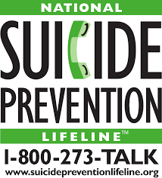
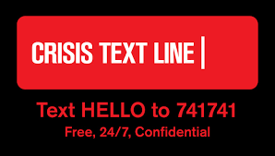
Resources- National

Slide 23
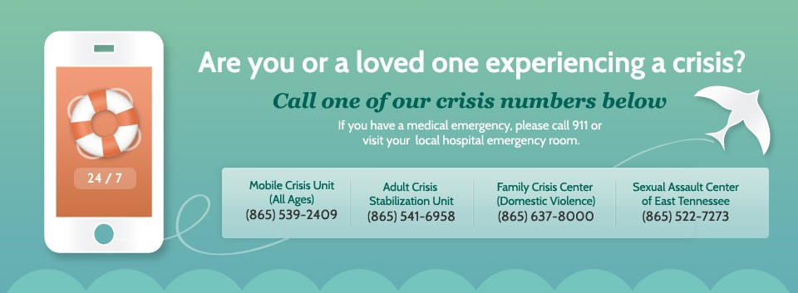

Resources- Local
865-539-2409

Slide 24
Resources- Local
Suicide Anonymous
3rd Tuesday of each month at 7:00PM Room 111, Cornerstone of Recovery 4726 Alcoa Highway Louisville, TN 37777
Suicide Grievers Support Group 2nd Thursday of each month at 7:00 PM Paula J. Alexander, LCSW, CGC (pj4031@tds.net)

Slide 25
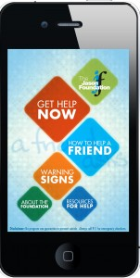
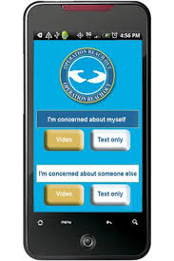
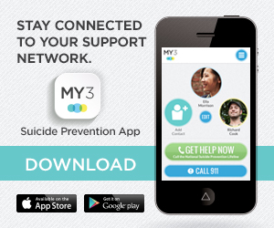


Resources- Mobile Apps
A Friend Asks
Jason Foundation
Operation Reach Out
MY 3

Slide 26
What Survivors want most. . .
“Just keep loving me.”
“I want to be treated with compassion and understanding.”
“Recognize the depth and validity of my despair.”
“Acknowledge what happened without dwelling on it.”
“I want the opportunity to talk about my feelings without being lectured or told all the things I did wrong.”
“Treat me like everyone else. Believe me, I already feel like a freak.”

Slide 28


