Slide 1
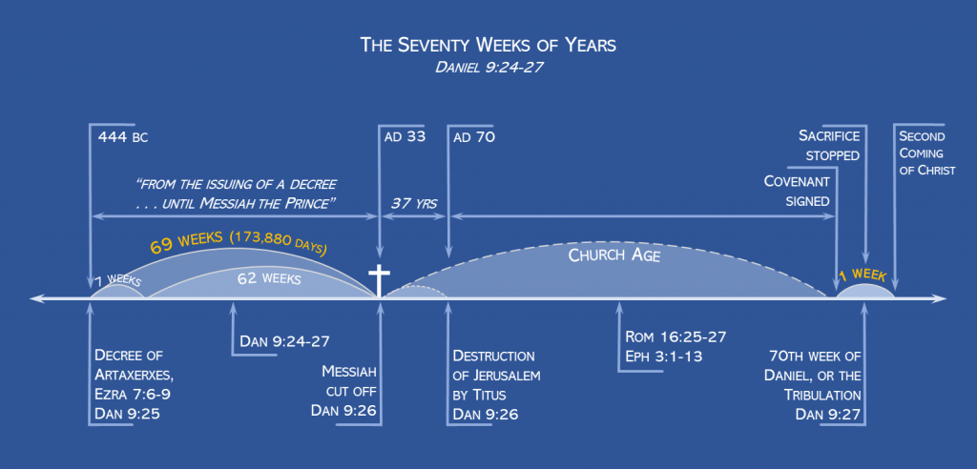
DANIEL’S 70 WEEKS PROPHECY DANIEL 9:24-27
2025 WE ARE HERE
https://www.orcuttchristian.org/The%20New%20Evidence%20That%20Demands%20a%20Verdict%20-%20Josh%20McDowell.pdf -page 253 Paragraph 3C.
God’s timing…..is perfect

Slide 2
Now when these things begin to take place, straighten up and raise your heads, because your redemption is drawing near.”29 And he told them a parable: “Look at the fig tree, and all the trees. 30 As soon as they come out in leaf, you see for yourselves and know that the summer is already near. 31 So also, when you see these things taking place, you know that the kingdom of God is near. 32 Truly, I say to you, this generation will not pass away until all has taken place. 33 Heaven and earth will pass away, but my words will not pass away. Luke 21:28
Why this is critical- the tig tree is Israel and End of the church age or the end of age of gentiles-
Israel in the land- May 14,1948
Capture of Jerusalem - June 7 th 1967
Israel recognized as capital - May 14, 2018
Presidents Trumps peace plan- October 8, 2025
The Prince’s peace treaty with Israel and world- Nations United

Slide 3
How do we get from where we are today to peace treaty signed by the prince that brings peace to whole world and Israel that allows them to rebuild their temple and to live in the land that God gave them?
Israel has to exist as a nation.
Israel has to prosper. Start up nation, 3rd military force in the world, #1 in R&D, feeds Europe, gas and oil, only democracy in the middle east that grants citizenship to all residents.
Israel has to be under persecution and in a state of war . (since 1948)
There will be apostasy, immorality and falling away from and the rejection of God in the world. Roman3 1-
The world gather in opposition to Israel and there will be worldwide antisemitism. Zechariah 12 and 14 (United Nations decrees)
The nations of the war defined in Ezkeial 38 and 39 that God destroys on the mountains of Israel have to be in play against Israel.

Slide 4
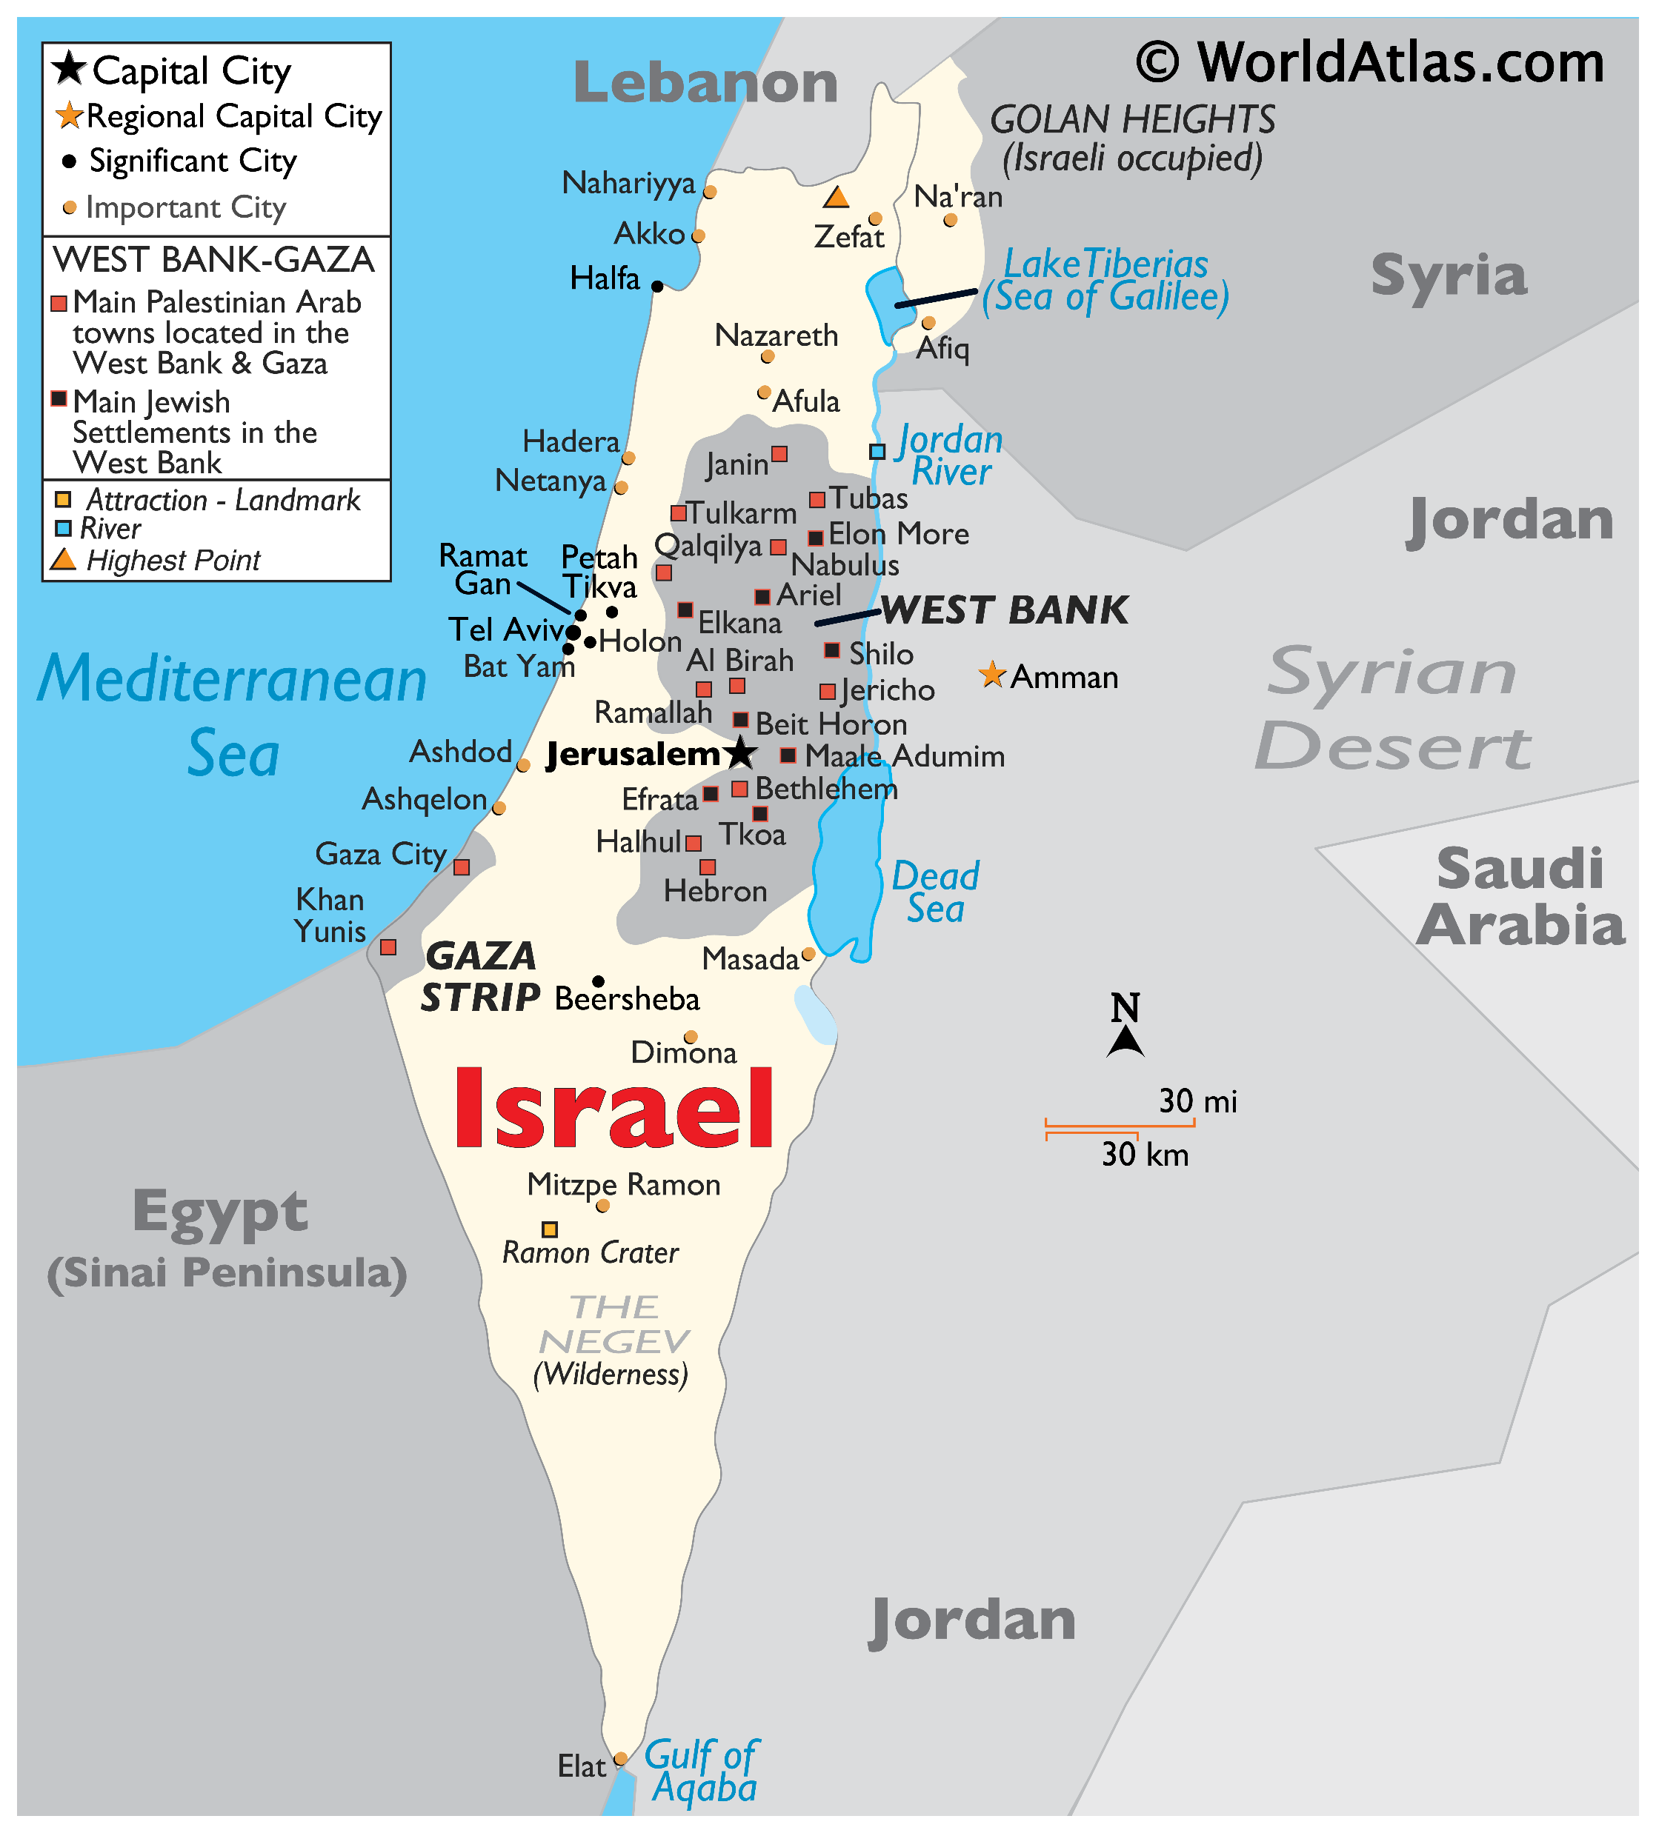
“And you, son of man, prophesy to the mountains of Israel, and say, O mountains of Israel, hear the word of the LORD. 2 Thus says the Lord GOD: Because the enemy said of you, ‘Aha!’ and, ‘The ancient heights have become our possession,’ 3 therefore prophesy, and say, Thus says the Lord GOD: Precisely because they made you desolate and crushed you from all sides, so that you became the possession of the rest of the nations, and you became the talk and evil gossip of the people, 4 therefore, O mountains of Israel, hear the word of the Lord GOD: Thus says the Lord GOD to the mountains and the hills, the ravines and the valleys, the desolate wastes and the deserted cities, which have become a prey and derision to the rest of the nations all around, 5 therefore thus says the Lord GOD: Surely I have spoken in my hot jealousy against the rest of the nations and against all Edom, who gave my land to themselves as a possession with wholehearted joy and utter contempt, that they might make its pasturelands a prey. 6 Therefore prophesy concerning the land of Israel, and say to the mountains and hills, to the ravines and valleys, Thus says the Lord GOD: Behold, I have spoken in my jealous wrath, because you have suffered the reproach of the nations. 7 Therefore thus says the Lord GOD: I swear that the nations that are all around you shall themselves suffer reproach. Ezekiel 36:1

Slide 5
Trump says he ‘will not allow’ Israel to annex occupied West Bank
US president rules out Israeli annexation of the occupied West Bank but analysts question whether he will follow through.
Speech at the United Nations
https://www.youtube.com/watch?v=pcH7YkHWiKU
Land for peace-
1948- United Nation mandat after the war between Israel and their neighbors
1967- United Nation mandat after the war between Israel and their neighbors
1978 The Camp David Accords requiring the withdrawal of Israeli troops from the West Bank and Gaza was agreed to occur after an election of a self-governing authority to replace Israel's military government. The Accords did not mention the Golan Heights, Syria, or Lebanon.
2025 – creating the state of Palistine
“I will make you into a great nation, and I will bless you; I will make your name great, and you will be a blessing. 3 I will bless those who bless you, and whoever curses you I will curse; and all peoples on earth
will be blessed through you.” Genesis 12:2

Slide 6
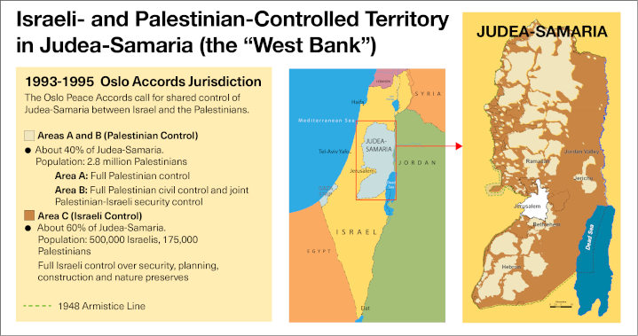

Slide 7
What to watch for—
Failure of Trump’s peace plan
Israel destroys Hamas ( as the world forms against them over humanitarian aid and genocide)
Israel starts to extend control over the occupied territories- Eze. 36
The United States turns from Israel and joined by Quatar, Russia, turkey Internation crimal court in condemning Israel
The United Nations declaring war on Israel with armies from the Ezekiel 37-8 nations.

Slide 8
Identified nations in Ezekiel 38
Magog: Interpreted as modern-day Russia or a coalition of nations including Russia and its satellites.
Rosh: Often seen as Russia itself.
Meshech and Tubal: Generally identified with modern-day Turkey.
Persia: Modern-day Iran.
Cush: Often identified as Ethiopia or the area of modern-day Sudan.
Put: Identified as Libya.
Gomer: Linked to parts of modern Turkey.
Togarmah: Also associated with modern-day Turkey.
Other Nations: The prophecy also mentions other countries from Eastern Europe, Southeastern Europe, and Afghanistan.

Slide 9
Now to join Jesus and His disciples as He fininshes His description of the new life and mission for His disciples

Slide 10
“Not everyone who says to me, ‘Lord, Lord,’ will enter the kingdom of heaven, but the one who does the will of my Father who is in heaven. 22 On that day many will say to me, ‘Lord, Lord, did we not prophesy in your name, and cast out demons in your name, and do many mighty works in your name?’ 23 And then will I declare to them, ‘I never knew you; depart from me, you workers of lawlessness.’
24 “Everyone then who hears these words of mine and does them will be like a wise man who built his house on the rock. 25 And the rain fell, and the floods came, and the winds blew and beat on that house, but it did not fall, because it had been founded on the rock. 26 And everyone who hears these words of mine and does not do them will be like a foolish man who built his house on the sand. 27 And the rain fell, and the floods came, and the winds blew and beat against that house, and it fell, and great was the fall of it.”
28 And when Jesus finished these sayings, the crowds were astonished at his teaching, 29 for he was teaching them as one who had authority, and not as their scribes. Mathew 7:21

Slide 11
When Jesus finished these sayings, the crowds were astonished at his teaching, 29 for he was teaching them as one who had authority, and not as their scribes. Mathew 7:28
Authority; exousia, power of choice, liberty of doing as one pleases
  the ability or strength with which one is endued, which he either possesses or exercises
The power of him whose will and commands must be submitted to by others and obeyed)
  Universally, authority over mankind
  specifically
    the power of judicial decisions
    of authority to manage domestic affairs
Lord Jesus Christ
Lord; kyrios, he to whom a person or thing belongs, about which he has power of deciding; master, lord
the possessor and disposer of a thing
  the owner; one who has control of the person, the master

Slide 12
If anyone forces you to go one mile, go with them two miles. — Matthew 5:41
The demands our Lord makes in the Sermon on the Mount are impossible for us to meet—unless he has done a supernatural work inside us. Not only does Jesus Christ demand that his disciples go the second mile, he also demands that there be no trace of resentment inside them when they come up against tyranny and injustice because of their commitment to him: Everything else in a disciple’s life may get muddied, but this relationship to Jesus Christ must remain perfectly clear.
If I am going to be a disciple of Jesus, I must be made one supernaturally.
The Sermon on the Mount isn’t some unattainable ideal. It’s a statement of what will actually happen in me when Jesus Christ has changed my disposition and put into me a disposition like his own. Jesus Christ is the only one who can fulfill the Sermon on the Mount.
By Oswald Chambers

