Slide 1

Attention-Deficit/ Hyperactivity Disorder
Nicole Greenberg, PhD

Slide 2

Background
Licensed clinical psychologist
Private Practice and FSU Children’s Learning Clinic
Graduated with PhD from University of Alabama
Focus on Clinical Child Psychology
LEND (Leadership Education in Neurodevelopmental and Related Disabilities) program

Slide 3
Myths about ADHD
Poor parenting causes ADHD
ADHD occurs less often in girls than boys
ADHD only occurs in childhood
ADHD is over-diagnosed

Slide 4
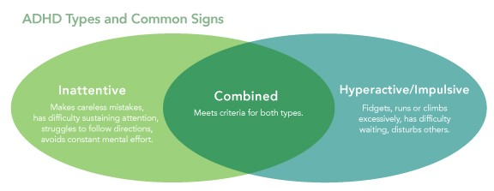
ADHD Overview
About 5-10% of children have ADHD
75-80% heritability rate
Diagnostic criteria from DSM-5-TR (diagnostic manual)
Onset prior to age 12
Presence of clinically significant symptoms of inattention and/or hyperactivity
Impairing in multiple settings (e.g., home, school, peer relationships)
Common associated impairments
Executive functioning
Academic performance
Emotion regulation
Peer functioning
About 1/3 of people with ADHD have another cooccurring diagnosis (i.e., comorbidity)

Slide 5

Meet Lucas
9-year-old boy
Referred for an ADHD evaluation because teachers are noticing difficulty staying seated and trouble focusing

Slide 6

Assessment
Pediatrician
Parent and teacher rating form
Psychologist/psychiatrist
Parent and teacher rating forms
Parent clinical interview
Testing with child
School evaluation
Request in writing to school administration

Slide 7
Psychological Evaluation
Intellectually, no concerns
Academically, showed significant difficulty with reading and a history of problems with reading
Parent reported some symptoms of anxiety and irritability
Parent and teacher reported symptoms of inattention and hyperactivity/impulsivity

Slide 8
Treatments
Depends by age (children younger than 6 vs. children 6 and older)
Pharmacological interventions: usually stimulant or non-stimulant medications
Consult pediatrician or psychiatrist
Psychosocial treatments
Behavioral parent training (school-aged) / Parent Child Interaction Therapy (PCIT; ages 2-7)
Classroom behavioral management (e.g., Daily Report Card)
School accommodations
May qualify for 504 Plan or Individualized Education Program

Slide 9
Treatment
Parents discussed medication options with pediatrician
Parents began behavioral parent training
Lucas is starting therapy to address difficulties with irritability and emotion regulation (Zones of Regulation)

Slide 10

Some Local Resources
For assessments and/or therapy:
FSU Psychology Clinic
FSU Multidisciplinary Center
Southeastern Behavioral Health
Children’s Learning Clinic (assessment and experimental treatment)
Assessment only
Mosaic Psychological Services
Nicole Greenberg, PhD
Call 211 Big Bend or talk to your insurance provider or pediatrician for additional resources

Slide 11
Additional Online Resources
CHADD
https://chadd.org/for-parents/overview/
Child Mind Institute
https://childmind.org/guide/parents-guide-to-adhd/

