Slide 1
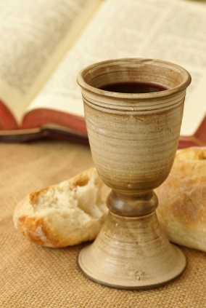

SUNDAY,
NOVEMBER 2,
2025

Slide 2


Slide 3

All things come of Thee, O Lord, and of Thine own, have we given Thee, AMEN

Slide 4
Order of Service 1
Call to Worship
Invocation
Hymn of the Morning
#248, “Down at the Cross”

Slide 5
Order of Service 2
TBC Creed
Voice of Hospitality
Pastoral Briefs
Offertory Prayer
Choir Selection

Slide 6
Order of Service 3
Scripture
Doxology
Sermonic Selection
The Message
Invitation to Christian Discipleship
Holy Communion

Slide 7
Order of Service 4
Communion Hymn
256, The Blood Will Never Lose its Power
Benediction

Slide 8
PARKING LOT DUTIES:
SAFETY TEAM

Slide 9
Sunday School Class #3 is sponsoring a flannel and sweatshirt drive for Miracle Hill, October through December 17. All sizes are needed. Thanking you in advance.

Slide 10
STUDENT RECOGNITION
It's time to recognize Tabernacle's students in 1st through 12th grade that made the honor roll for the first quarter. Please make sure report cards are given to Beverly Brown by Sunday, November 2nd.

Slide 11
STUDENT RECOGNITION
Recognition will be held on Sunday, November 9th. Report cards, Back Pack Grades or copies of Power School can be emailed to bevbrown124@charter.net. Please make sure the child's name, school, grade level and the quarter grades can be seen clearly.

Slide 12
Tabernacle, the Youth Department extends sincere appreciation to our Church family for the generous candy donations, monetary gifts, and the time dedicated in support of our annual Fall Festival. The children had a wonderful time and the festival was a gleaming success!

Slide 13
Special thanks to Darrell for his culinary skills that fed us well; Demond for setting up the popcorn machine and popping the popcorn; Rev. Dumas for providing the extra fire pit that kept us warm and cozy, and Sapp for being our safety officer on duty. Thanks also to Lady Battle for her support and encouragement and Pastor Battle for monitoring the gate.

Slide 14
Special shout-out to our newest youth advisors: Janie Milliam, Staci Austin, Daquis McKinney, and Daniqua and Kimberly McKinney for stepping up and pitching in where needed. Lastly, many thanks to our Youth Advisors who always come through. To God be the Glory!!

Slide 15
The Shaw’s Wills Clinic has been rescheduled to January 10, 2026 due to a scheduling conflict with the lawyers. If you attended the Will & Trust Seminar on Thursday, August 21st and did not complete your application, please contact Rosa Grayden. Thank you.

Slide 16
If you live in the City of Greenville, SC and are in need of a ride to the poll(s) please call the church on Monday Nov 3rd or Tuesday Nov 4th. Rides will begin at 9am.

Slide 17
A one-hour Thanksgiving Service will be held at TBC at 7pm on November 25, 2025

Slide 18


Slide 19


Slide 20
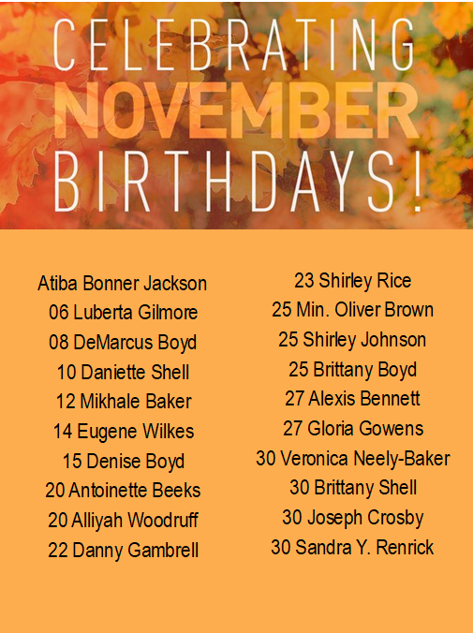

Slide 21


Slide 22
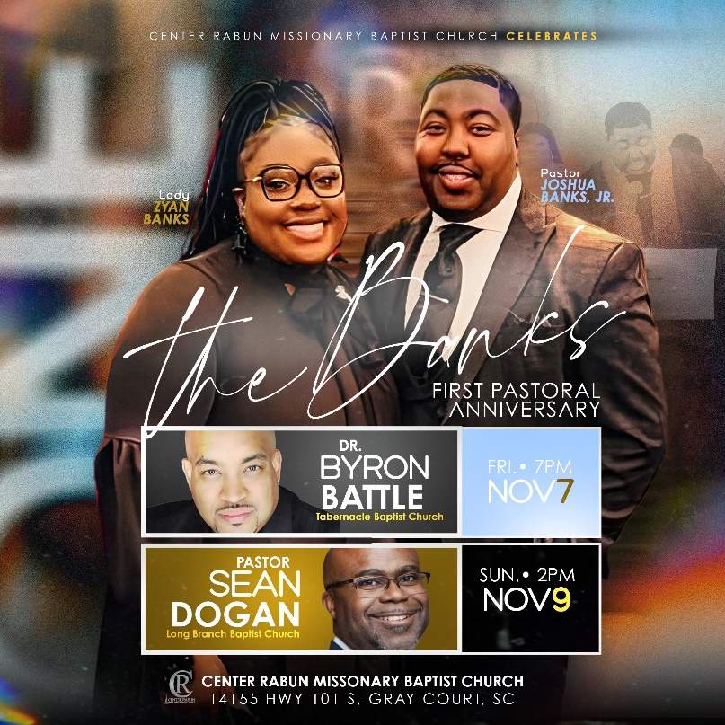

Slide 23


Slide 24


Slide 25
